Slide 1

Smart City Stack and Devops
December 2023
By Abhilash Venkatesh

Slide 2
The Data eXchange Platform

Slide 3


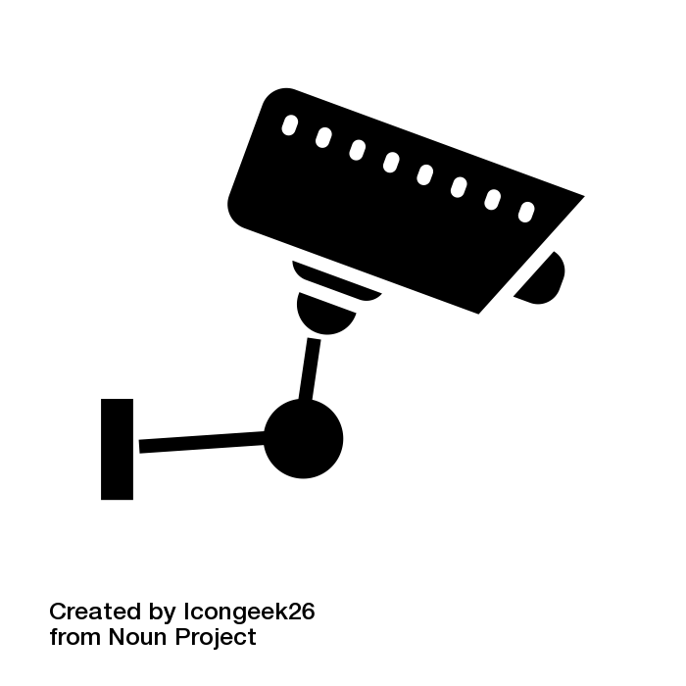
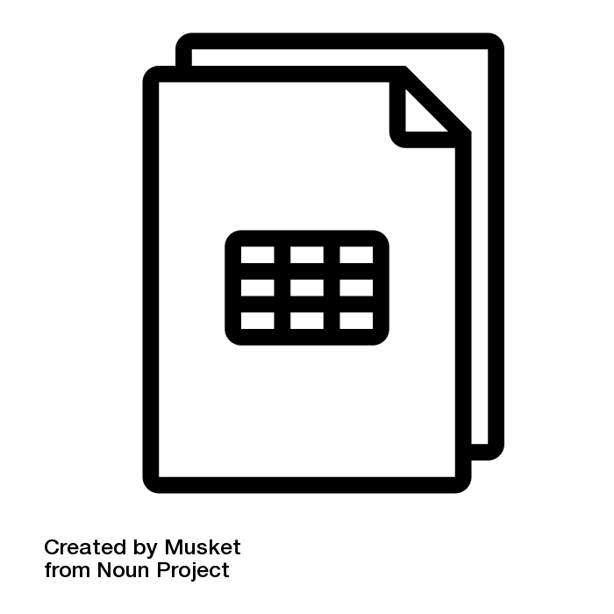

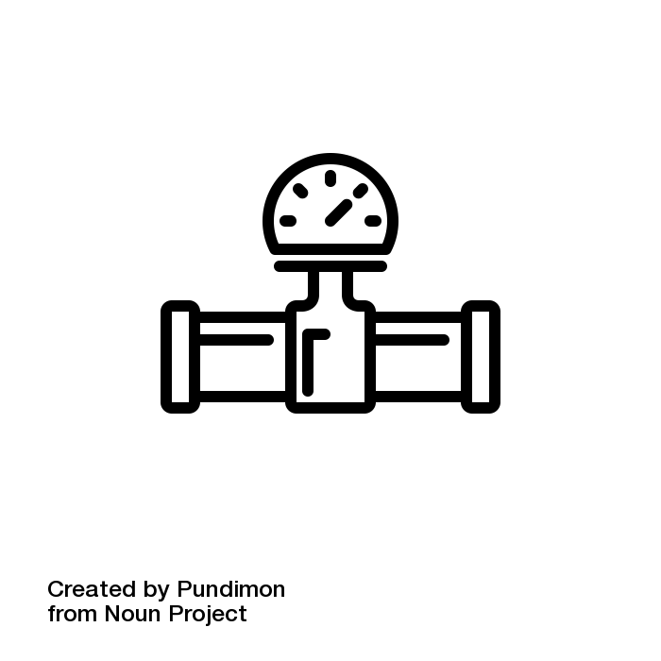
Smart City Mission and Indian Institute of Science came together to conceptualize & build IUDX
.
Controlled & secure any-any exchange of all forms of public and privately owned non-personal data–not just “open data”
Dedicated Program Unit with an expert staff
Open Source (code freely available)
Collaborative- Govt, Industry, Academia, citizens and communities
Governance, Policy and Economic framework being developed
Smart Cities: Deployed as cloud service in 10 cities. Another 15 this year.
Other sectors have strong applicability to be explored
Applications
Standardized Data
Models
Standardized APIs
Catalog Server
Finds and describes data sets
Consent server
Applies Security, Privacy, Policy, Payment, Logs
Resource Server
Transfers data, Translates to common format
IUD
Public
Private
Property, Legal, Utilities,..
Sensors, Devices, Cameras,..
Repositories, Databases,…

Slide 4
A Data Portal vs A Data Exchange
 | Data Portal (e.g. data.gov) | Data Exchange
Data | Aggregated. Data copied | Federated. Data stays with owners. No data copied.
Access | Open or Login based | Each data provider defines policy. Rigorous consent enforcement for personal data.
Sources | Few public sources | Multiple Public, Private, Personal sources.
Users | Citizens | Application developers

Slide 5
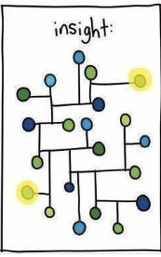
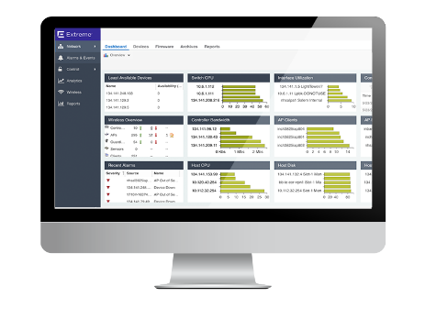
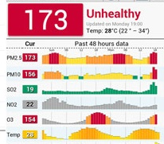
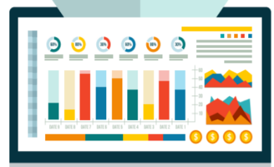

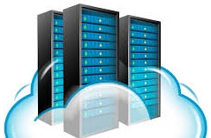




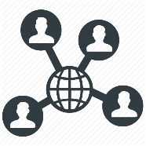





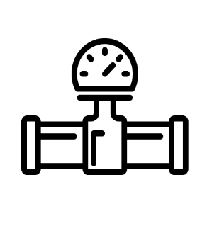




A data space built around IUDX
Urban Governance
Data Space
Applications,
Analytics…
An App ecosystem
Data Exchange
Platform
Data Policy and Economics
Training, Best Practices,
Use case templates
Public Data
Privately Owned Data

Slide 6
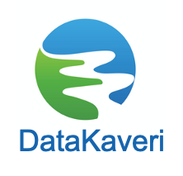

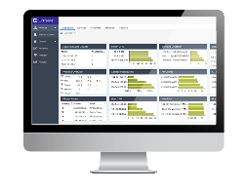
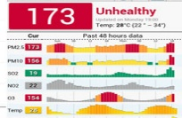







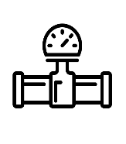


Beyond smart cities
Mobility
Urban Governance
Variety of
Data Spaces based on same framework
Healthcare
Mobility Data Space
Agriculture
Applications,
Analytics…
Industrial
An App ecosystem
Data Policy and Economics
Training, Best Practices,
Use case templates
States
Public Data
Privately Owned Data

Slide 7
Components of DX Platform

Slide 8



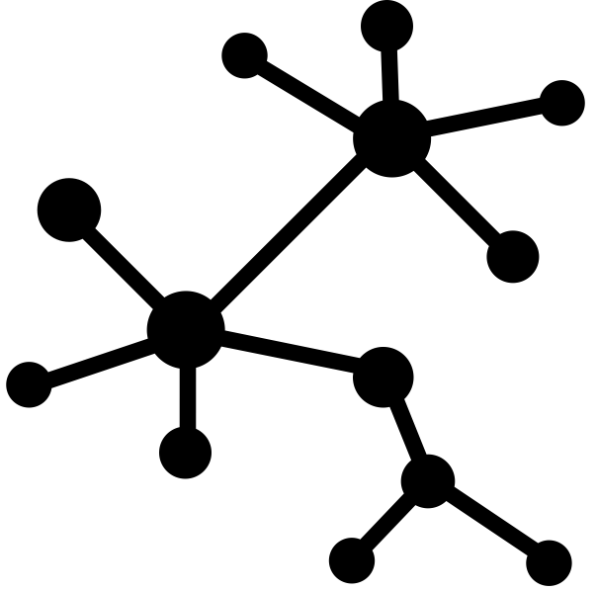
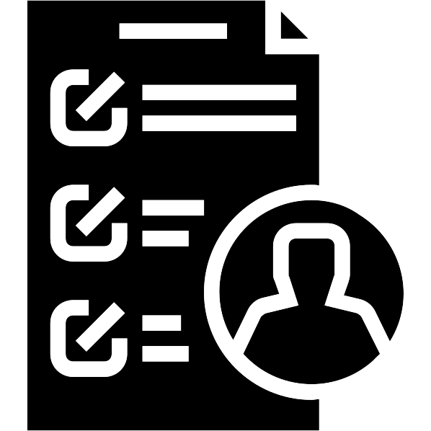
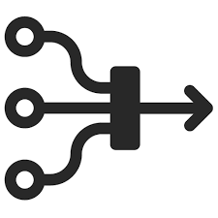
DX Stakeholders and concerns
Data Consumer would like to …...
Data Provider would like to ….
Discover data sources of interest
Access data from these sources in a secure fashion
Get authorizations for data sources that are not open
Get additional context for data
Ease of operations
Control access to its data sources
  Create, update, delete policies
Data to be served according to the set policies only
Onboard data from its sources and add meta-information to make the resource discoverable
Ease of operations

Slide 9
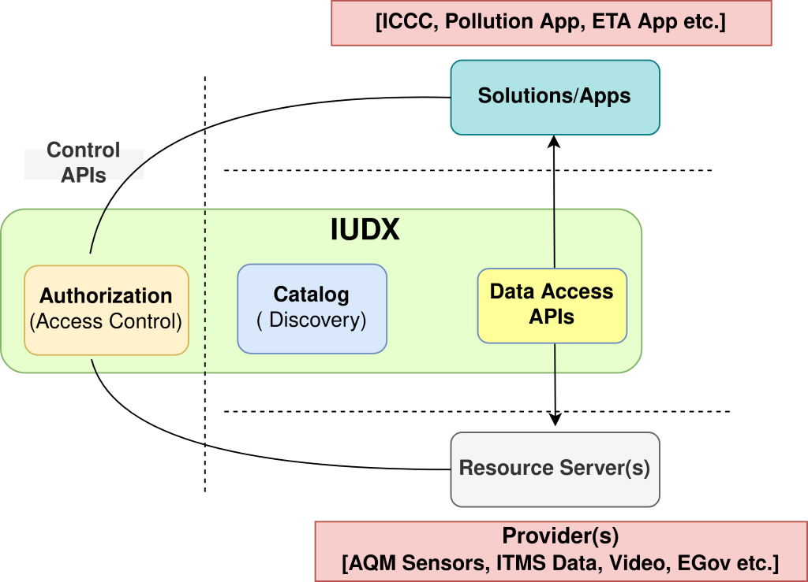
An Open Data Exchange Platform for Urban, Agriculture, Geospatial domains and beyond
Framework Enables
  Exchange of data between various IT systems
  Non-personal data
Two key stakeholders
  Data Consumers/App Developers
  Data providers
Catalogue
  Information about data sets
  Discovery by app developers
  Data models
Authorization
  Access Control
  Data privacy
Standardized APIs to access data
Standardized Data Models
Connects data sources to solution providers to extract full value
Notes:
What are APIs ?

Slide 10
IUDX Core Components
Catalogue Server (Discovery APIs)
  https://api.catalogue.iudx.org.in/apis
Resource Server (Data Access APIs)
  https://rs.iudx.org.in/apis
Authorization Server (Access Control APIs)
  https://authorization.iudx.org.in/apis

Slide 11
Catalogue Service
Stores Meta-information about the resources
Search and discovery
  Tags, Locations etc.
Data Descriptors
  Meta-info about data
  Units, data formats (number, string etc.), resolutions etc.
Additional context
  Links of data attributes to other known vocabularies (uses linked data)
  Open or private data resource

Slide 12
Authorization Service
Authorization to grant access to protected resources
  Manage consumer access tokens
    Grant new tokens
    Add/remove resources
    Provide validation of access tokens to resource servers
Management of access policies
  Who can access, What data, For how long etc.
  Add/Delete/Renew policies
Authentication to identify all stakeholders
    OAuth 2.0 based authentication
Allows data sharing while respecting ownership and privacy requirements

Slide 13
Data Access Service
Data Discovery
  Allow Data Consumers to Search, Query using HTTP APIs
  Allow Data Consumers to subscribe for data using the data broker
Data Ingestion
  Allow Data Providers to register, publish data into the system
    Publish endpoints
    Adaptor/Connector Registrations with the Data broker
Resource Integration and Validation
  Ensure resources (registered or discovered) has a foot-print in the Catalogue Service
  Auth and catalogue integration
    Compliance with privacy requirements
    Data served only if a valid token is presented for secure data

Slide 14
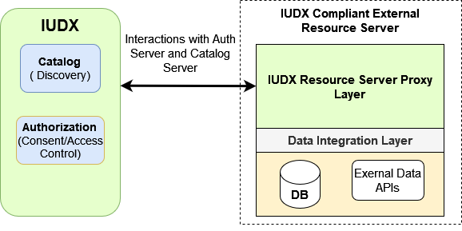
Resource Server Proxy

Slide 15
Components needed to share Personal Data

Slide 16

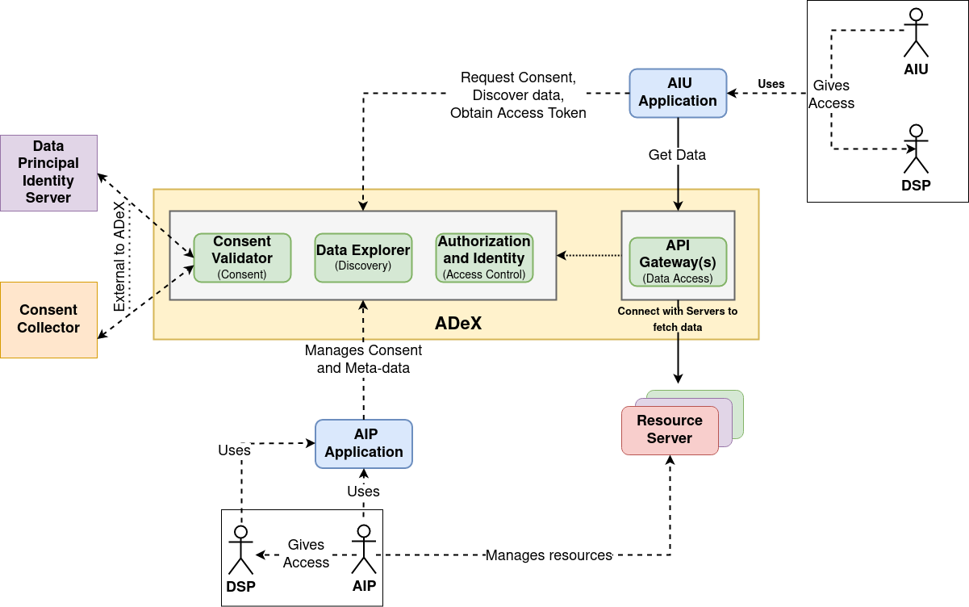
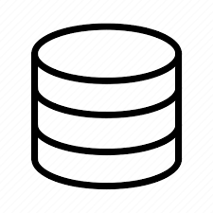
ADeX Core : High Level Architecture
Examples: Credit Agencies, Banks etc.
Application Development
Cloud Based
Open Source
Cybersecure
No stored data
Scalable
Data Onboarding
AIP hosted
Multiple Data Sources
Examples: Govt. Departments, Agri Universities, Private data publishers etc.

Slide 17
Scaling the DX using
City Operations Platform
(COP)

Slide 18
Data
Persistence
ICCC
System (NEC)
Operational apps (NEC)
Proposed Architecture
Data
Exchange
Data Exchange (IUDX)
CIL (IUDX)
City Operations Platform (COP)
Data
Cleaning and Integration
City Operating System (COS)
Data Connectors (IUDX)
Data Connectors pull data from Sensor Cloud
Simplified IoT Platform for AQM, Flood etc. for multiple vendors (onem2m)
Data
Collection
Interface to Read and Write
Ingest data to IoT platform
Sensor Cloud for Vendor-1 (AQM)
Sensor Cloud for Vendor-2 (Flood)
AQM, Flood, etc.
IoT Systems and Sub-Systems
Sensors
Vendor - 1
Vendor - 1
AQM Sensors
Flood Sensors

Slide 19
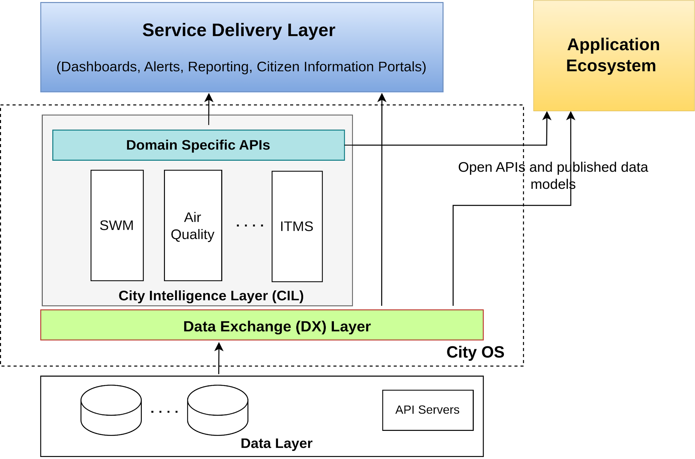
City Operating System (COS): Augment Data Exchange with Extensible City Intelligence Layer
Information infrastructure View
City Intelligence API’s
Transform
Digital infrastructure View
Layered approach: Decoupled CI-API and visualization layer
Extensible: New DS-APIs can be easily added

Slide 20
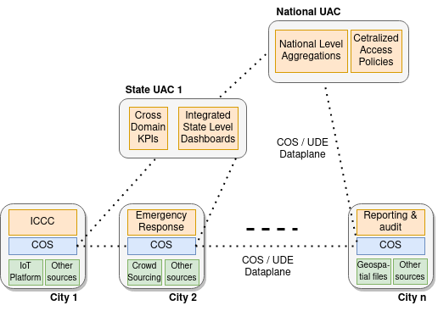
Federated COS/COP Architecture

Slide 21
DX in Production
Deploy anywhere in multiple forms
  Cloud Agnostic
  Auto-scalable and Highly available system based on Kubernetes
Enables Data Marketplace
  Immutable and tamper proof audit logs
  Metered Data Access
Automated Alerting, System Monitoring and Security
  Alerts to multiple notification channels to identify failures
  Privacy Isolation and Component Security preserved using Service Mesh
Open Source code base at https://github.com/datakaveri
Continuous Integration and Testing
  Test Driven Development
  Continuous Integration with Automated Testing for security, load, regression and integration with GIt

Slide 22
Using DX
IUDX Demo video
IUDX Sandbox
AdeX Demo Video
IUDX SDK

Slide 23
Architecture Summary
Technology Reference Model
  Open standards
  Minimalistic and extensible
  Technology independent architecture
  Cloud ready, Microservices approach
  Scalable Service Mesh Design
Security Reference Model
  Data exchanged with only authorized entities
  Security built into all architectural components

Slide 24
Security and Privacy
TLS based secure communications
All services are exposed as per the access control policies
Certificate based authentications for issuing tokens
Communication between IUDX components is not exposed to public IP network
Using API gateway for authenticating, controlling and analyzing API traffic
Explicit validation for HTTP requests to debar invalid requests
Limited port exposure for all the public services
Rate limiting provisions for preventing DDOS attacks for open resources
Security built into all architectural components

Slide 25
Summary
IUDX is a data exchange service that
  Hosts and manages meta-information about resources and facilitates their discovery (Catalogue)
  Facilitates exchange of data (Resource Server)
  Facilitates authentication, authorization and accounting mechanisms (Auth Server)
Defines 2 main participants
  Data providers
  Data Consumers/Applications
Defines the flow of information between
  Providers/Consumers and catalogue
  Consumers and Resource servers
  Providers/Consumers/Resource-servers and Authorization servers

Slide 26
Introduction to Devops

Slide 27
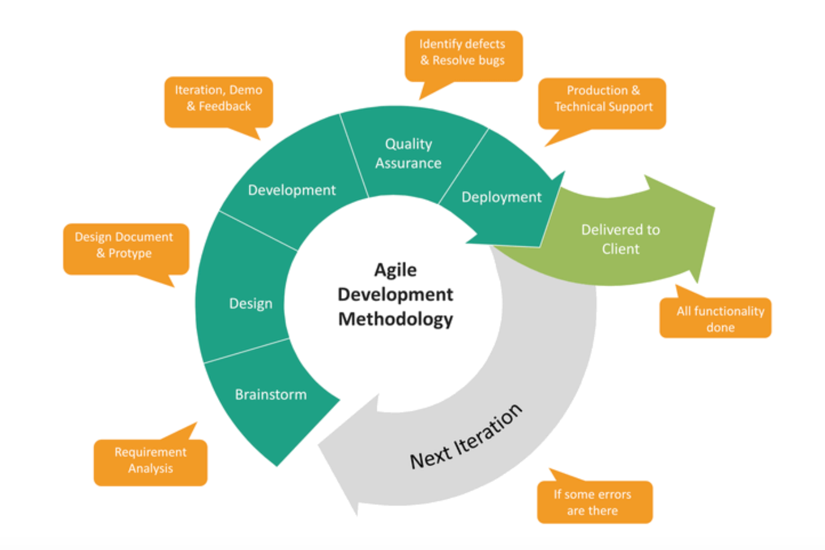
Software Life Cycle

Slide 28
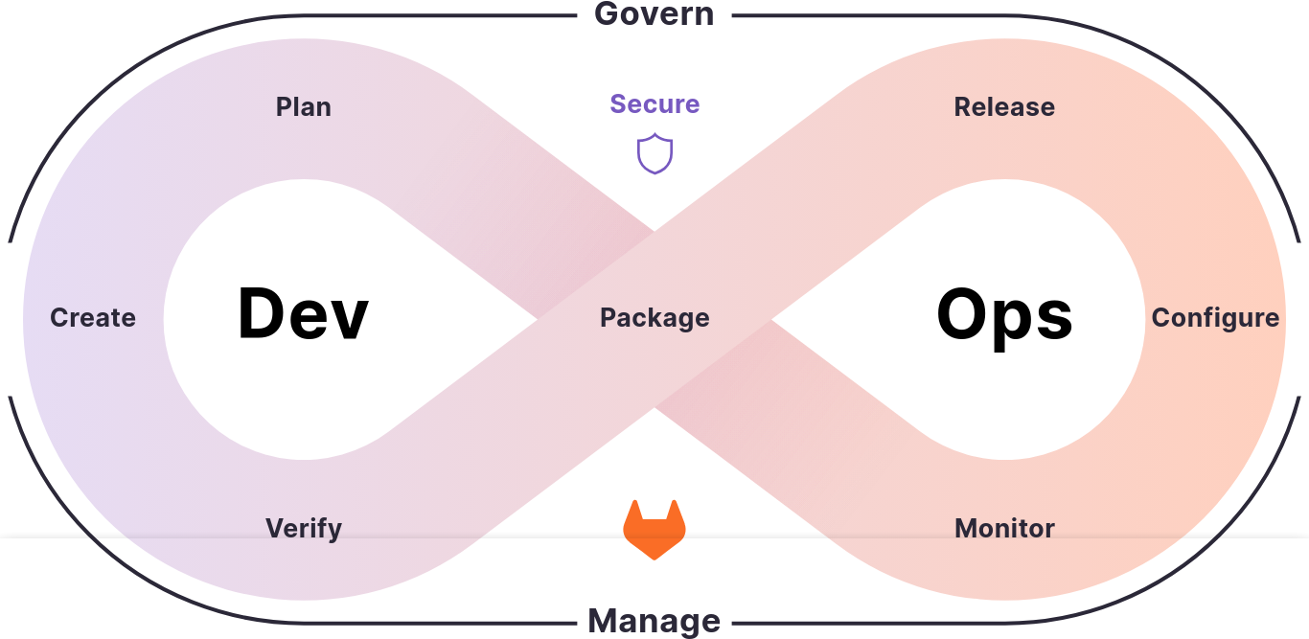
DevOps: The need
Developers and Traditional Ops working silos --> causing more delivery time and bug fixing time
Working together to conceive, build and deliver secure software at top speed
Extension of agile culture.
Enabled by automation tools .

Slide 29
Dev(Sec)Ops: Principle
Agility
Scalability
Reliability
Security

Slide 30
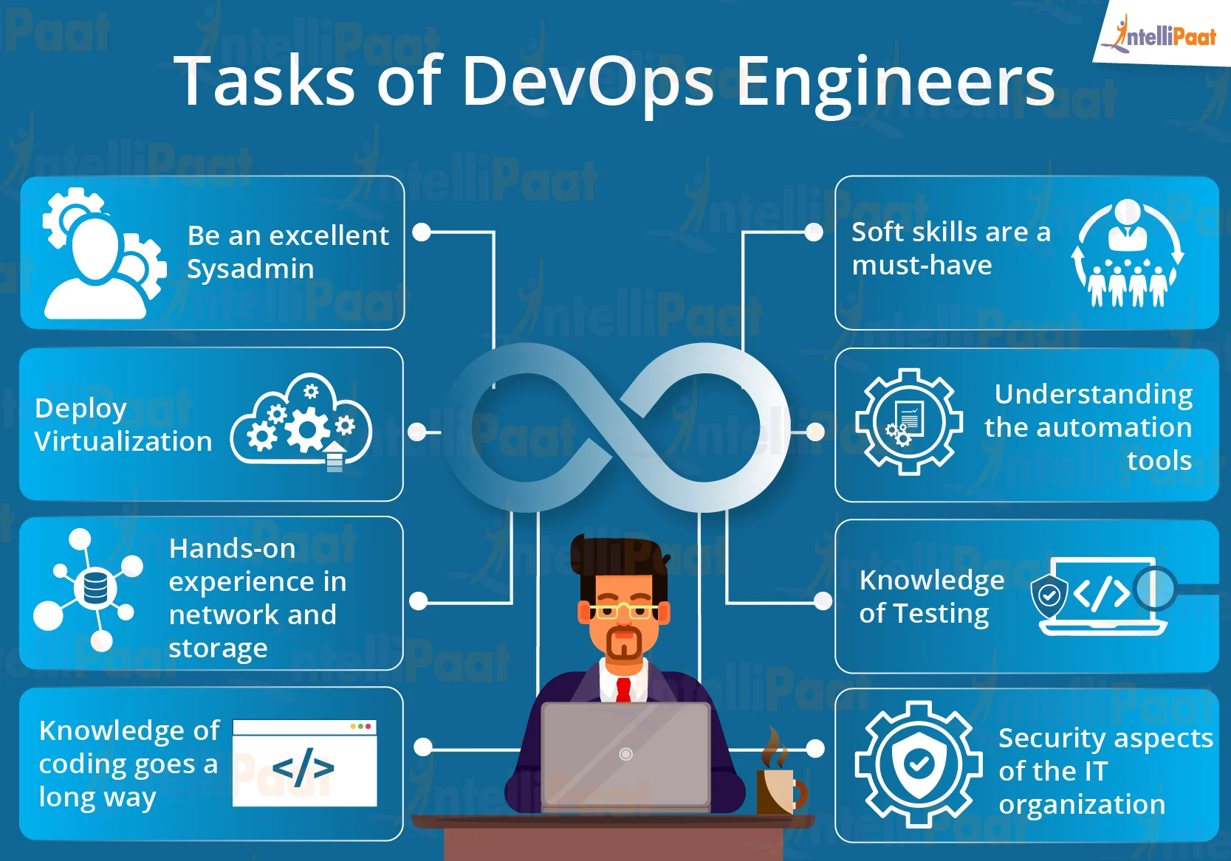
DevOps: Role

Slide 31
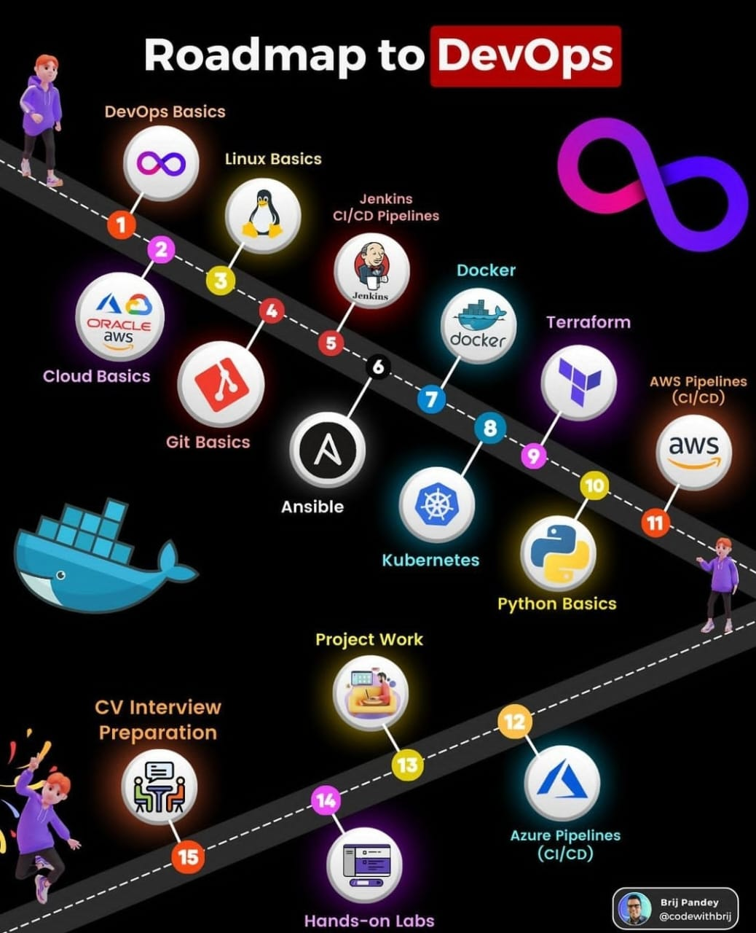
DevOps: Technologies

Slide 32
Workshop

Slide 33
Why Containers (docker)?
Consider two python3 applications – Django based application
One application needs specific
  Python3 version – >=3.10,
  Requests – 2.10
  Django version – 4.2
Another application needs
  Python3 version – >=3.10,
  Requests – >=2.11
  Django version – 5.0
Notes:
- Explain the differences between vms, containers
- Virtual Machines – entire machine is simulated – hardware – ram, disk, cpu. Entire operating system runs, OS thinks
In a seperate hardware . Isolation between different vms but not different process. Hypervisor beneath which helps in simulating multiple virtual devices on a single machine
- Container – isolated process sharing same OS. Isolation network, file, process. - Lightweight
- Shipping from developer to prod in standard fashion

Slide 34
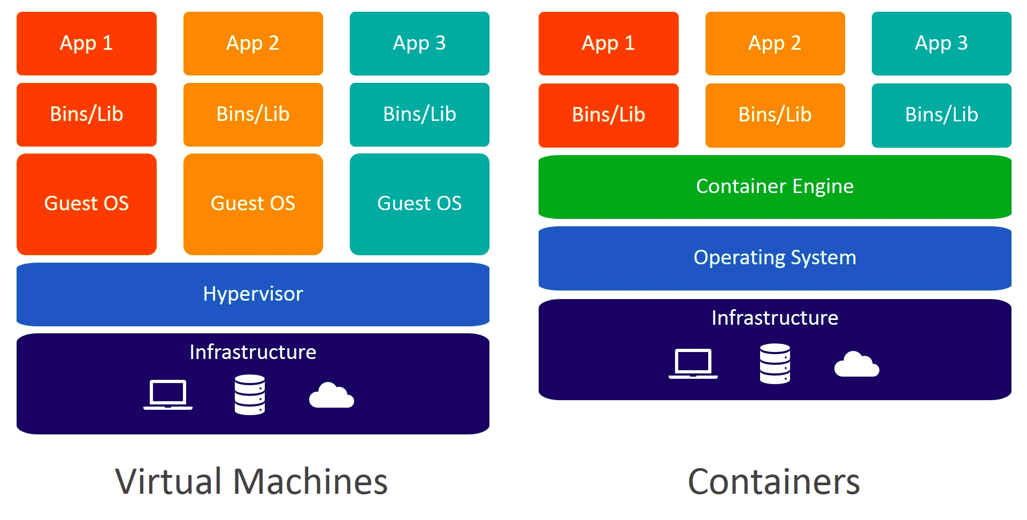
What are Containers (docker) VMs?
Virtualisation on top of OS
Container --> Think as isolated process(es)
Notes:
- Explain the differences between vms, containers
- Virtual Machines – entire machine is simulated – hardware – ram, disk, cpu. Entire operating system runs, OS thinks
In a seperate hardware . Isolation between different vms but not different process. Hypervisor beneath which helps in simulating multiple virtual devices on a single machine
- Container – isolated process sharing same OS. Isolation network, file, process. - Lightweight
- Shipping from developer to prod in standard fashion

Slide 35
What is Containers Tech (docker)?
Shipping and deploy application in standardised fashion
Provides isolation in terms of network, process, package dependency
How it does ?
Process isolation, network isolation using Linux cgroups -> for resource constraints and namespaces

Slide 36
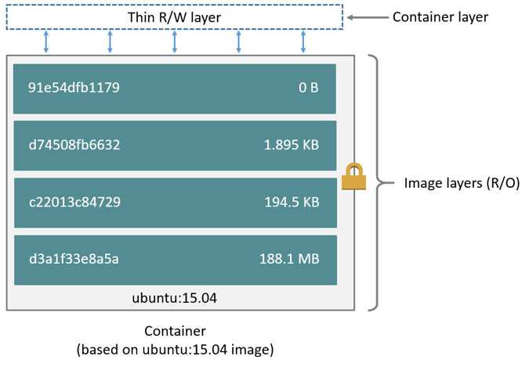
Docker Containers and Images
The image building definition is written in Dockerfile
Think Docker images as program code + libraries
Docker containers as running instance of code/process
Containers lifecycle is similar to process lifecycle
  Stop : docker container stop <container-name>
  Delete: docker container rm <container-name>
  Start: docker container start <container-name>

Slide 37
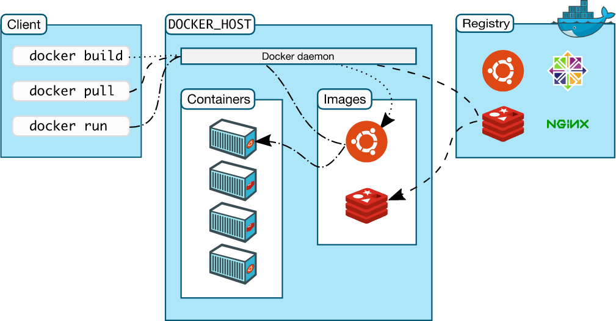
Docker Architecture
Notes:
- External Archtitecure
- Client Server model
- Image – application binary, libraries --

Slide 38
Lets Do Hands On
https://tinyurl.com/IUDX-Devops

Slide 39
Container Technologies
Docker Swarm – Small scale container orchestrator
Kubernetes(K8s) – Large scale Container Orchestrator with autoscaling
KubeFlow – Orchestrate ML application in scalable, agile manner in K8s

Slide 40
How to start learning DevOps and Career

Slide 41
DevOps: Skill sets
Operating Systems – Linux,
Networks - Understanding of each layer, IP addressing, protocols,
Dev skills – Python, Bash
Databases
Security
Troubleshooting skill sets

Slide 42
DevOps: Technologies

Slide 43
DevOps: Career
Why choose/learn Devops skills:
  Easily host,
  To better understand and build whole system. End to end
Different Career roles
  System Admin , IT support
  Platform Engineer
  Software Reliability Engineer
  Design Architect

Slide 44
Resources
Fundamental of Networks, OS, System Admin, Security, IT support - https://www.coursera.org/professional-certificates/google-it-support
Overview of docker : https://docs.docker.com/get-started/overview/
Playlist to learn docker : https://youtube.com/playlist?list=PLc_rqlUaBHqucMG3yMIS5JsLtR5i3OY4U
Docker Mastery: https://www.udemy.com/course/docker-mastery/
K8s microservices: https://www.udemy.com/course/kubernetes-microservices/

Slide 45
References
IUDX catalogue – https://catalogue.cos.iudx.org.in
AdeX – https://dataexplorer.adex.org.in
GSX – https://catalogue.gsx.iudx.io
Overview of docker : https://docs.docker.com/get-started/overview/
Playlist to learn docker : https://youtube.com/playlist?list=PLc_rqlUaBHqucMG3yMIS5JsLtR5i3OY4U

Slide 46
Questions

Slide 47
Thank You

