Slide 1
Learning Management System
Team Members
Abhinav Singh (20BCS008)
Abhishek Ramgoliyan (20BCS014)
Gautam Singhal (20BCS087)
November 16th 2021

Slide 2
Introduction
Our project is a web-app based LMS
Will act as a visual classroom
Better management and Ease of access

Slide 3
Purpose & Scope
To make learning process efficient.
Handle course classes, exams, assignments, doubts and announcements
Post-pandemic world
Technology Stack
Front end: Html, CSS, React JS , JavaScript.
Back end: Node JS, PHP.
Database: My SQL

Slide 4
Project Modules
Sign up and Login page( Gmail – login)
Dashboard that contains:
Profile
Courses
Announcement
Assignments
Files/notes
Quizzes
Doubts (open forum)
Help (FAQ)

Slide 5
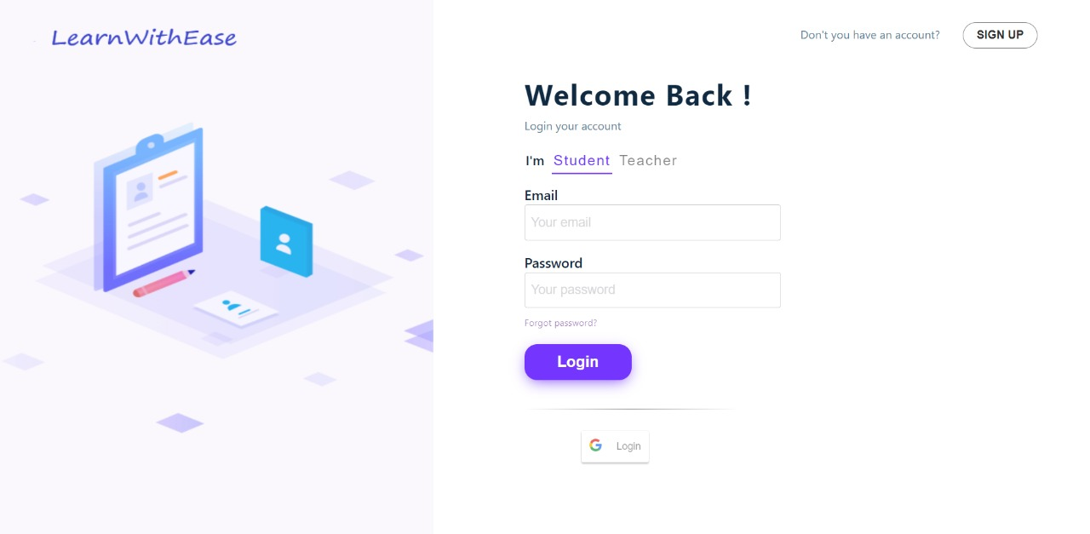
Login Page:

Slide 6
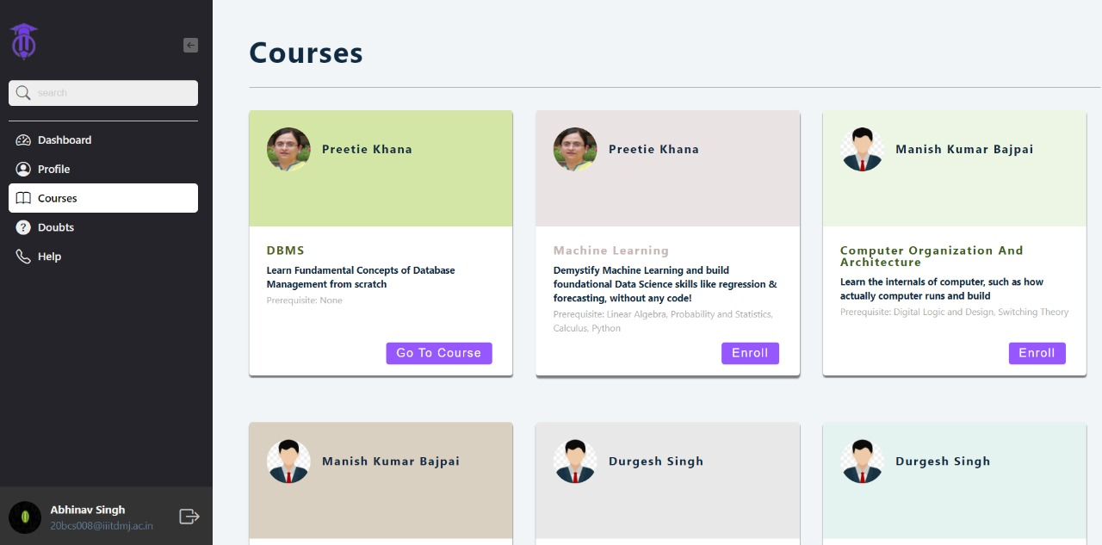
Courses:
Add screenshots

Slide 7
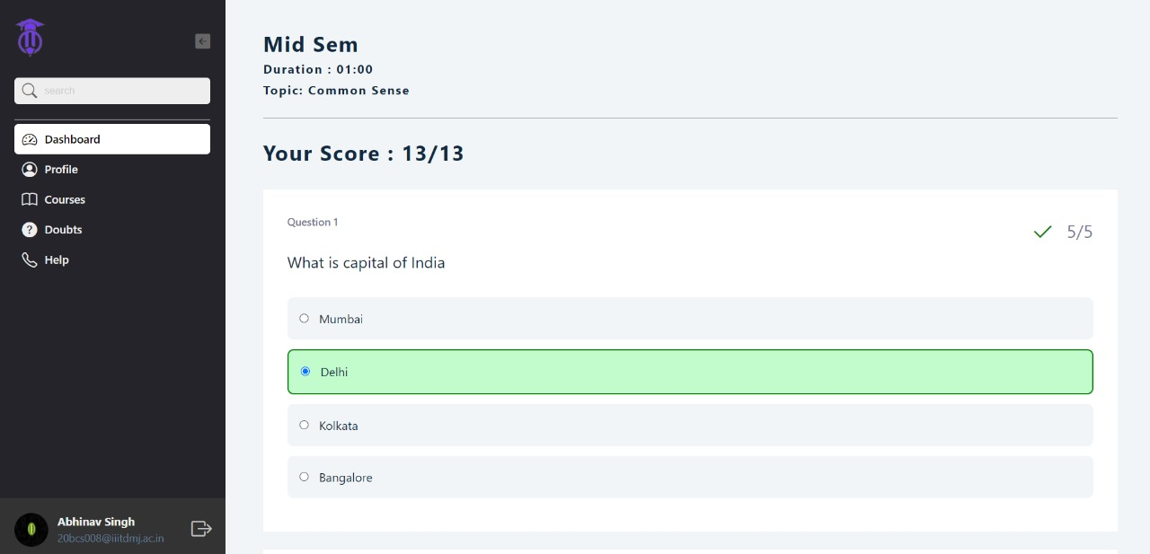
Quizzes (student)

Slide 8
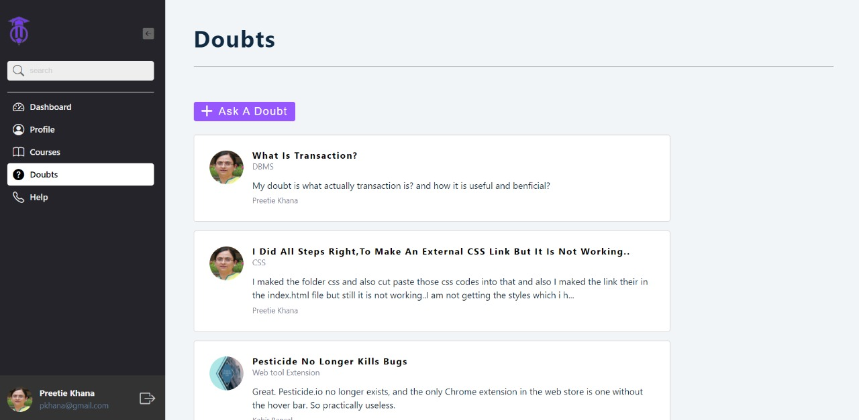
Doubts:

Slide 9
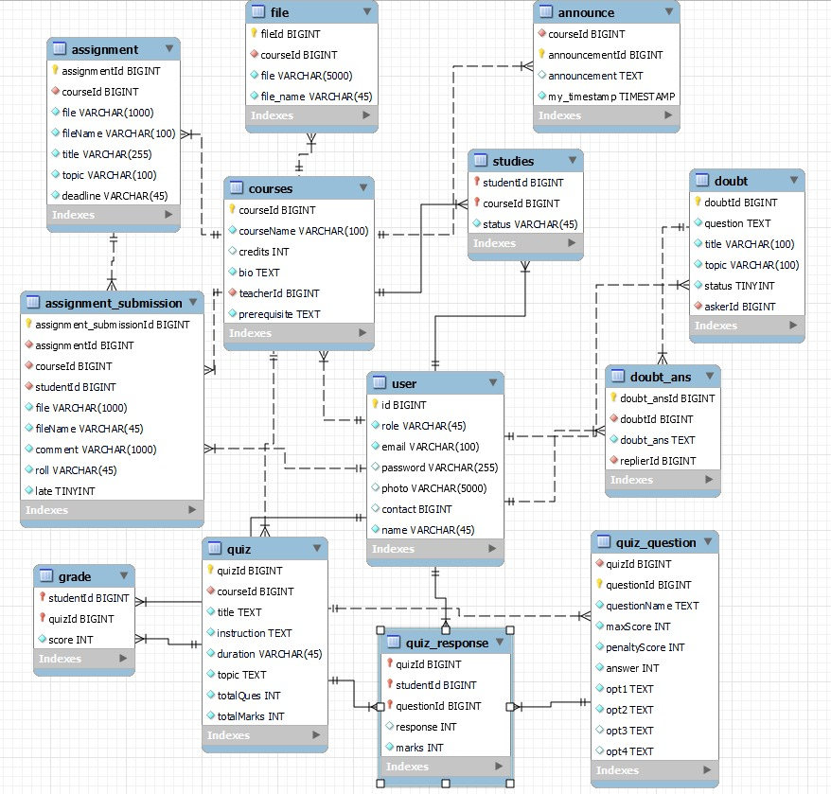
Database-Schema

Slide 10


