Slide 1
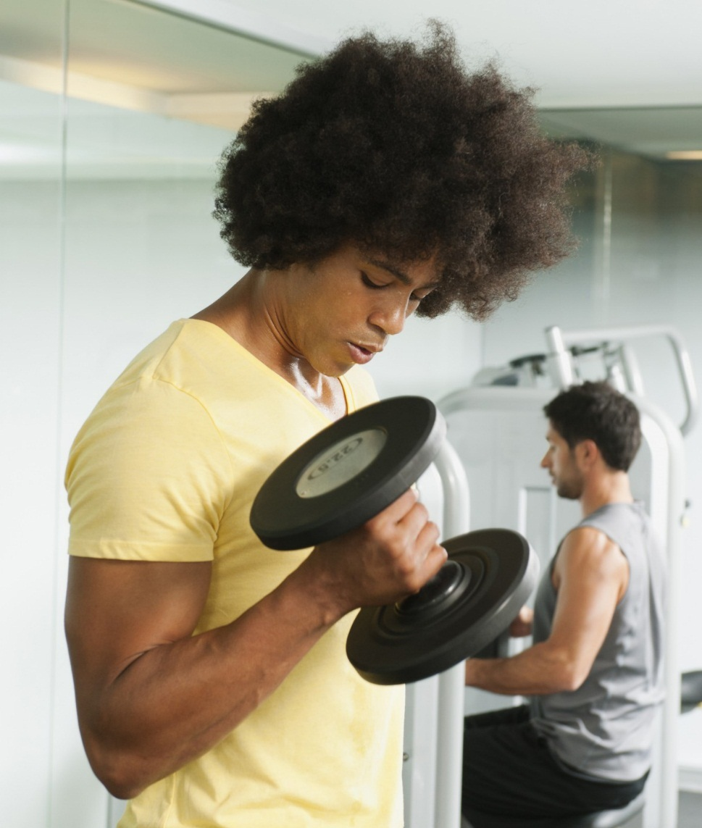
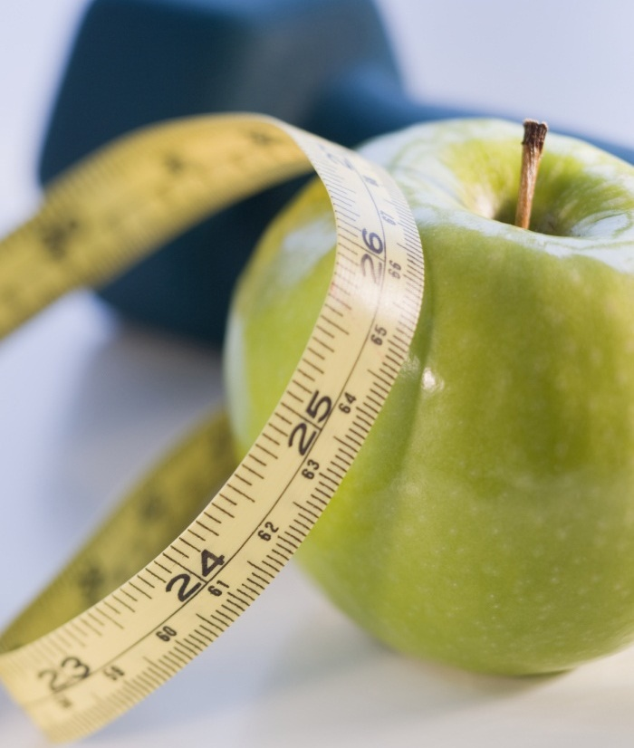
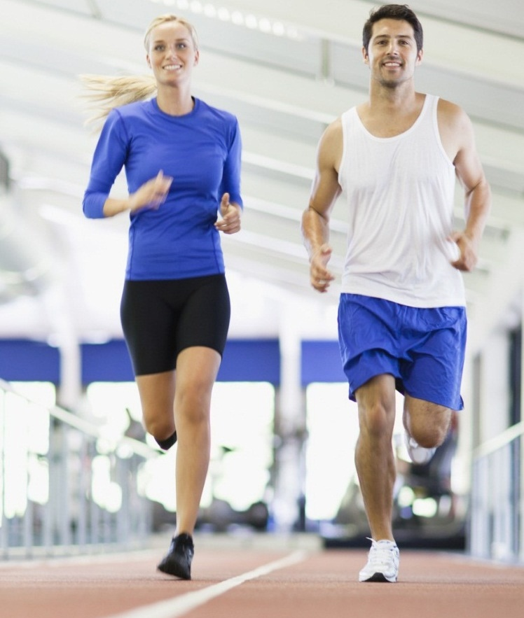
ENHANCED PREDICTIVE LEARNING APPROACHES FOR PERSONALIZED DIET RECOMMENDATION SYSTEM IN HEALTHCARE
TECH TYCOONS – MAJOR PROJECT 2020

Slide 2
INTRODUCTION
In this modern world various people suffer from different types of diseases and illnesses. It is generally very difficult to suggest a diet as quickly as possible.
What should I eat ? When should I eat ? How often should I eat ? How much should I eat ? These are some of the questions which arise in the minds of the people.
A healthy and balanced diet is a key element in everyone’s life.
Most people have a dire need to Lose Weight, Gain Weight or stay Healthy. Time has also become a possible constraint.

Slide 3
OBJECTIVE
A diet recommendation system using machine learning algorithms has been proposed in this project which will suggest food items to the user from a predefined dataset depending upon user preferences for healthy food or food for weight loss or food for weight gain.
The project makes use of a dataset which contains various nutrients in the correct amount.
In the wake of the situation, we have tried to develop a program that recommends diet to the people. The items recommended are limited to three categories: Weight Loss, Weight Gain and Healthy category.
Our project uses Machine Learning Algorithms named K-Means Clustering for clustering the data and Random Forest Classification to classify according to the categories listed.

Slide 4
EXISTING SYSTEM
The existing working model of the Diet Recommendation System gives recommendations concerning food based on user inputs in general life style.
ISSUES IN THE EXISTING SYSTEM
The issues that are being faced by the current working model is it does not facilitate a user with the food classification based on the food timings on a daily basis like Breakfast/Lunch/Dinner along with additional features like Body Mass Index (BMI) and age range details.

Slide 5
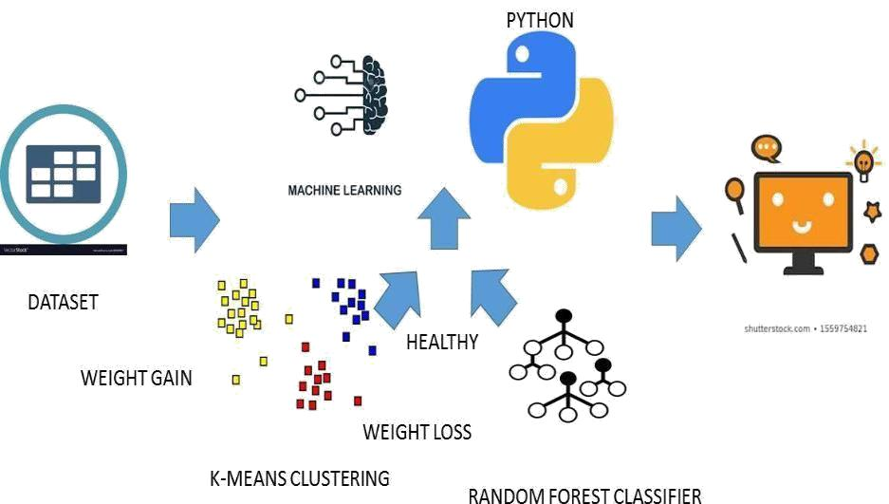
SYSTEM ARCHITECTURE
The above figure shows the architectural diagram for the working prototype of the Diet Recommendation System. The code is written in Python which is used to implement various Clustering and Classification algorithms in Machine Learning for predicting a proper diet to the user.

Slide 6
SYSTEM WORKFLOW
CLUSTERING – K-Means
DATASET
CLASSIFICATION - RANDOM FOREST CLASSIFIER
DIET RECOMMENDATIONS
USER ITERFACE

Slide 7
DATASET
The dataset used in this model involves a wide variety of food and its nutritional values.
Initially segregation of food items is done depending on the meal timings i.e. Breakfast , Lunch and Dinner.
K-MEANS CLUSTERING
The dataset is then utilized by the K – Means Clustering Algorithm to classify the entire data into clusters of Weight Loss, Weight Gain and Healthy

Slide 8
RANDOM FOREST CLASSIFIER
Random Forest Classifier is used to predict the nearest food items which best suites the appropriate diet.
USER INTERFACE
As part of user interface , the inputs needed from the user are Age , Height , Weight and also the purpose for which the diet is required.
Additional information like Body Mass Index(BMI) is also calculated.
DIET RECOMMENDATION
Depending upon it, from the appropriate clustering , specific food items are classified and recommended to the user.

Slide 9
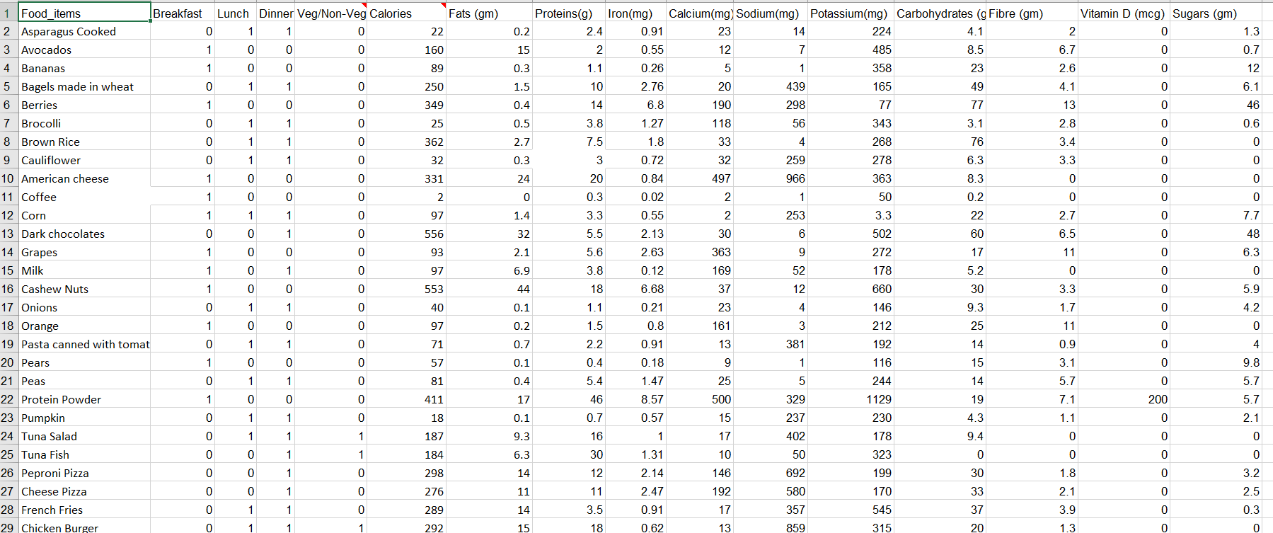
MODULES
DATASET

Slide 10
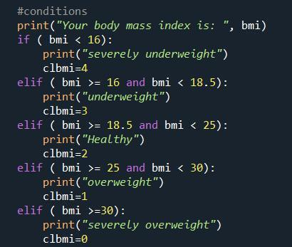
The dataset comprises of different variety of foods along with different nutritional values like calories, fats, proteins, iron, calcium, sodium, potassium, carbohydrates, fibre, vitamin D and sugars.
After reading the dataset, the entire dataset is classified into Breakfast, Dinner and Lunch.
The Diet Recommendation System calculates the Body Mass Index taking into consideration the Height and Weight of the user. An age range is also displayed to state the comparison of the BMI for a specific range group. Based on the BMI calculated the category is specified that the human is underweight, healthy, overweight or severely overweight.

Slide 11
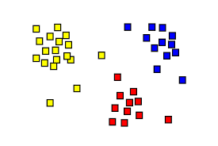
2. MACHINE LEARNING ALGORITHM
K – MEANS CLUSTERING
WEIGHT GAIN
WEIGHT LOSS
HEALTHY
The clusters are classified as –
Weight Loss
Weight Gain
Healthy

Slide 12
Now the application of K – Means Clustering Algorithm comes into play. The number of clusters decided for the module is three namely Weight Gain, Weight Loss and Healthy.
All the food items at the time of Breakfast, Lunch and Dinner falls into any of these categories.
The data is fitted to the model and then make predictions for the food items.
Now we take the data of a specific cluster and divide it into the test and the train dataset which is further used to train the Random Forest Classification model to make recommendations of the food items to the user.

Slide 13
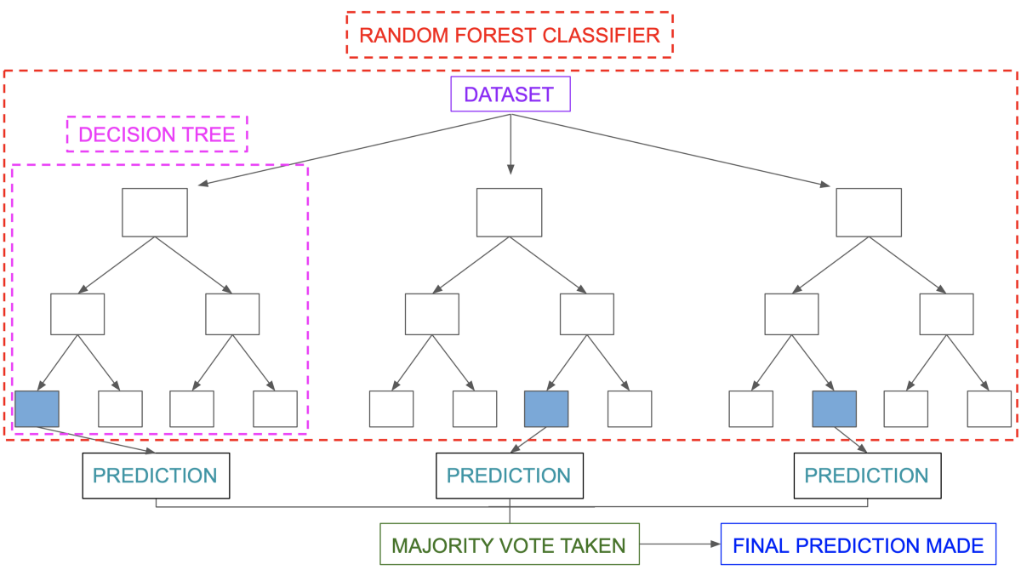
RANDOM FOREST CLASSIFIER
The Forest Classifier will classify various food items depending upon the nutrient values into different categories and when the user prompts for a diet, the system would generate food items from different classifiers whichever suits more appropriate depending upon the user profiles.

Slide 14
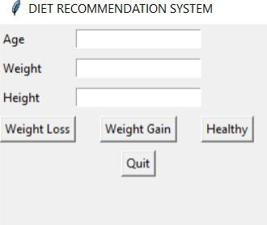
3. GRAPHIC USER INTERFACE
The implementation of the Diet Recommendation System begins with the user input as accepted from the Graphical User Interface (GUI).
The GUI is build using Python’s library Tkinter.
The GUI contains three labels and text entry boxes each for Age, Veg/Non-Veg, Weight and Height and align it to a specific position on the screen.
Four Buttons stating the Weight Loss, Weight Gain, Healthy and Quit options are made available on the GUI so that the required functions can be called and then the food can be recommended as per the user’s inputs.

Slide 15
IMPLEMENTATION PROCEDURE
For training of the system, the initial process involves the segregation of food items depending upon the meal for which they are consumed i.e. Breakfast , Lunch and Dinner.
The clustering of various nutrients depending upon which are essential for the weight loss , weight gain and healthy is performed.
After the clustering is performed , using Random Forest classifier , the nearest food items are predicted which best suites for the appropriate diet.
As part of user interface , the inputs needed from the user are Age , Height , Weight and also the purpose for which the diet is required.
Depending upon it, from the appropriate clustering , specific food items are classified and recommended to the user.

Slide 16


TECH STACK AND TOOLS
Python 3.4
Spyder 3

Slide 17
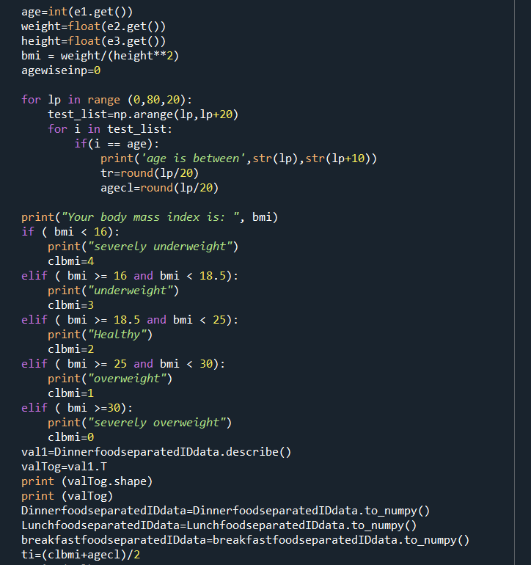
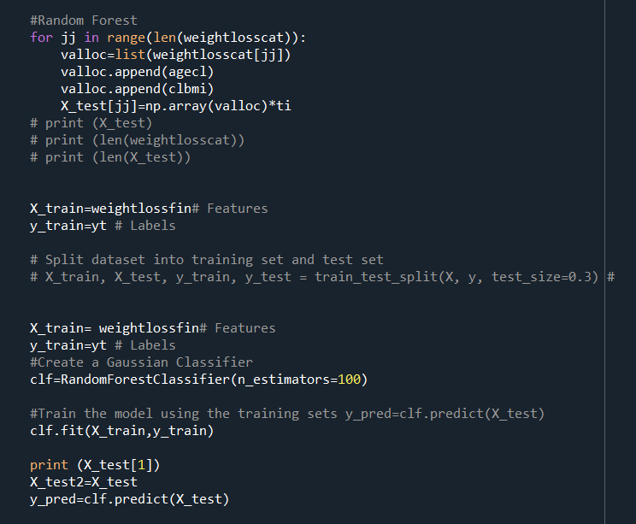
CODE

Slide 18
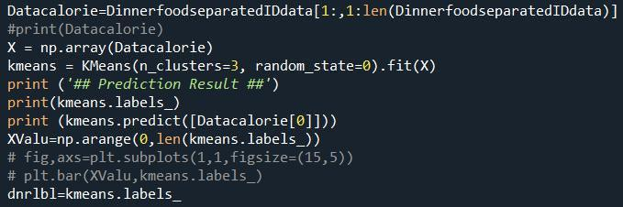
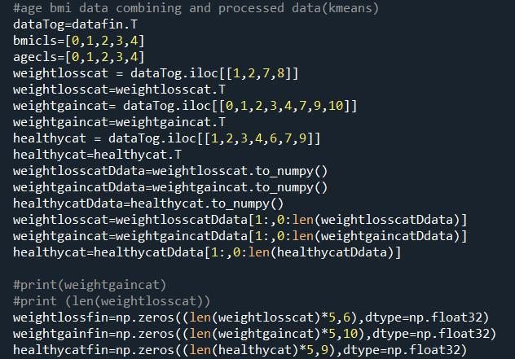
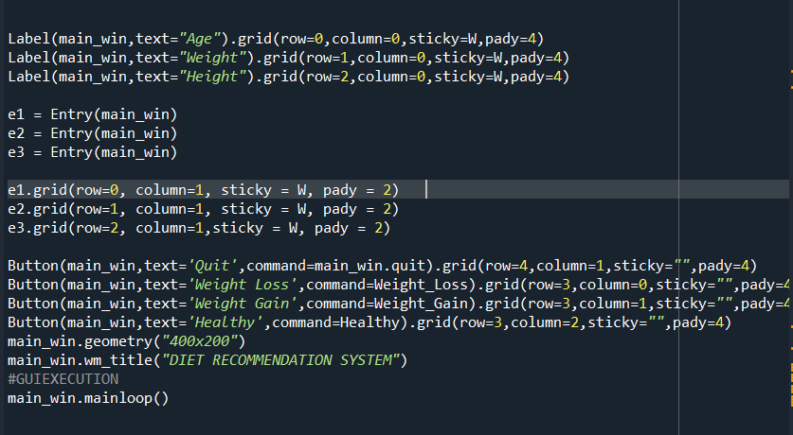
CONT…

Slide 19
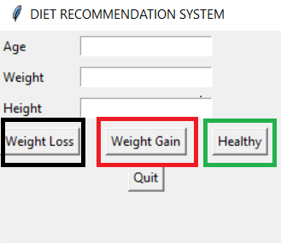
RESULT
A working prototype of a Diet Recommendation System is established.
The module works on the basis of K-Means Clustering and Random Forest Classification Algorithms.
Tkinter based GUI is implemented.

Slide 20
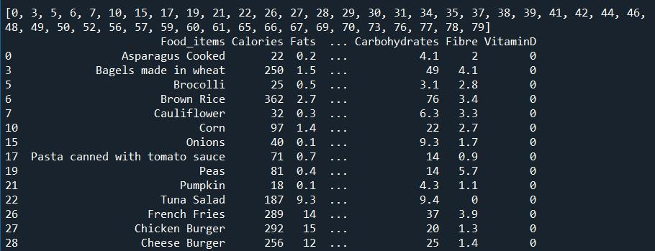
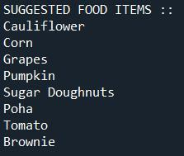

CONT…

Slide 21
CONCLUSION
A Diet Recommendation System is implemented with the working functionalities like:
Desired food list prediction.
Weight category prediction.
BMI Calculation.
Health is vital for an individual and can be achieved with this working module. Thus making life healthy.

Slide 22

TEAM – TECH TYCOONS
TEAM MEMBERS
ABHISHEK VERMA - RA1611008010402
MOHNISH RAVAL – RA1611008010453
TANYA OJHA – RA1611008010525
UDIT SAVLA – RA1611008010565
PANEL MEMBERS
SAVEETHA D
NIMALA K
GUIDE
NALLARASAN V

Slide 23


