Slide 1
Predicting Bed Allotment in Hospitals using Condition space and Hierarchical clustering
Guide:
Mrs. M. Sailaja
Assistant Professor
Project By:
18501A0581 - Abhinav.M
18501A05B9 - N V Sai Bhargava.Y
18501A0576 - Deva Harsha.M
18501A0588 - V Ratna Sravanth.P

Slide 2
Contents:
. Problem Statement
. Object
. Design Methodology
. Implementation

Slide 3
Problem Statement:
The length of stay (LOS) is very important to both patient and hospital. It is an indicator of the efficiency of hospital management. Reduction in the number of inpatient days results in decreased risk of infection and medication side effects, improvement in the quality of treatment, and increased hospital profit with more efficient bed management.
But it is not an easy task, it is dependent on many crucial factors like age, sex, weight, diagnose, sub diagnose, medicament, flora, active substance etc. Given its importance and difficulty, we need the best possible way to predict the no.of days a patient will stay in hospital (or) predicting bed allotment in hospitals.

Slide 4
Object :
The mathematical problem of patient information analysis is formalized, which will help identify critical personal characteristics based on conditioned space analysis. The condition space is given in cube form as a reflection of the functional relationship of the general parameters to the studied object. Dataset is divided into clusters using K-means clustering. A hierarchical predictor based on clustering and an ensemble of weak regressors is built. With this we will predict days.

Slide 5
Design Methodology:
• Exploratory data analysis
• The condition space development
• Clustering
• The hierarchical predictor development
• Results evaluation

Slide 6
Implementation

Slide 7
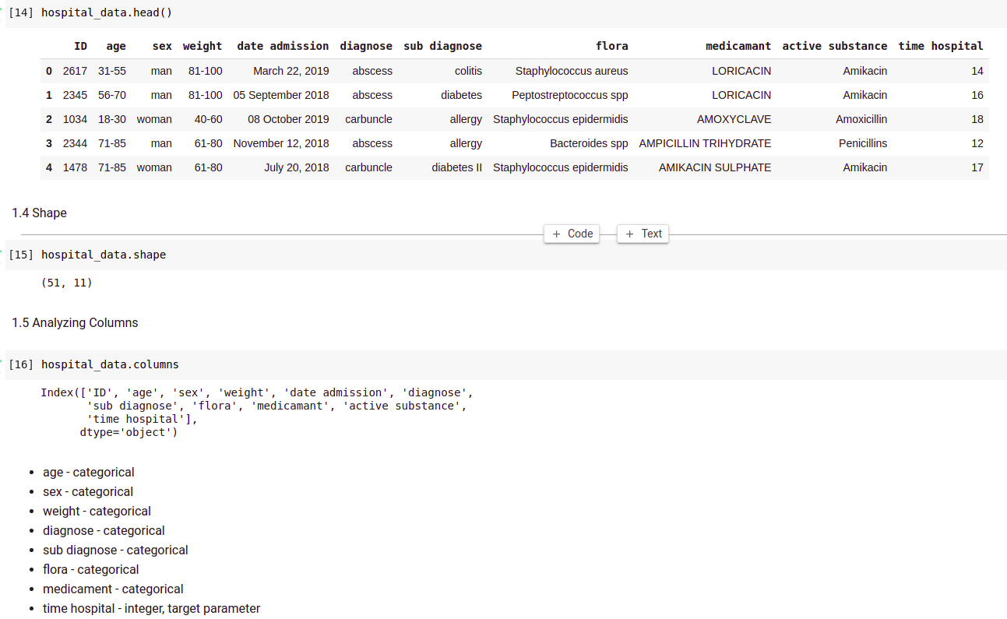
Exploratory Data Analysis:
First we have to understand the collected data.

Slide 8
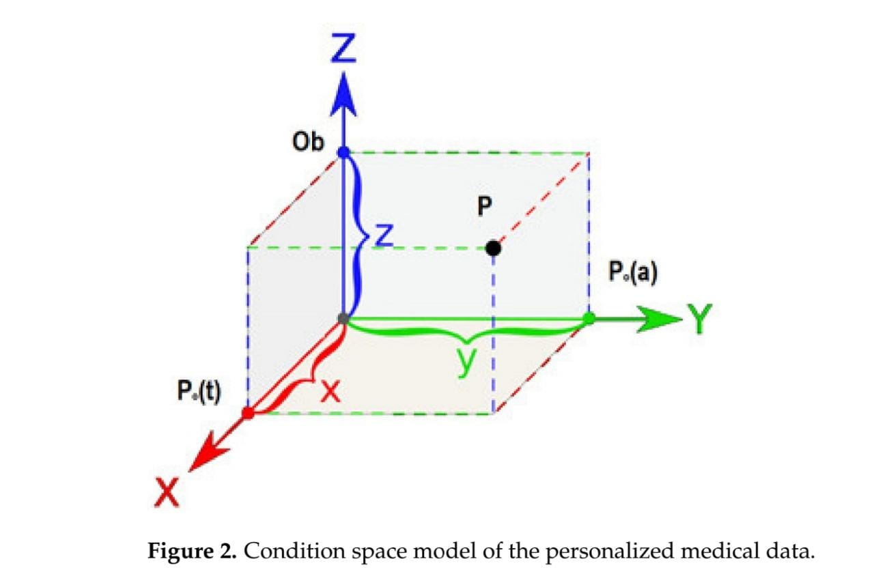
Conditional space analysis:
It provides the solution for the critical personal characteristics and these can be done by forming a cube which is formed by the relationship between the parameters.

Slide 9
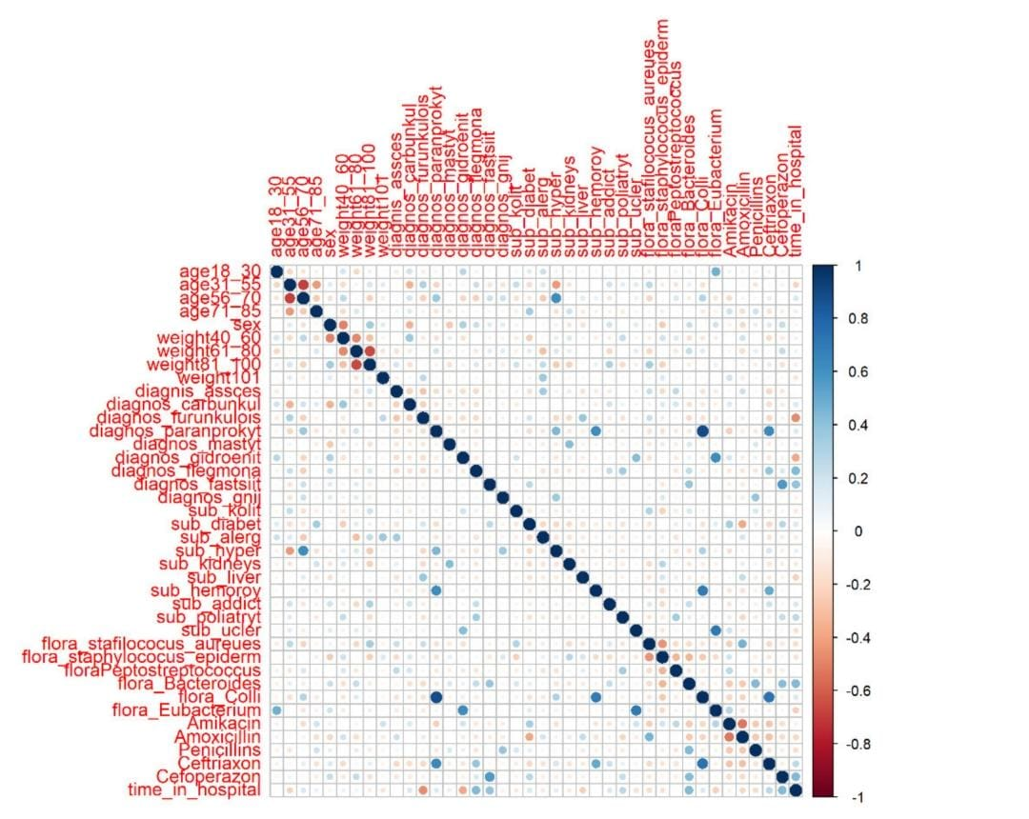
Correlation Matrix:
Correlation matrix is used to find the dependency relation among parameters in the data set.
But the major problem with correlation matrix is it doesn’t give the parameters which are required to analyse the result so that we use boruta algorithm.

Slide 10
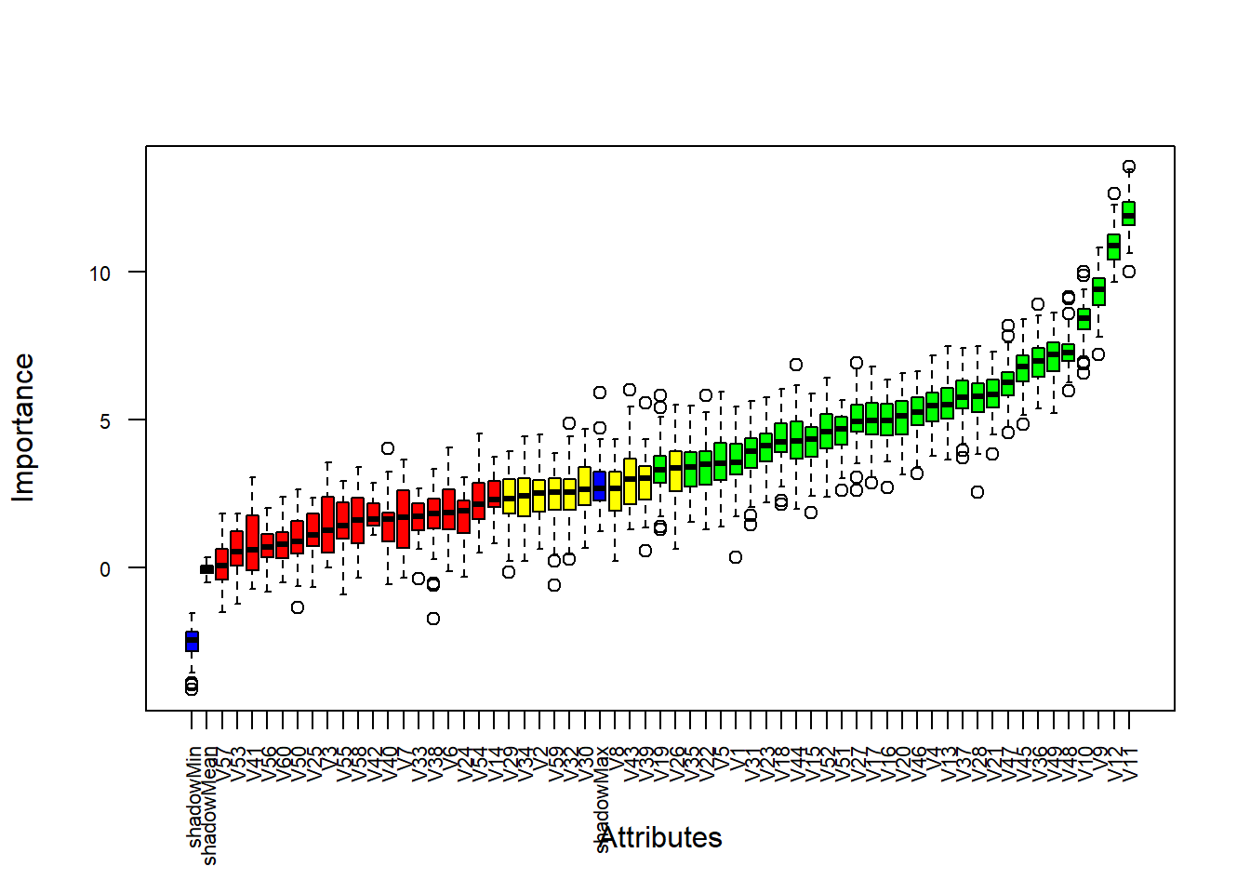
Boruta Algorithm:
The boruta algorithm is a wrapper built around random forest classification. This algorithm checks for each of the real attributes, if they have higher importance.

Slide 11
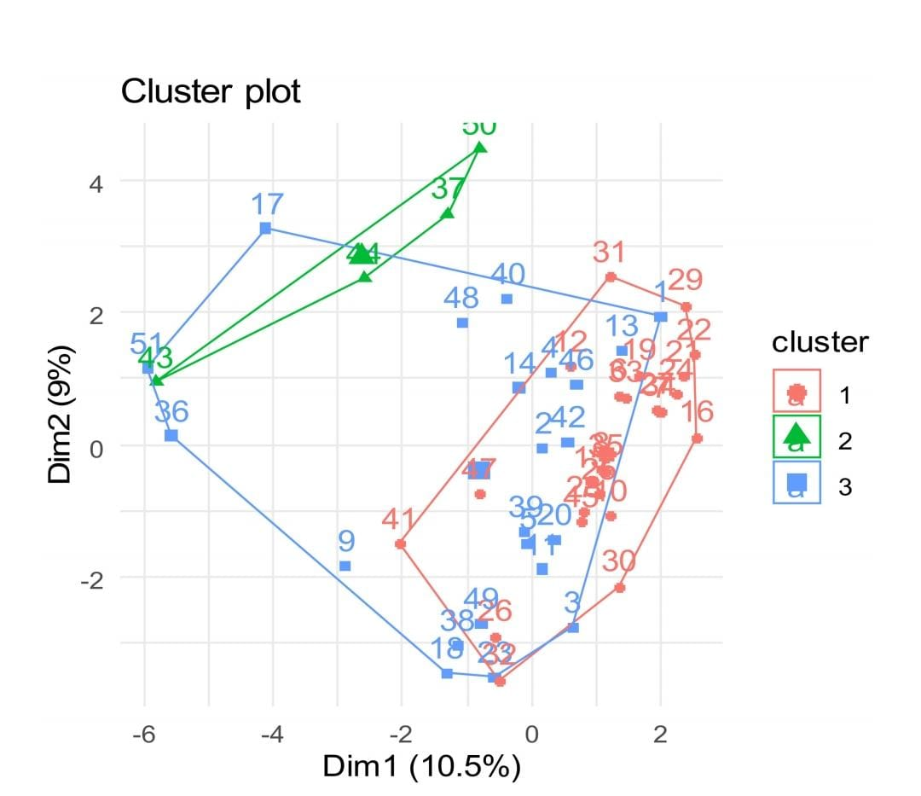
K-means clustering:
By using k- means clustering we can plot the clusters from
the condition space cube.

Slide 12
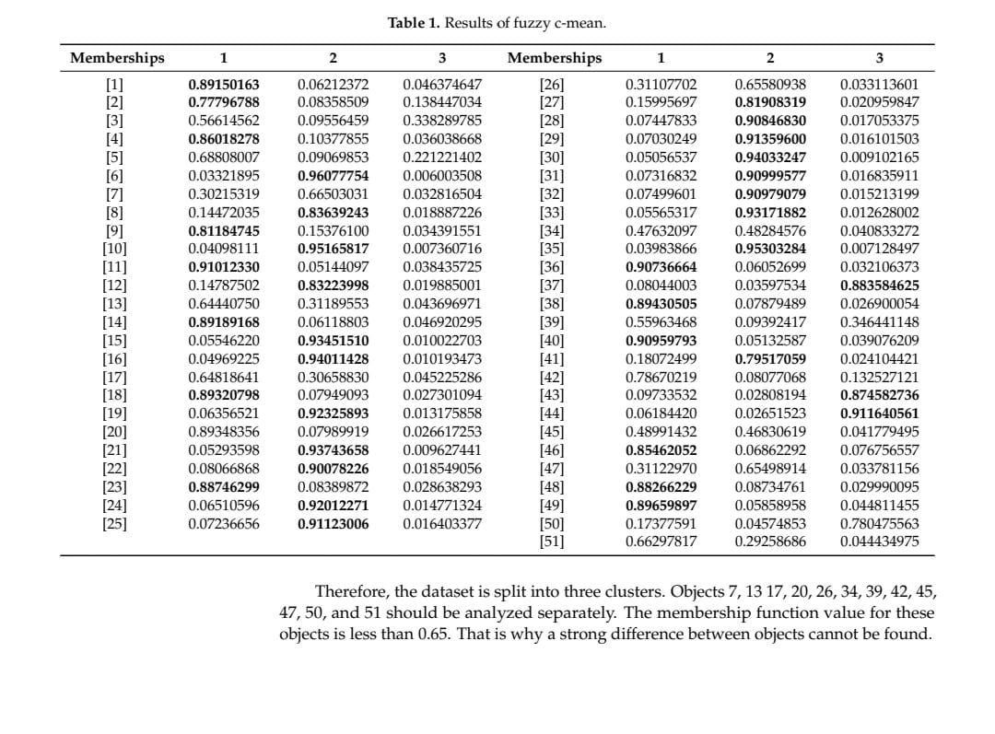

Slide 13
Hierarchical predictor:
. By using Hopkins statistic, fuzzy cluster is formed i.e.., if the value is less than 0.71 then we need to assume the parameters to be a fuzzy parameter.
. We will create k+1 clusters where k clusters are normal ones, and one fuzzy cluster.
. Linear regression random forest, SVM with radial basis kernel, and SVM with
polynomial kernel are used for each cluster separately.
. Average voting on the obtained results is provided. Based on it, average value will be
selected.

Slide 14
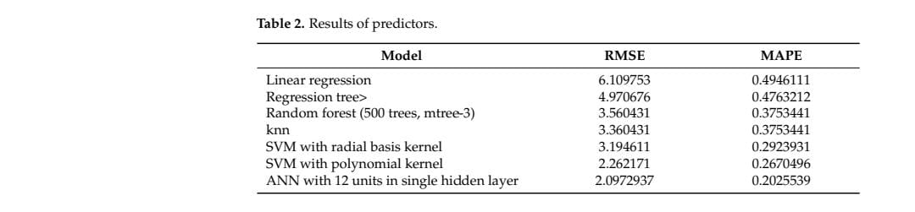

Slide 15
Thank You

