Slide 1
Predicting a Patient’s Stay using Conditional Space Development and Hierarchical Prediction
Guide:
Mrs. M. Sailaja
Assistant Professor
Project By:
18501A0581 - Abhinav.M
18501A05B9 - N V Sai Bhargava.Y
18501A0576 - Deva Harsha.M
18501A0588 - V Ratna Sravanth.P

Slide 2
Problem Statement:
The length of stay (LOS) is very important to patient. Reduction in the number of inpatient days results in decreased risk of infection. But it is not an easy task, it is dependent on many crucial factors like age, sex, weight, diagnose, sub diagnose, medicament, flora, active substance etc. We are given with a dataset containing above features. We need the best possible way to predict the no.of days a patient will stay in hospital.

Slide 3
Objective:
To develop a patient’s length of stay predictor that can effectively predict number of days a patient will stay in hospital accurately.
The proposed model is based on Conditional Space Development and Hierarchical Prediction.

Slide 4
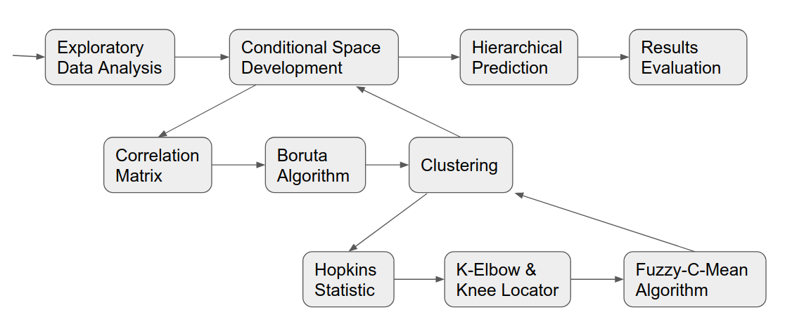
Design Methodology

Slide 5
Exploratory Data Analysis:
Understanding the data.
Removing unnecessary parameters.

Slide 6
ConditionalSpaceDevelopment Flow Chart
Correlation Matrix
To understand what parameters are highly correlated and remove them.
Boruta Algorithm
This is used for feature selection, i.e, which parameters need to be considered.
Clustering

Slide 7
Clustering Flow chart
Hopkins Statistic
This is used to decide whether our data is hard clusterable or soft clusterable.
K - Elbow & KneeLocator
These are used to find the optimal number of clusters we need to divide the data into.
Fuzzy - C - Mean Algorithm
This is a soft clustering algorithm. This divides the data into clusters and gives membership value of each data point in each cluster.

Slide 8
Hierarchical Prediction
1. Get test data and check for its corresponding cluster.
2. Consider all the data from that corresponding cluster only.
3. Training Random Forest regression, SVM with radial basis kernel and SVM with polynomial kernel models on that data only.
4. Predict three Length of Stays with these three models and taking average of these three is our result.

Slide 9
IMPLEMENTATION

Slide 10
EXPLORATORY DATA ANALYSIS

Slide 11
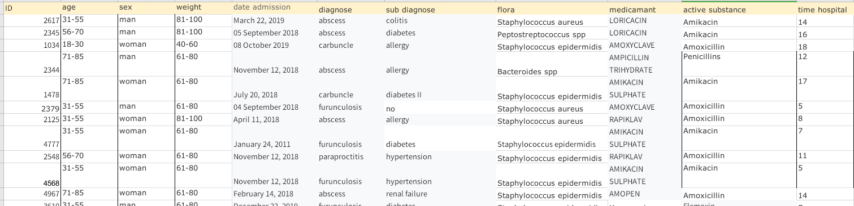
Understanding the I/P & O/P

Slide 12
Removing unnecessary parameters
Unnecessary parameters are the parameters of data which are of no use in deciding the result. They can also participate in misleading the results. So it is better to drop them.
Id is unique for every patient; recovery of patient doesn’t depend upon id.
Date of admission also has no effect on recovery.
Thus “ID” and “date admission” are dropped.

Slide 13
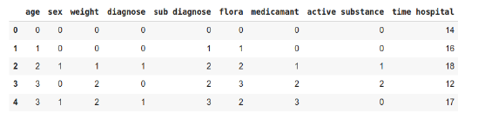
Label Encoding
Categorical Columns are - Age, Sex, Weight, Diagnose, Sub Diagnose, Flora, Medicament, Active Substance. All the categorical columns need to be label encoded.

Slide 14
CONDITIONAL SPACE DEVELOPMENT

Slide 15
Correlation matrix
Sometimes there will be some parameters which are dependent on other parameter too much that their effect on result will be same, there will be no change in result if we remove one of them.
For example, DOB and age are highly correlated, removing one of them will not have effect on result and also one less parameter to the model to process upon.
Yet this is the most obvious example, sometimes we cannot find highly correlated parameters with just observing the table, this is where correlation matrix comes.

Slide 16
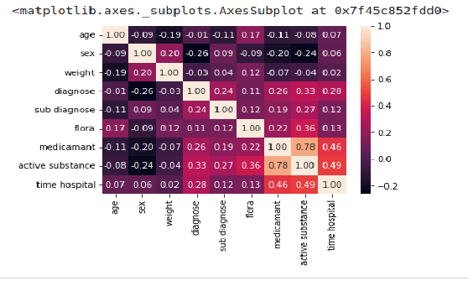
In this heatmap of correlation you can see that medicament and active substance are highly correlated, so one of them can be dropped.

Slide 17
Boruta Algorithm:
Boruta is a feature selection algorithm. Precisely, it works as a wrapper algorithm around Random Forest. Feature selection is important because you often need not use every feature at your disposal to train a model.
How does Boruta works:
1. It adds randomness to the given data set by creating shuffled copies of all features (which are called shadow features).
2. Then, it trains a random forest classifier on the extended data set and applies a feature
importance measure (the default is Mean Decrease Accuracy) to evaluate the importance of
each feature with higher means more important.

Slide 18
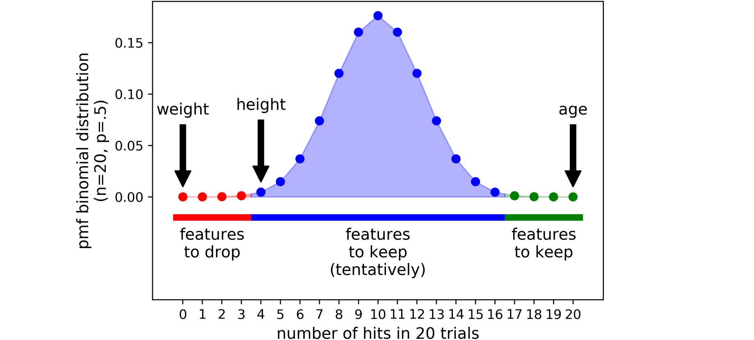

3. At every iteration, it checks whether a real feature has a higher importance than the best of its shadow features (i.e. whether the feature has a higher Z score than the maximum Z score of its shadow features) and constantly removes features which are deemed highly unimportant.
4. Finally, the algorithm stops either when all features gets confirmed or rejected or it reaches a specified limit of random forest runs.
In boruta algorithm there are three types of parameters - red, blue, green.
Green parameters are the parameters with highest importance.
Blue parameters are left to our choice to use or not.
Red parameters have no effect on result.
In above picture we printed red and blue parameters. “weight” is missing, that means it is safe to drop “weight”.

Slide 19
Clustering
There is need for deciding between hard clustering and soft clustering. In non-fuzzy clustering (also referred to as hard clustering), data is divided into distinct clusters, where each data point can only belong to exactly one cluster. For example, an apple can be red or green (hard clustering), but an apple can also be red and green (fuzzy clustering). Here, the apple can be red as well as green to a certain degree. Instead of the apple belonging to green [green = 1] and not red [red = 0], the apple can belong to green [green = 0.5]. These value are normalized between 0 and 1; however, they do not represent probabilities, so the two values do not need to add up to 1.

Slide 20
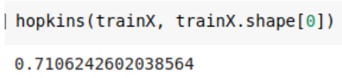
> Hopkins Statistic
Hopkins statistic decides whether we should perform hard clustering or soft clustering on data.
The smaller the value of hopkins statistic the greater the data can be clusterable.
For the data we considered we got 0.71 for hopkins statistic.
Thus data cannot be clusterable or we can say cannot be hard clusterable.
So we need to perform a soft clustering algorithm like fuzzy-c-mean algorithm.

Slide 21
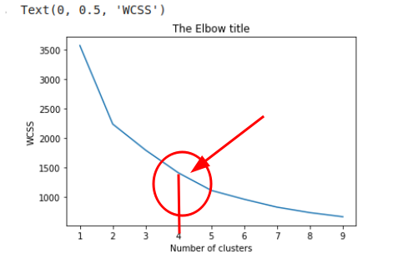
> K-Elbow & Knee locator
The number of clusters we choose has a huge impact on the accuracy of the model. So choosing optimal number of clusters is very important. We Used K-elbow method to choose optimal number of clusters.
K-Elbow depicts graph more like our arm and the point from where graph is more straight is considered to be elbow, and it is the most optimal number of clusters.
From this diagram we came to know 4 is the optimal number of clusters.

Slide 22
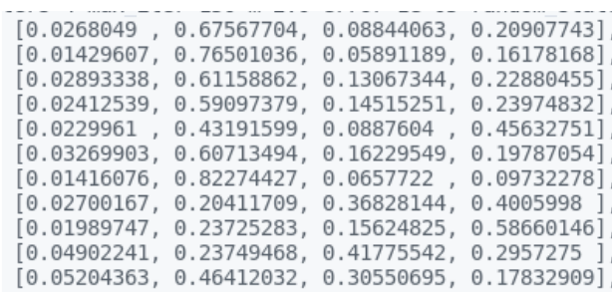
> Fuzzy - c - means
FCM (Fuzzy-c-means) is a soft clustering algorithm. As we discussed in soft clustering algorithm a data point may present in multiple clusters with membership values which says how much a data point belongs to a particular cluster.

Slide 23
We took 0.65 as the breaking point of membership i.e, if a element’s max membership is 0.65 then it belongs to corresponding cluster, else it’ll belong to new cluster having elements similar to it (elements with max membership value less than 0.65 will form a new cluster). That means by the end of clustering we will end up with (number of clusters from k elbow method + 1).
1st element -> max(0.02...,0.67...,0.08...,0.20...) = 0.67 -> 2nd cluster
2 nd element -> max (0.01..., 0.76..., 0.05..., 0.16...) = 0.76 -> 2nd cluster
3 rd element -> max (0.02...., 0.61..., 0.13..., 0.22...) = 0.61 -> 4th cluster
4 th element -> max (0.02..., 0.59..., 0.14..., 0.23...) = 0.59 -> 4th cluster
5 th element -> max (0.02..., 0.43..., 0.08..., 0.45...) = 0.45 -> 4th cluster

Slide 24
HIERARCHICAL PREDICTION

Slide 25
Predicting with weak selectors gives more error. So we chose hierarchical prediction.
Hierarchical prediction flow:
1. Get test data and check for its corresponding cluster.
2. Consider all the data from that corresponding cluster only.
3. Training Random Forest regression, SVM with radial basis kernel and SVM with polynomial kernel models on that data only.
4. Average of these three is our result.

Slide 26
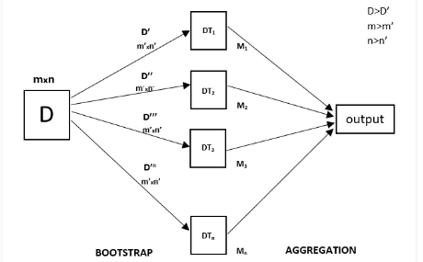
> Random Forest Regression Model
Every decision tree has high variance, but when we combine all of them together in parallel then the resultant variance is low as each decision tree gets perfectly trained on that particular sample data and hence the output doesn’t depend on one decision tree but multiple decision trees.

Slide 27

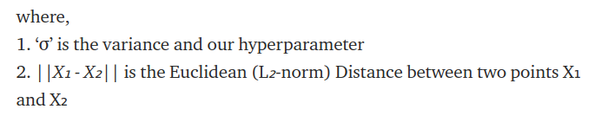
> SVM - Support Vector Machines
The RBF kernel function for two points X₁ and X₂ computes the similarity or how close they are to each other.
The linear kernel divides data linearly.
Training SVM with linear kernel is Faster than with any other Kernel.

Slide 28
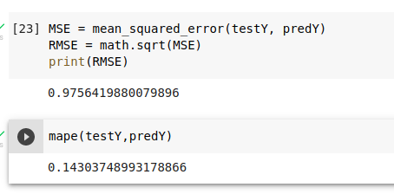
Results

Slide 29
Conclusion
This project is achieved through conditional space development and hierarchical clustering. As our data is Soft clusterable we applied Fuzzy-C-Means and we predicted result from test data related cluster rather than from whole data.
When compared to our base paper we decreased more error in prediction by choosing optimal no.of clusters using K-elbow and KneeLocator.

Slide 30
Future Scope
The dataset we are using now is covering only abdominal diseases, using more sophisticated data will cover more areas.
Adding another model in hierarchical precidtion may increase accuracy.
We can create a web interface for this project.

Slide 31
Thank You

