Slide 1
Assignment 3
Abhishek G Rao (14S602)
Arjun Goleria (14S609)
Mayank Apte (14S624)
Nikhil K Ravindran (14S629)
Sahil Vashishta (14S640)
Shourya Gupta (14S646)
Team
5
Tourism Australia

Slide 2

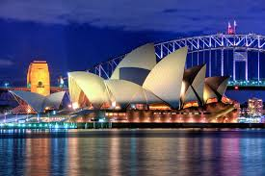
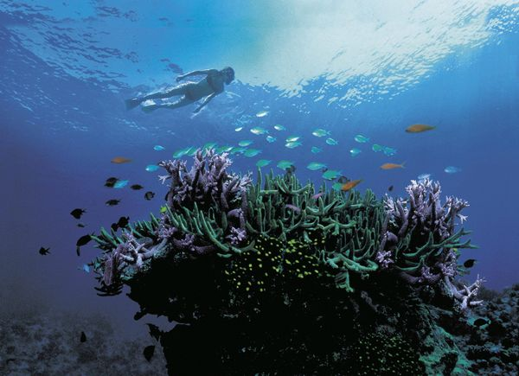
Tourism Australia

Slide 3
Natural Wonder of The World
Facebook targeting parameter:
Location:
China, United Kingdom, India, United States
Interests:
Adventure recreation, Adventure travel, Beaches, Scuba diving, Surfing or Recreational fishing
Age:
24 - 55
Language:
English (All)
Potential Reach: 38,000,000 people
Idea basis the parameter:
Its an Aww moment!!! One of the seven natural wonders of the world – the great barrier reef with Tourism Australia
Videos and Images of the reef and activities around the region

Slide 4
Kangaroo ISLAND - Wildlife
Facebook targeting parameter:
Location:
China, United Kingdom, India, United States
Interests:
Safari, Wildlife, Wildlife photography
Age:
25 - 45
Language:
English (All)
Potential Reach: 2,400,000 people
More categories: All frequent travelers
Idea basis the parameter:
Experience wildlife 1st hand with Tourism Australia at Kangaroo Island.
Content with high quality wildlife images inspiring wildlife photography

Slide 5
Heaven on earth – blue mountains
Facebook targeting parameter:
Location:
China, Germany, France, United Kingdom, India, United States
Interests:
Mountaineering, Climbing and Landscape photography
Category:
All frequent travelers
Age:
25 - 45
Language:
English (All)
Potential Reach: 1,300,000 people
Idea basis the parameter:
Find heaven on earth with tourism Australia at Blue Mountains
Videos showcasing the beauty of Blue Mountains

Slide 6
Wine-CUISINE
Facebook targeting parameter:
Location:
China, Germany, France, United Kingdom, India, United States
Interests:
Australian cuisine, Australian wine, Cuisine or Wine
Category:
All frequent travelers
Age:
18 - 65+
Language:
English (All)
Potential Reach: 26,000,000 people
Idea basis the parameter:
World class cuisine and wine. The food never tasted better with Tourism Australia
Videos of cookery shows showcasing the variety in cuisine in food and wine. Tag videos of Master chef Australia as well

Slide 7
ASHES
Facebook targeting parameter:
Location:
Bangladesh, United Kingdom, India, Sri Lanka, New Zealand, Pakistan, South Africa
Interests:
The Ashes, England cricket team or Test cricket
Age:
18 - 65+
Language:
English (All)
Potential Reach: 9,600,000 people
Idea basis the parameter: Who will earn the urn!!!
Targeting the cricket crazy fans around the world to witness the Ashes series with Tourism Australia.
Camping Using :
1. Hashtag: #EarnTheUrn
2. Using Videos of Best moments of historical Ashes Match

Slide 8
Thank you!!!

