Slide 1


Slide 2
Introduction
Dr. Agarwal – promoted by Lt. Shri J Agarwal was incorporated in 1994
The entire family has been in the profession of eye care services for almost 5 decades prior to this
The Hospital is a Single specialty care providing complete eye care solutions
60 hospitals operating mainly in AP, Tamil Nadu & Rajasthan, 12 in Africa & 1 in Cambodia
Footfall – 1000 patients/day 10000 Surgeries/month

Slide 3
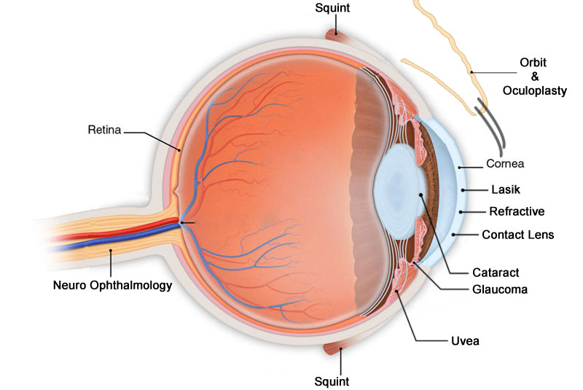
Business Overview
Forefront of every medical advancement in the field of Ophthalmic Care
Some of its achievements include Micro Phakonit Cataract Surgery, Aberropia
Continuous training & development programs to develop skilled surgeons
Major Revenue Segment is Surgeries

Slide 4
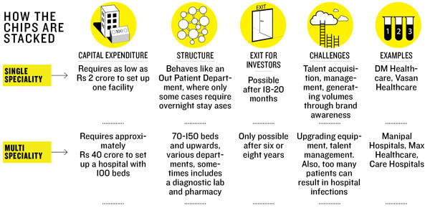
Industry Analysis
Current Health Care Sector size is $100 billion expected to be $280 billion by 2020
Eye Care Business size is around $2 billion expected to be around $4 billion by 2020
Single v/s Multispecialty hospital

Slide 5
Competitors
Dr. Agarwal's key competitors are Apollo Hospital Chain, Fortis Health, Lotus Eye & Vasan Eye Care
Apollo, Fortis are multispecialty hospitals whereas Dr. Agarwal, Lotus Eye & Vasan Eye Care specially focus on Eye care
 | No of outlets | Area of operations | Revenues | Establishment
Vasan Health Care | 200 | Pan India | 603 | 2002
Centre for Sight | 60 | North India | 112 | 1996
Eye-Q | 40 | Delhi NCR | 45 | 2006
Maxivision | 15 | AP, Tamil Nadu | 100 | 1996
Dr. Agarwals | 60 | Tamil Nadu, Karnataka | 118 | 1960

