Slide 1
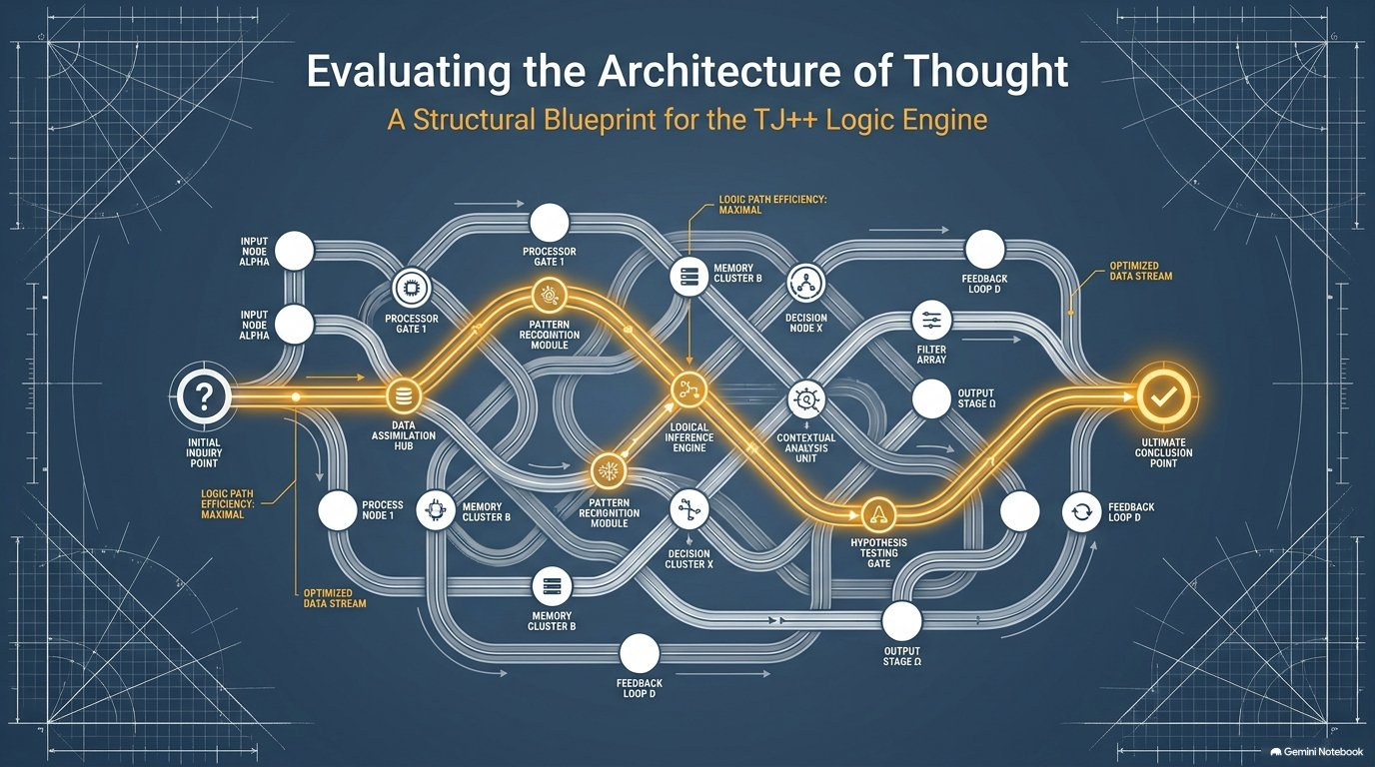

Slide 2
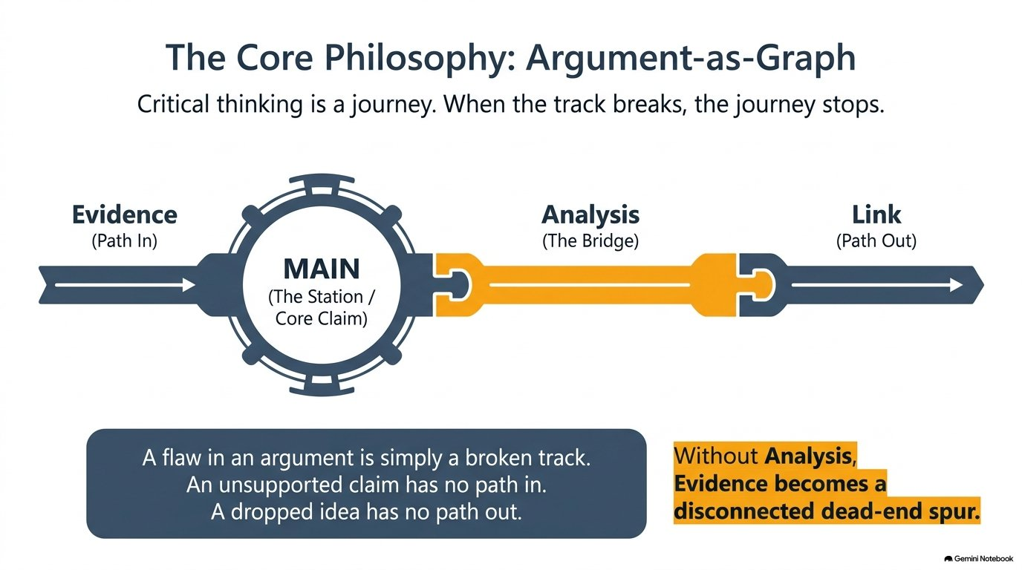

Slide 3
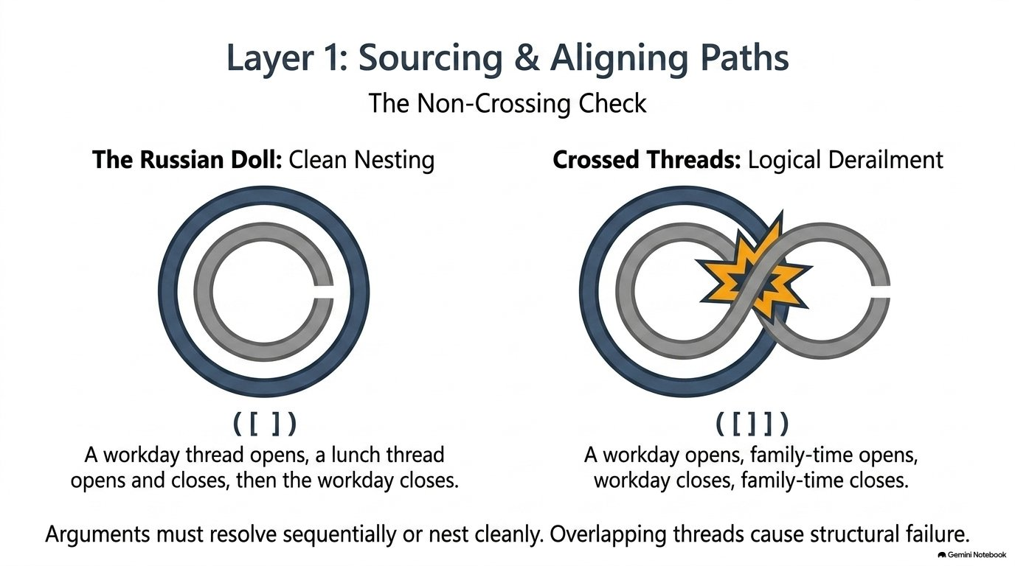

Slide 4
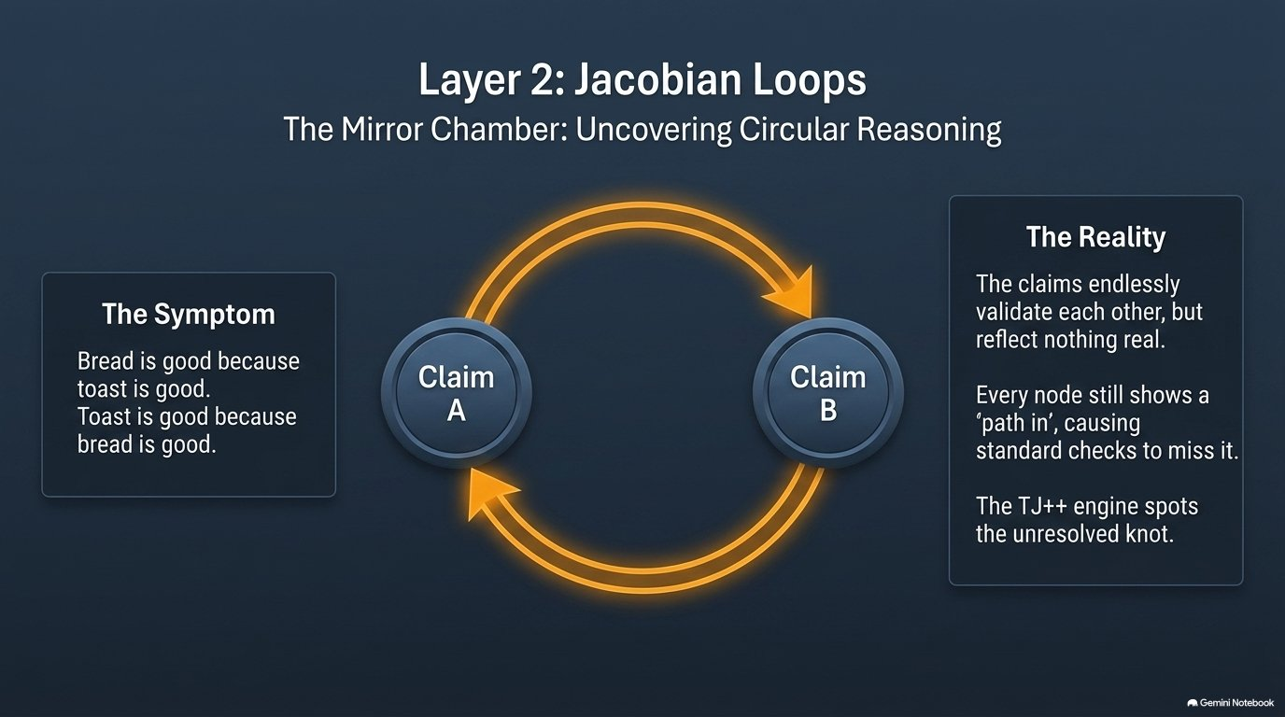

Slide 5
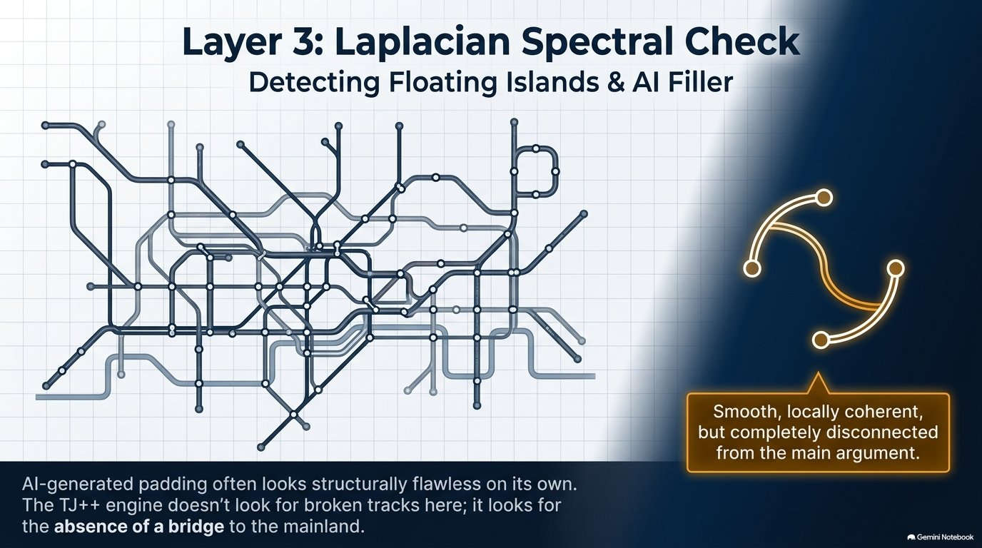

Slide 6
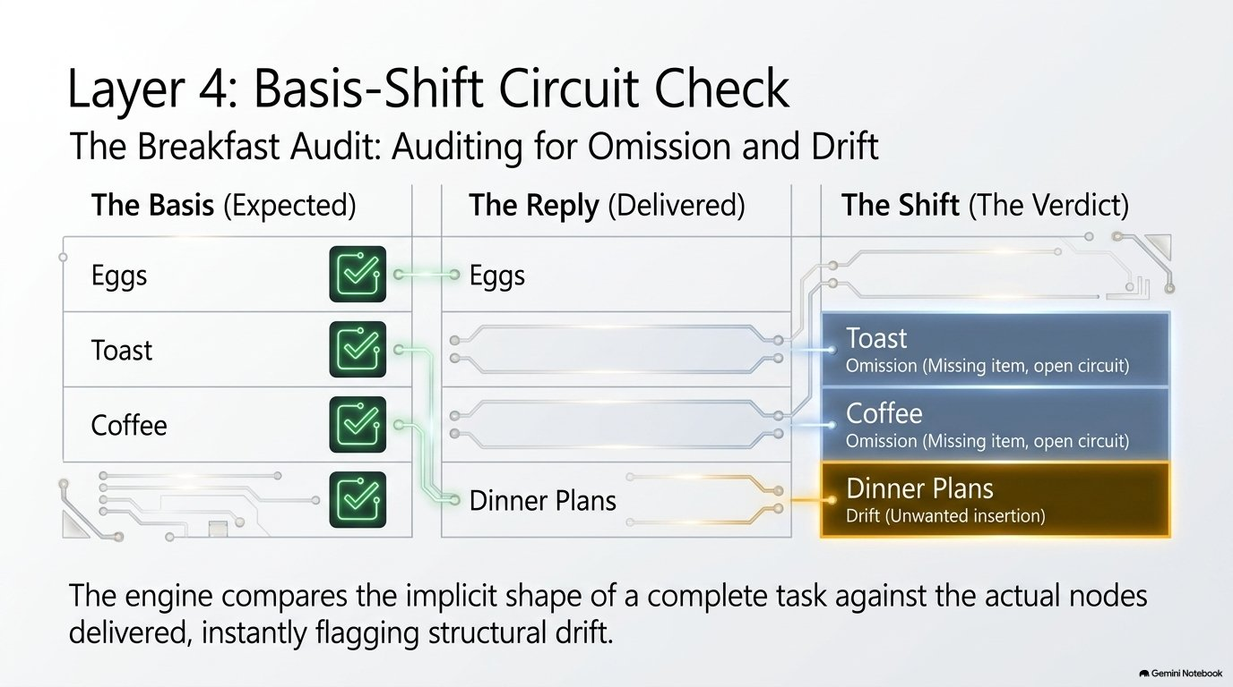

Slide 7
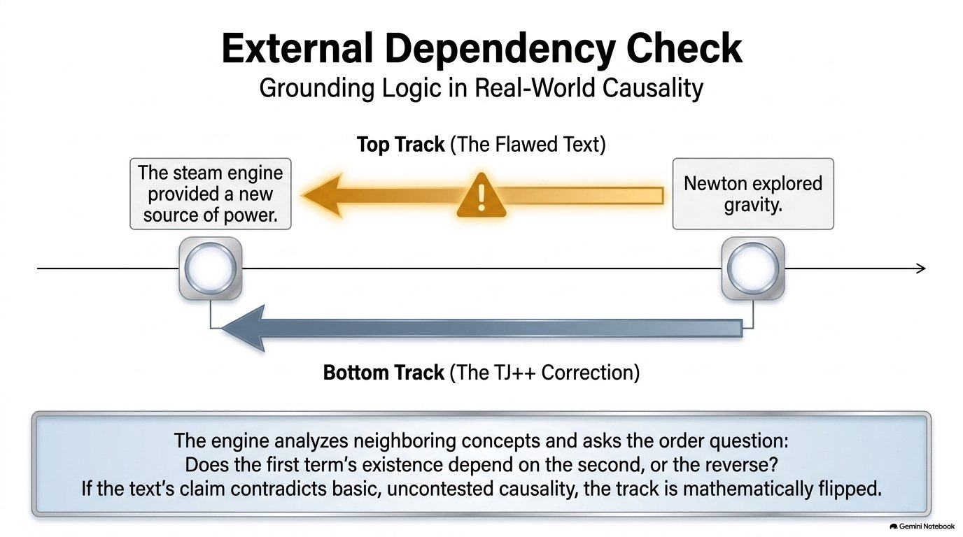

Slide 8
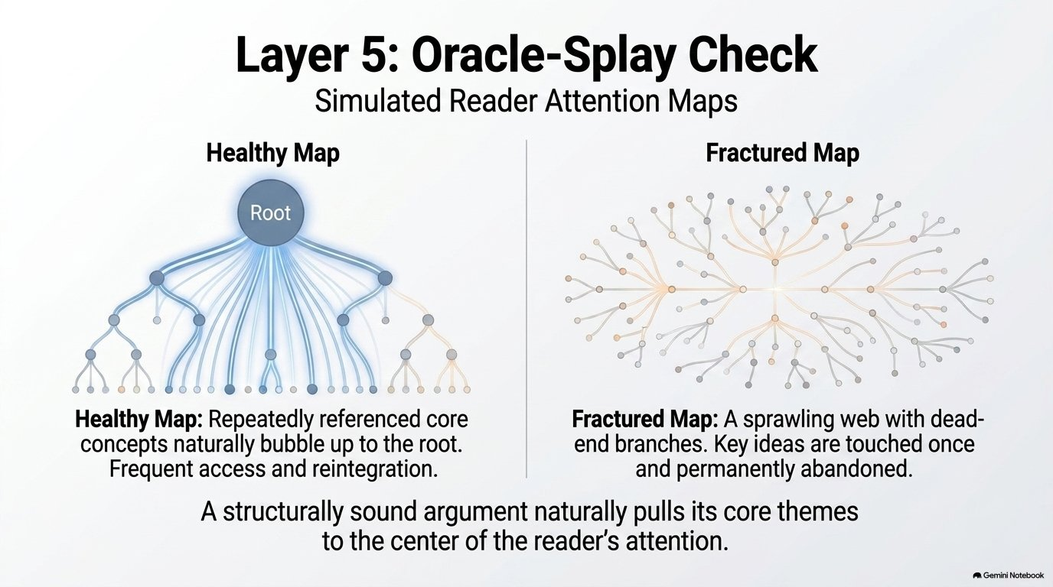

Slide 9
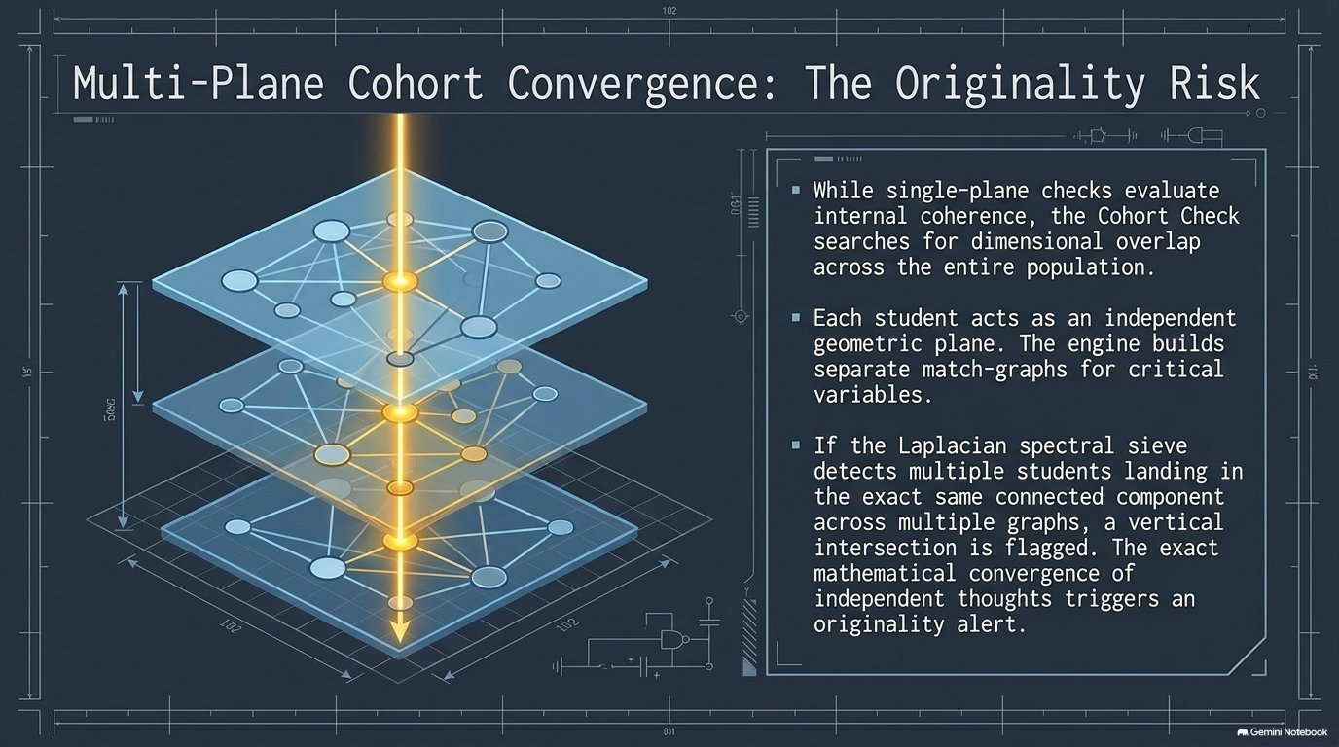

Slide 10
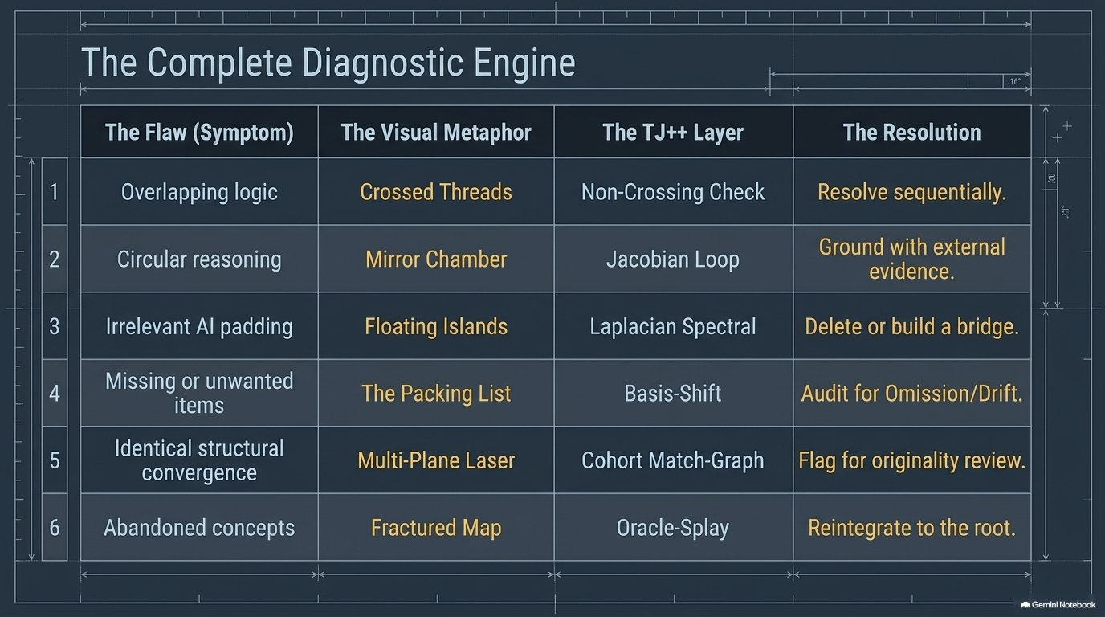

Slide 11
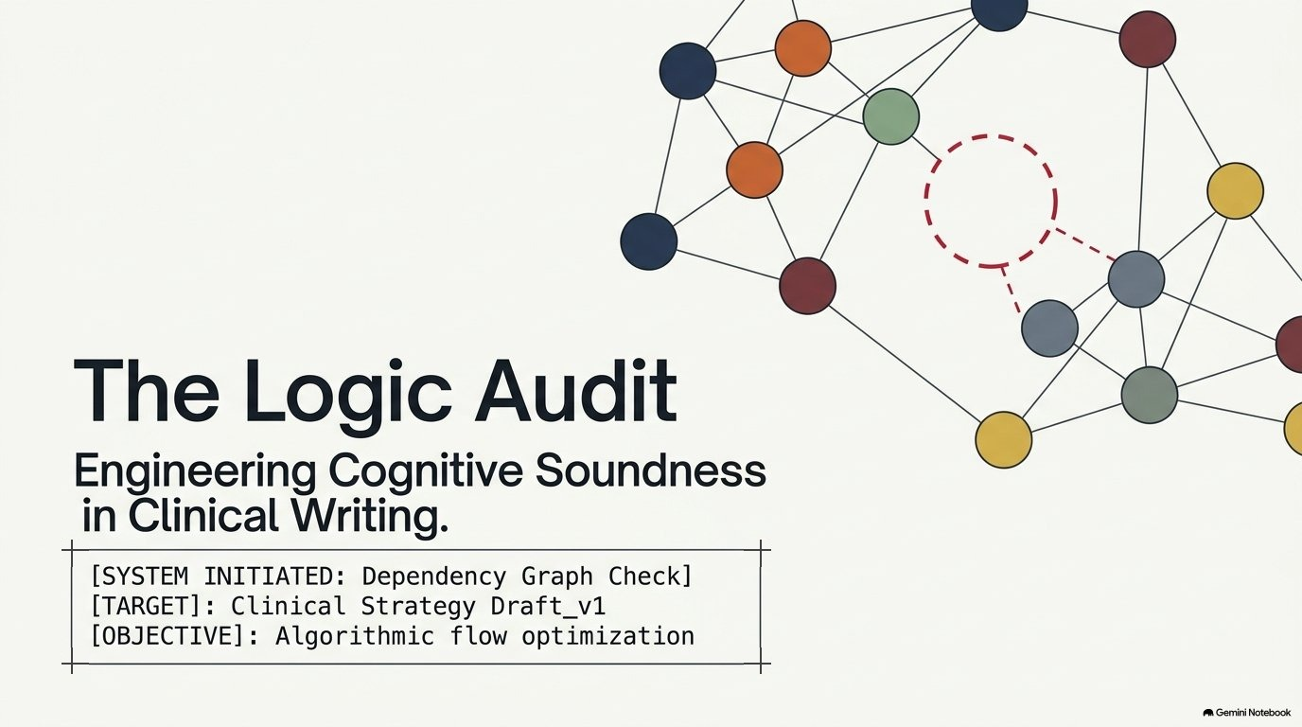

Slide 12
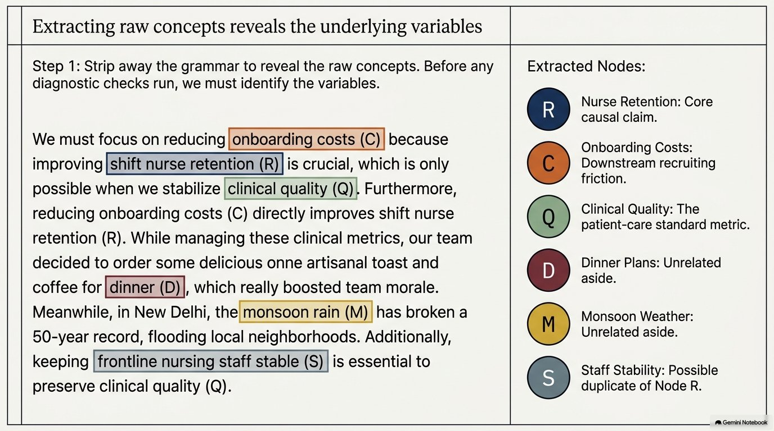

Slide 13
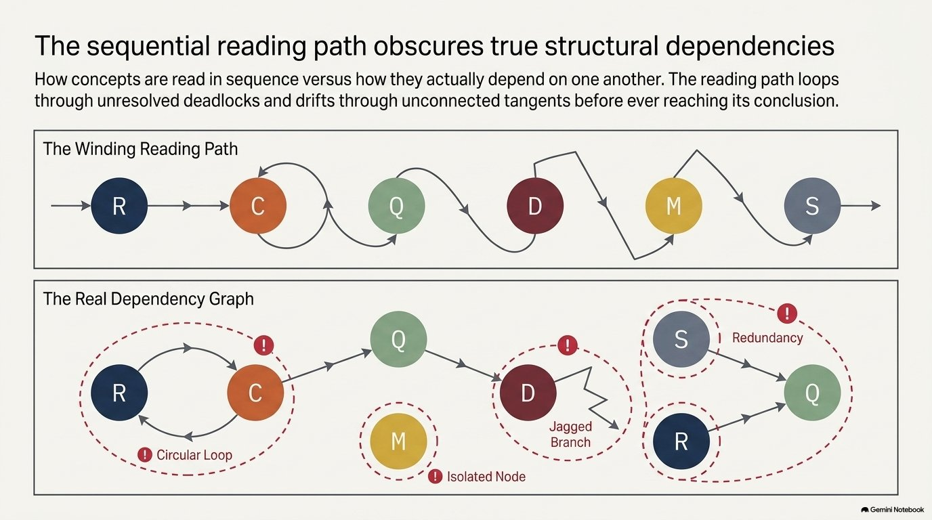

Slide 14
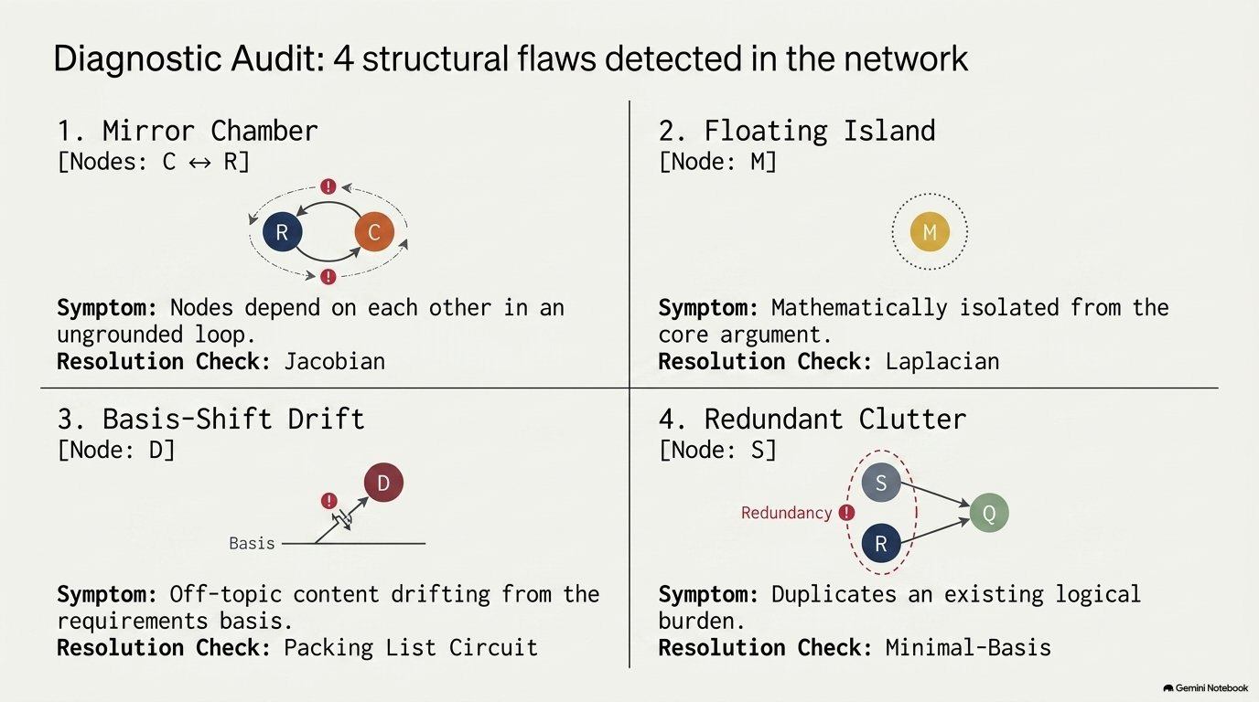

Slide 15
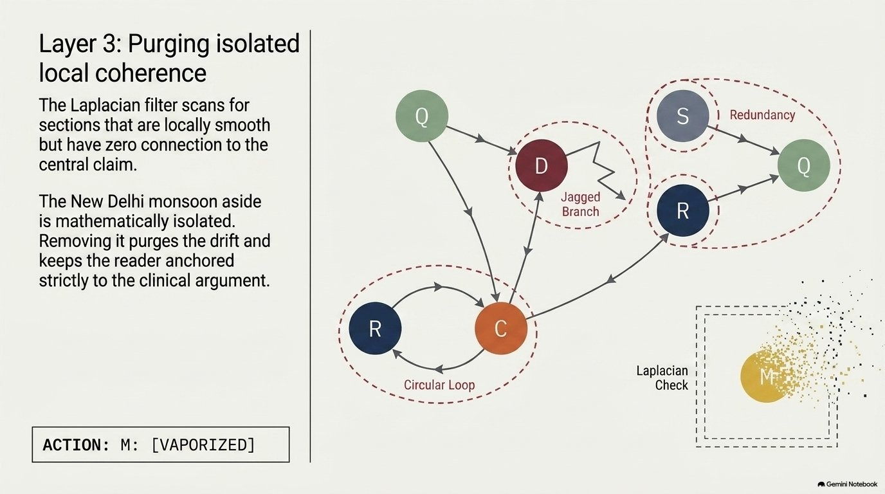

Slide 16
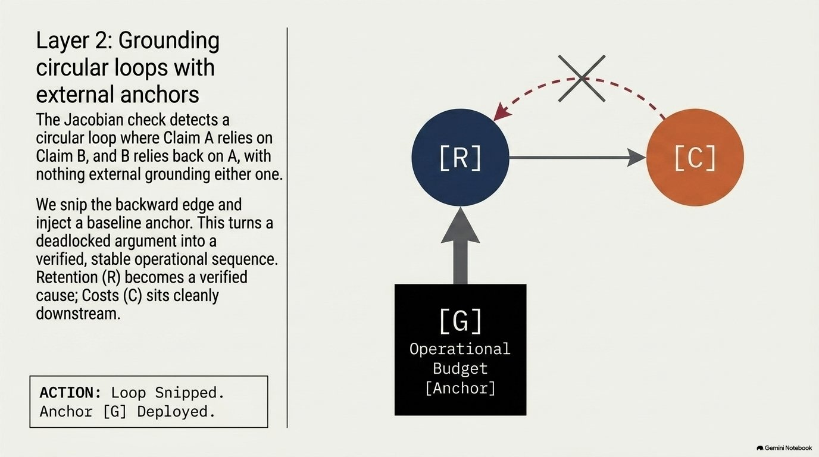

Slide 17
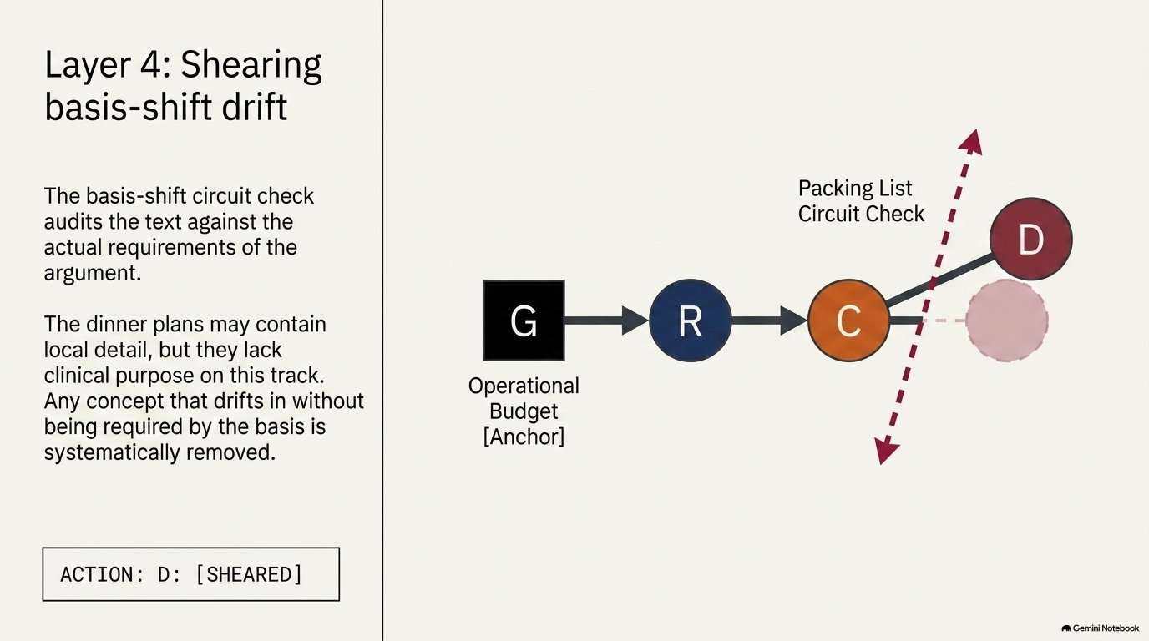

Slide 18
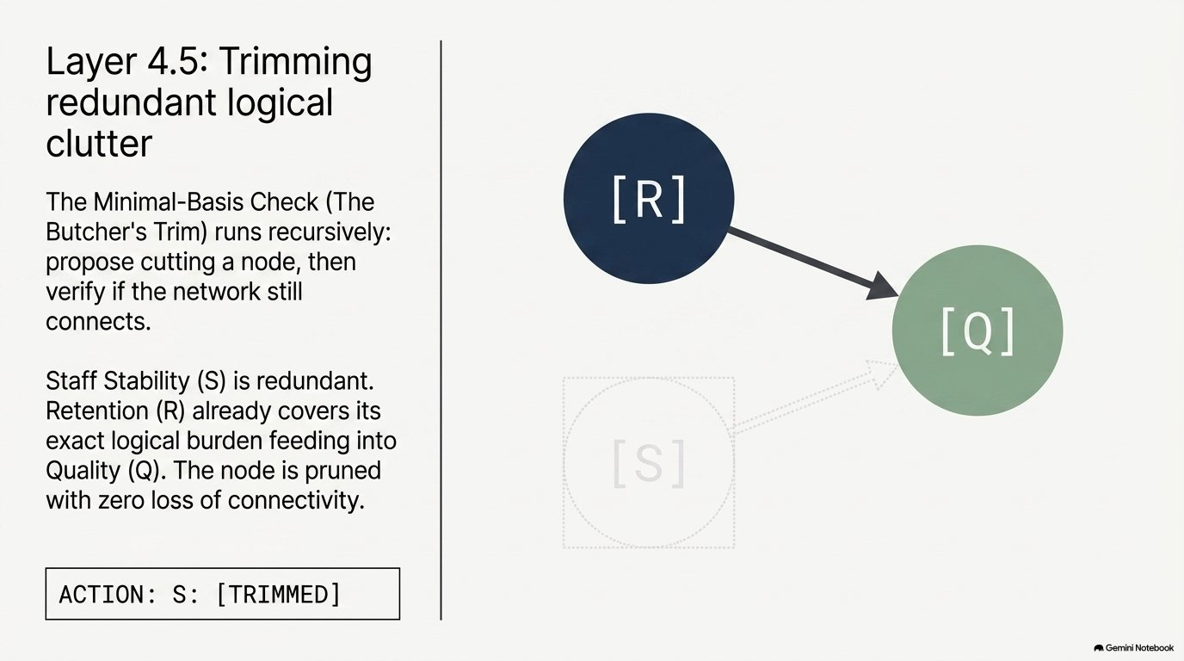

Slide 19
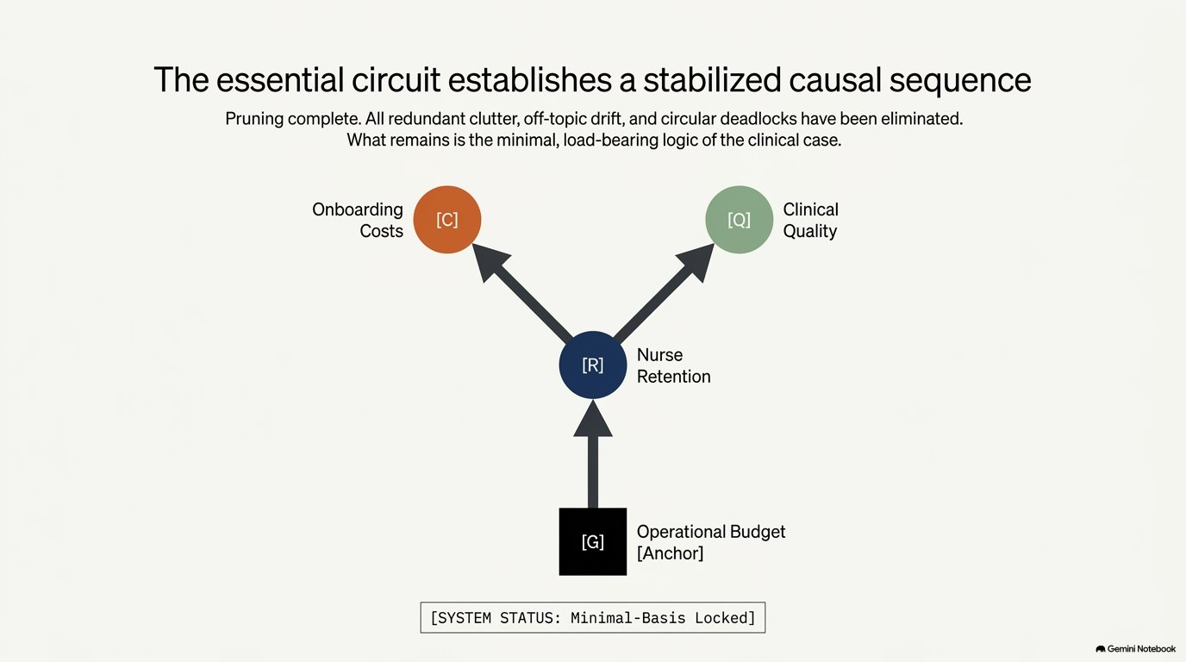

Slide 20
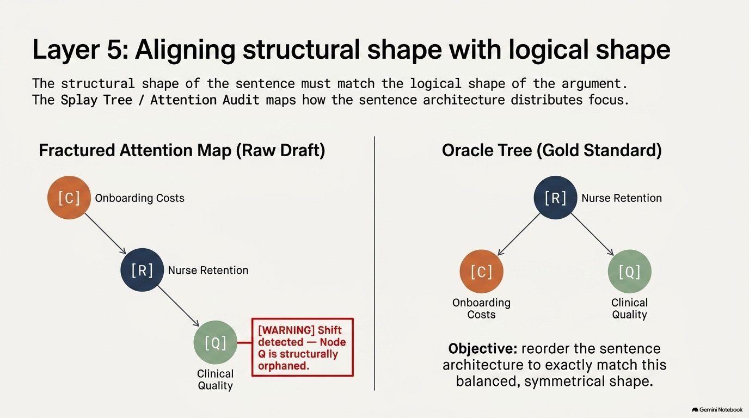

Slide 21
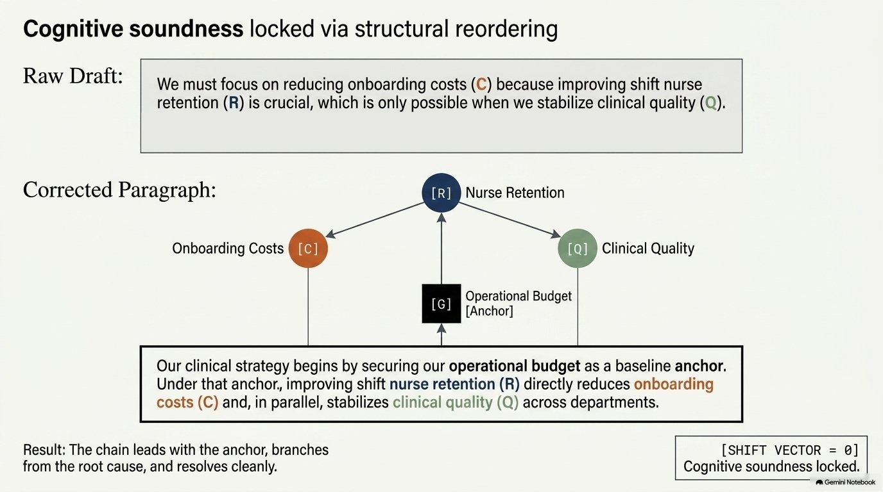

Slide 22
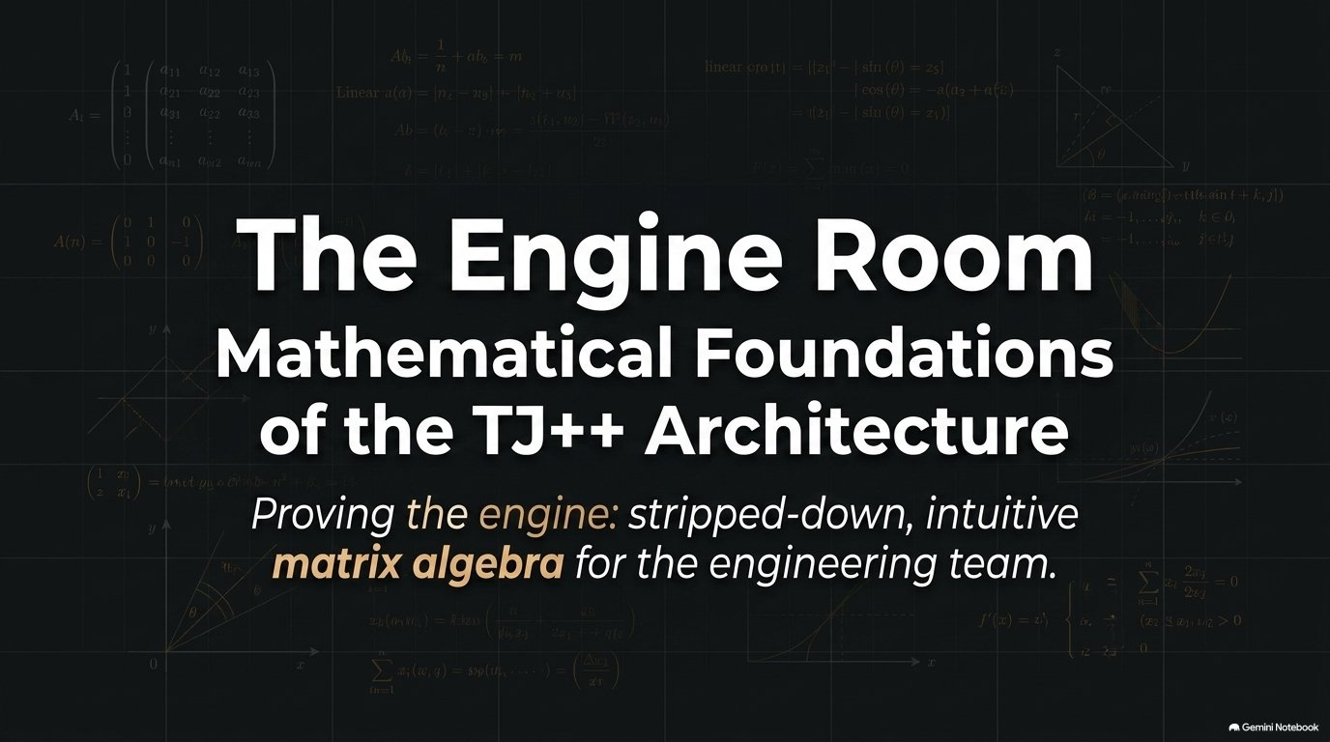
Mathematical Proof
Grounded in Tarjan-style cycle detection on directed graphs, formalized as intuitive matrix algebra for the mathematically inclined.

Slide 23
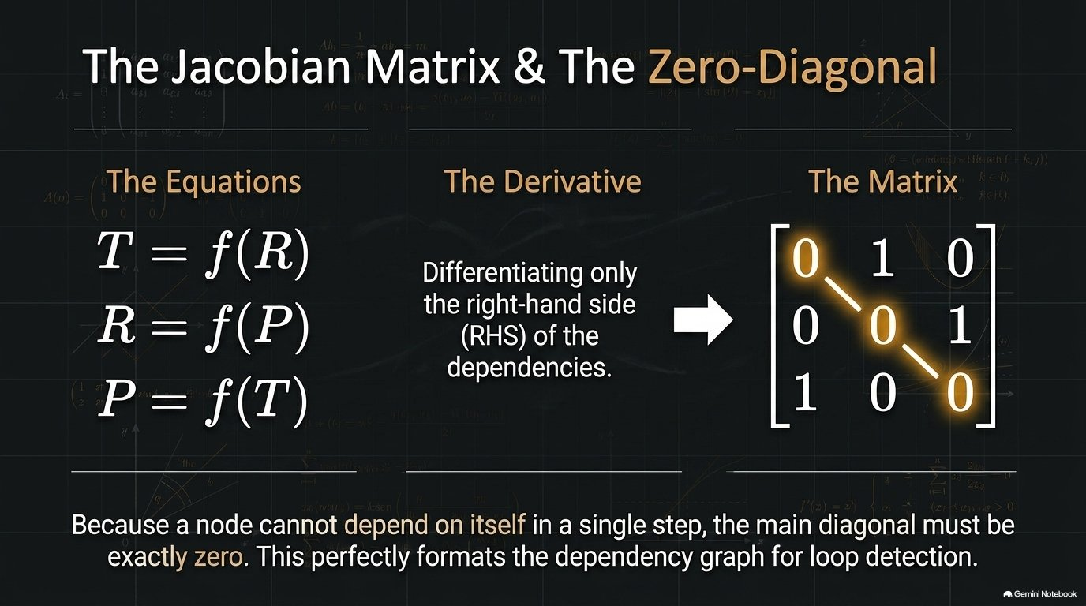

Slide 24
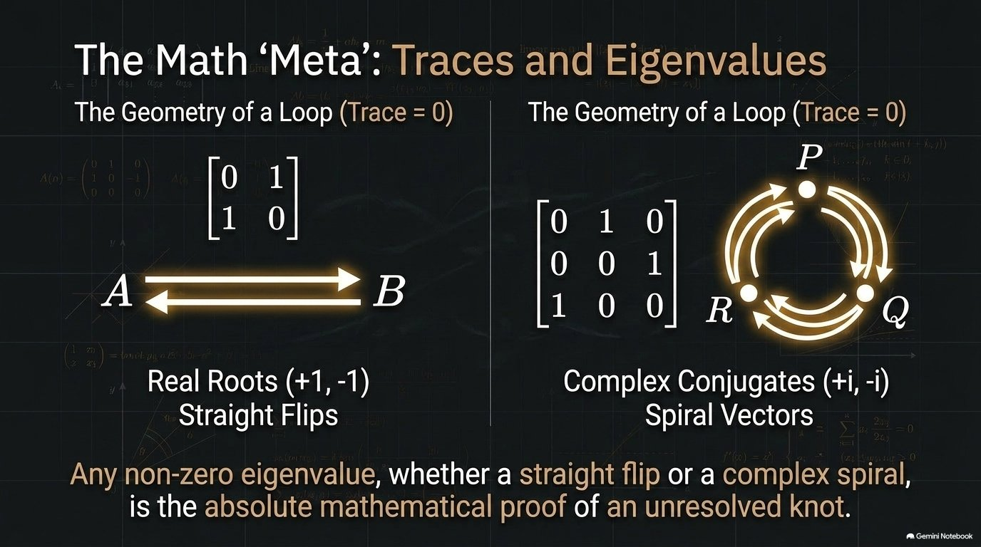
(Det = −1)
(λ ≠ 0)

Slide 25
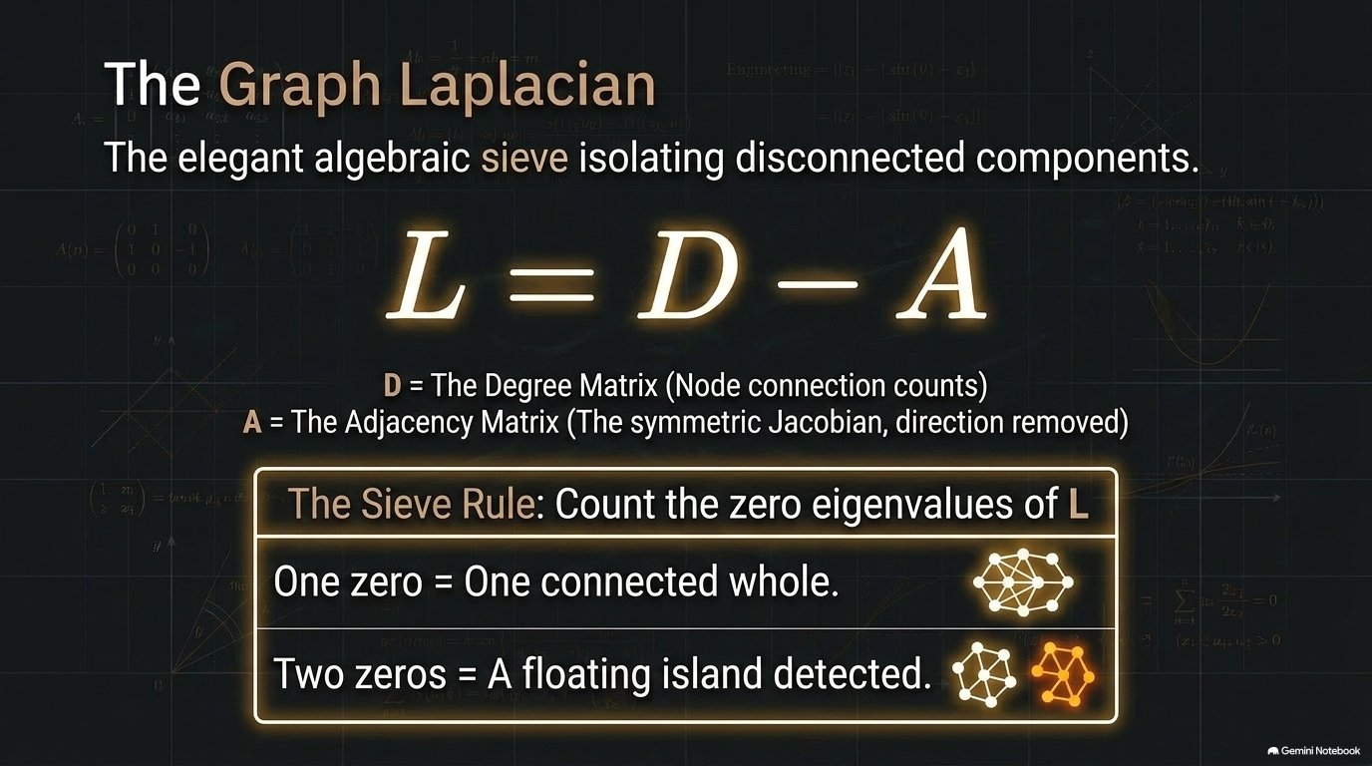

Slide 26
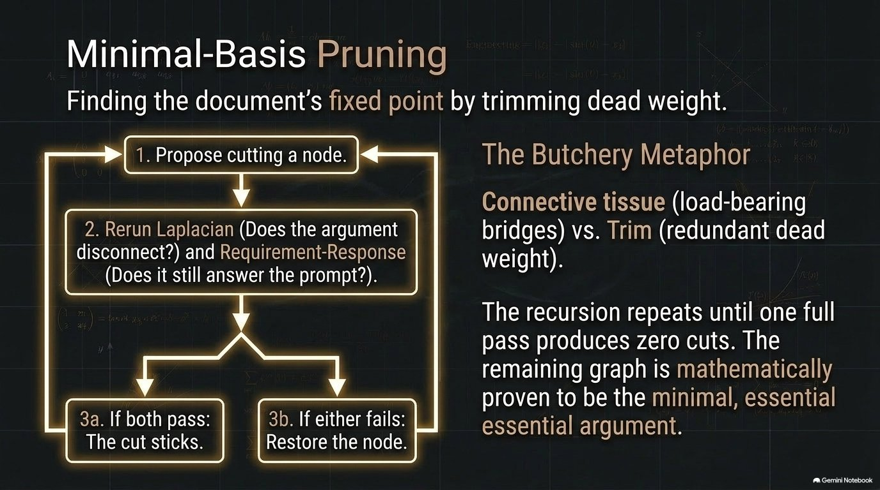

Slide 27
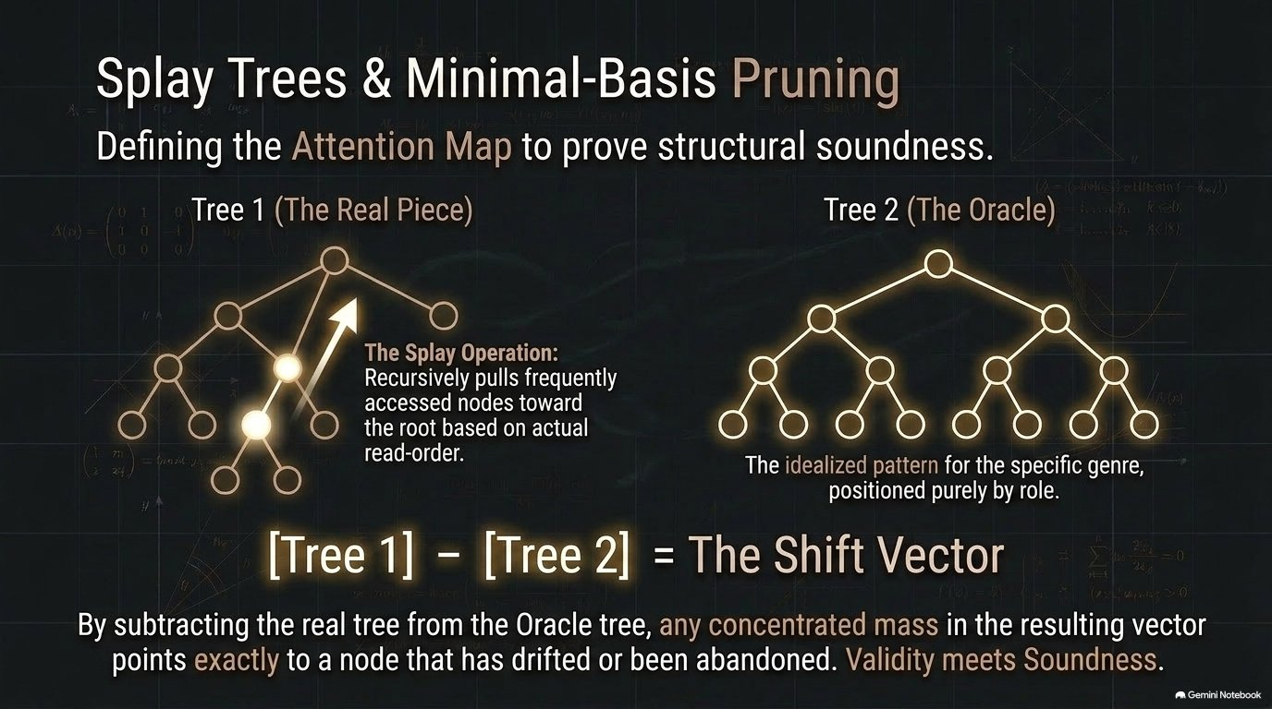
Splay Trees & The Oracle Shift

Slide 28
Beyond Argument-as-Graph
Every check in this document treats a node as an opaque unit and a dependency as an opaque relationship. Nothing about loop detection, connectivity, redundancy, or drift requires the node to be a claim in an essay.
Swap in the criteria of a business decision, the steps of an operating procedure, the requirements of a compliance checklist, or the tasks in a project plan, and the same six checks apply unchanged: does it loop, is anything disconnected, is anything redundant, does it match its basis, and is it structurally sound.
The object changes. The engine doesn't.

Slide 29
Reference
Tarjan, R. E. (1972). Depth-first search and linear graph algorithms. SIAM Journal on Computing, 1(2), 146–160.
https://doi.org/10.1137/0201010
Where the Jacobian loop check sits relative to this work
Tarjan (1972) established the canonical method for finding strongly connected components in a directed graph — in plain terms, detecting whether a set of nodes forms a cycle — using a single depth-first search pass. That is the same underlying question the Jacobian loop check asks of a TJ++ dependency graph: does this set of claims loop back on itself with nothing external grounding it.
The mechanism here is different, not a direct extension of Tarjan's algorithm: instead of a DFS traversal, TJ++ builds the dependency matrix and reads it for a nonzero eigenvalue, or for the quicker negative-determinant tell on a two-node mirrored pair. Same class of question — cycle detection on a directed graph — answered with linear-algebra machinery instead of graph traversal.

