Slide 1
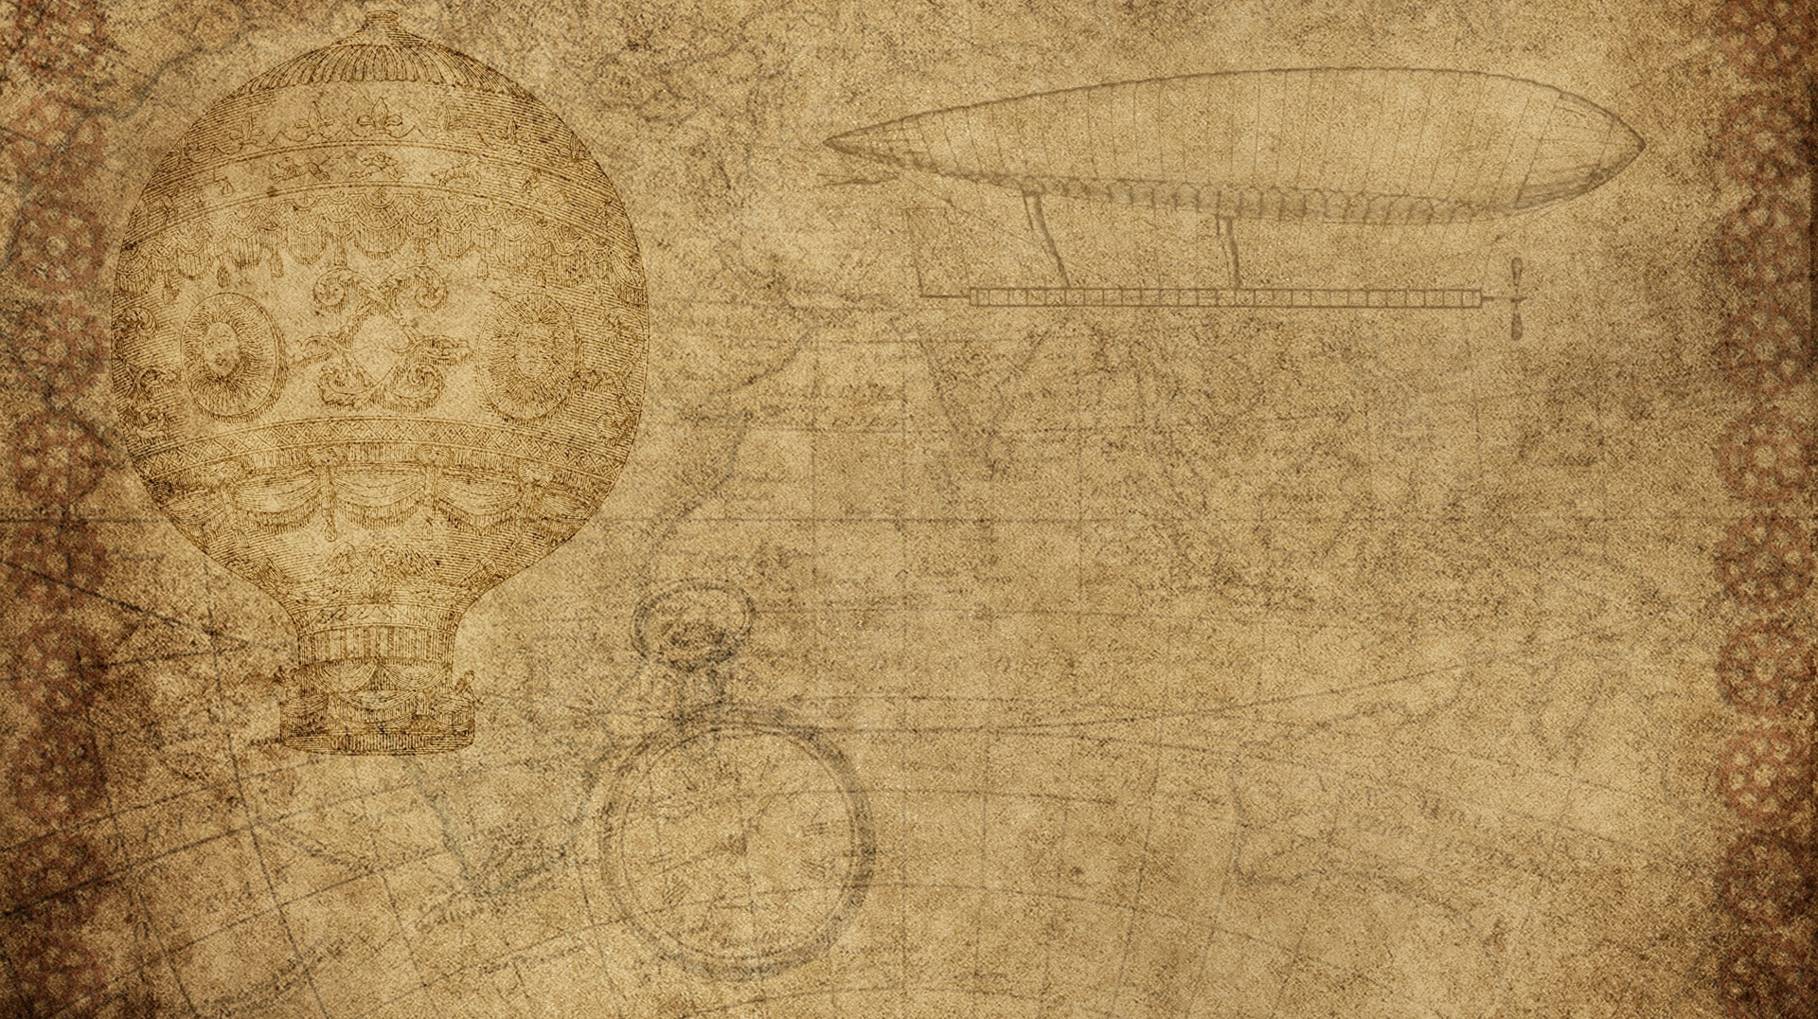
Image Recognization Using wavelet Transformation
Second Mid term Project
Section-D
Ml Lab

Slide 2
Presented By - -
Image Recognization
Presented to -
Dr. Devesh Bandil
Abhishek Joshi (PIET20AD015)
Hemant Deshwal (PIET20AD018)

Slide 3
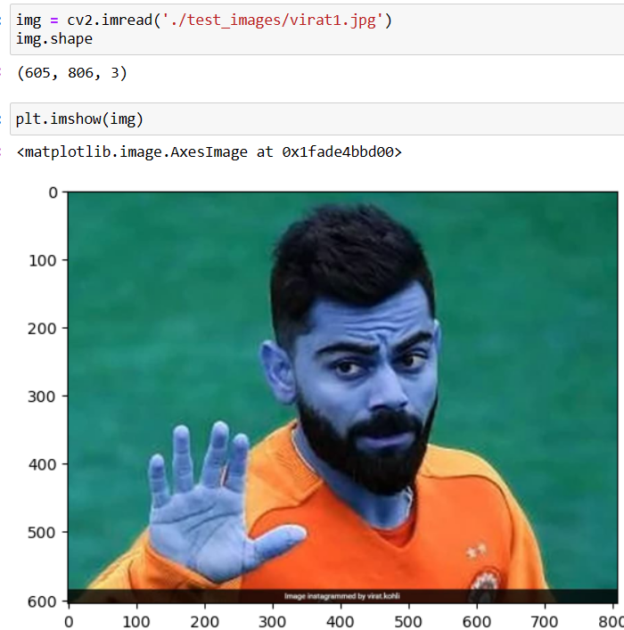
Snapshots of the project

Slide 4
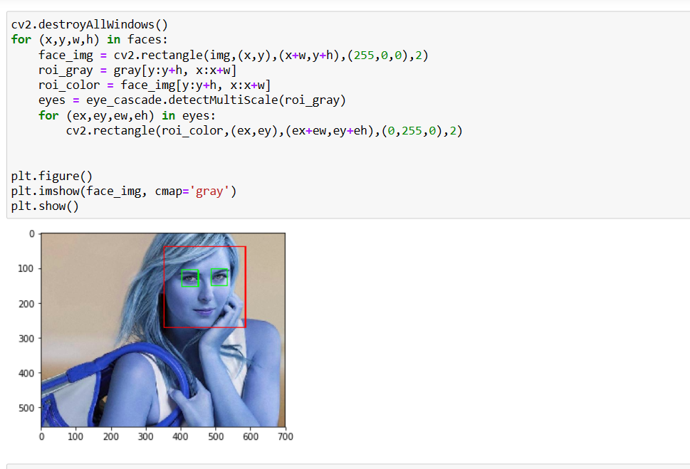
Snapshots of the project

Slide 5
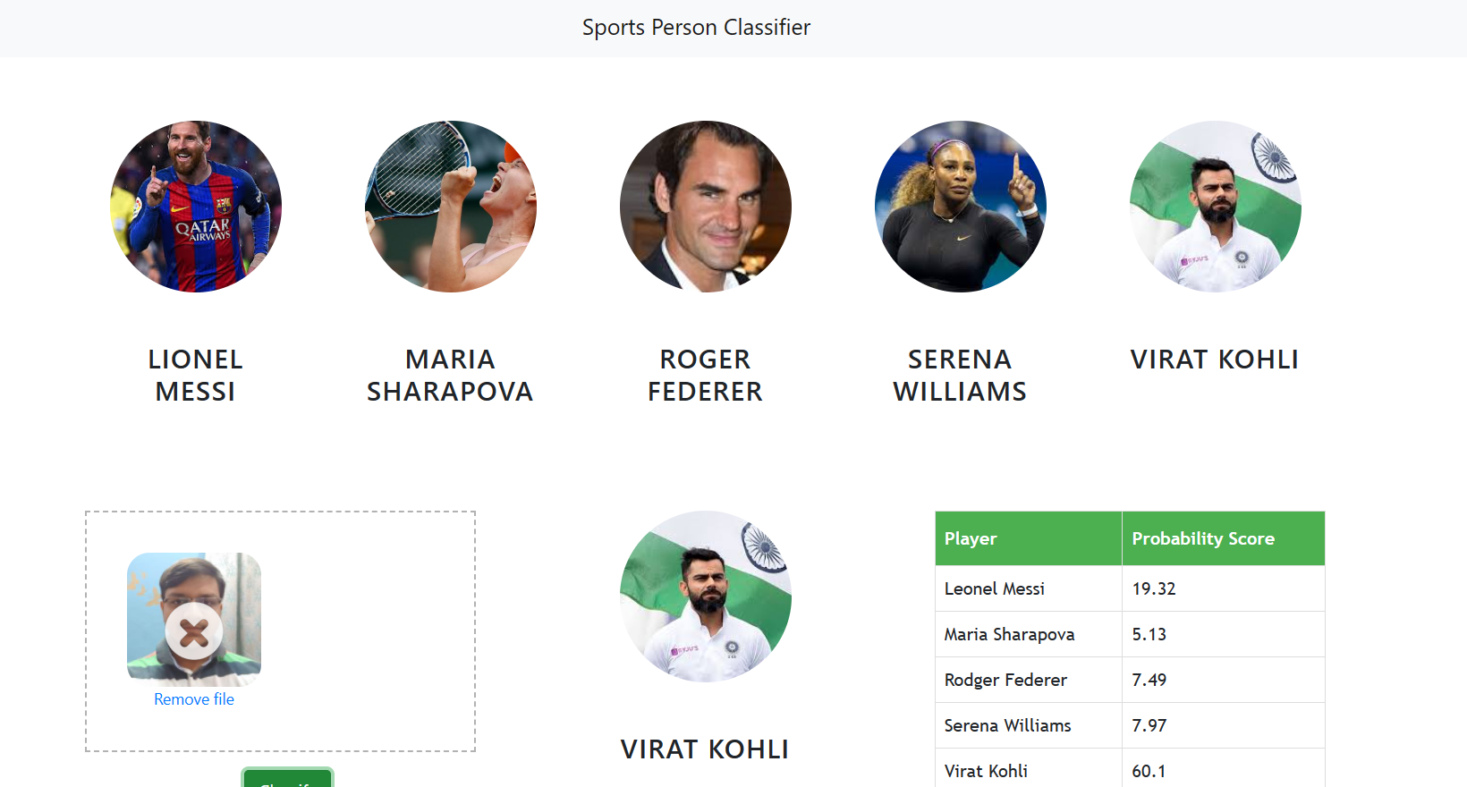
Snapshots of the project

Slide 6
Technical Stack of the project
Python Numpy and OpenCV for data cleaning Matplotlib & Seaborn for data visualization Sklearn for model building Jupyter notebook, visual studio code and pycharm as IDE Python flask for http server HTML/CSS/Javascript for UI

Slide 7
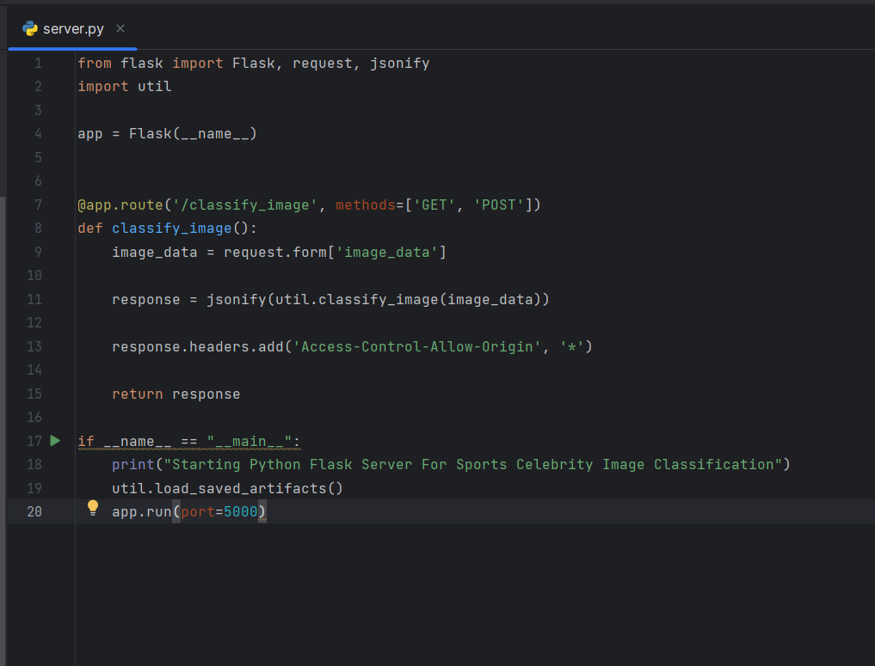
Deployment through flask

Slide 8
Image Recognization
Thanks you

