Slide 1



Slide 2

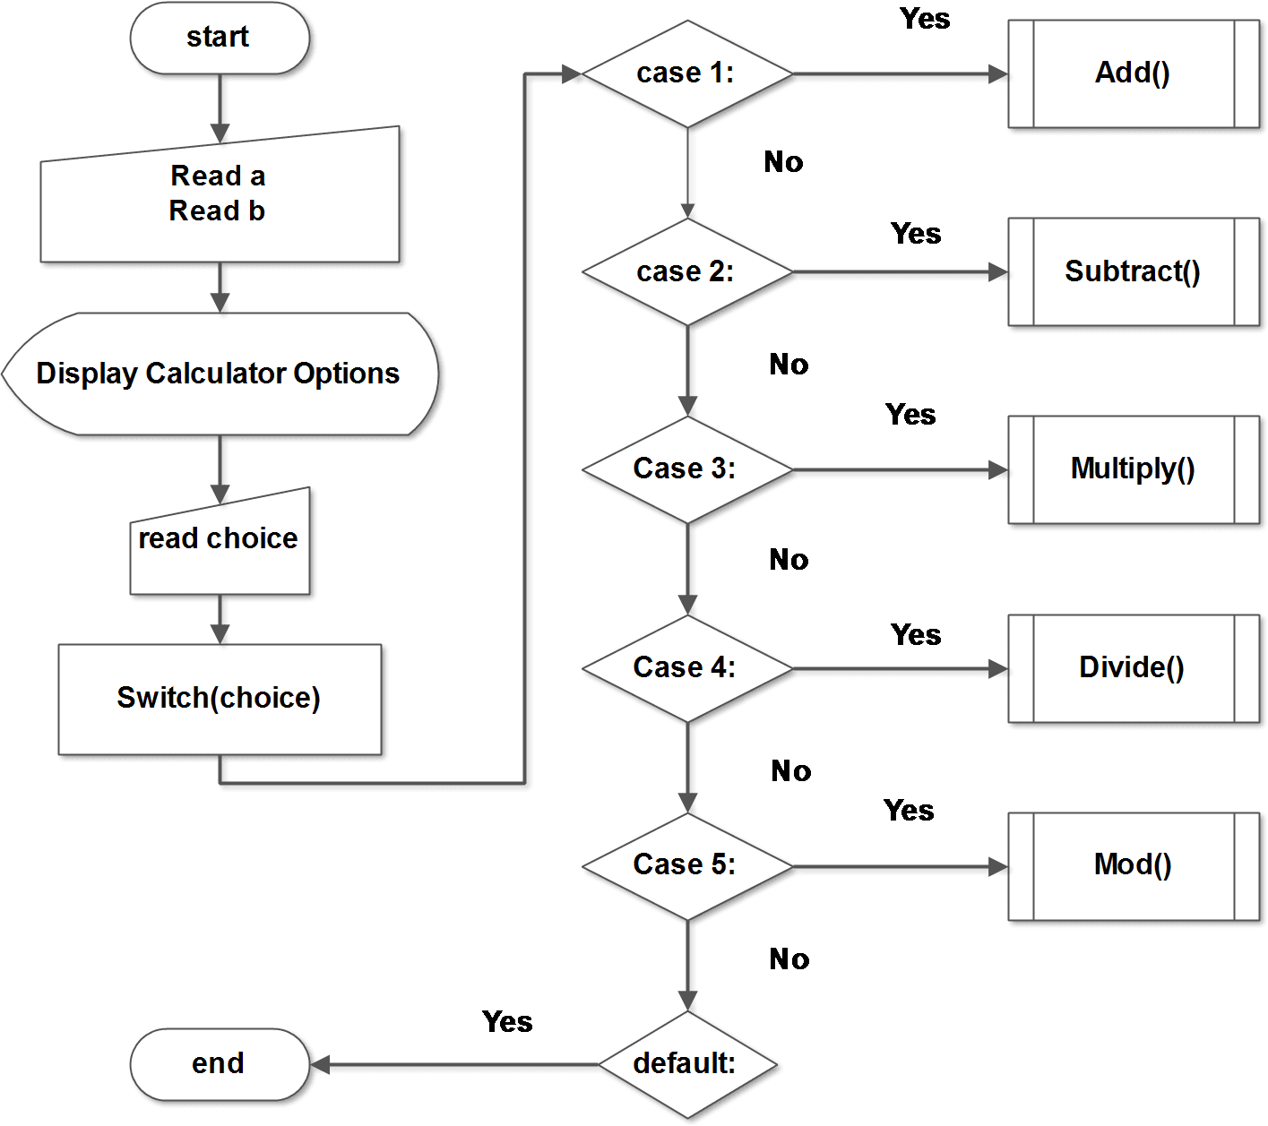
SYSTEM DESIGN

Slide 3
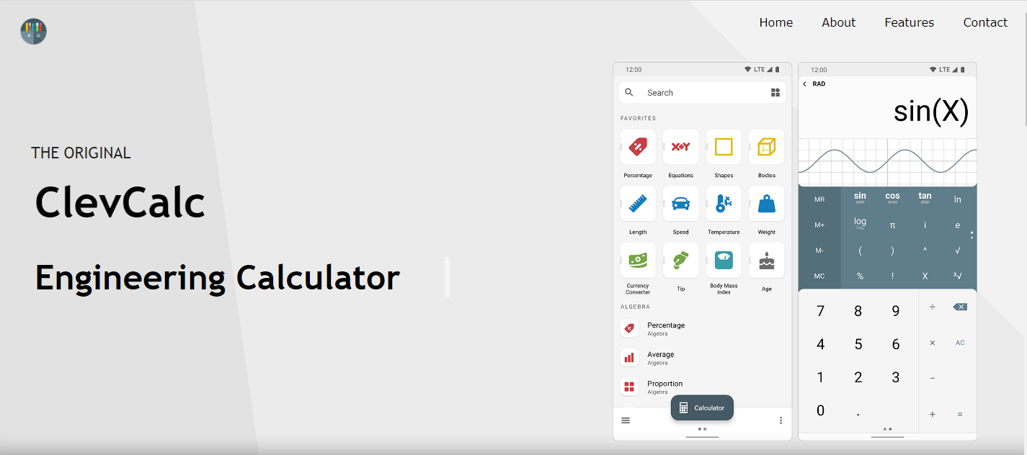
HOME PAGE

Slide 4

FEATURES

Slide 5
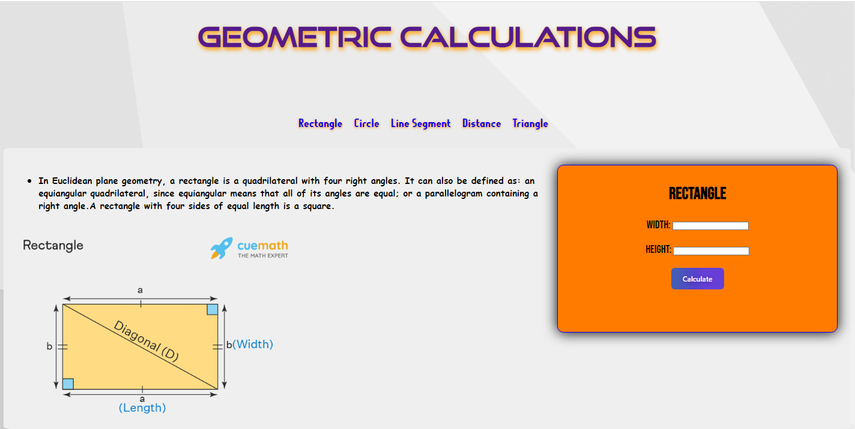

Slide 6


Slide 7
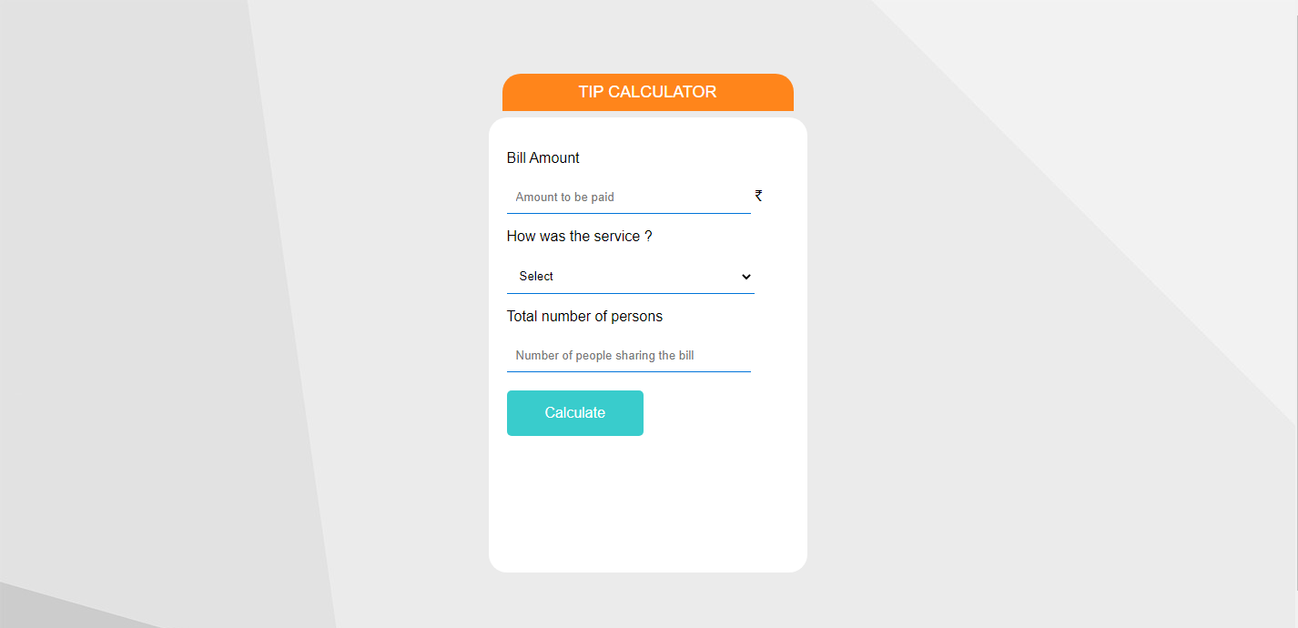

Slide 8


Slide 9
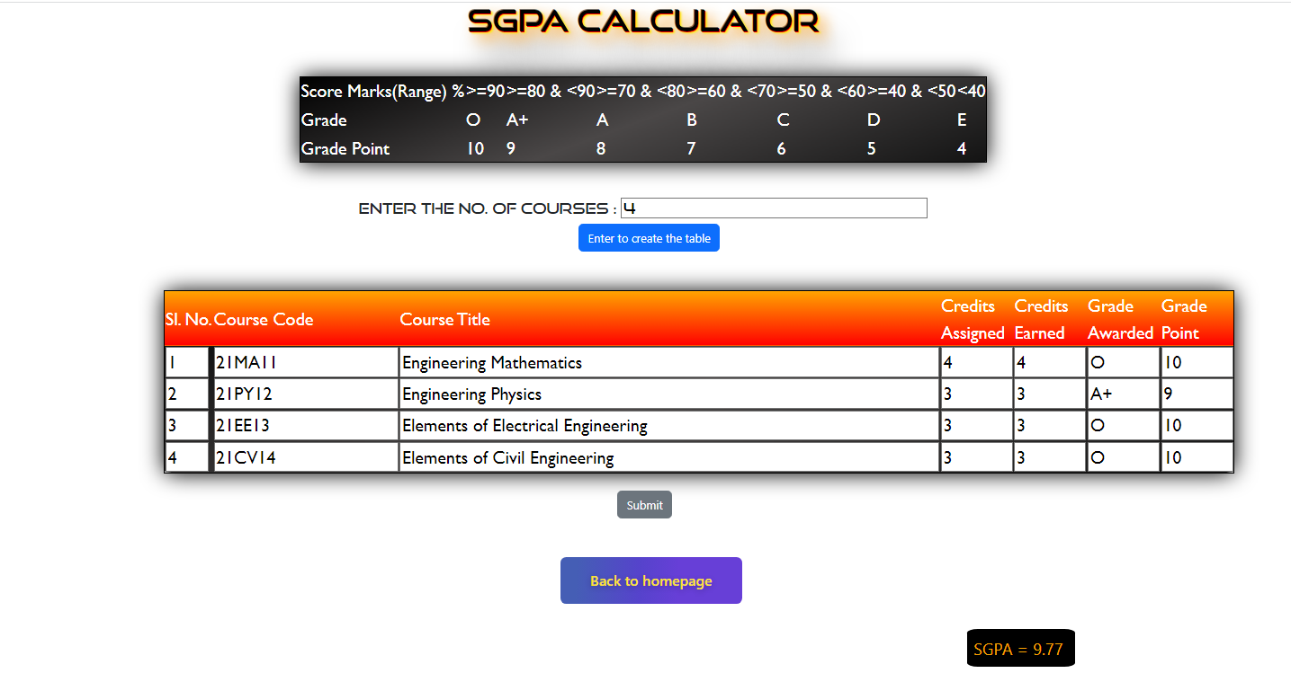

Slide 10


