Slide 1
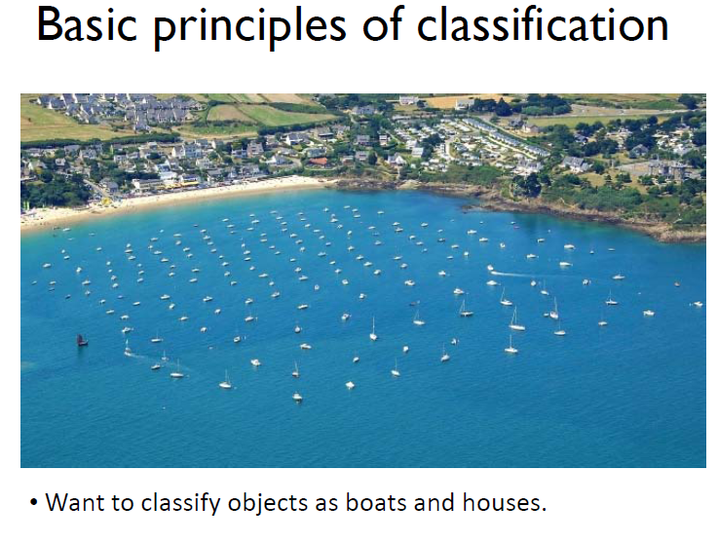
SVM

Slide 2
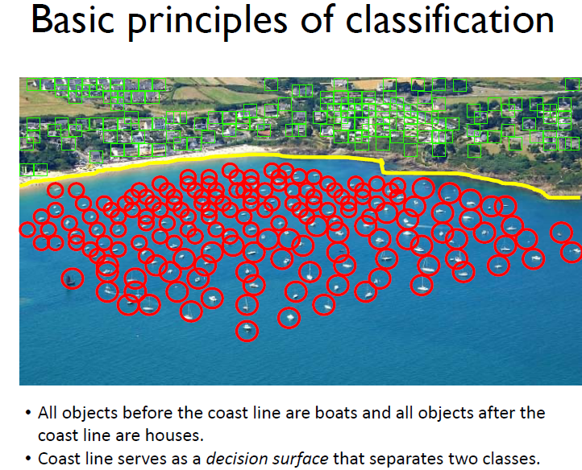

Slide 3
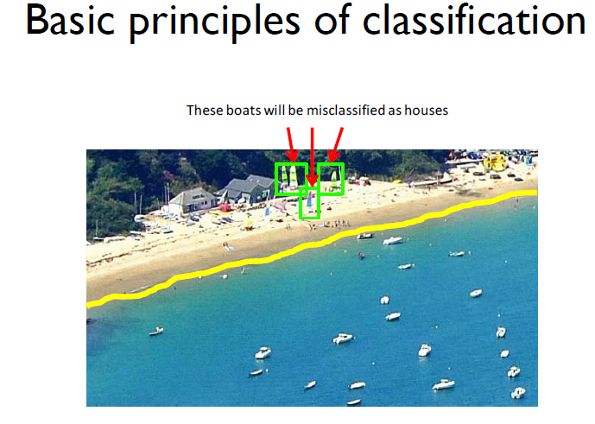

Slide 4
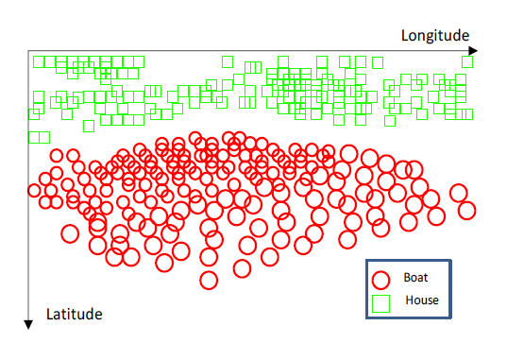

Slide 5
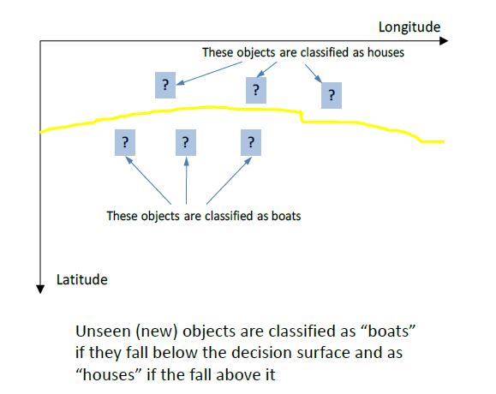

Slide 6
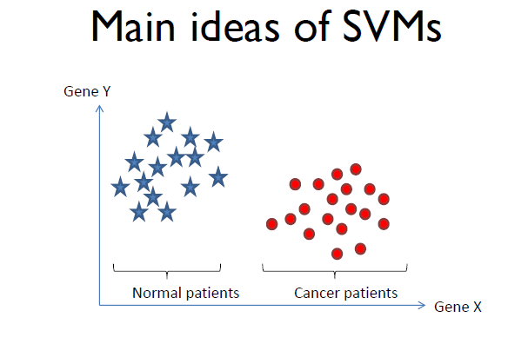

Slide 7
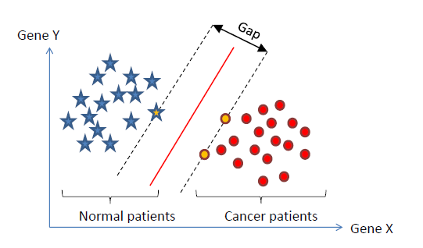

Slide 8
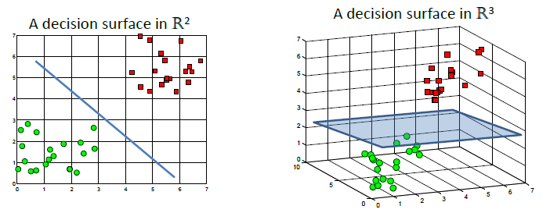

Slide 9
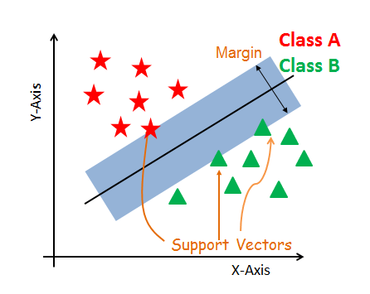
One more ….

Slide 10
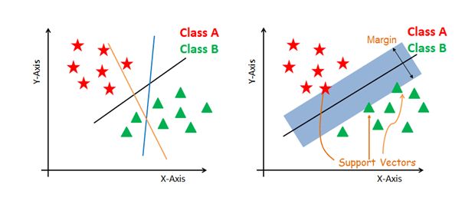
….

Slide 11
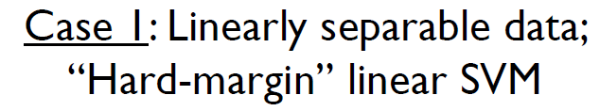
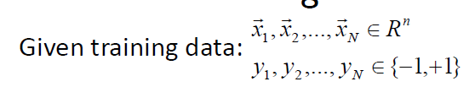
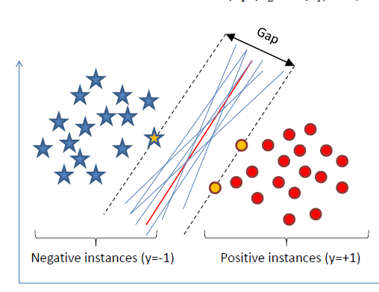

Slide 12
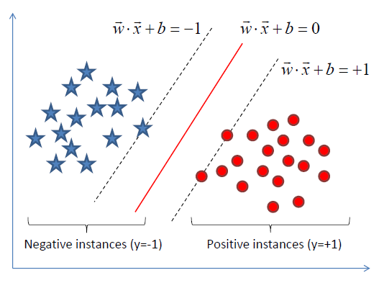

Slide 13
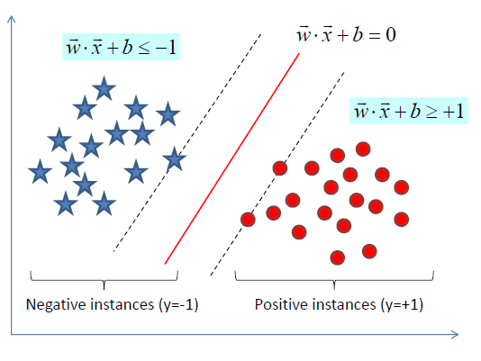

Slide 14
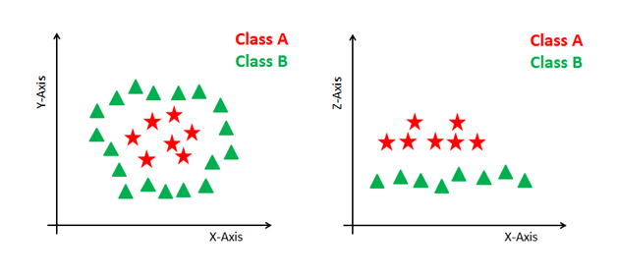
non-linear

Slide 15
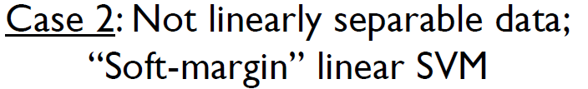
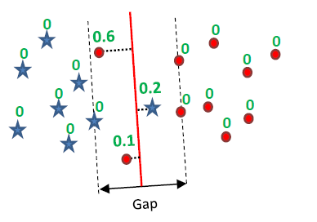

Slide 16
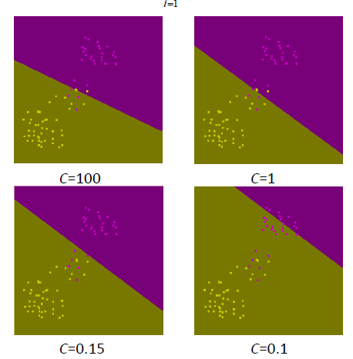

Slide 17
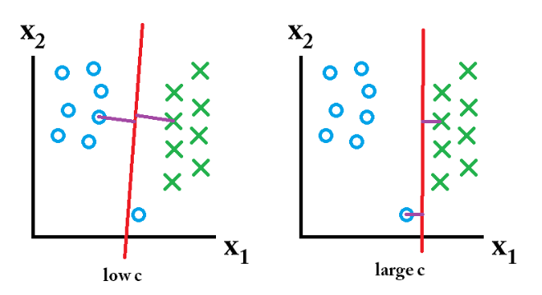
Significance of C value

Slide 18
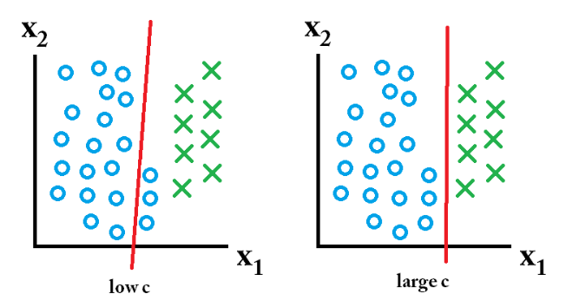
C value…..

Slide 19
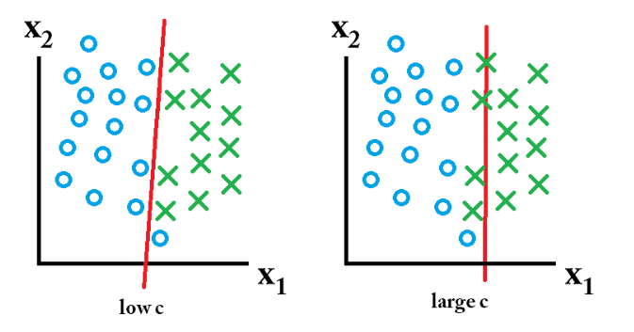
C value…

Slide 20
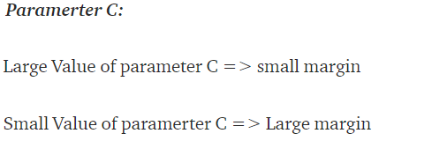
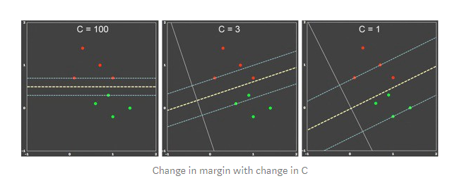
C values

Slide 21
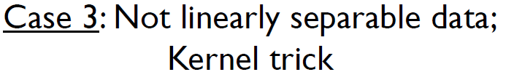
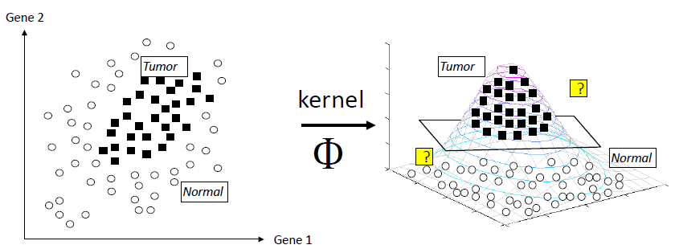

Slide 22
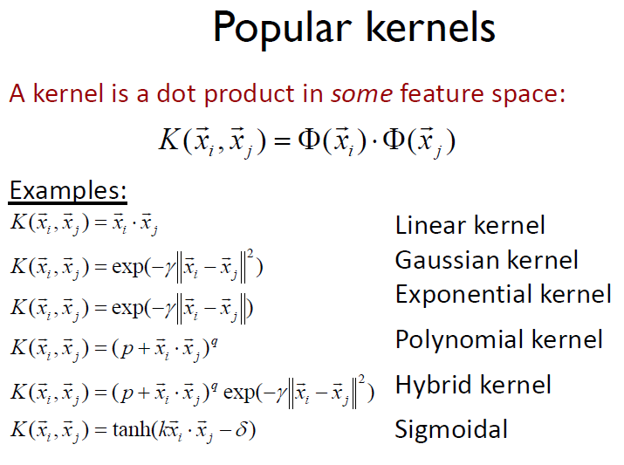

Slide 23
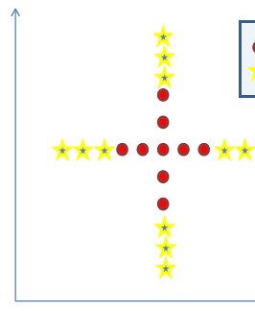

Slide 24
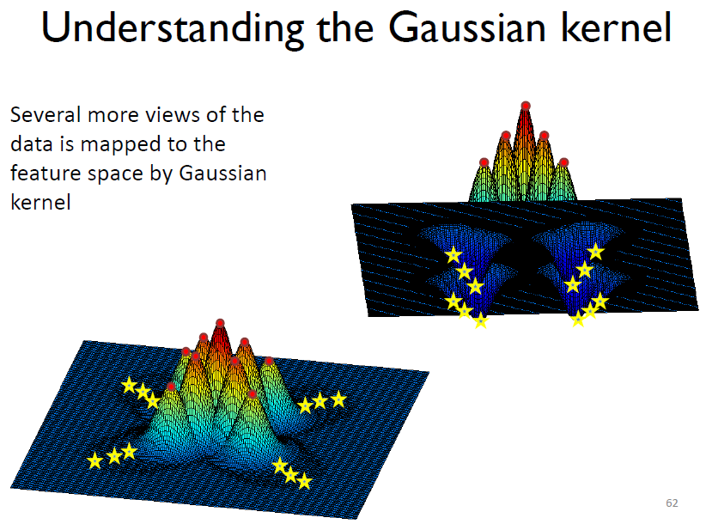

Slide 25
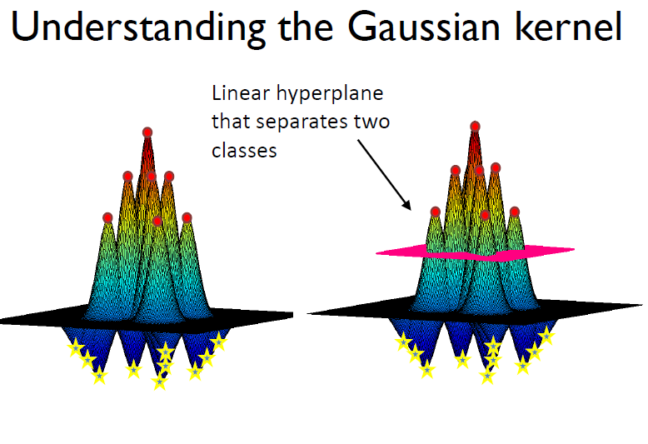

Slide 26
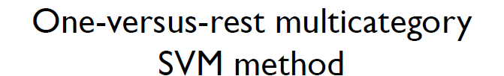
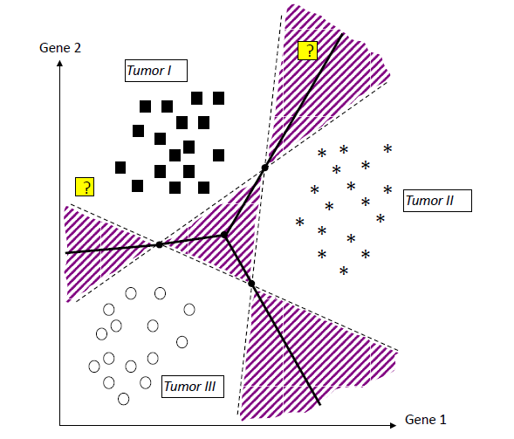

Slide 27
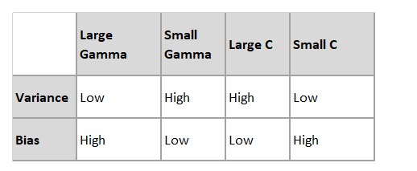
C and Gamma Val

Slide 28
SVM parameter tuning
1- C (for poly and RBF kernels)
2- Gamma (for poly and RBF kernels)
3- Coefficient (for poly kernel)
4- Degree (for poly kernel)

Slide 29
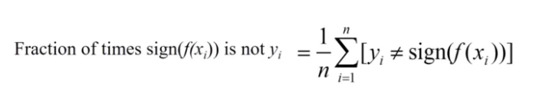

Hinge loss
Predict the accuracy of the model
Optimising the cost function so that we are getting more value out of the correctly classified points than the misclassified ones

Slide 30
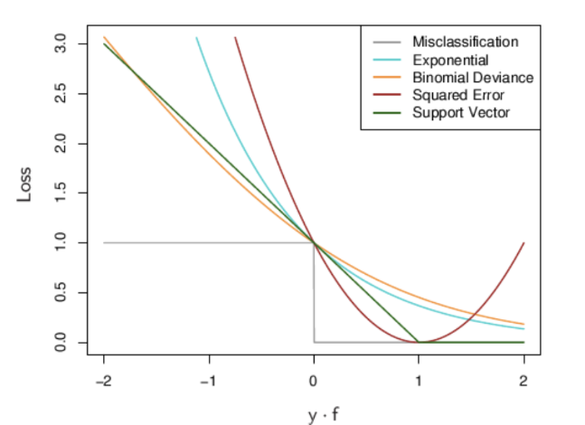
Loss of yf(x) for various algorithm

Slide 31
Lagrangian multipliers
Let us consider the following optimization problem:
Minimize (x,y) => f(x,y)=x2+y2
Subject to
gi(x,y)=x+y−1=0
constraint function g(x,y)

Slide 32
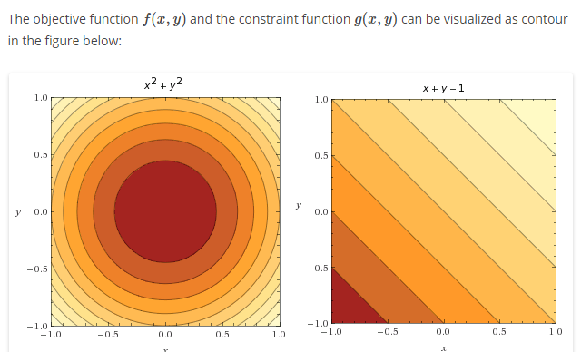
Continue …. Lagrangian multipliers

Slide 33
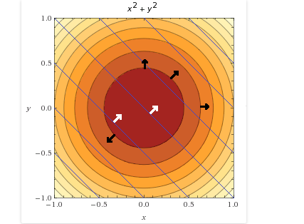
Continue …. Lagrangian
Can see the constraint function depicted by blue lines and vectors of the objective function (in black) and some gradient vectors of the constraint function (in white)

Slide 34
Continue …. Lagrangian
we are not interested in the whole constraint function. We are only interested in points where the constraint is satisfied, i.e. g(x,y)=0
It means that we want points where:
x+y−1=0x+y−1=0
x+y=1x+y=1
y=1−x

Slide 35
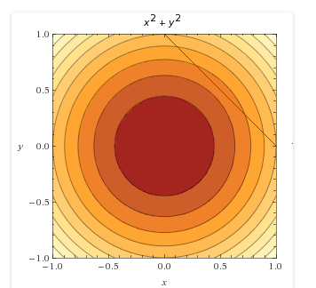
Continue …. Lagrangian
we plot the line y=1−xy=1−x on top of the objective function. We saw earlier that this line is also called the feasible set

Slide 36
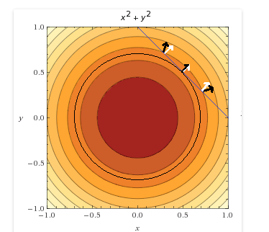
Continue …. Lagrangian
What did Lagrange find? He found that the minimum of f(x,y) under the constraint g(x,y)=0 is obtained when their gradients point in the same direction.

Slide 37
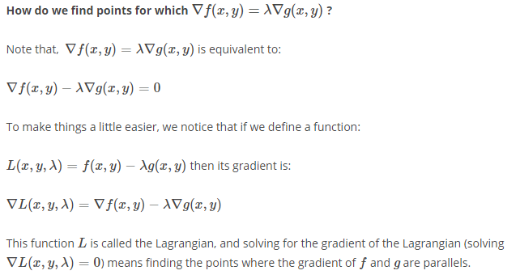
Continue …. Lagrangian

