Slide 1
Farmstack Project Progress Update
A presentation showing the current progress of the Farmstack project and the tech stack being used

Slide 2
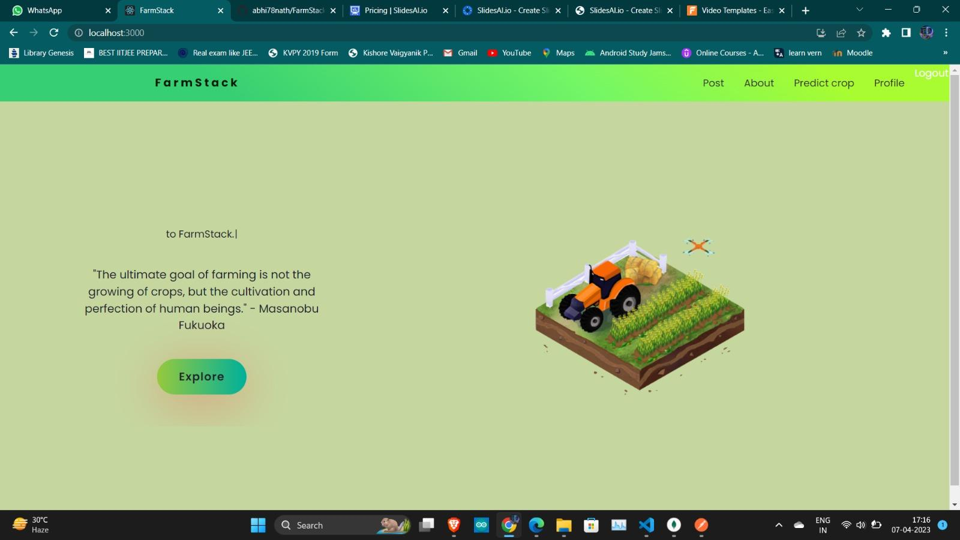
Implemented Features
Landing page
Chat system using Socket.io
Cropadvisor backend using Decision Tree JS and ipapi for location
Post system backend
Authentication system

Slide 4
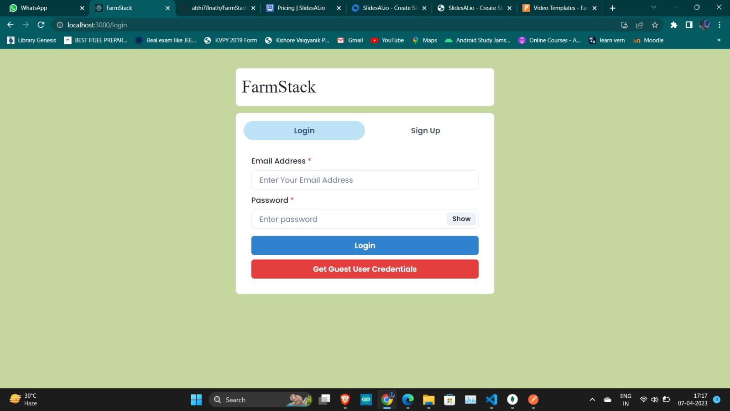

Slide 5
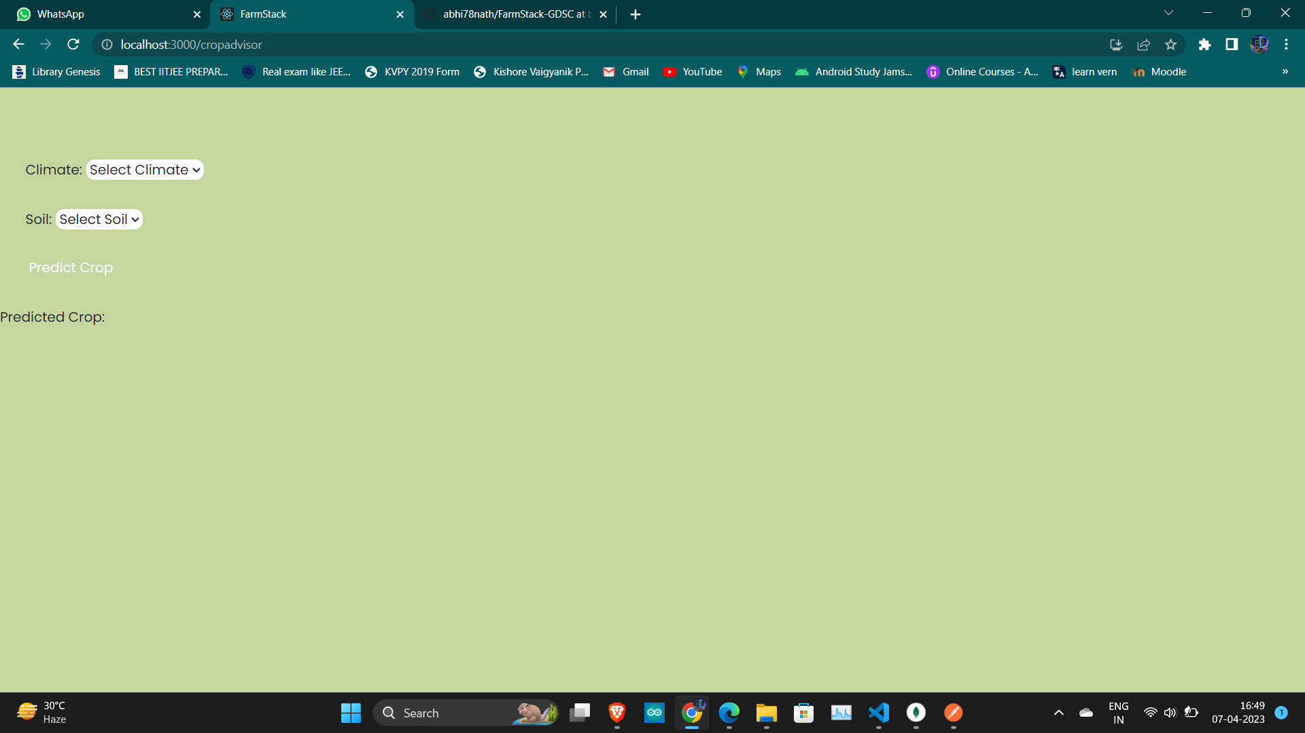

Slide 6
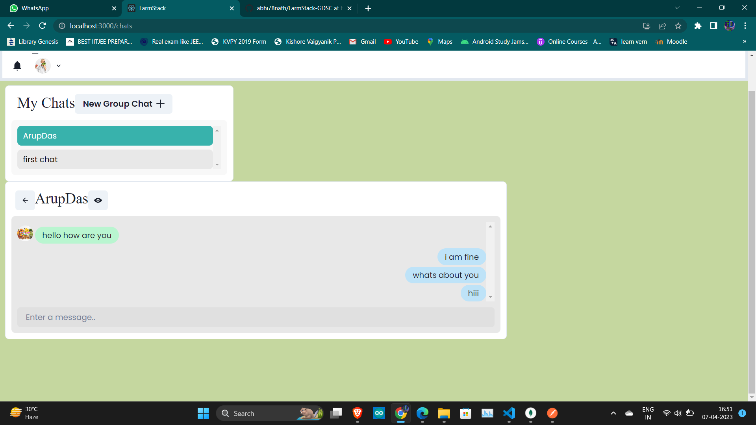

Slide 7
Future Work
Revamp frontend for better user experience
Implement additional features based on user feedback

Slide 8
Tech Stack
ReactJS for frontend
NodeJS and ExpressJS for backend
MongoDB for database
MaterialUI and ChakraUI for UI/UX

Slide 9
Conclusion
Farmstack project progressing well
Exciting updates to come with improved frontend and additional features
Tech stack allowing for efficient development and scalability
Note: Images and graphics related to farming, agriculture, and technology can be used to enhance the overall theme and feel of the presentation.

Slide 10
Thank you for your time 😊

