Slide 1
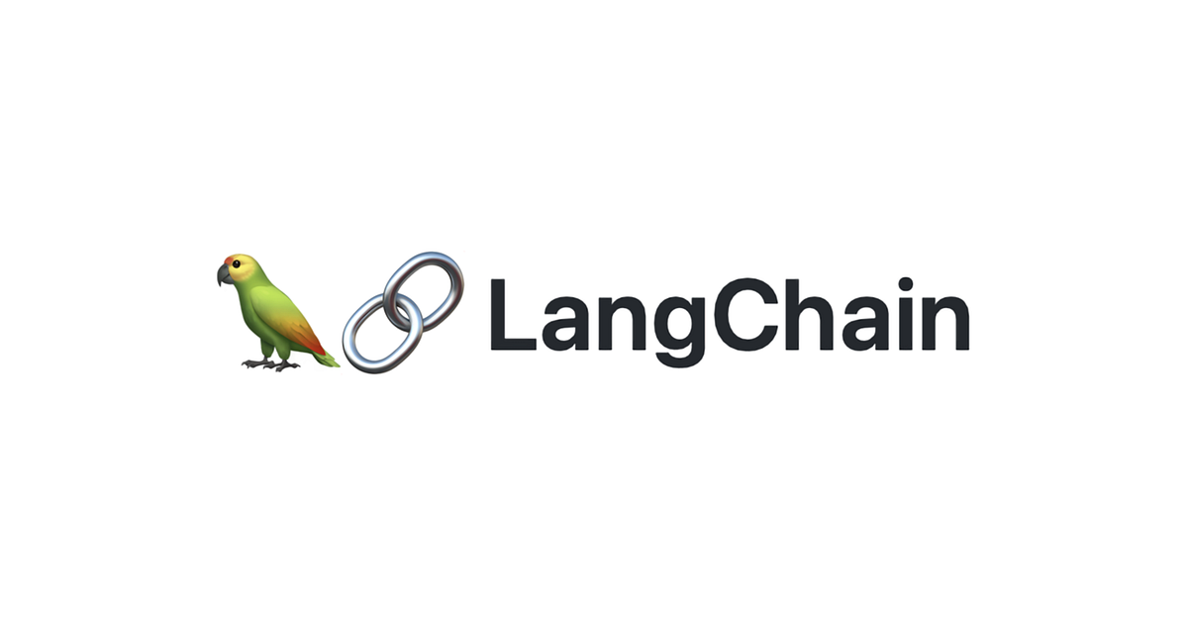
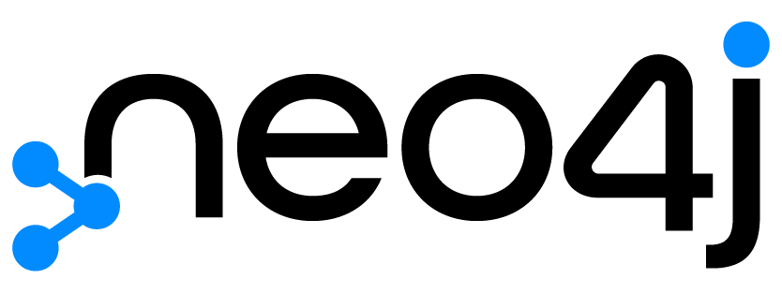


SupplyChain Insights - Understanding Global Supply Chain Operations using Graph RAG
Abhishek Shankar

Slide 2
Introduction
Understanding Supply Chain Operations – Many companies have large datasets either as structured or unstructured data around their products. This project aims to provide a comprehensive solution for accessing and understanding the entire supply chain network.
The final product will facilitate the analysis and visualization of data, enabling organizations to gain insights into their supply chain operations efficiently.
This project demonstrates the application of advanced data science techniques, such as Graph Data Science and Retrieval-Augmented Generation (RAG), to real-world supply chain data, showcasing how these methods can provide actionable insights and enhance decision-making in the industry.

Slide 3
Project Description
Detailed Description: Constructing a Neo4j graph database on a supply chain shipment pricing dataset, using Graph Data Science and RAG for advanced analysis.
Problem Addressed: Enhances understanding and access to complex supply chain networks, focusing on the health care/pharmaceutical industry.
Scope: Integrates data analysis with Graph Data Science and RAG, providing insights into global spending and supply chain trends for informed decision-making.

Slide 4
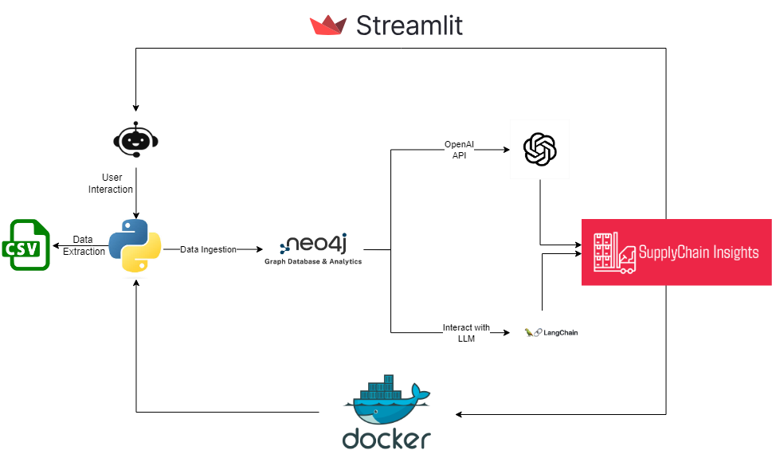
Project Architecture

Slide 5
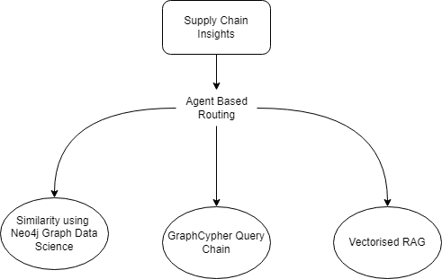
Whats Different?

Slide 6
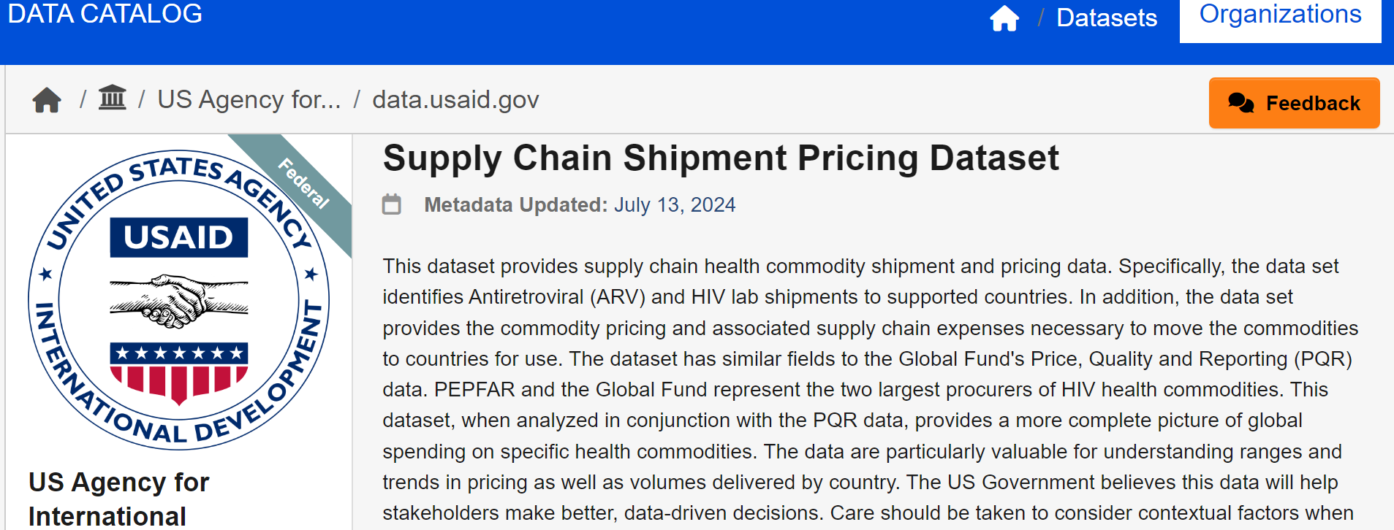
Data Collection and Preprocessing
Using Python for preprocessing and Cypher for populating my database
Any data cleaning will be done through Python.

Slide 7
RAG Pipeline Implementation
Neo4j Database Setup
Nodes
Mapping Similarity
Langchain
Python
Edges
Vectorizing Nodes
Streamlit

Slide 8
Performance Metrics
Key Metrics: Accuracy of similarity searches, efficiency of data retrieval, and user satisfaction.
Calculation Methods: Use precision and recall for similarity searches, response time for data retrieval, and user feedback surveys.
Initial Results: High accuracy in similarity searches, fast data retrieval times, and positive initial user feedback.

Slide 9
Methods to Improve Metrics
Improvement Strategies: Optimize graph database queries, enhance vector indexing algorithms and refine RAG processes
01
Planned Enhancements: Implement query optimization techniques, refine vector indexing, integrate advanced ML models, and adjust RAG parameters for better context understanding.
02
Expected Impact: Improved search accuracy, faster data retrieval, and increased user satisfaction through more precise and efficient insights.
03

Slide 10
Deployment Plans
Steps to Deploy: Integrate all components and set up the production environment for the Neo4j graph database and application functionalities.
Tools and Platforms: Use a cloud service provider (e.g., AWS, Azure, GCP) for hosting and Neo4j for database management or containerize the pipeline using docker.
User Testing and Feedback: Launch a beta version using a LinkedIn post or Blog, collect user feedback, and iterate based on insights before full-scale deployment.

Slide 11
Future Scope
Potential Extensions: Integrate additional datasets for broader supply chain analysis and use more unstructured datasets like PDFs to understand product supply chains.
Long-term Vision: Develop a comprehensive supply chain management tool with real-time monitoring and data visualization features.
Further Development: Collaborate with industry stakeholders to refine the tool, incorporate advanced AI techniques, and scale for enterprise use.

Slide 12
Conclusion
Summary of the Project: Developed a Neo4j graph RAG Pipeline to understand global supply chains, utilizing advanced data science techniques for analysis.
Key Takeaways: Improved understanding of supply chain networks, enhanced data retrieval, and actionable insights for better decision-making.
Final Thoughts: The project demonstrates the potential of integrating graph databases and advanced analytics to solve complex industry problems and provides a foundation for future enhancements.

Slide 13

ANY QUESTIONS ?????? ☺

