Slide 1

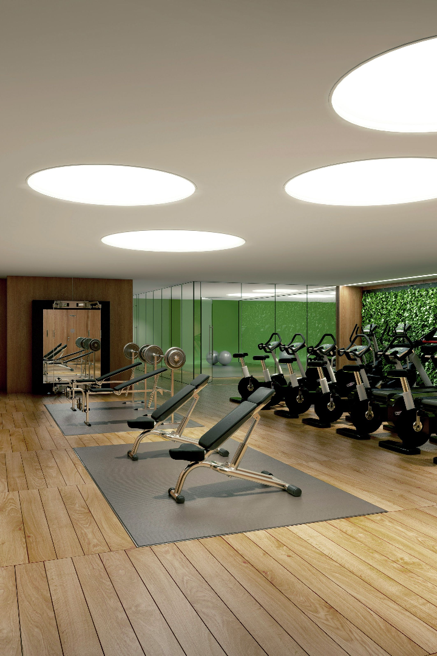


Gym 24 - Your Fitness Destination
Welcome to Gym 24, the ultimate fitness destination. Discover a world-class gym with top-notch facilities and expert trainers to help you reach your fitness goals.
by Abhijit Singh
Roll no.- 2110990041
Group- 5

Slide 2

About Gym 24
Gym 24 is a cutting-edge fitness center that provides a range of services and facilities designed to meet all your fitness needs. Experience a welcoming and motivating environment that will transform your fitness journey.
1
Fitness Experts
2
Diverse Class Selection
Our certified trainers are dedicated to helping you maximize your workouts and achieve your goals. Personalized training plans ensure results!
From high-intensity interval training to yoga and spin classes, our group fitness options cater to all ages and fitness levels.
3
Premium Equipment
Our gym is equipped with state-of-the-art machines and free weights, creating an optimal training environment for strength and cardio workouts.

Slide 3
Membership at Gym 24
Join our fitness community and enjoy exclusive benefits with a Gym 24 membership.
Flexible Memberships
Member Perks
Choose from various membership options based on your fitness goals and preferences. We offer short-term and long-term plans to suit every individual.
Enjoy access to additional amenities such as saunas, showers, and nutritional guidance. Members also receive discounts on personal training sessions and exclusive promotions.
Convenient Payment Options
24/7 Access
We provide flexible payment methods including monthly, quarterly, and annual billing cycles. Experience hassle-free membership management with our user-friendly online portal.
Experience the freedom to work out whenever it suits you with our round-the-clock access. No more scheduling conflicts or limited gym hours!

Slide 4
FAQs - Your Questions Answered
Find answers to frequently asked questions about Gym 24.
How can I become a member?
What are your operating hours?
Signing up is easy! Visit our website, call our membership hotline, or drop by the gym reception to get started.
Gym 24 is open 24 hours a day, 7 days a week. You can work out whenever it fits your schedule.
Where are you located?
Our gym is conveniently located in the heart of the city, with ample parking facilities and easy access to public transport.

Slide 5
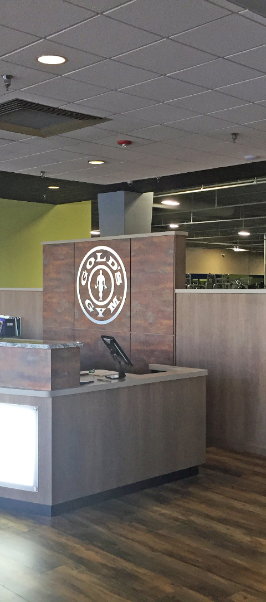
Contact Us
Have questions or need assistance? Contact Gym 24 or stop by our reception to speak with our friendly staff.
Phone
Email
Call us at +91-1234567890 to speak with a member of our team. We're here to help!
Reach out to us at info@gym24.com with any inquiries. We aim to respond to all emails within 1-2 working days.
Social Media
Stay connected with Gym 24 through our social media channels. Follow us on Instagram, Facebook, and Twitter for fitness tips, updates, and special offers.

Slide 6


Conclusion
Gym 24 is the destination for your fitness journey. With dedicated trainers, top-notch facilities, and a thriving community, we are here to support you. Visit our website to learn more and start your fitness transformation today!

