Slide 1

GROCETERIA Mini Project KCS 554/ 5th Sem.
STUDENT NAME
1.Abhay Verma (2000320120004)
2.Abhishek Singh (2000320120010)
3.Anurag Pandey (200020120041)
SUPERVISOR NAME:
Mr. Dhaneshwar Kumar

Slide 2
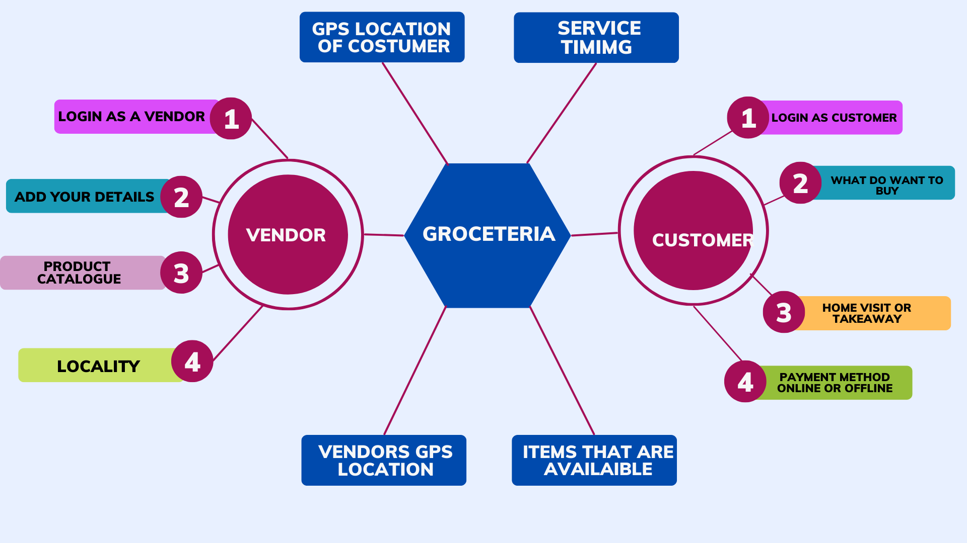
ABSTRACT
In this project we are integrating all the unorganized vendors at a single platform where they can sell their products online and can also get customer leads online . On this platform after getting customer lead the vendor can directly reach the door of customer to sell his product.

Slide 3
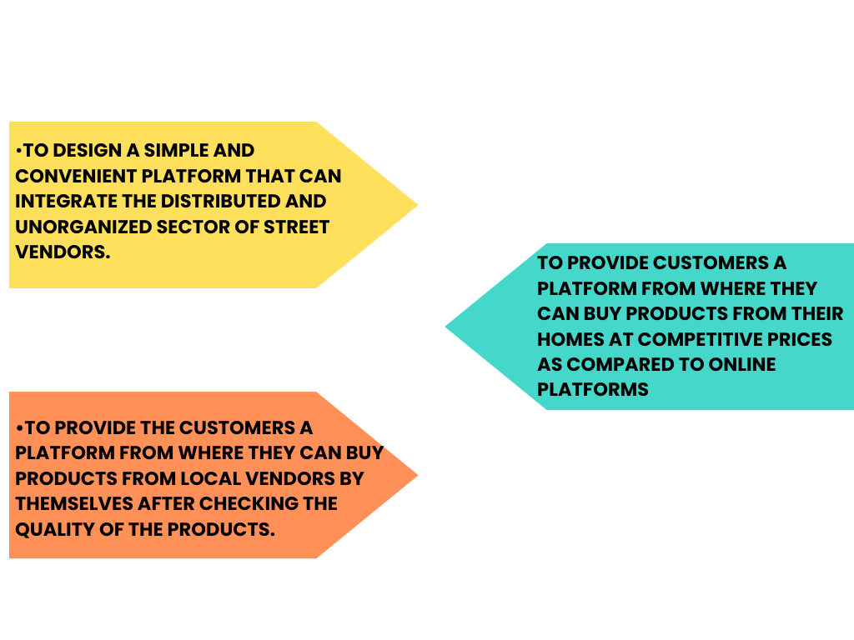
OBJECTIVE [

Slide 4
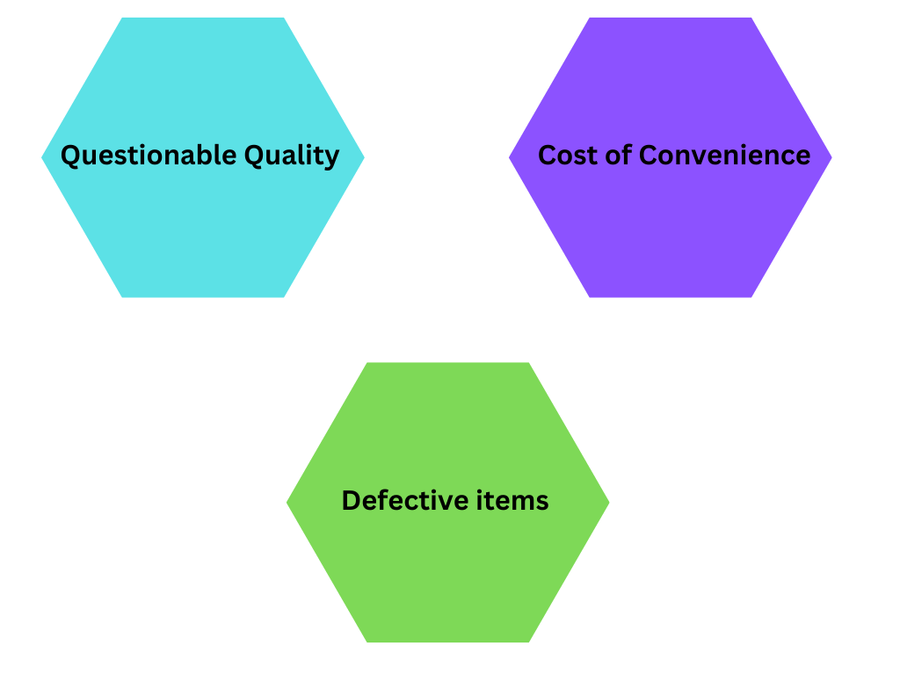
SCOPE of the Problem Statement

Slide 5
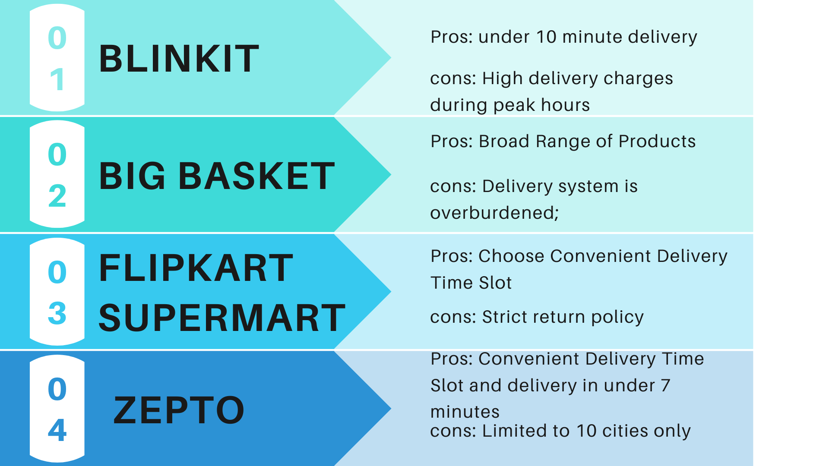
REVIEW /SURVEY

Slide 6
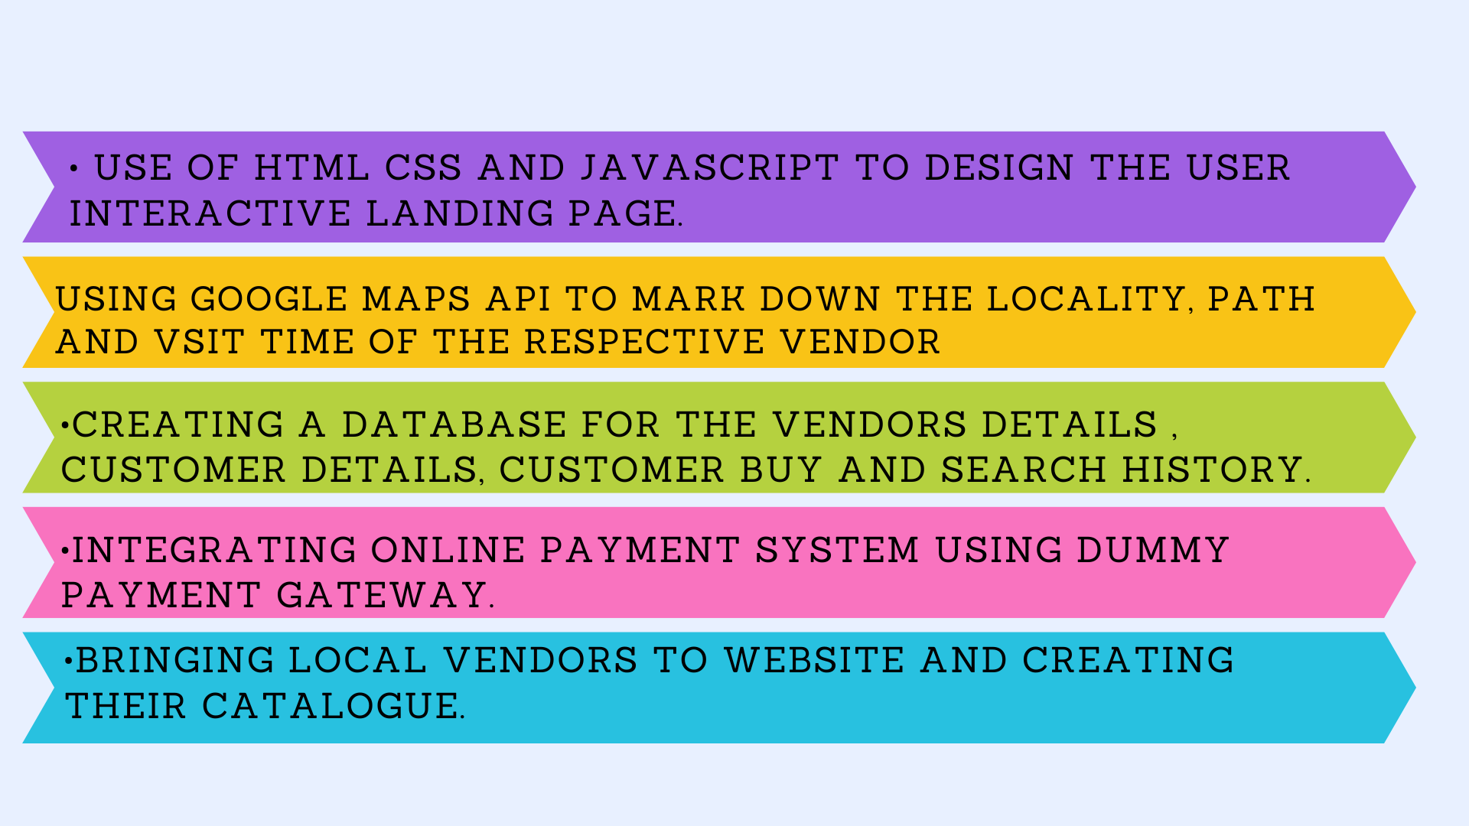
Proposed Methodology :

Slide 7
THANK YOU

