Slide 1
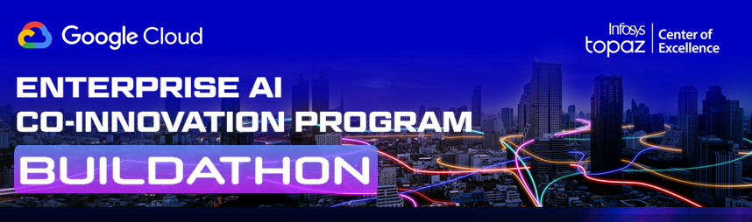


AI Agents in Action
Infosys Gemini Hackathon 2024 | Jun 07 – July 16
Agent development window is open from 24th Feb -14th March, 2025
Landshield : An AI-powered due diligence for Indian land documents

Slide 2
TEAM and USE CASE
TEAM NAME | TEAM MEMBER NAME | EMAIL ID | DU
Trust Trailblazers | Abhishek Partap Singh | abhishekpartap.s@infosys.com | ORCMW
 | Sachin Deshpande | sachin_deshpande02@infosys.com | ORCMW
 | Ashwin Deepak Kondhalkar | ashwin_kondhalkar@edgeverve.com
Use Case details | Use Case: Land document fraud detection and verification Domain: Real Estate Subdomain: Document Verification Use case description: Gen AI Agent to Read and Verify the land documents are compliant with Secure Land-Law Guidelines. The Guidelines can be configured as JSON file. The agents will parse the documents listed in the bundle to verify any known fraud patterns or statutory violations exist in public land records and case law available on the internet.

Slide 3
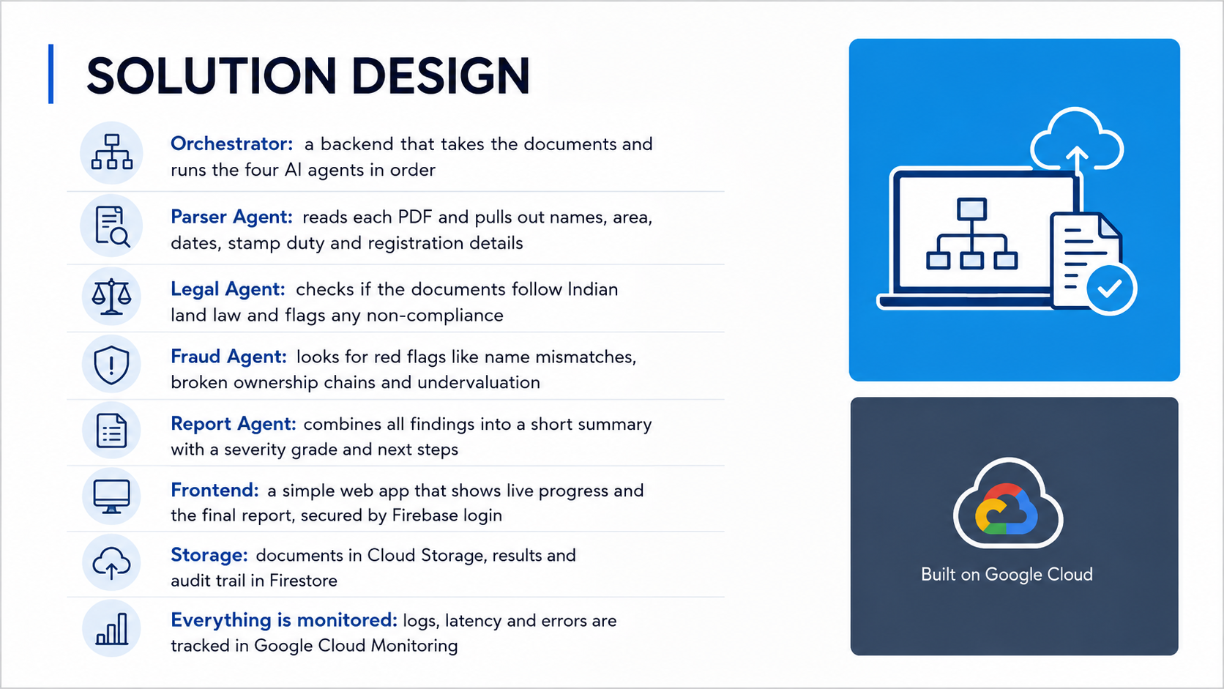
Solution Design
Orchestrator: a backend that takes the documents and runs the four AI agents in order
Parser Agent: reads each PDF and pulls out names, area, dates, stamp duty and registration details
Legal Agent: checks if the documents follow Indian land law and flags any non-compliance
Fraud Agent: looks for red flags like name mismatches, broken ownership chains and undervaluation
Report Agent: combines all findings into a short summary with a severity grade and next steps
Frontend: a simple web app that shows live progress and the final report, secured by Firebase login
Storage: documents in Cloud Storage, results and audit trail in Firestore
Everything is monitored: logs, latency and errors are tracked in Google Cloud Monitoring

Slide 4
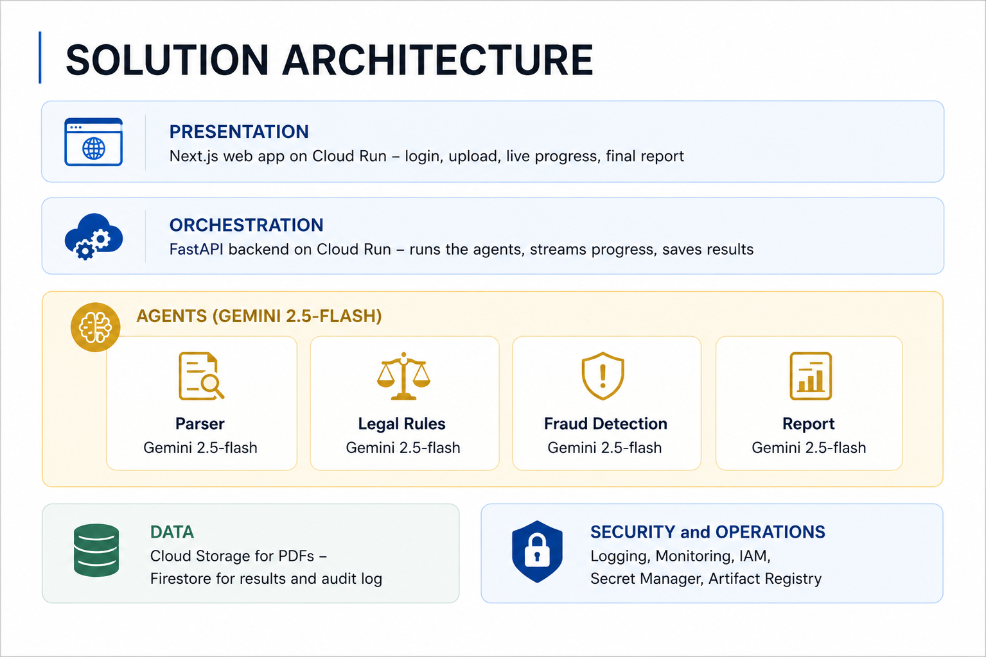
Solution Architecture
PRESENTATION
Next.js web app on Cloud Run - login, upload, live progress, final report
ORCHESTRATION
FastAPI backend on Cloud Run - runs the agents, streams progress, saves results
AGENTS (GEMINI 2.5-FLASH)
Parser
Gemini 2.5-flash
Legal Rules
Gemini 2.5-flash
Fraud Detection
Gemini 2.5-flash
Report
Gemini 2.5-flash
DATA
Cloud Storage for PDFs - Firestore for results and audit log
SECURITY and OPERATIONS
Logging, Monitoring, IAM, Secret Manager, Artifact Registry

Slide 5
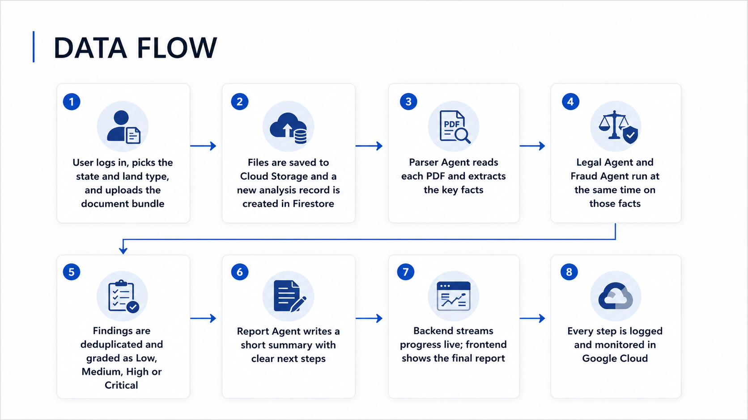
Data Flow
User logs in, picks the state and land type, and uploads the document bundle
Files are saved to Cloud Storage and a new analysis record is created in Firestore
Parser Agent reads each PDF and extracts the key facts
Legal Agent and Fraud Agent run at the same time on those facts
Findings are deduplicated and graded as Low, Medium, High or Critical
Report Agent writes a short summary with clear next steps
Backend streams progress live; frontend shows the final report
Every step is logged and monitored in Google Cloud

Slide 6
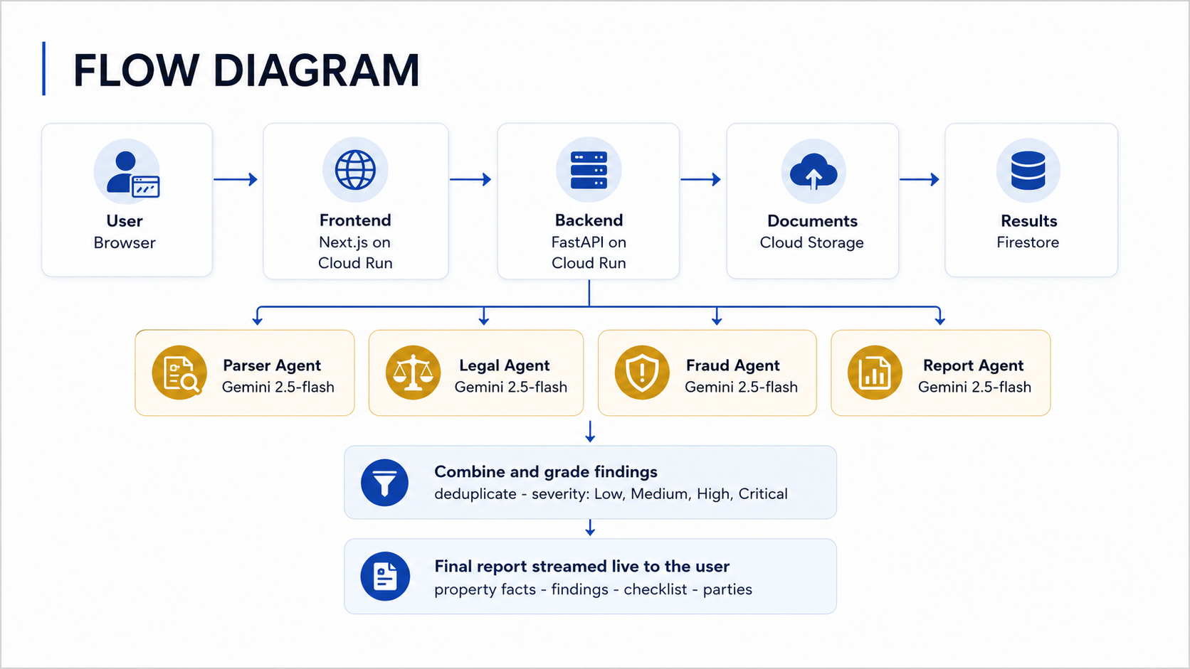
Flow Diagram
User
Browser
Frontend
Next.js on Cloud Run
Backend
FastAPI on Cloud Run
Documents
Cloud Storage
Results
Firestore
Parser Agent
Gemini 2.5-flash
Legal Agent
Gemini 2.5-flash
Fraud Agent
Gemini 2.5-flash
Report Agent
Gemini 2.5-flash
Combine and grade findings
deduplicate - severity: Low, Medium, High, Critical
Final report streamed live to the user
property facts - findings - checklist - parties

Slide 7
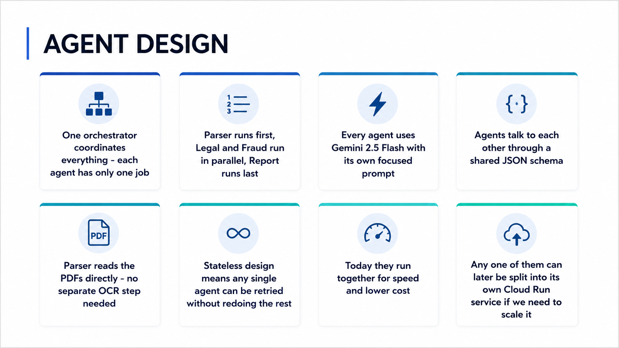
Agent Design
One orchestrator coordinates everything - each agent has only one job
Parser runs first, Legal and Fraud run in parallel, Report runs last
Every agent uses Gemini 2.5 Flash with its own focused prompt
Agents talk to each other through a shared JSON schema
Parser reads the PDFs directly - no separate OCR step needed
Stateless design means any single agent can be retried without redoing the rest
Today they run together for speed and lower cost
Any one of them can later be split into its own Cloud Run service if we need to scale it

Slide 8
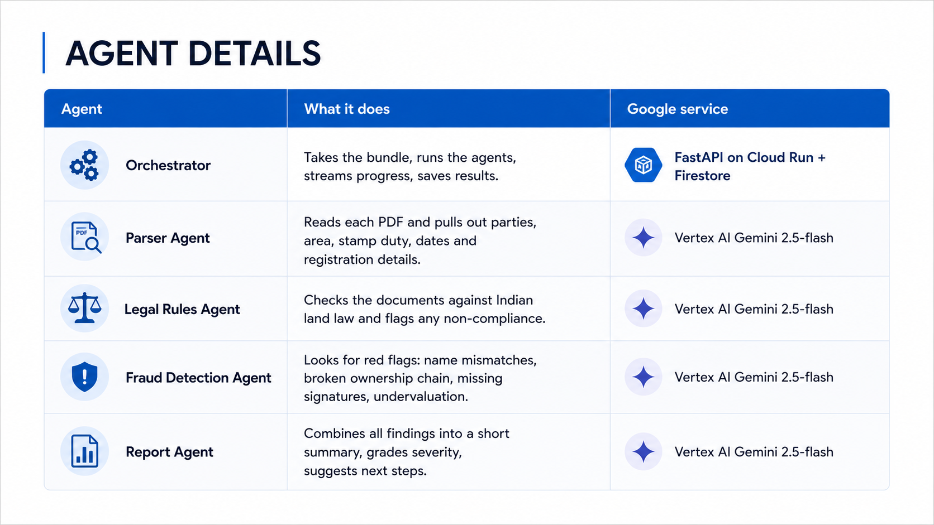
Agent Details
Agent | What it does | Google service
Orchestrator | Takes the bundle, runs the agents, streams progress, saves results. | FastAPI on Cloud Run + Firestore
Parser Agent | Reads each PDF and pulls out parties, area, stamp duty, dates and registration details. | Vertex AI Gemini 2.5-flash
Legal Rules Agent | Checks the documents against Indian land law and flags any non-compliance. | Vertex AI Gemini 2.5-flash
Fraud Detection Agent | Looks for red flags: name mismatches, broken ownership chain, missing signatures, undervaluation. | Vertex AI Gemini 2.5-flash
Report Agent | Combines all findings into a short summary, grades severity, suggests next steps. | Vertex AI Gemini 2.5-flash

Slide 9
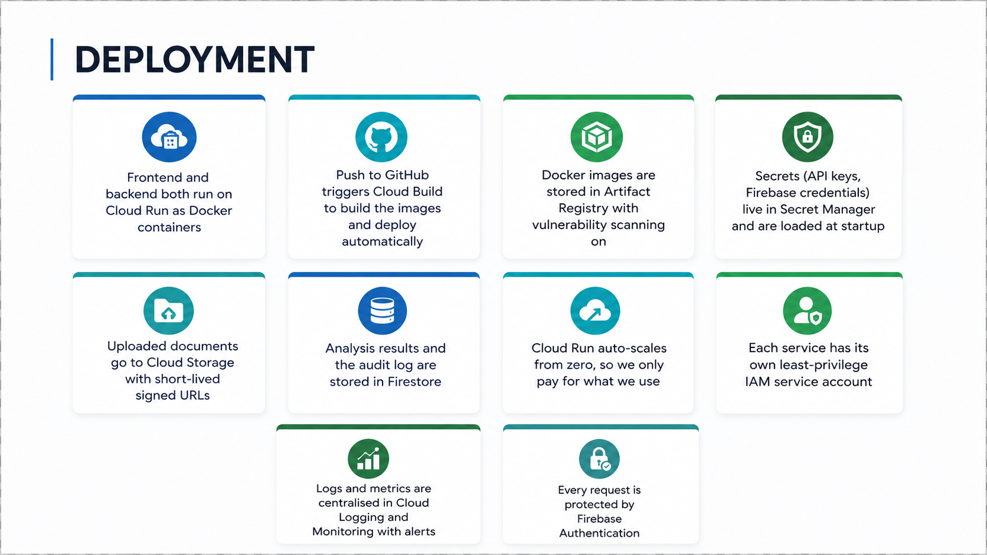
Deployment
Frontend and backend both run on Cloud Run as Docker containers
Push to GitHub triggers Cloud Build to build the images and deploy automatically
Docker images are stored in Artifact Registry with vulnerability scanning on
Secrets (API keys, Firebase credentials) live in Secret Manager and are loaded at startup
Uploaded documents go to Cloud Storage with short-lived signed URLs
Analysis results and the audit log are stored in Firestore
Cloud Run auto-scales from zero, so we only pay for what we use
Each service has its own least-privilege IAM service account
Logs and metrics are centralised in Cloud Logging and Monitoring with alerts
Every request is protected by Firebase Authentication

Slide 10
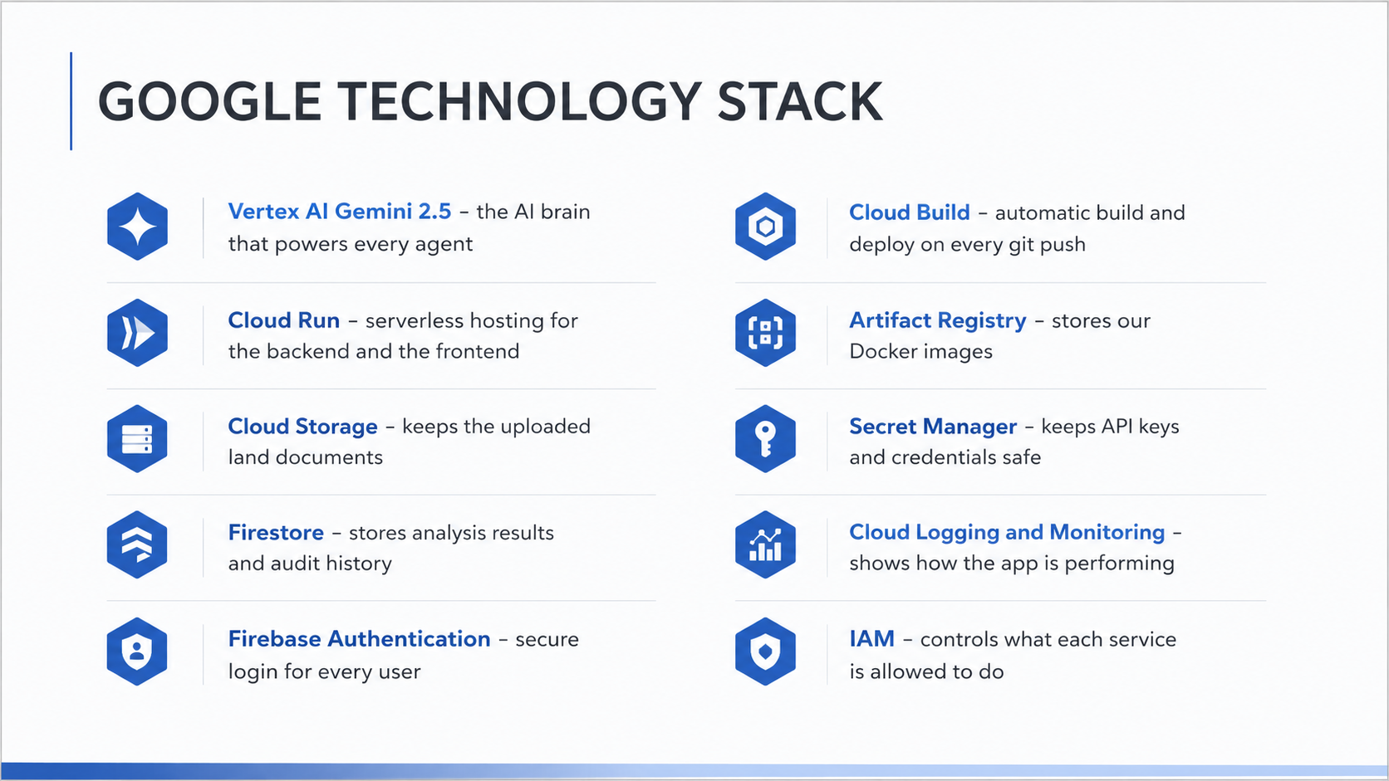

Slide 11
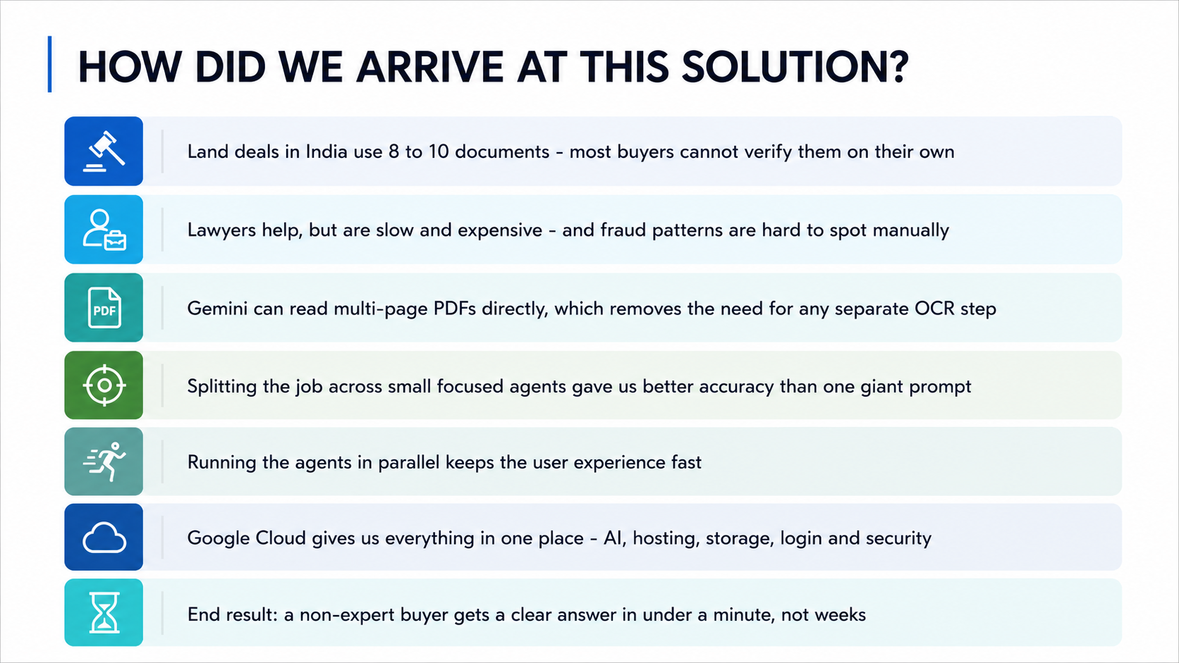
How did we arrive at this solution?
Land deals in India use 8 to 10 documents - most buyers cannot verify them on their own
Lawyers help, but are slow and expensive - and fraud patterns are hard to spot manually
Gemini can read multi-page PDFs directly, which removes the need for any separate OCR step
Splitting the job across small focused agents gave us better accuracy than one giant prompt
Running the agents in parallel keeps the user experience fast
Google Cloud gives us everything in one place - AI, hosting, storage, login and security
End result: a non-expert buyer gets a clear answer in under a minute, not weeks

Slide 12
Thank You
Landshield – Makes your land buying decisions smarter.

