Slide 1
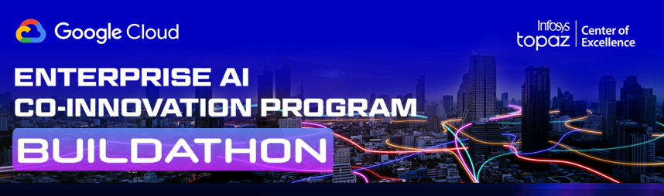


AI Agents in Action
Infosys Gemini Hackathon 2024 | Jun 07 – July 16
Agent development window is open from 24th Feb -14th March, 2025
Use case Name

Slide 2
TEAM and USE CASE
TEAM NAME | TEAM MEMBER NAME | EMAIL ID | DU
AI Altitude
Use Case details | Use Case: Code security vulnerability analysis Domain: Workforce Productivity Subdomain: Code Assist Use case description: Gen AI Agent to Scan and Verify the code is developed based on Secure SDLC Guideline. The Guidelines can be configured as JSON file. The agents will scan the packages listed in the code to verify any known security vulnerability reports exists on the internet.

Slide 3
Solution Design
Vertex AI Agent Builder: This will be the core of Agentic solution. It will orchestrate the tasks, interact with the user, and process the code and security guidelines. We'll use it to define the agent's actions (e.g., code scanning, vulnerability lookup, report generation).
Cloud Storage: Store the code repositories, the JSON security guidelines, and any generated reports.
Cloud Functions/Cloud Run: Implement custom logic for interacting with external tools (e.g., vulnerability databases, package managers). Cloud Run will be used for longer running process.
Vertex AI Models (Gemini): Will be utilized for natural language understanding, code analysis, and report generation.
External Vulnerability Databases (NVD, Snyk, GitHub Advisory Database): Provides vulnerability information for identified packages.
Cloud Logging & Monitoring: Track the agent's performance, errors, and user interactions.

Slide 4
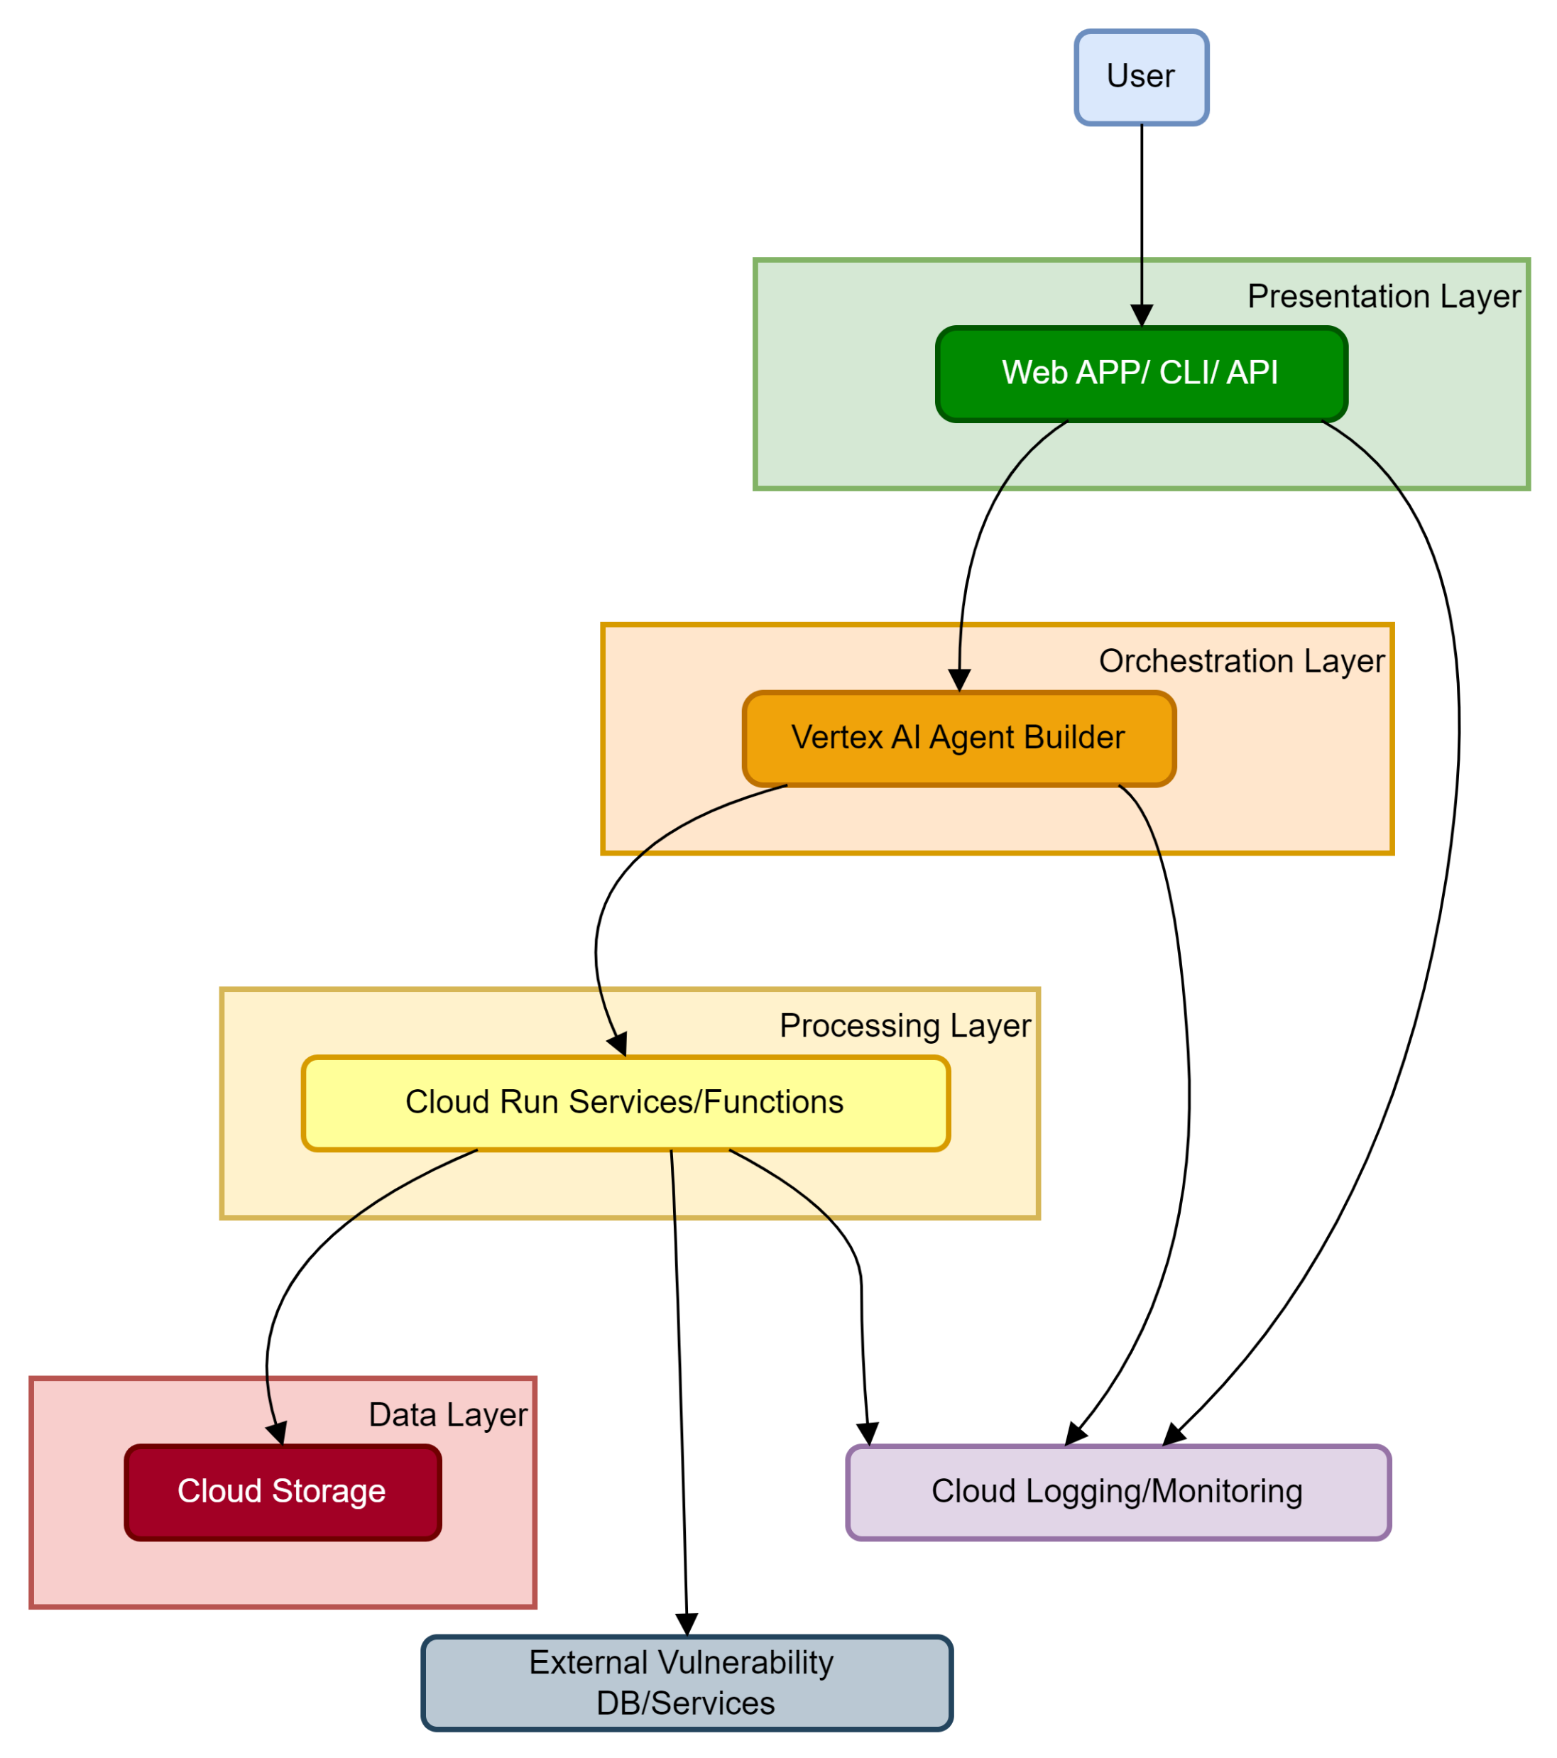
Solution Architecture (Diagram)
Presentation Layer (User Interaction): Presentation Layer comprises of the user interface (e.g., web app, CLI, API) that interacts with the user.
Orchestration Layer (Agent Management): Orchestration Layer has the Vertex AI Agent Builder, which manages the overall workflow and agent logic.
Processing Layer (Task Execution): Cloud Run services that perform specific tasks (vulnerability lookup, code analysis etc.).
Data Layer (Storage): Cloud Storage bucket that stores code, guidelines, and reports.
Cross-Cutting Concerns: Cloud Logging and Monitoring services that provide observability across all layers.
External services: External vulnerability databases that the Cloud Run services interact with.

Slide 5
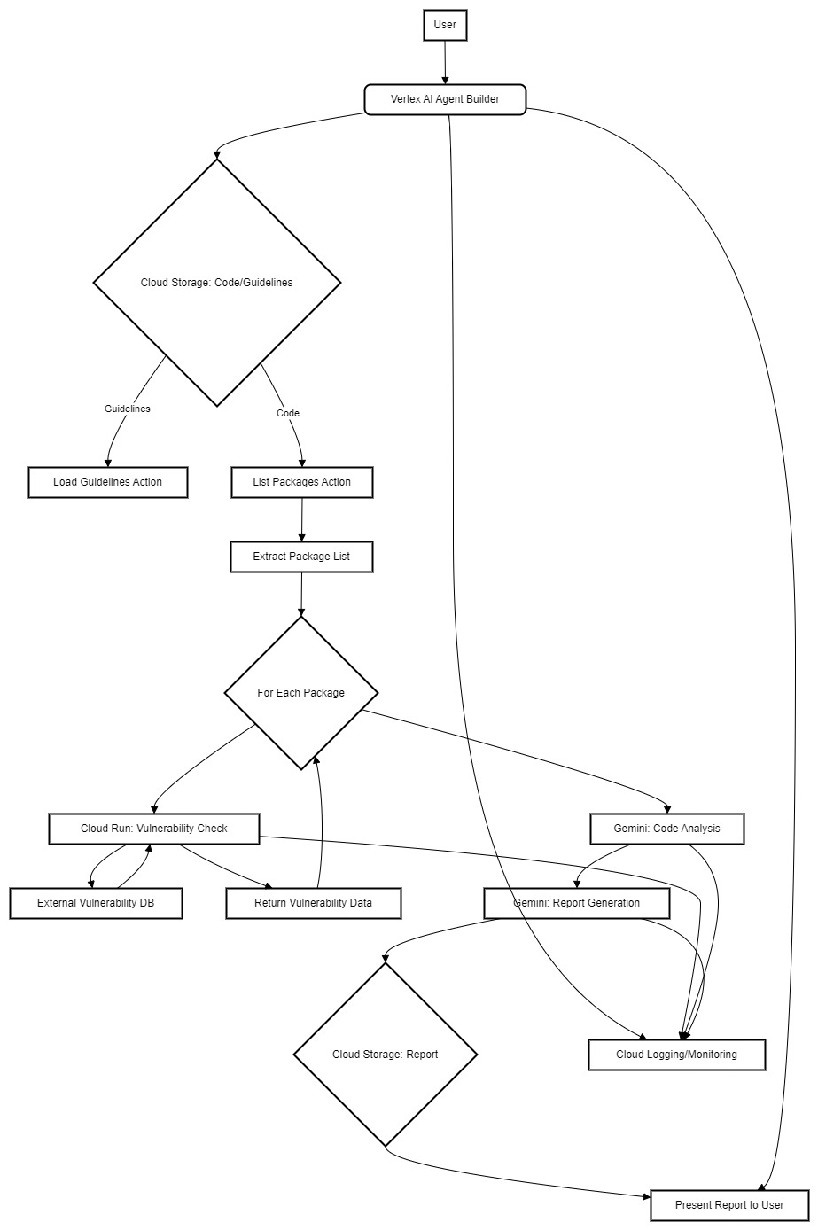
Data Flow with Flow diagram
User uploads code repository (or provides a link to it) to Cloud Storage.
User initiates the security analysis through the Vertex AI Agent.
Agent retrieves security guidelines from Cloud Storage.
Agent extracts package list from the code.
For each package, the agent triggers a tool in Cloud Run/Function to query vulnerability databases.
The tool returns vulnerability details to the agent.
Agent uses Gemini models to analyze the code against the security guidelines.
Agent compiles a report with vulnerability findings and code analysis results.
Agent stores the report in Cloud Storage.
Agent presents the report to the user.
Cloud logging and monitoring gather all the process logs, and metrics.

Slide 6
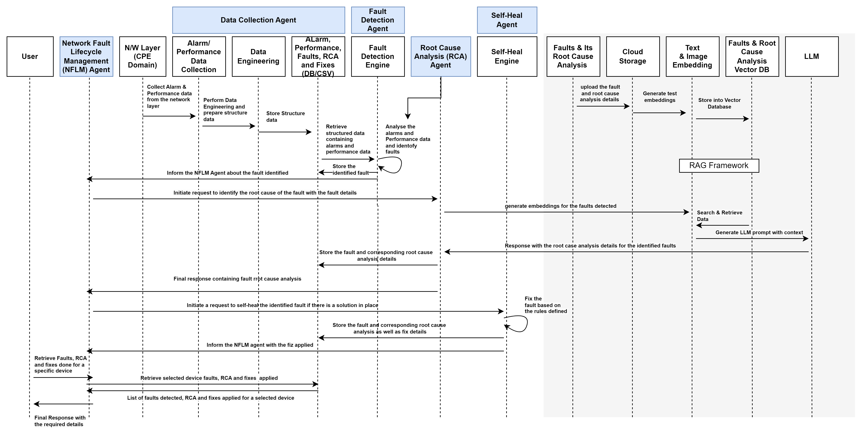
Technical Solution
SOLUTION ARCHITECTURE – FLOW DIAGRAM

Slide 7
Agent Design
Orchestration Agent (Vertex AI Agent Builder):
This is the primary agent, responsible for managing the overall workflow.
It acts as a coordinator, delegating tasks to other specialized agents or services.
It handles user interactions, manages the flow of information, and generates the final report.
It uses Gemini as its core reasoning and language model.
Specialized Agents/Services (Cloud Run):
These are task-specific agents or services deployed as Cloud Run containers.
They perform specific functions, such as vulnerability database queries or complex code analysis.
They communicate with the orchestration agent via API calls.
Agent Communication:
The orchestration agent communicates with the specialized agents/services via REST API calls.
Data is exchanged in JSON format.
This allows for loose coupling and scalability.

Slide 8
Agent Details
List down in the tabular format the agents you will build to develop this use case.
Agent Name | Agent Description | Google service used
Orchestrator Agent | Manages the overall workflow. Interprets user input. Calls other agents/services. Compiles and presents results. Handles user communication and provides the final output. | Vertex AI Agent Builder
Vulnerability Lookup Agent | Queries external vulnerability databases (NVD, Snyk, etc.). Retrieves vulnerability information for specific packages. | Cloud Run/Function
Code Retrieval Agent | Retrieves code from various sources, such as repositories (GitHub, Cloud Source Repositories) or local files. Handles authentication and authorization for accessing code repositories. | Cloud Run/Function
Code Analysis Agent | Performs deeper static analysis of the code. Checks for compliance with specific security guidelines. May use static analysis tools. | Cloud Run/Function
Reporting Agent | Compiles the results from the analysis agent and presents them in a clear and concise format. Generating and formatting the security analysis reports. Integrates with reporting tools and platforms. | Cloud Run/Function

Slide 9
Deployment
User Interface:
Web interface can be deployed using Cloud Run or App Engine.
API interface cab be deployed using Cloud Run and accessed via API gateway.
Vertex AI Agent: Deployed directly through the Vertex AI Agent Builder console.
Cloud Run/Function:
Containerize the vulnerability lookup and code analysis logic. Deploy the container to Cloud Run.
Create short running simpler tools in Cloud Function
Cloud Storage: Cloud Storage bucket to store code, guidelines, and reports.
Artifact Registry: Container image storage for Cloud Run deployments.
Secrets Manager: Configure environment variables for API keys and database connections.
Cloud Logging: Centralized logging for all components.
Cloud Monitoring: Performance monitoring, alerting, and metrics collection.
Identity and Access Management (IAM): Access control and security for GCP resources.

Slide 10
Google Technology Stack
Vertex AI:
Vertex AI Agent Builder: Core agent orchestration and flow management.
AI Models: Natural language processing, code analysis, and report generation.
Cloud Storage: Storage for code repositories, JSON security guidelines, and generated reports.
Cloud Run: Containerized deployment for custom logic (vulnerability lookup, complex code analysis).
Cloud Logging: Centralized logging for all components.
Cloud Monitoring: Performance monitoring, alerting, and metrics collection.
Identity and Access Management (IAM): Access control and security for GCP resources.
Artifact Registry: Container image storage for Cloud Run deployments.
Secret Manager: Secure storage for API keys and sensitive information.
API Gateway (Optional): API management for exposing the agent's functionality.

Slide 11
How did you arrive at this solution?
Requirement Analysis:
The primary requirement was to build an agent that could analyze code for security vulnerabilities based on configurable guidelines.
The need to interact with external vulnerability databases and perform complex code analysis led to the use of Cloud Run.
GCP Ecosystem:
Vertex AI Agent Builder was chosen for its ability to create and manage conversational AI agents.
Cloud Storage was selected for its scalable and cost-effective storage capabilities.
Cloud Run was selected for its ability to run containerized applications with ease.
Gemini was selected for its advanced code analysis and natural language capabilities.
Scalability and Reliability:
Cloud Run provides a scalable and reliable environment for running custom logic.
Cloud Storage offers durable and highly available storage.
Cloud logging and monitoring provide observability.

Slide 12
Thank you

