Slide 1

BUNDELKHAND UNIVERSITY, JHANSI
INSTITUTE OF ENGINEERING AND TECHNOLOGY
A PROJECT PRESENTATION ON
“PIXELVAULT - A MARKETPLACE FOR NFT”
DEPARTMENT OF COMPUTER SCIENCE AND ENGINEERING
GUIDED BY
Er. Manoj Verma
Assistant Professor
Dept. of Computer Science & Engg.
IET BU, Jhansi
COORDINATOR
Er. Priyanka Pande
Head of Department
Dept. of Computer Science & Engg.
IET BU, Jhansi
PROJECT IN CHARGE
Dr. Sadik Khan
Assistant Professor
Dept. of Computer Science & Engg.
IET BU, Jhansi
SUBMITTED BY : Group2324-CSE01
1. Abhay Singh – 201381030001
2. Abhishek Singh – 201381030004 (Leader)
3. Aditya Gautam – 201381030007
4. Aditya Raj Pathak – 201381030008
5. Amarendra Singh Yadav – 201381030013
6. Tanu – 191381030060

Slide 2

Introduction to PixelVault
PixelVault is a straightforward gateway to the world of NFTs. It's a marketplace where digital creators and collectors meet, offering a practical space to discover, trade, and own digital assets. With a clean interface and easy connectivity to wallets like MetaMask, PixelVault simplifies the process of buying, selling, and even swapping NFTs. It's a platform designed for those who appreciate digital art without unnecessary frills. Join PixelVault for a no-nonsense approach to NFT trading, where simplicity and functionality take center stage.

Slide 3




What is a NFT?
An NFT, or Non-Fungible Token, is a type of digital asset that represents ownership or proof of authenticity of a unique item or piece of content using blockchain technology. Unlike fungible tokens such as cryptocurrencies (e.g., Bitcoin or Ethereum), each NFT is distinct and cannot be exchanged on a one-to-one basis with another token. NFTs are often used to represent digital art, collectibles, music, videos, virtual real estate, and other digital creations. The ownership and transaction history of NFTs are recorded on a blockchain, providing transparency and verifiable proof of ownership. The popularity of NFTs has grown significantly in various creative industries, allowing artists and creators to monetize their digital works and providing collectors with a new way to own and trade unique digital assets.

Slide 4
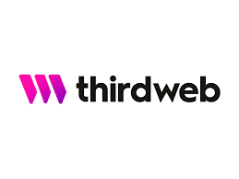


Technologies Used
Third Web:
Connects with wallets for blockchain interactions.
Facilitates secure purchases and transactions.
Manages user authentication and authorization for wallet-related actions.
Next.js:
Efficient Frontend Development with React.
Server-side Rendering for improved performance.
Dynamic and responsive user interfaces.
Third Web (Wallet Integration):
MongoDB:
MongoDB is a popular document database that stores data in a flexible, JSON-like format called BSON.
Unlike traditional relational databases, MongoDB doesn’t require a fixed schema.
MongoDB offers a fully managed cloud service called Atlas, which allows you to start using MongoDB in seconds.

Slide 5
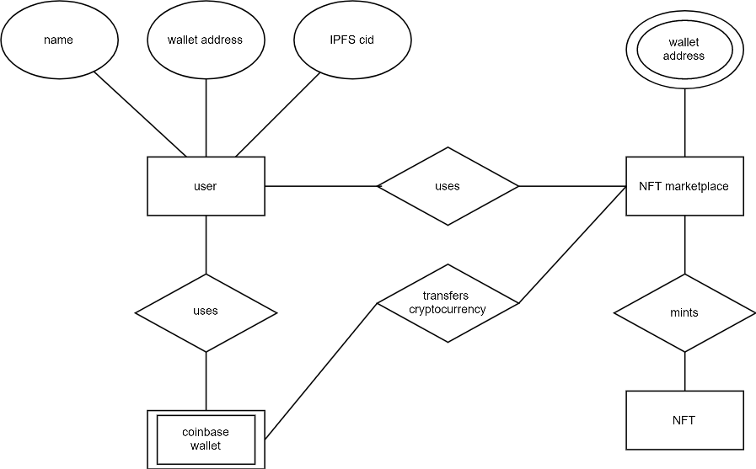
ER Diagram

Slide 6
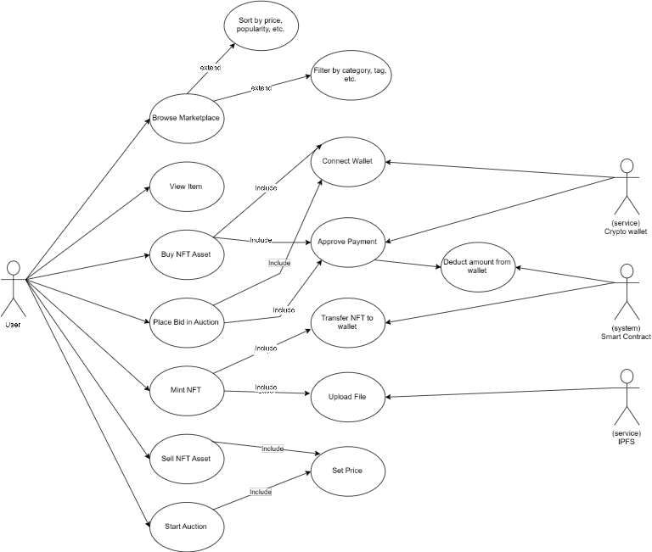
UML Diagram

Slide 7
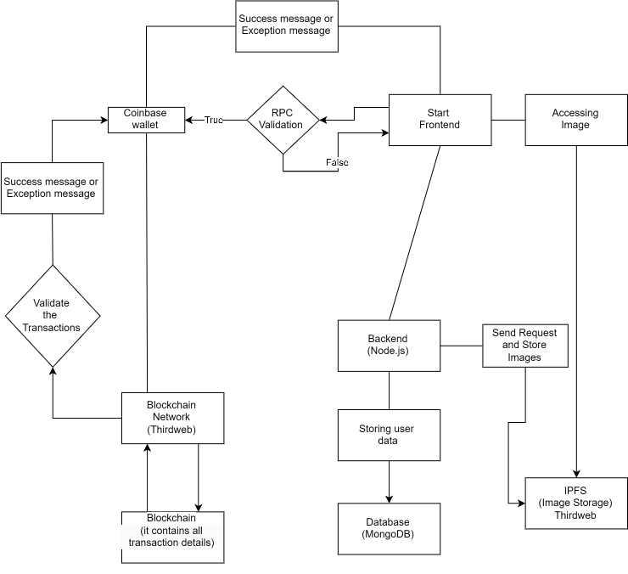
DFD Diagram

Slide 8
Trading and Exchange
6.Sell NFTs:
List NFTs for sale with specified prices. Wait for potential buyers to make transactions.
7.Auctions and Bidding:
Participate in auctions by placing bids on NFTs. The highest bidder wins the item.
8.Swapping or Exchanging:
Explore features for swapping or exchanging NFTs directly with other users on the platform.
9.Transaction Confirmations:
Confirm transactions through your connected digital wallet. Verify funds and review associated fees.
10.Ownership and Transfers:
NFT ownership transfers on the blockchain. Confirm changes in ownership within your wallet.
Access PixelVault Web App:
Go to the PixelVault web app.
Explore NFT Marketplace:
Navigate the marketplace to discover featured and trending NFTs.
View NFT Details:
Click on an NFT to see its details, including description, creator info, and pricing.
Connect Digital Wallet:
Connect your digital wallet, such as MetaMask, to trade or exchange NFTs.
Buy NFTs:
Purchase NFTs directly from the marketplace. Confirm the transaction through your wallet.

Slide 9
Advantages
Community Engagement:
Features to foster a community, such as forums, discussions, or social aspects.
Auction and Bidding:
Capability for users to participate in auctions and place bids on NFTs.
Customizable Content:
Ability for creators to customize and describe their NFTs with metadata.
Transparent Ownership Records:
Utilization of blockchain for transparent and verifiable ownership records

Slide 10
Disadvantages
Limited User Base:
Challenges if the platform has a smaller user base compared to larger marketplaces.
Transaction Fees:
Possible fees associated with buying, selling, or trading NFTs on the platform.
Scalability Concerns:
Issues with scalability if the platform experiences rapid growth.
Security Risks:
Security vulnerabilities or risks associated with wallet integration.
Limited Asset Variety:
Potential limitations in the types or variety of NFTs available.

Slide 11
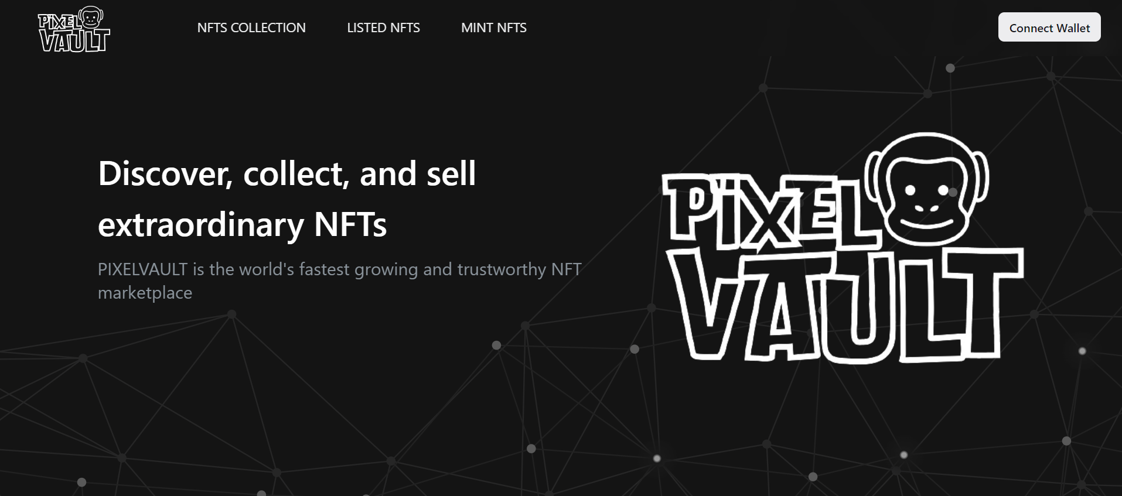
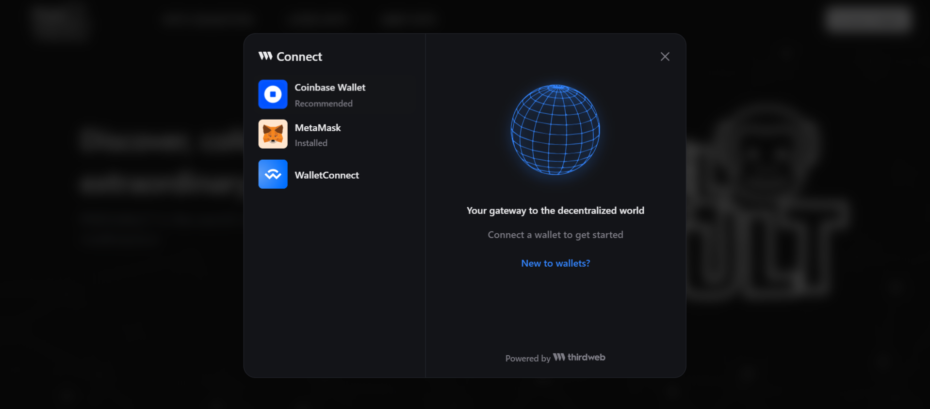
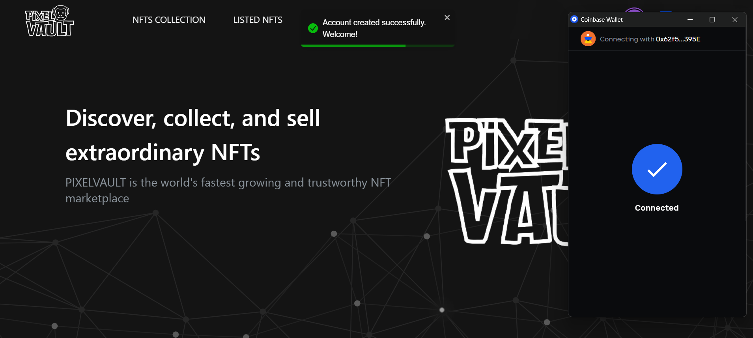
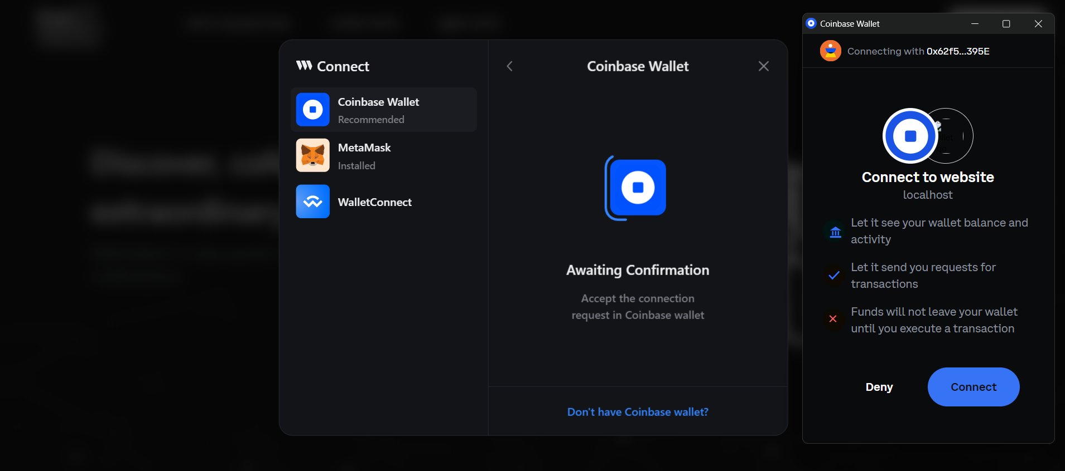
Creating a PixelVault Account
Open the web application :
Locate the "Connect Wallet" Button
Choose a Wallet
Connect Your Wallet
Authorize Access
Wallet Connected
Successful Login

Slide 12
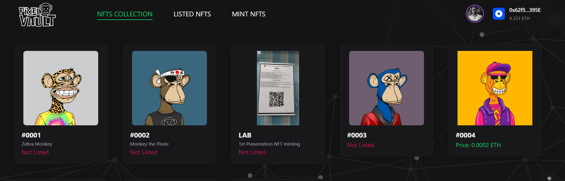
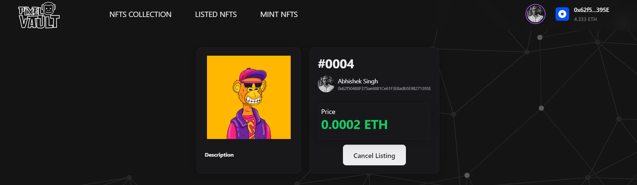
Exploring the NFT Marketplace
Go to the web application
Explore featured and trending NFTs on the homepage.
Click on an NFT to access details like description, creator, and price.
Connect your digital wallet to engage in buying or bidding on NFTs.
Discover diverse collections and artists for a wide range of NFT options.

Slide 13
Let’s Navigate Pixelvault Web App

Slide 14
Thank You

