Slide 1
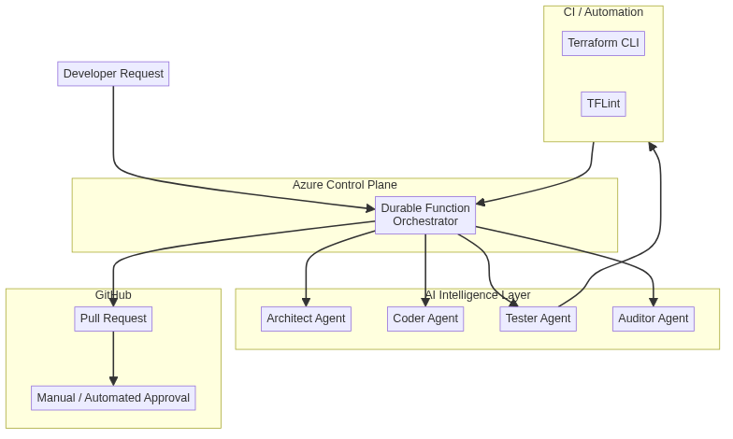
CI/CD Reference Architecture
Customer Context (Editable)
• CI/CD Tool:
• Cloud:
• Security:
• Notes:
Reference Architecture (Generated) – Do not modify structure

