Slide 1
CS-3404: Minor Project
A comparative study of clustering algorithms for Blog tag networks
Done by,
Abhijith V Mohan
10400EN001
CSE IDD-Part 3
Under the guidance of Prof. Bhaskar Biswas

Slide 2
Objective
To implement the following 2 clustering algorithms:
  Markov Clustering(MCL)
  K Clique Maximal percolation
To cluster the given data of blogs based upon their tags using both the algorithms and compare the results in terms of performance, and the quality of clusters generated

Slide 3

Input Dataset
The input dataset was a list of blogs with their corresponding tags.
A tag graph was constructed from those nodes where the blogs and there where edges between two nodes who shared any tag
If the tag set of the blog corresponding to node i is denotes as Ti, then the weight of edge connecting nodes i & j expressed as percentage is given by the formula:

Slide 4
Clustering
A cluster/community is a subgraph of a graph which has an intra cluster link density much higher and inter cluster link density much lower than the average link density of the graph.
Intuitively, a node in a cluster has more edges to nodes within the clusters than to other nodes.

Slide 5
Why clustering?
Recognising patterns and relations within the data
Clustering Web clients who have similar interests and are geographically near to each other
Identifying customer clusters with similar interests allows online retailers (such as flipkart.com) to set up efficient recommendation systems
Ad­hoc wireless networks usually have no centrally maintained routing tables. Clustering the nodes enables one to route through efficient paths and at the same time have compact routing tables

Slide 6
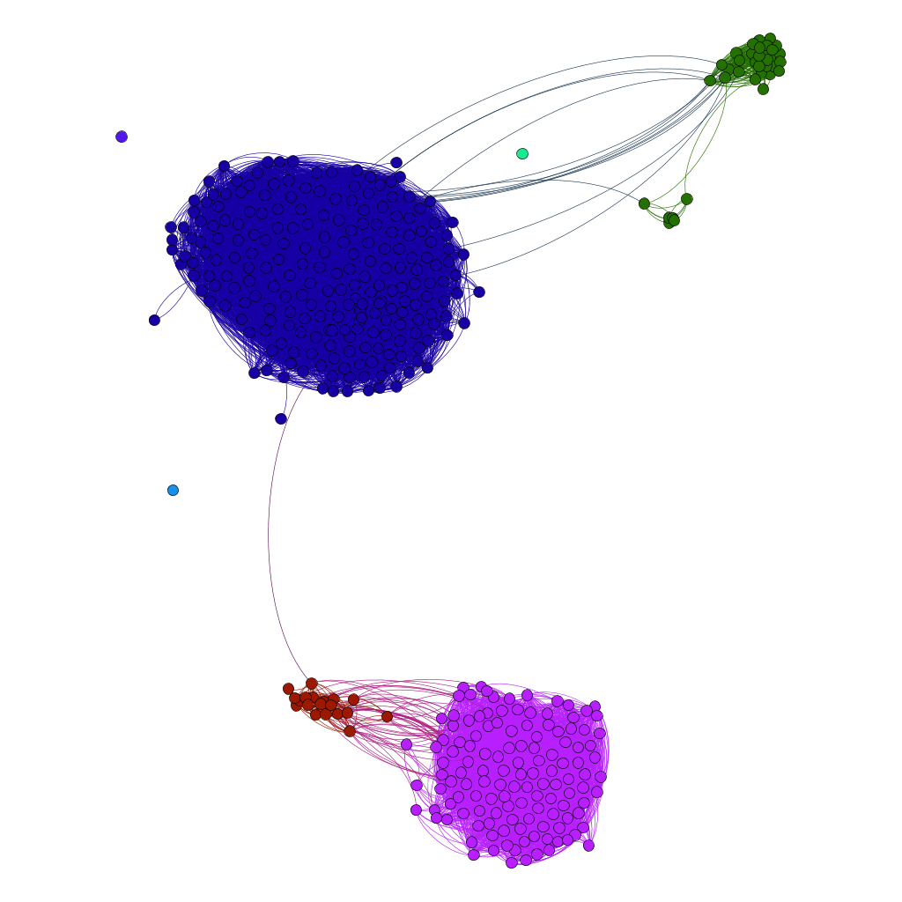
Clustering applied to an FB network

Slide 7
Markov Clustering

Slide 8
Algorithm
Column normalize the matrix
While the steady state has not been reached:
  Expand(W,e)
  Inflate(W,i)
Interpret the resulting matrix as the adjacency matrix of a graph whose connected components are the clusters in the original graph

Slide 9
Expansion parameter
The expansion parameter is the length of each random walk before the inflation process is applied to the matrix to deteriorate the weak probabilities further
It does not have a very strong effect on the result compared to the inflation parameter

Slide 10
Inflation parameter
The inflation parameter, i has a strong effect on the granularity of the clusters
The weaker transition probabilites drop to zero with higher value of inflation parameter
With higher i value, the members of any cluster are more strongly related.
It has no physical meaning unlike the expansion parameter

Slide 11
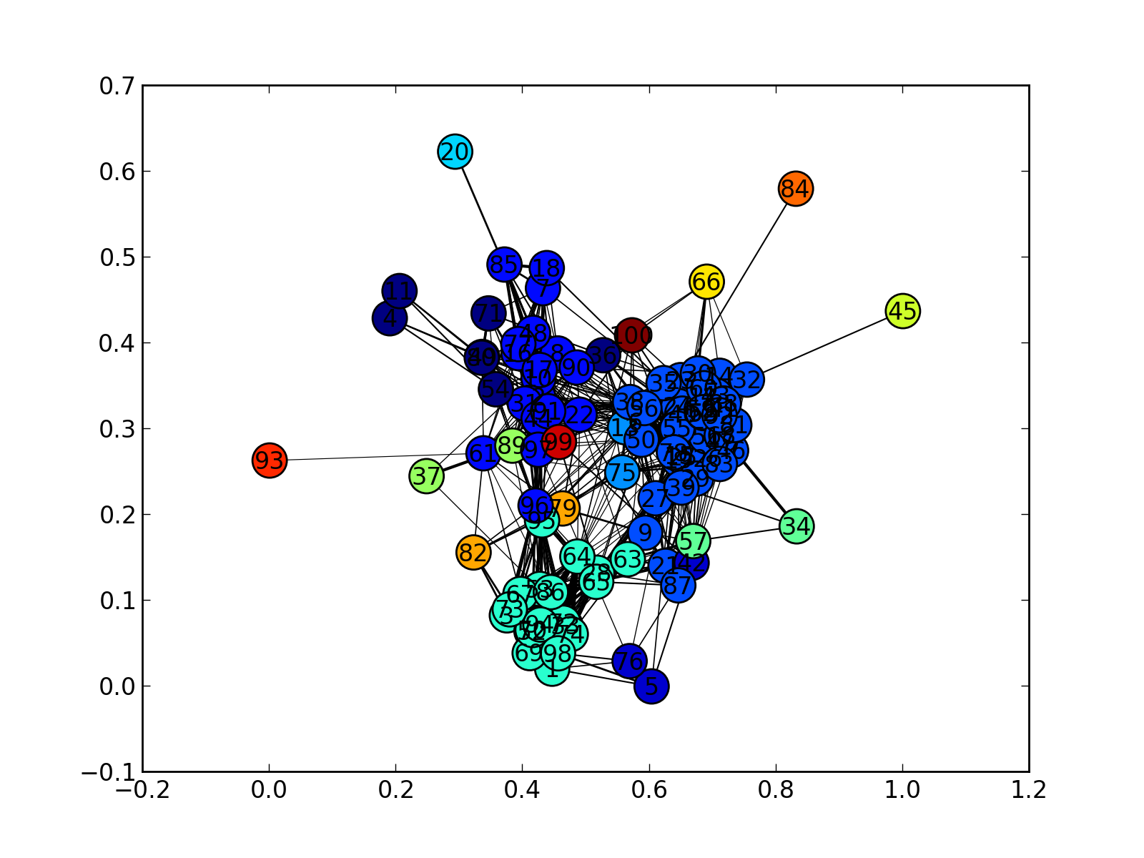
n=100, e=2, i=2
16 clusters, 4 with min 5 nodes

Slide 12
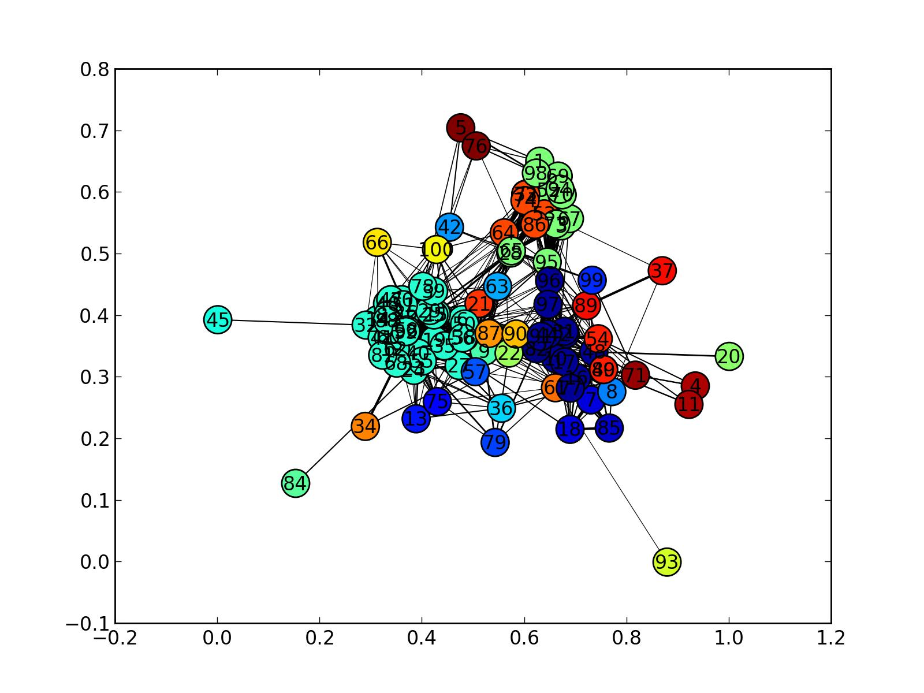
n=100, e=2, i=5
34 clusters, 4 with min 5 nodes

Slide 13
Features of MCL
O(N³) time complexity (expansion is O(N³) and inflation is O(N²) )
It has a natural parameter to influence cluster granularity
Easily scalable and parallelizable

Slide 14
K Clique Clustering

Slide 15
Algorithm
Given K and the graph G.
Find C = the set of all K-cliques in G.
Find the set of all maximal unions of adjacent K-cliques. 2 K-cliques are adjacent if they have K-1 nodes in common
Each such union corresponds to a cluster in the graph.

Slide 16
Some considerations
Some of the nodes may not be a member of any K-cliques. In that case, that node will not be a part of any cluster
Some nodes may be part of more than one maximal union of adjacent K-cliques. In that case, the node will be a part of more than one cluster
So the K-Clique clustering generates a cover rather than a partitioning.

Slide 17
N=100, K=10
{2 6 10 77 16 17 22 89 90 91 80 31 96 97 38 44 48 49 50 54 56 61 95}
{6 12 13 14 15 19 23 24 25 26 27 29 30 32 35 38 39 40 41 43 46 47 50 51 55 56 58 59 60 62 68 75 78 81 83 88 92}
2 clusters were formed. It can be seen that some nodes are present in both and some are in neither of them.

Slide 18
The parameter K
If K=1, then every node on the graph is a part of the same cluster and the whole graph becomes a single graph
If K=2, then every node other than the single nodes are part of a cluster. Each cluster corresponds to a connected component on the graph
For large values of K, K-cliques may not be found especially in sparse graphs. Many nodes in such a case may not be a part of either cluster

Slide 19
Conclusion
The 9614 node blogger dataset has 5 clusters with at least 100 nodes in them
Of these 5, 2 clusters contain more than 1000 nodes in each (3108 & 2011 nodes respectively)
So there are 2 major clusters in the dataset.

Slide 20


Implementation details
Both algorithms were implemented in python with the aid of the following scientific computing libraries
  Networkx, a graph library
  Scipy, a scientific computing library
  Matplotlib, a plotting library

Slide 21
End

