Slide 1




Spotify Lintening Analysis Dashboard
View in Power BI
A deep dive into user listening behavior
Abhinav Kadam
Date: June 2025

Slide 2
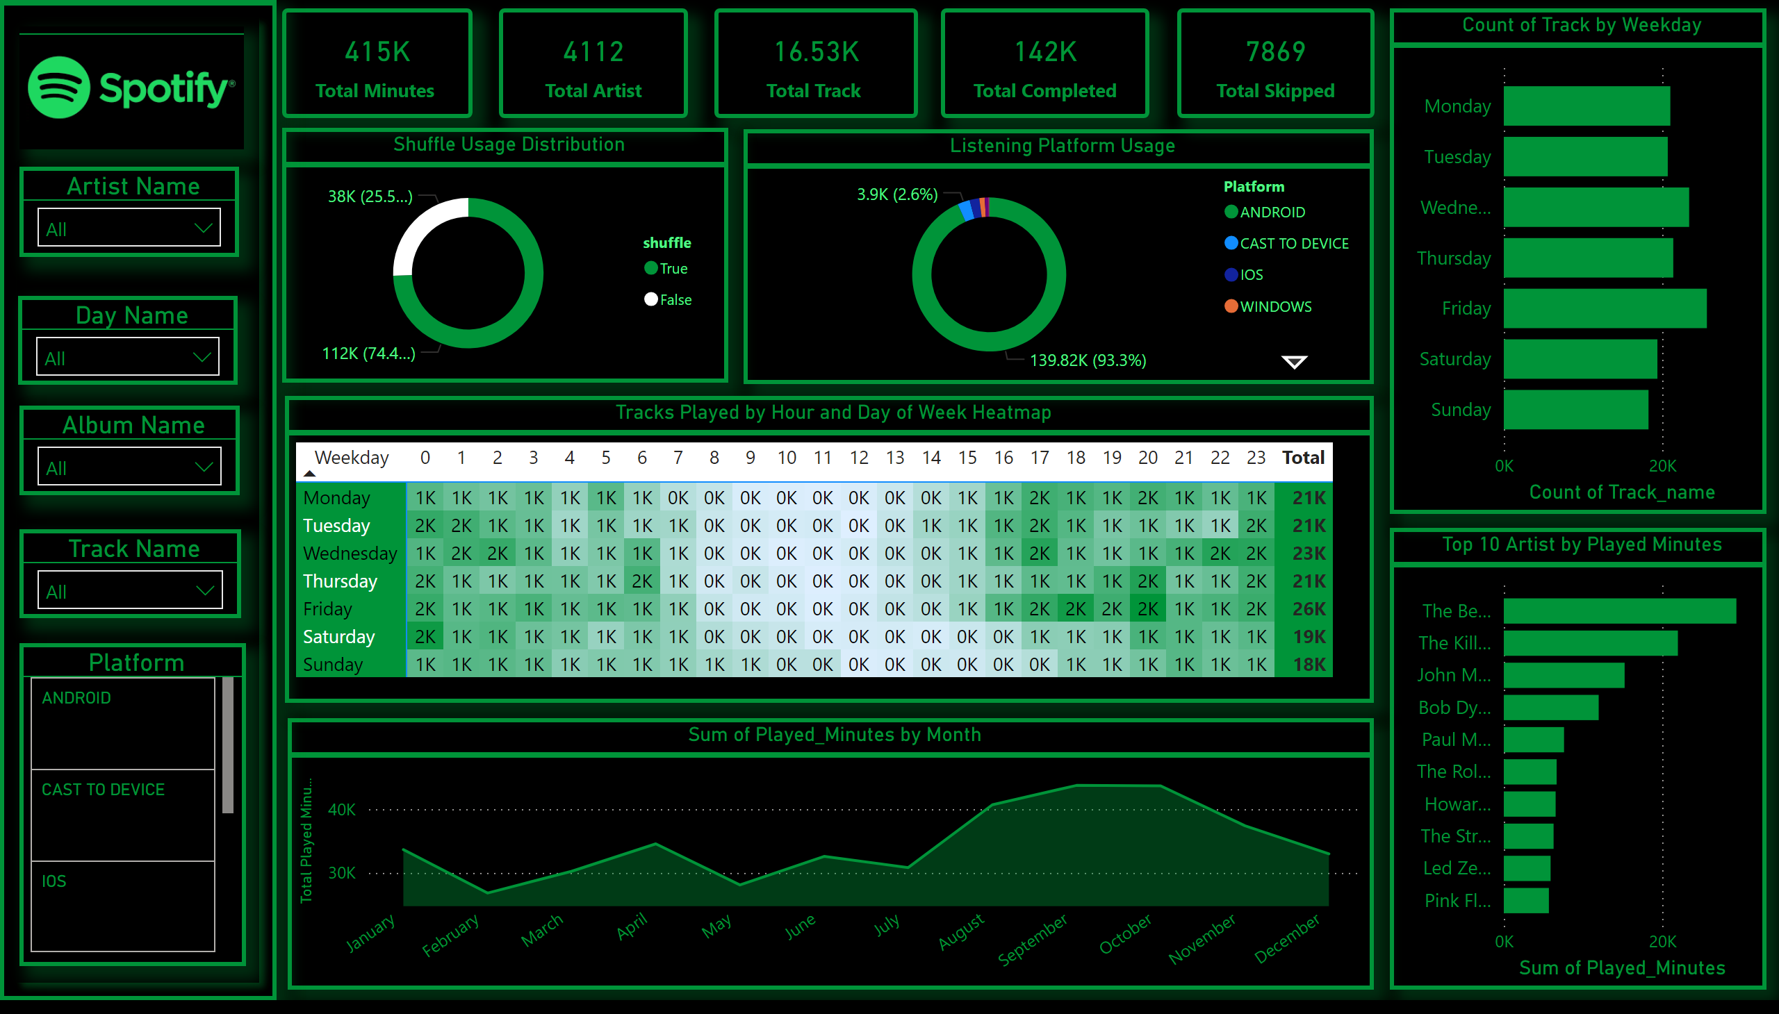
Page 1
Dashboard
This dashboard analyzes over 415,000 minutes of Spotify listening data, focusing on usage patterns by time, device, artist, and track completion behavior.
Notes:
Total Minutes Played
No alt text provided
Total Minutes Played
No alt text provided
Total Minutes Played
No alt text provided
Total Minutes Played
No alt text provided
Total Minutes Played
No alt text provided
lineChart
No alt text provided
image
No alt text provided
shape
No alt text provided
advancedSlicerVisual
No alt text provided
Shuffle Usage Distribution
No alt text provided
Listening Platform Usage
No alt text provided
Artist Name
No alt text provided
Day Name
No alt text provided
Top 10 Artist by Played Minutes
No alt text provided
Count of Track by Weekday
No alt text provided
Tracks Played by Hour and Day of Week Heatmap
No alt text provided
Album Name
No alt text provided
Track Name
No alt text provided

Slide 3
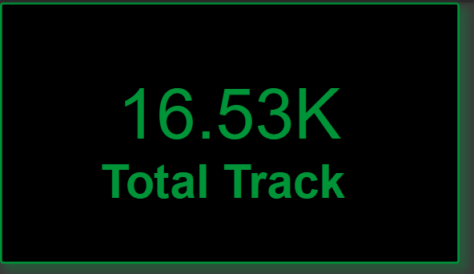
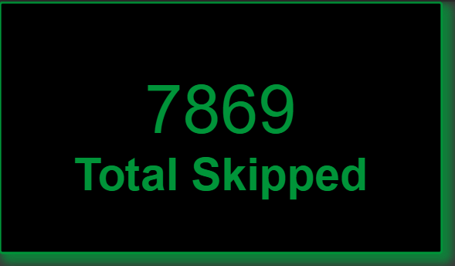
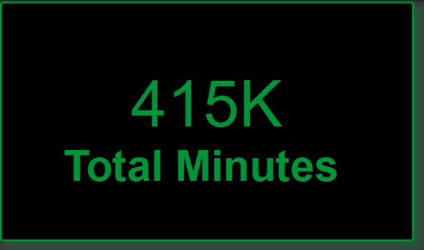
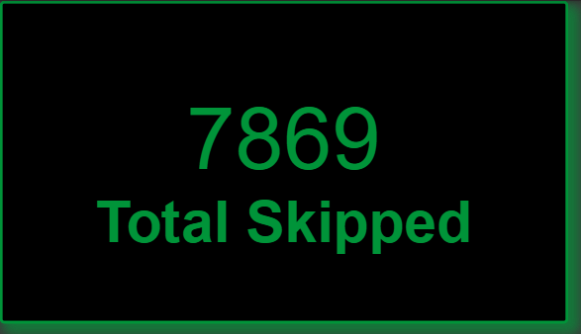
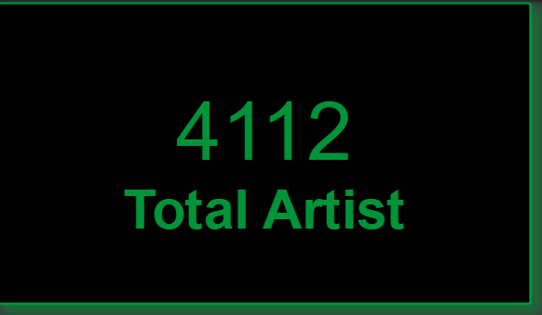
Key Metrics
Visual Elements: KPI Cards
The user has listened to over 415,000 minutes of music, covering 16.5K tracks across 4,112 artists. Most tracks were completed, with a relatively low skip rate, indicating high engagement.

Slide 4
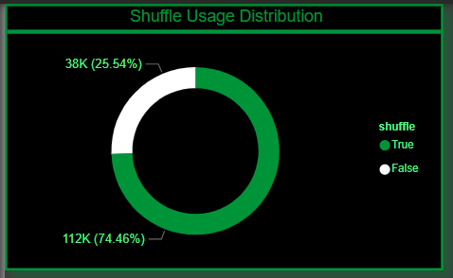
Shuffle Usage Distribution
Visual Type: Donut Chart
Shuffle mode was used in 25.5% of plays, with 112K plays in non-shuffle mode. This suggests a preference for linear or album-style listening.

Slide 5
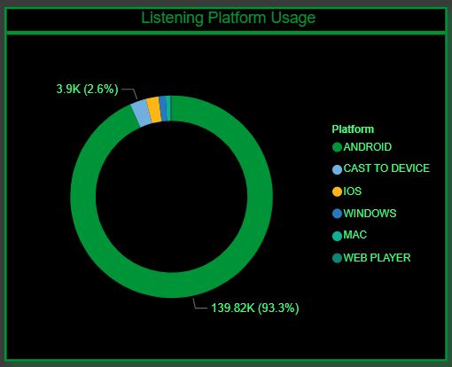
Platform Usage
Visual Type: Donut Chart
93.3% of listening occurred on Android devices, showing a dominant mobile-first behavior. Other platforms like iOS, Cast, and Windows have minimal share.

Slide 6
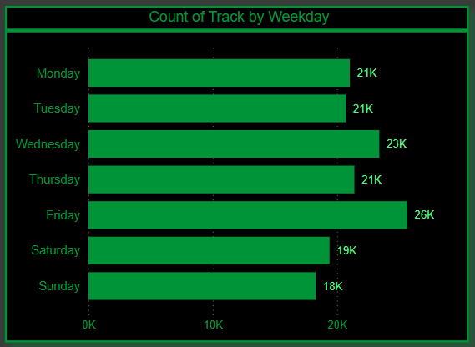
Listening Patterns by Weekday
Visual Type: Bar Chart
Listening peaked on Fridays (over 26K tracks), suggesting more leisure time or end-of-week mood. Sunday and Saturday had lower counts, possibly due to other offline activities.

Slide 7
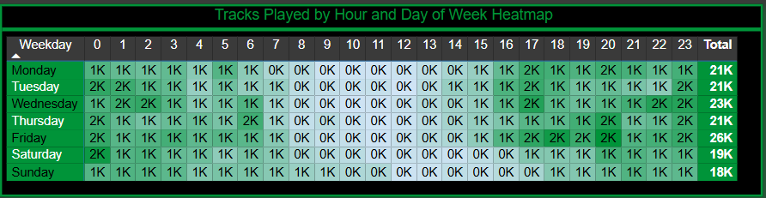
Heatmap – Tracks by Hour and Weekday
Visual Type: Matrix Heatmap
Most active listening hours are between 16:00 to 21:00 across weekdays. Friday and Thursday evenings stand out, hinting at winding-down routines.

Slide 8
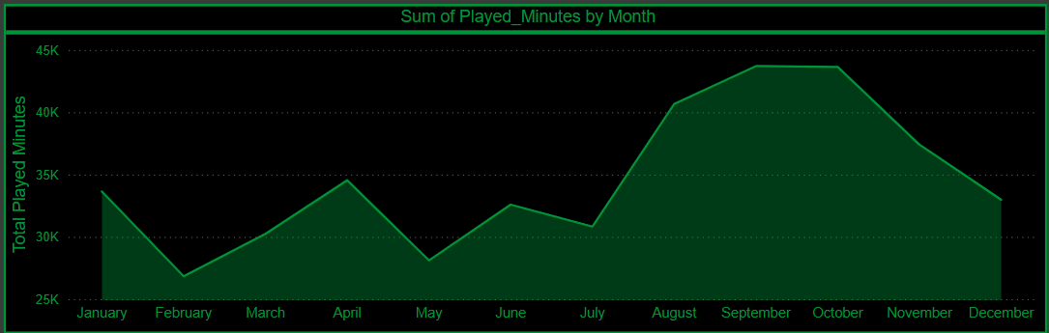
Monthly Listening Trend
Visual Type: Area Chart
Listening time peaked in September and October, with a gradual dip in December. This might align with academic or personal life patterns.

Slide 9
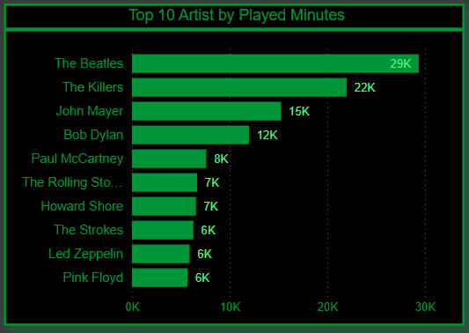
Top 10 Artists by Minutes
Visual Type: Bar Chart
The Beatles dominate listening time, followed by The Killers and John Mayer. This indicates strong artist loyalty and preference for classic/alternative rock.

