Slide 1

Face-Mask-Detection-for-ATM-Security
Presented by:
Pro. Kajari Sur(Mentor)
Professor ,IT- department
Institute of engineering and management
Abhishek Anand
12019002004044
Institute of engineering and management
Jay Prakash Pandey
12019002004044
Institute of engineering and management
Rohan Das
1201900204440
Institute of engineering and management

Slide 2
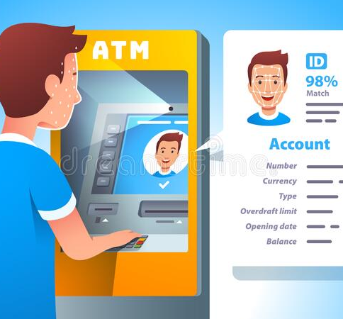
1.Introduction
Automated Teller Machine is a computerized machine that provides the customers of banks the facility of accessing their accounts for dispensing cash and to carry out other financial transactions without the need of actually visiting a bank branch.
Services available through an ATM include:
Make deposits of cash and checks.
Withdraw cash.
Transfer money between accounts.
Obtain account balance

Slide 3
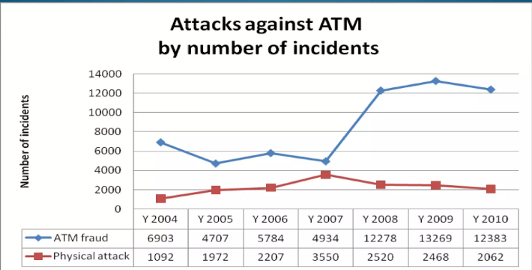
Why we need this project
As we can see from data collected by RBI from 2004-2010 there is exponential increase of ATM attacks, we come with solution which provides:
Security: Our Project provides a higher level of security.
Reliable: Our model is more reliable in providing security by using image processing,which avoids the various attacks in ATM system.
AI model : The chance given for hackers to make use of covered face is strictly avoided, which makes ATM more secure.
Low cost: This required less amount of hardware and easy to implement anywhere.
IOT: Internet of things our model make easy to interact with system and take action as need which use M2M service.

Slide 4
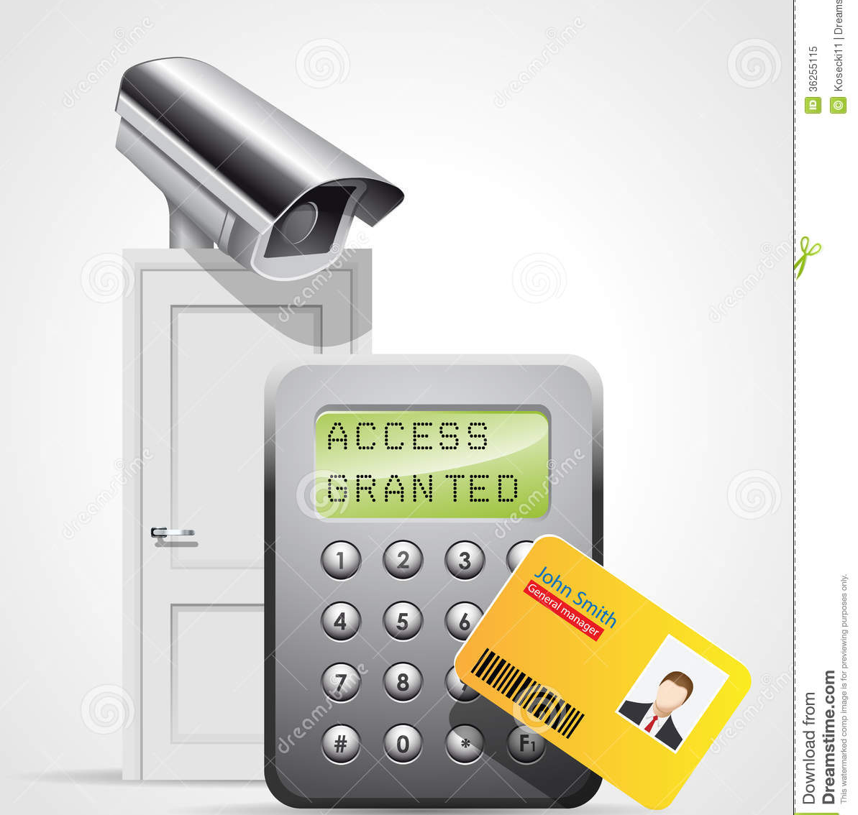
Features
Surveillance camera.
Auto Detect and Warnings.
Recognition and validation of person.
Doors that automatically lock if there is an attempt to break open the machine.

Slide 5
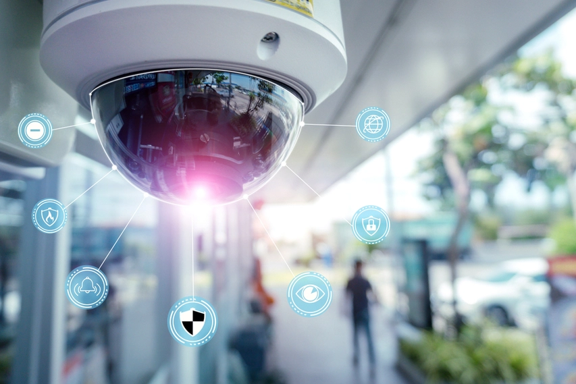
APPLICATION
Time and Attendance system
Airports
Libraries
Gym
Schools and colleges
Offices

Slide 6



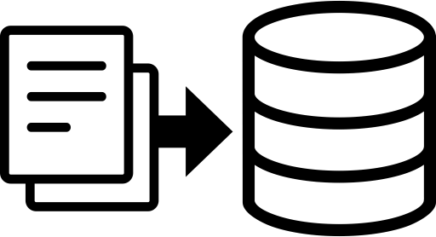

METHODOLOGY(Flowchart of the Algorithm)
Append Image Arrays
20% Image for Test
80% Image for Training
Input Image
Convolution
Max Pooling
Fully Connected
Output
Base Model
Read Model
Pre-Trained Weight
Using MobileNet
METHODOLOGY Through the IDEAS (Steps involved in the Process)
Detection of Mask or Without Mask
Give Output in a Frame
2
4
1
3
5
Decision Making
Accessibility
Read Image and decide whether the person is with or without face mask using the algorithm.
Upload the Fetched Data into the Clouds to Ensure Easy Accessibility while working with it.
Sharing the Data
Image Detection
Encapsulation
of the Data
Publishing the Information about the % of people wearing mask or not in a particular area through app or website.
At First, The Trained Model detects Human Faces from a Live Video
Collect the Cumulative Data of the People both with or without Face Mask

Slide 7
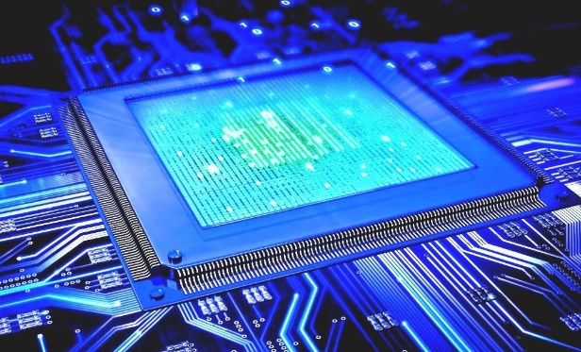
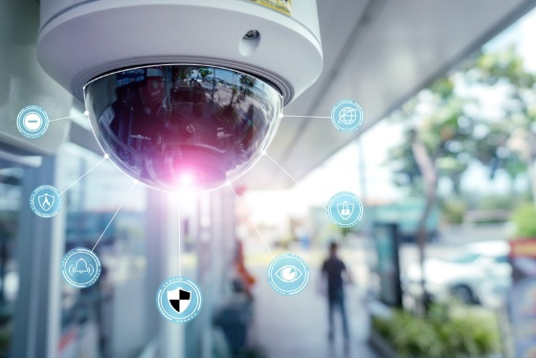
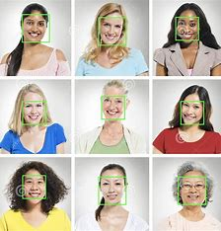
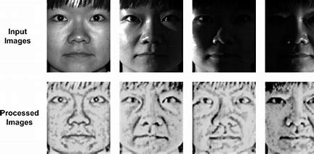
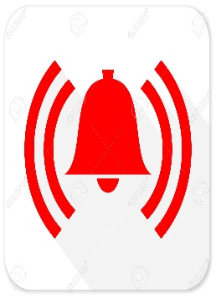
Working Model
Capture image/video
Detect Faces in stream and crop faces of 120x120.
Extract each Face ROI
Apply model to each face ROI
Load classifier model
Alarm if covered or threat detected.

Slide 8
Future Works
Add features to Recognise the persons id.
Save Persons snapshots if threaten find with time stamp.
Infrared camera to capture more accurate in night also.

Slide 9
19.
"Keras documentation: About Keras", 2020, [online] Available: Keras.io.
Show in Context Google Scholar
20.
"OpenCV", 2020, [online] Available: Opencv.org.
Show in Context Google Scholar
21.
D. Meena and R. Sharan, "An approach to face detection and recognition", 2016 International Conference on Recent Advances and Innovations in Engineering (ICRAIE), pp. 1-6, 2016.
Show in Context Google Scholar
22.
S. Ge, J. Li, Q. Ye and Z. Luo, "Detecting Masked Faces in the Wild with LLE-CNNs", 2017 IEEE Conference on Computer Vision and Pattern Recognition (CVPR), pp. 426-434, 2017.
References
1. "Coronavirus disease 2019 (covid-19): situation report 205", 2020.
2. "Coronavirus Disease 2019 (COVID-19) – Symptoms", Centers for Disease Control and Prevention, 2020, [online] Available: https://www.cdc.gov/coronavirus/2019-ncov/symptoms-testing/symptoms.html.
3. "Coronavirus — Human Coronavirus Types — CDC", 2020, [online] Available: Cdc.gov
4. "Advice on the use of masks in the context of COVID-19: interim guidance", 2020.
5. M. Jiang, X. Fan and H. Yan, "RetinaMask: A Face Mask detector", 2020, [online] Available: arXiv.org.
6. B. Suvarnamukhi and M. Seshashayee, "Big Data Concepts and Techniques in Data Processing", International Journal of Computer Sciences and Engineering, vol. 6, no. 10, pp. 712-714, 2018.
7. F. Hohman, M. Kahng, R. Pienta and D. H. Chau, "Visual Analytics in Deep Learning: An Interrogative Survey for the Next Frontiers", IEEE Transactions on Visualization and Computer Graphics, vol. 25, no. 8, pp. 2674-2693, Aug. 2019.
8. C. Kanan and G. Cottrell, "Color-to-Grayscale: Does the Method Matter in Image Recognition?", PLoS ONE, vol. 7, no. 1, pp. e29740, 2012.
9. "Changing Colorspaces — Opencv-Python Tutorials 1 Documentation", 2020, [online] Available: Opencv-python-tutroals.readthedocs.io.
10. M. Hashemi, "Enlarging smaller images before inputting into convolutional neural network: zero-padding vs. interpolation", Journal of Big Data, vol. 6, no. 1, pp. 2019.
11. WS. Ghosh, N. Das and M. Nasipuri, "Reshaping inputs for convolutional neural network: Some common and uncommon methods", Pattern Recognition, vol. 93, pp. 79-94, 2019.

