Slide 1
Recognize Food Images using SIFT
Abhianshu Singla
ab808557

Slide 2
SIFT – Scale Invariant Feature Transform
Scale-space extrema detection: Searches over all scales and image locations using difference-of-Gaussian (DoG) function to identify potential interest points that are invariant to scale and orientation.
Key point localization: Initial Rejection - Discard low contrast key points Outlier Rejection – Reject less stable or far away key points using Hessian Matrix
Orientation assignment: Assign one or more orientations to each key point based on local image gradient directions.
Key point descriptor: Local image gradients are measured at the selected scale in the region around each key point. These are transformed into a representation (8 bin histogram) that allows for significant levels of local shape distortion and change in illumination. Each key point has a descriptor of length 128.

Slide 3
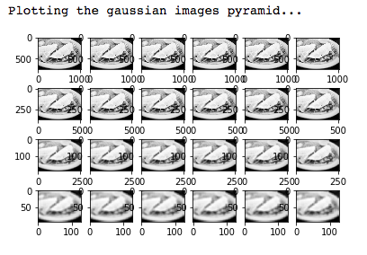
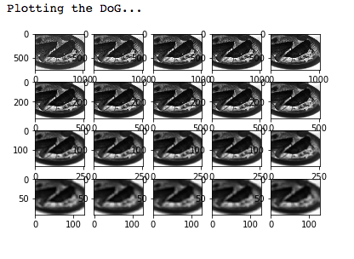
Gaussian Images and Difference of Gaussian

Slide 4
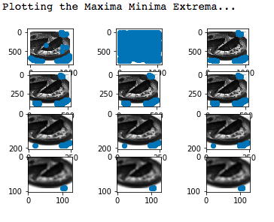
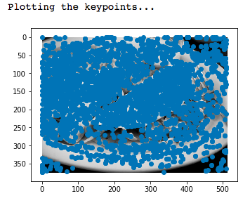
Key points detected at different scales and octaves

Slide 5
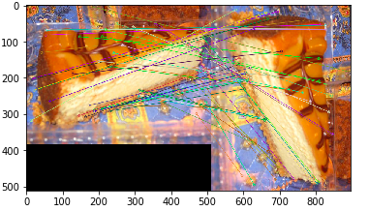
Key point Matching

Slide 6
Bag of Words Model for Object Recognition
Vertical stack of all descriptors
Clustering: k means cluster classifier unsupervised learning, clusters = 100
Generating Vocabulary Histogram of clustered feature descriptors
Training and testing - SVC (Support Vector Classifier) Accuracy – 62% - Random Forest Classifier Accuracy – 75%

Slide 7


