Slide 1
CNC

Slide 2
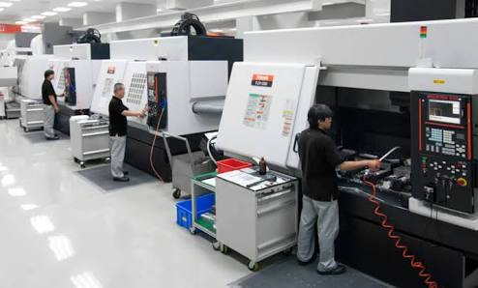
U must be wondering, what does the CNC mean?
CNC means computerised numerical controller
What it basically does is, it controls machinery with the help of code written in the CNC machining language.

Slide 3
Components used
Arduino UNO D:\Arduino_Uno\Arduino.ipt.stl
Stepper motors D:\Untitled\Motor_NEMA17.stl Doc1.docx
Motor drivers(L293D)
Servo motor D:\2051_servo_tower-pro-sg90.pk2.stl
CPU fan
Some pieces of wood, metal rods, wires etc.

Slide 4
Much needed software
Arduino IDE
Inkscape
Processing 3

Slide 5
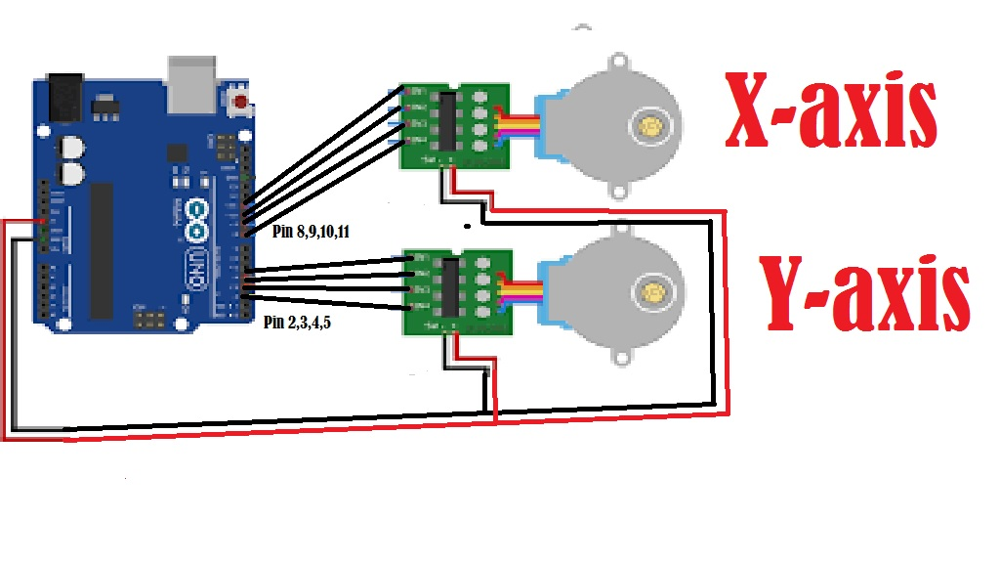
Schematics

Slide 6
Working mechanism
cnc1.3mf

Slide 7
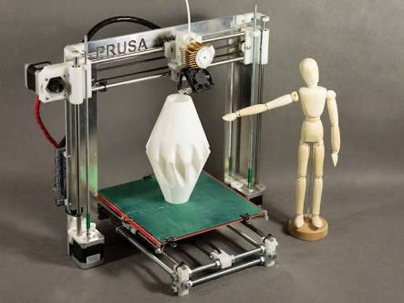
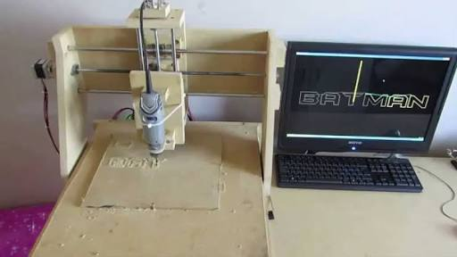
Scope
3D printer, lathe machine, laser cutter, mills, routers, grinders etc.

Slide 8


