Slide 1
Information Extraction
Abhibha Gupta

Slide 2
Problem Statement
Domain model
Entity Extraction
Molecules
Ni-P
Actions
electro-plated
Processes
thermal spray process
Corpus of Steel Coatings text
Coating formulation filename
Coating Type
Stainless Steel
Substrate
Steel
To generate a stainless steel coating, 3 µm Ni-P was electro-plated on a steel substrate at 10ºC using thermal spray process
Quantities
3µm
Conditions
10ºC
Equipment

Slide 3
Dataset
Text
To generate a stainless steel coating, 3 µm Ni-P was electro-plated on a steel substrate at 10ºC using thermal spray process
Preprocess
ChemData Extractor
Quantulum
Allen NLP tagger
Returns molecule names
Extract related quantities
Extract Verbs
Extract Arg1
Molecules
Ni-P
Quantities, Conditions
3 µm, 10ºC
Returns action words
lookup process names
Actions
electro-plated
Process
Thermal spray process

Slide 4
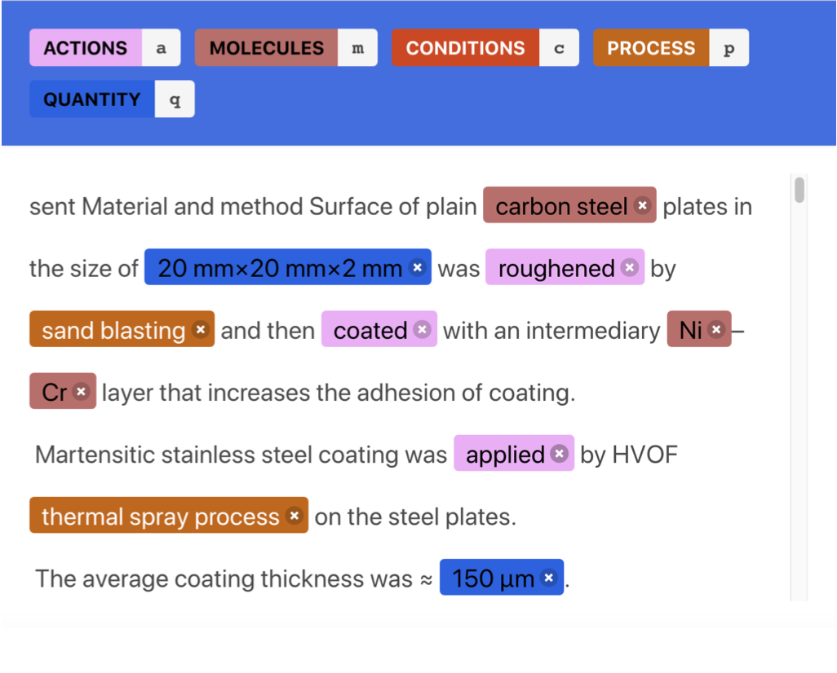
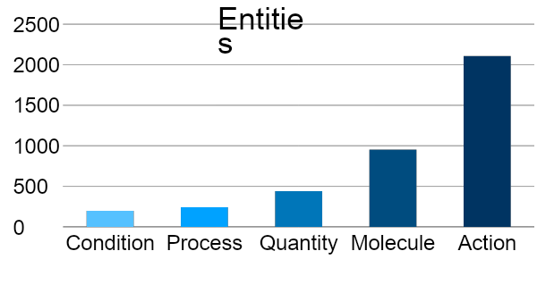
Manual Annotation

Slide 5
Named Entity Recognition (NER) Models
Incremental learning
Dataset
Append instances
to train
Train and test
model
Record scores
100 instances
itr1: Train=10
Test=90
No
itr2: Train=20
Test=80
test
instances = 0?
Yes
End training

Slide 6
NER Model
Spacy NER
Sentence
Preprocess
Split into training-testing sets
Initialize model
Record F1 scores
Train incrementally for 25 epochs

Slide 7
NER Model
CRF Suite
Sentence
Extract features
Split into training-testing sets
Initialize model
Record F1 scores
Train incrementally for 100 epochs

Slide 8
NER Model
Sequence-to-Sequence Model
Sentence
Create feature
arrays
Split into training-testing sets
Initialize model
Record F1 scores
Train incrementally for 3 epochs

Slide 9
Results
 | Spacy | CRF Suite | Seq2Seq
Actions | 0.64 | 0.95 | 0.93
Molecules | 0.57 | 0.43 | 0.64
Quantities | 0.53 | 0.13 | 0.0
Processes | 0.50 | 0.167 | 0.0
Conditions | 0.53 | 0.0 | 0.0
Overall | 0.83 | 0.88 | 0.68

