Slide 1


Slide 2
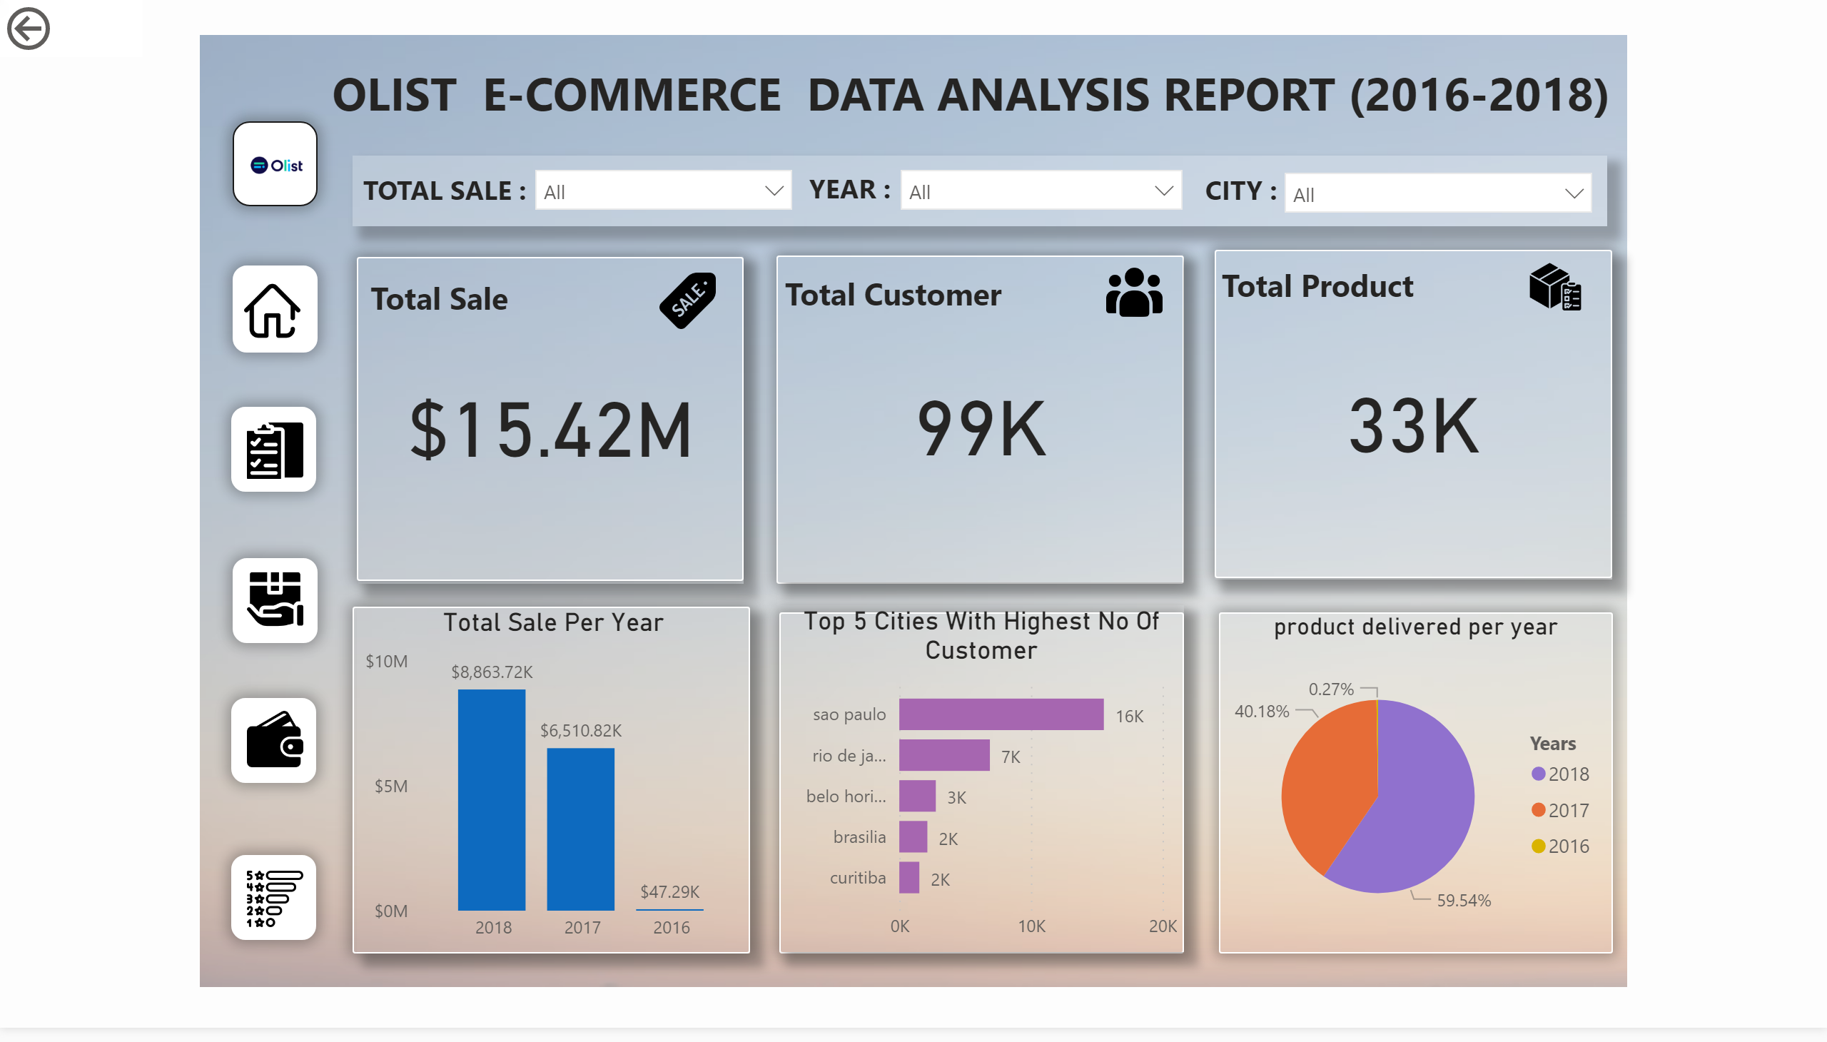
Home
Notes:
image
No alt text provided.
image
No alt text provided.
image
No alt text provided.
image
No alt text provided.
basicShape
No alt text provided.
basicShape
No alt text provided.
basicShape
No alt text provided.
basicShape
No alt text provided.
basicShape
No alt text provided.
textbox
No alt text provided.
image
No alt text provided.
basicShape
No alt text provided.
basicShape
No alt text provided.
basicShape
No alt text provided.
basicShape
No alt text provided.
basicShape
No alt text provided.
basicShape
No alt text provided.
Total Sale Per Year
No alt text provided.
Top 5 Cities With Highest No Of Customer
No alt text provided.
card
No alt text provided.
textbox
No alt text provided.
card
No alt text provided.
card
No alt text provided.
textbox
No alt text provided.
textbox
No alt text provided.
image
No alt text provided.
image
No alt text provided.
image
No alt text provided.
slicer
No alt text provided.
actionButton
No alt text provided.
slicer
No alt text provided.
slicer
No alt text provided.
textbox
No alt text provided.
textbox
No alt text provided.
textbox
No alt text provided.
image
No alt text provided.
basicShape
No alt text provided.
product delivered per year
No alt text provided.

Slide 3
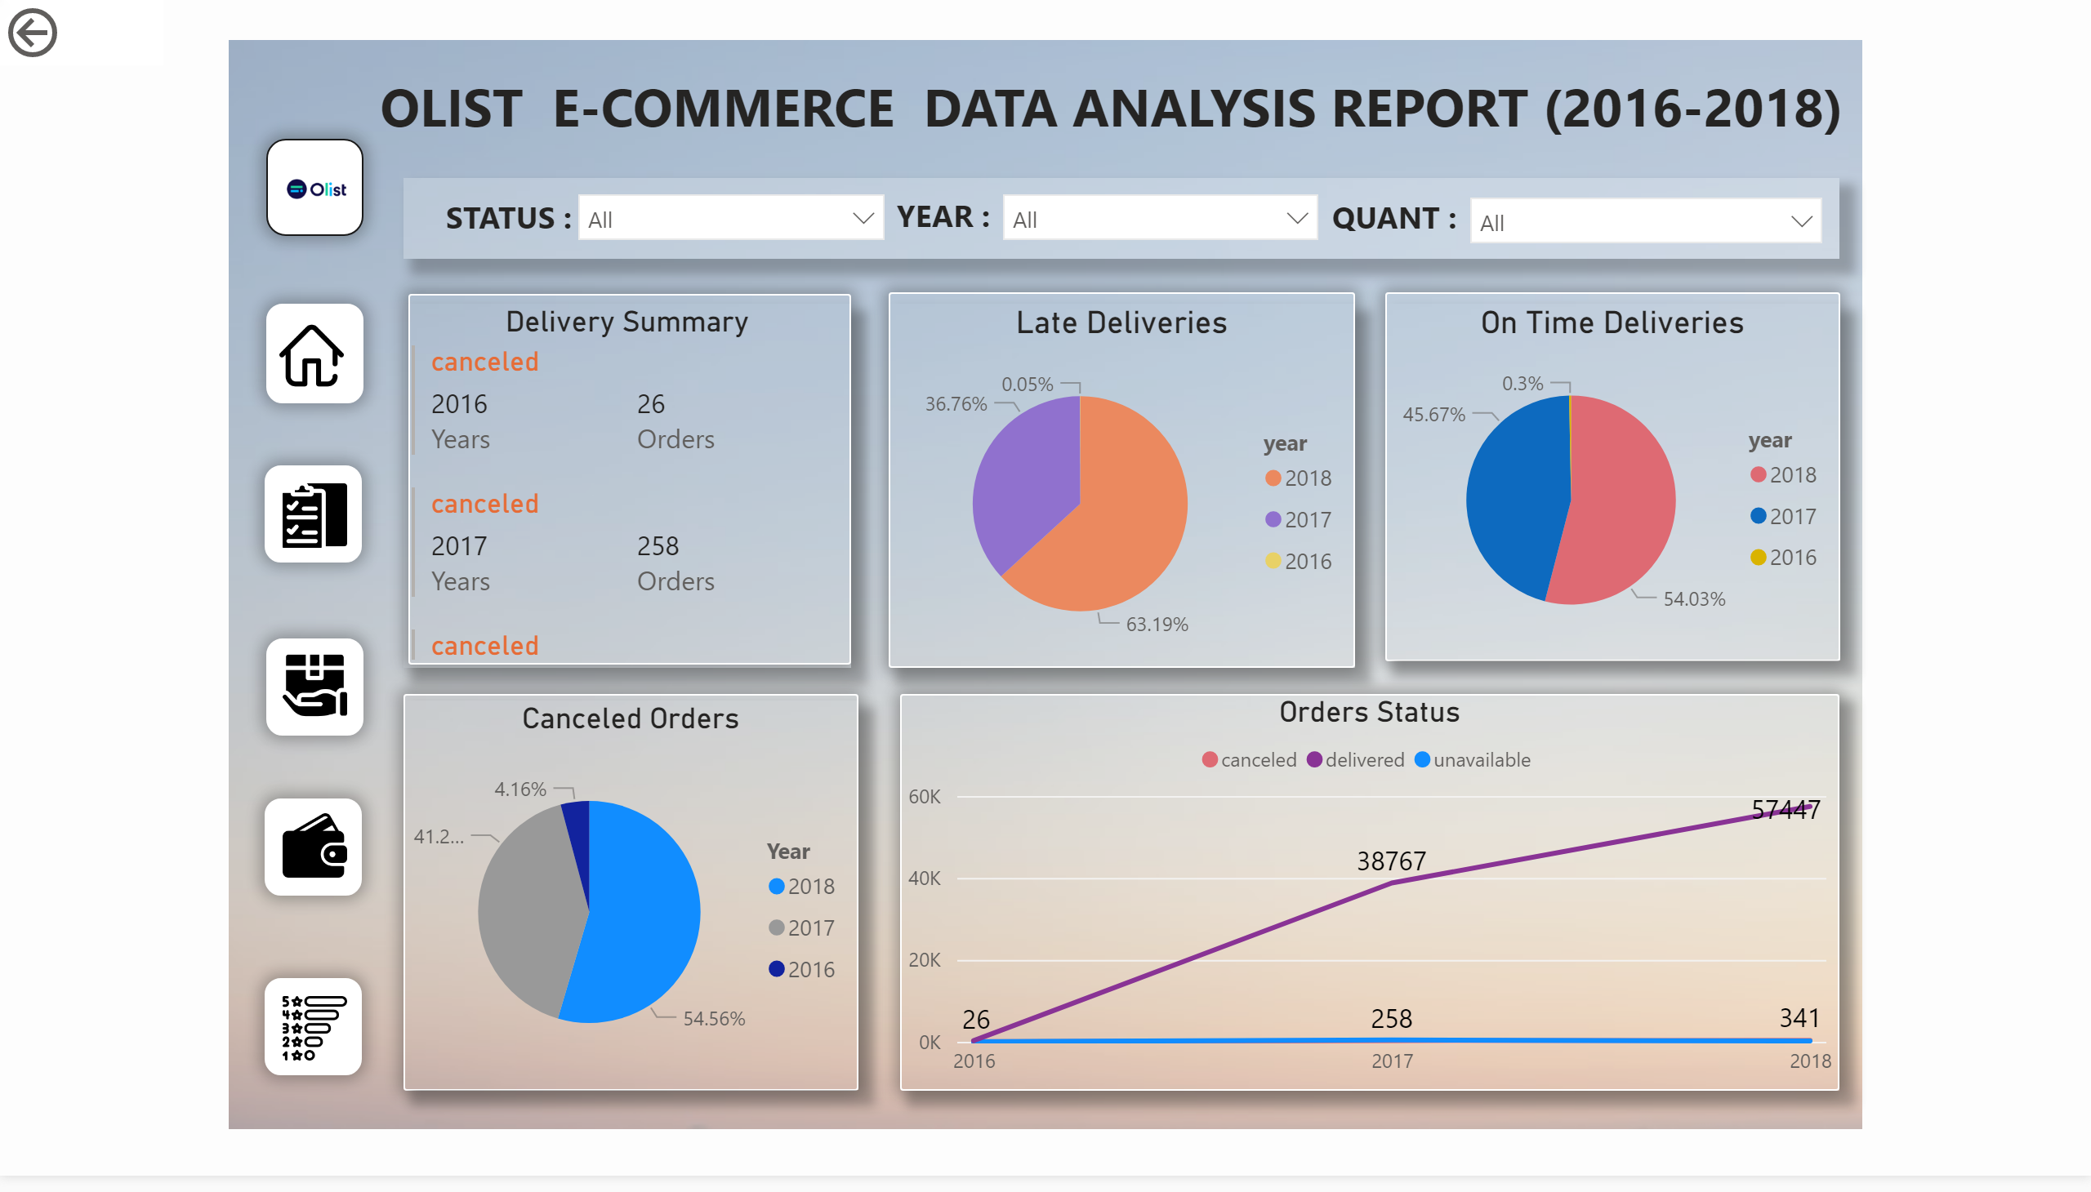
Orders
Notes:
image
No alt text provided.
image
No alt text provided.
image
No alt text provided.
image
No alt text provided.
basicShape
No alt text provided.
basicShape
No alt text provided.
basicShape
No alt text provided.
basicShape
No alt text provided.
basicShape
No alt text provided.
textbox
No alt text provided.
image
No alt text provided.
basicShape
No alt text provided.
basicShape
No alt text provided.
basicShape
No alt text provided.
basicShape
No alt text provided.
basicShape
No alt text provided.
slicer
No alt text provided.
actionButton
No alt text provided.
slicer
No alt text provided.
slicer
No alt text provided.
textbox
No alt text provided.
textbox
No alt text provided.
textbox
No alt text provided.
image
No alt text provided.
Delivery Summary
No alt text provided.
basicShape
No alt text provided.
Late Deliveries
No alt text provided.
On Time Deliveries
No alt text provided.
Canceled Orders
No alt text provided.
Orders Status
No alt text provided.

Slide 4
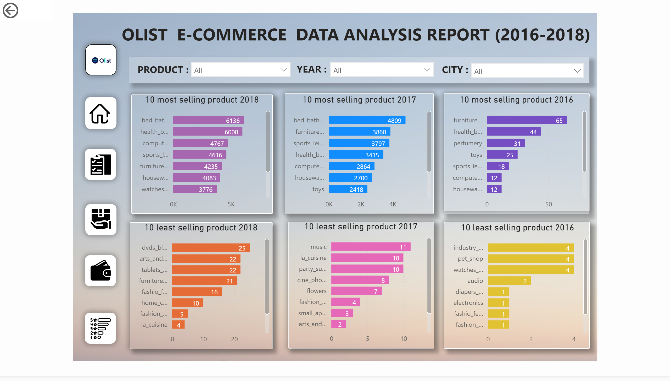
Products
Notes:
image
No alt text provided.
image
No alt text provided.
image
No alt text provided.
image
No alt text provided.
basicShape
No alt text provided.
basicShape
No alt text provided.
basicShape
No alt text provided.
basicShape
No alt text provided.
basicShape
No alt text provided.
textbox
No alt text provided.
image
No alt text provided.
basicShape
No alt text provided.
basicShape
No alt text provided.
basicShape
No alt text provided.
basicShape
No alt text provided.
slicer
No alt text provided.
actionButton
No alt text provided.
slicer
No alt text provided.
slicer
No alt text provided.
textbox
No alt text provided.
textbox
No alt text provided.
textbox
No alt text provided.
image
No alt text provided.
basicShape
No alt text provided.
basicShape
No alt text provided.
10 most selling product 2018
No alt text provided.
basicShape
No alt text provided.
10 most selling product 2017
No alt text provided.
10 most selling product 2016
No alt text provided.
10 least selling product 2018
No alt text provided.
10 least selling product 2017
No alt text provided.
10 least selling product 2016
No alt text provided.

Slide 5
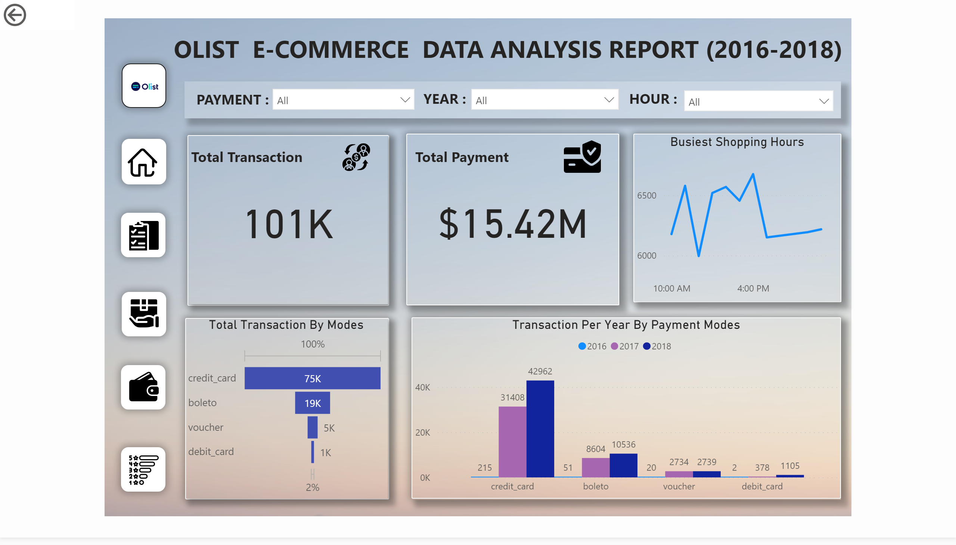
Payment
Notes:
image
No alt text provided.
image
No alt text provided.
image
No alt text provided.
image
No alt text provided.
basicShape
No alt text provided.
basicShape
No alt text provided.
basicShape
No alt text provided.
basicShape
No alt text provided.
basicShape
No alt text provided.
textbox
No alt text provided.
image
No alt text provided.
basicShape
No alt text provided.
basicShape
No alt text provided.
basicShape
No alt text provided.
basicShape
No alt text provided.
slicer
No alt text provided.
actionButton
No alt text provided.
slicer
No alt text provided.
slicer
No alt text provided.
textbox
No alt text provided.
textbox
No alt text provided.
textbox
No alt text provided.
image
No alt text provided.
basicShape
No alt text provided.
basicShape
No alt text provided.
card
No alt text provided.
textbox
No alt text provided.
image
No alt text provided.
Transaction Per Year By Payment Modes
No alt text provided.
Total Transaction By Modes
No alt text provided.
card
No alt text provided.
textbox
No alt text provided.
image
No alt text provided.
Busiest Shopping Hours
No alt text provided.

Slide 6
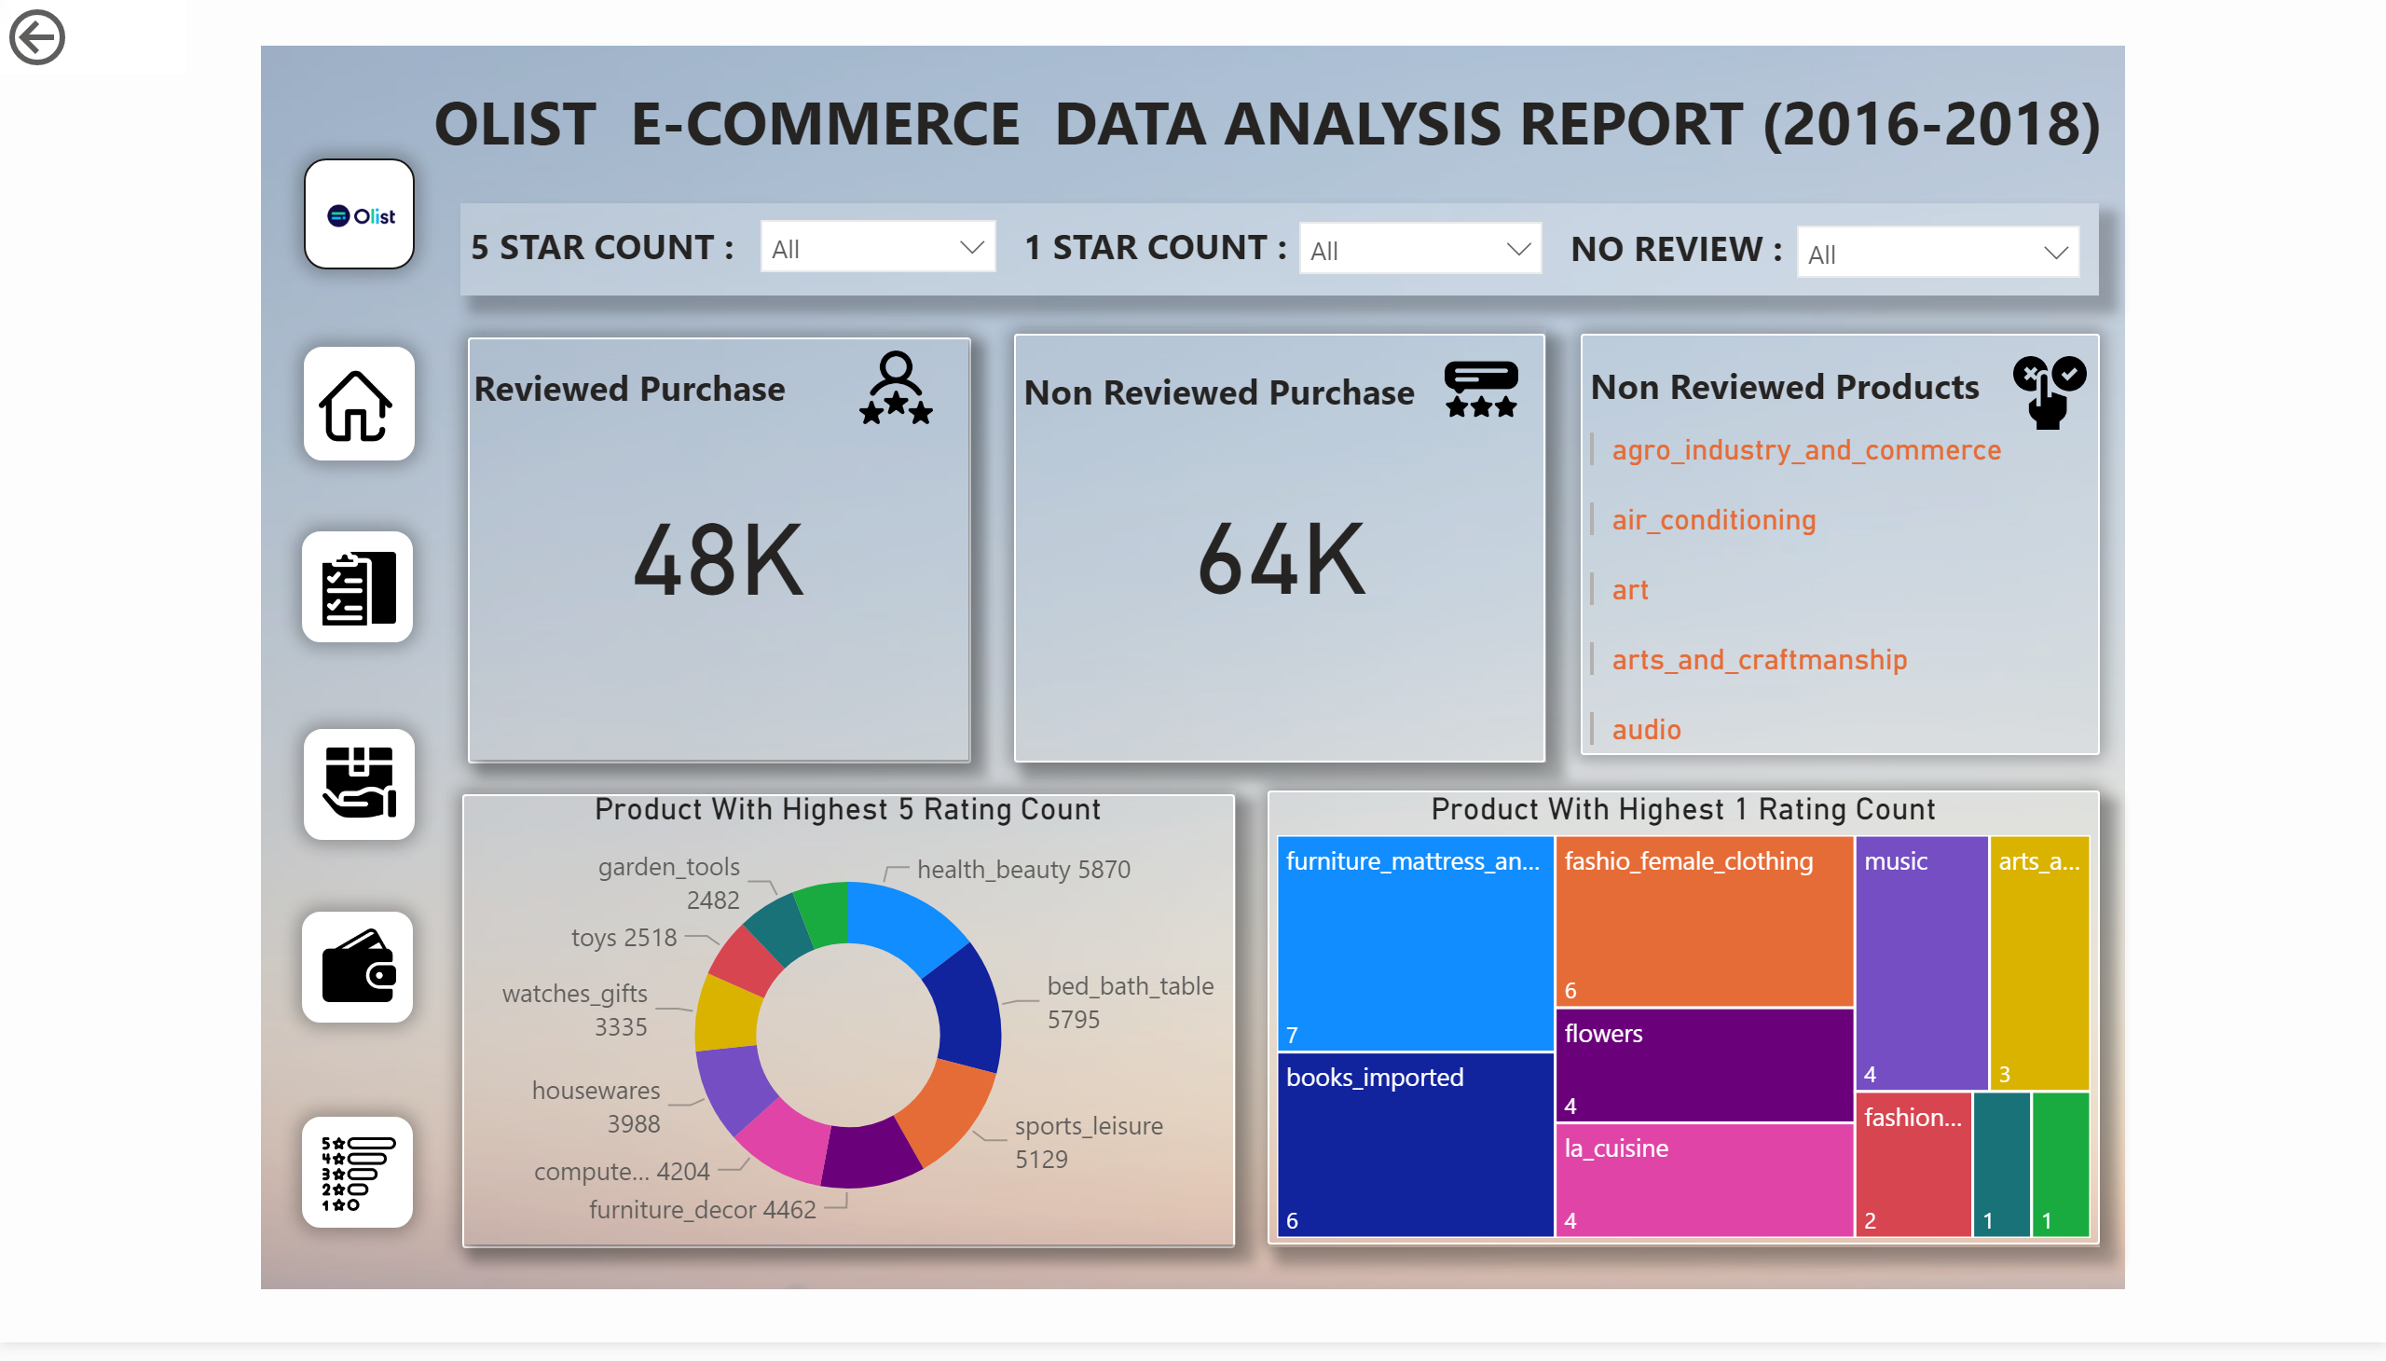
Reviews & Rating

