Slide 1
Mechanisms and Robotics DE ES ZG561
Lecture-14

Slide 2
Contents
Manipulator Singularities
Trajectory Planning
Path and Trajectory
Joint Space Vs. Cartesian Space
Third Order Polynomial Trajectory Planning
Linear Segments with Parabolic Blending
Numerical Examples

Slide 3
Manipulator Singularities
The points at which Jv(q) loses rank are known as Joint Space Singularities
Joint Space Singularity
Boundary Singularity
Interior singularity
Boundary singularity – occurs when the tip reaches the outer surface of the work envelope
Interior Singularity – occurs when two or more axis of a robot form a straight line.
One axis movement can cancel the other in interior singularity.

Slide 4
Manipulator Singularities
The points at which Jv(q) loses rank are known as Joint Space Singularities
This implies that at the point q there exist infinitesimal tool displacements du that are not physically realizable by any joint displacement dq.
If J(q) is a 6Xn matrix. If n<6, or if the manipulator is at a joint-space singularity, then rank[J(q)] < 6.
If q is a joint space singularity, there are directions in which the manipulator tool cannot exert a force or moment when it in contact with the environment not matter what joint torques and forces are applied.

Slide 5
Rank of a Matrix
The rank of a matrix is defined as (a) the maximum number of linearly independent column vectors in the matrix or
the maximum number of linearly independent row vectors in the matrix. Both definitions are equivalent.
For an r x c matrix, If r is less than c, then the maximum rank of the matrix is r.
If r is greater than c, then the maximum rank of the matrix is c.
The rank of a matrix would be zero only if the matrix had no elements. If a matrix had even one element, its minimum rank would be one.

Slide 6
Trajectory Planning
Path and trajectory planning relate to the way a robot is moved from one location to another in a controlled manner.
Path and trajectory planning require the use of both kinematics and dynamics of robots.
In practice precise motion requirements are so intensive that approximations are always necessary.

Slide 7
Path and Trajectory
Path is defined as a collection of a sequence of positions a robot makes to go from one place to another without regard to the timing of these positions.
If a robot goes from point A to point B to point C, the sequence of positions between A and B and C constitutes a path.
A trajectory is related to the timing at which each part of the path must be attained.

Slide 8
Joint-Space Vs. Cartesian-Space
The description of the motion to be made by the robot by its joint values is called Joint-space description.
Consider a robot which moves from point A to point B.
The arm will be directed using the inputs received from the inverse kinematic equations of the robot.
In this case, although the robot will reach its target point, but the path will be unpredictable.

Slide 9
Joint-Space Vs. Cartesian-Space
If a straight line is drawn between points A and B and the robot is programmed to move from A to B on a straight line.
It will be necessary to divide the lines into small portions and move the robot through the intermediate points.
To accomplish the inverse kinematic equations of all the points are solved and joint variables are calculated and the controller is directed to drive the robot to those values.
The sequence of movements the robot makes is described in Cartesian-space and is converted to joint-space at each segment.

Slide 10
Joint-Space Vs. Cartesian-Space
Cartesian- Space trajectories are very easy to visualize.
However, Cartesian-space trajectories are computationally intensive and require faster processing time for similar resolution than joint-space trajectories.
If not careful, we may specify a trajectory that requires the robot to run into itself or to reach a point outside its work envelope – Which of course is impossible.

Slide 11
Basics of Trajectory Planning
Consider the following cases
R-R Manipulator – Joint Space trajectory planning
Two joints running at the same velocity
Two joints running for the same time
R-R Manipulator – Cartesian Space Trajectory Planning

Slide 12
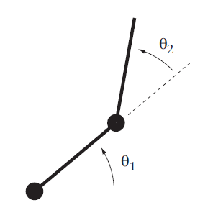
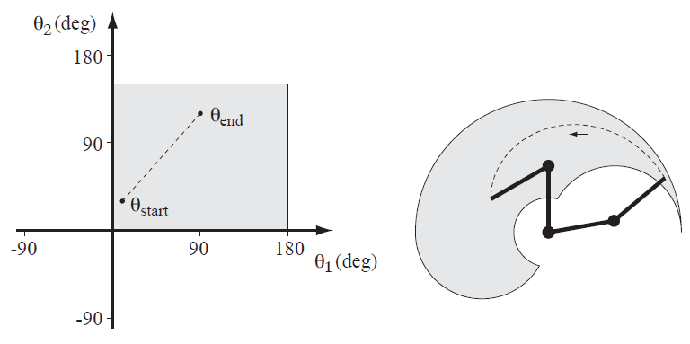
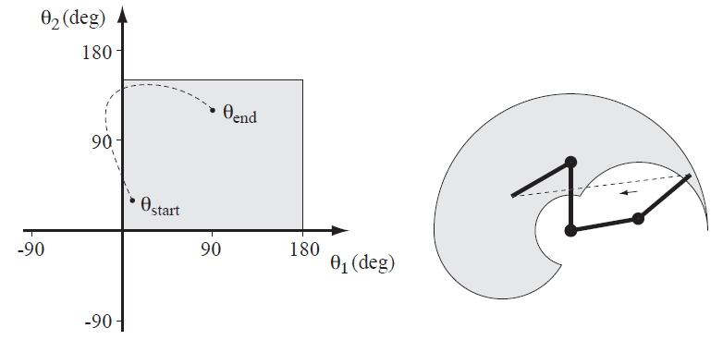
Basics of Trajectory Planning
Image Source: Modern Robotics, Park, Lynch

Slide 13





Third order Polynomial Trajectory Planning
In this application the initial location and the orientation are known and using inverse kinematic equations, the final joint angles for the desired position and orientation are found.
$$θ\left(t\right)=a_{0}+a_{1}t+a_{2}t^{2}+a_{3}t^{3}$$
The Initial and final conditions are
$$θ\left(t_{i}\right)=θ_{i}$$
$$θ\left(t_{f}\right)=θ_{f}$$
$$\dot{θ}\left(t_{i}\right)=0$$
$$\dot{θ}\left(t_{f}\right)=0$$

Slide 14
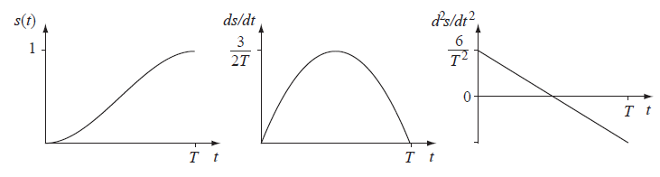
Third-order Polynomial Time Scaling
Plots of s(t), s˙(t), and s¨(t) for a third-order polynomial time scaling

Slide 15
Problem 1
It is desired to have the first joint of a 6-axis robot to from initial angle of 30° to a final angle of 75° in 5 seconds. Using a third-order polynomial, calculate the joint angle at 1, 2, 3 and 4 seconds.

Slide 16
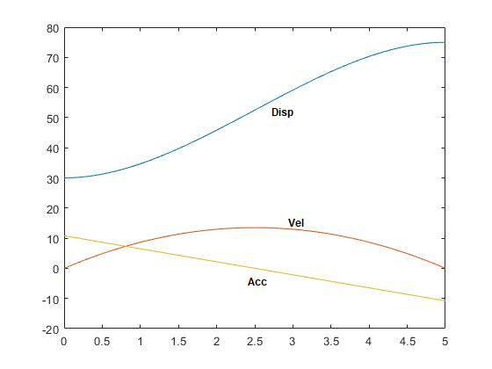
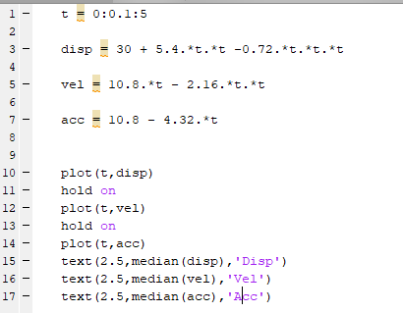
Solution

Slide 17
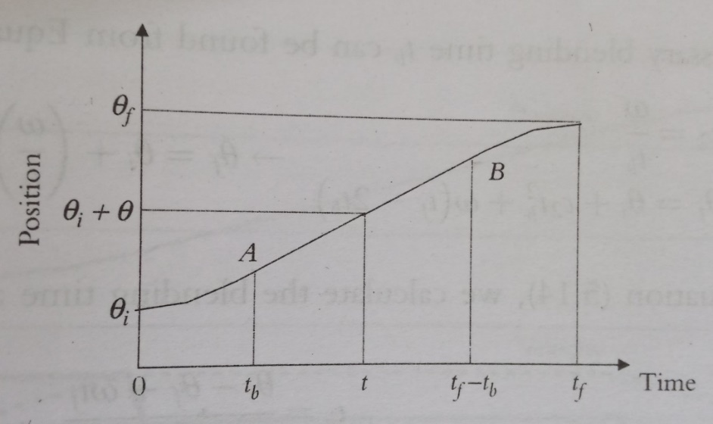
Linear segments with Parabolic Blends
Another alternative for joint-space trajectory planning is to run the joints at constant speed between the initial and final locations.
This is equivalent to first order polynomial where the velocity is constant and the acceleration is zero.
However this also means that at the beginning and at the end of the motion segment, accelerations must be infinite In order to create instantaneous velocities at the boundaries.
To prevent this linear segment can be blended with parabolic sections at the beginning and at the end of the motion segment, creating a continuous position and velocity.

Slide 18
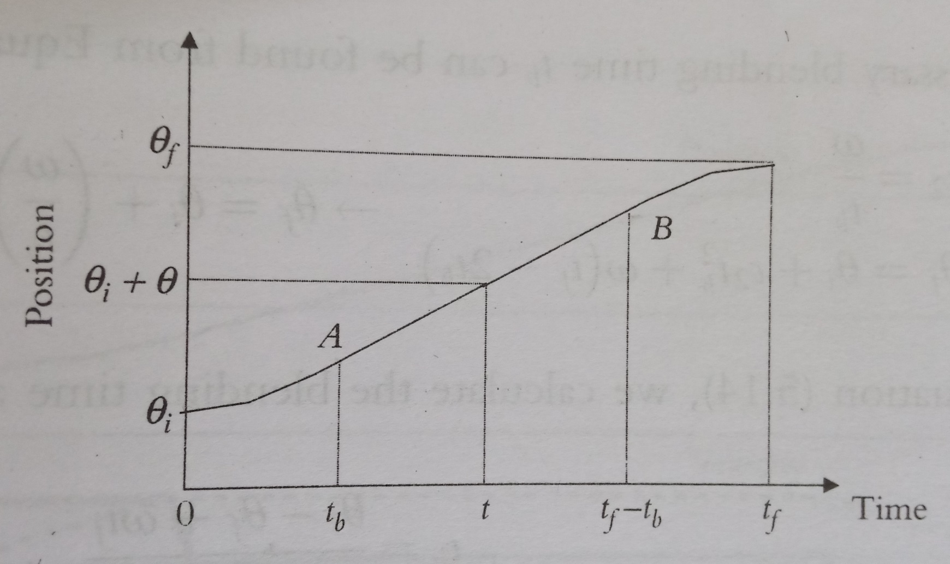
Displacement Vs. time

Slide 19

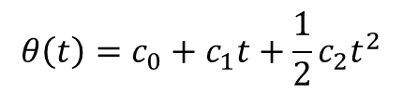

Linear segments with Parabolic Blends
Assuming the initial and final positions as θi and θf at times ti = 0 and tf and the parabolic segments are symmetrically blended with the linear section at blending times tb and tf-tb, we can write
Acceleration is constant for parabolic segments, yielding a continuous velocity at the common points (called knot points) A and B.
$$θ\left(t\right)=c_{0}+c_{1}t+\frac{1}{2}c_{2}t^{2}$$
$$\dot{θ}\left(t\right)=c_{1}+c_{2}t$$
$$\ddot{θ}\left(t\right)=c_{2}$$

Slide 21




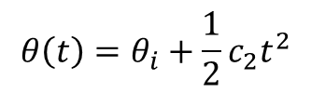

Linear segments with Parabolic Blends
Substituting the boundary conditions into the parabolic segment yields:
This will result in parabolic segments in the form
$$θ\left(t=0\right)=θ_{i}=c_{0}$$
$$\dot{θ}\left(t=0\right)=0=c_{1}$$
$c_{2}$ $=\ddot{θ}\left(t\right)$
$$θ\left(t\right)=θ_{i}+\frac{1}{2}c_{2}t^{2}$$
$$\dot{θ}\left(t\right)=c_{2}t$$
$$\ddot{θ}\left(t\right)=c_{2}$$

Slide 22
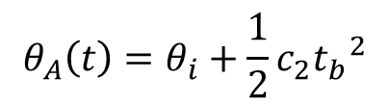

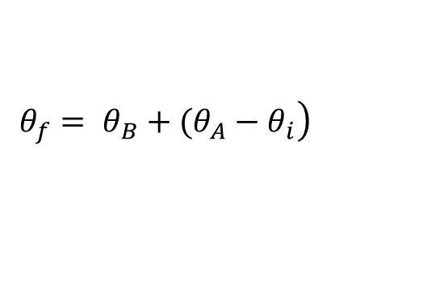


Linear segments with Parabolic Blends
For the linear segment the velocity is constant and can be chosen based on the physical capabilities of the actuators.
Substituting zero initial velocity and a constant joint velocity ω in the linear portion and zero final velocity, we find the joint positions and velocities for points A, B
$$θ_{A}\left(t\right)=θ_{i}+\frac{1}{2}c_{2}{t_{b}}^{2}$$
$$\dot{θ_{A}}\left(t\right)=c_{2}t_{b}= ω$$
$$\left.θ_{B}\left(t\right)=θ_{A}\left(t\right)+ω\left(\left(t_{f}−t_{b}\right)−t_{b}\right)= θ_{A}\left(t\right)+ω(\left(t_{f}−{2t}_{b}\right)\right)$$
$${\dot{θ}}_{B}={\dot{θ}}_{A}=ω$$
$$\left.θ_{f}= θ_{B}+(θ_{A}−θ_{i}\right)$$
$${\dot{θ}}_{f}= 0$$

Slide 23
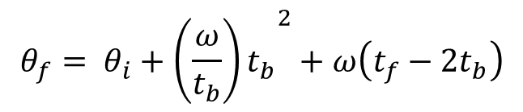
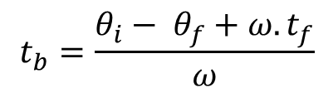
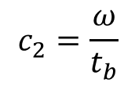

Linear segments with Parabolic Blends
The necessary blending time can be found from
$$c_{2}=\frac{ω}{t_{b}}$$
$$θ_{f}= θ_{i}+{{c_{2 }t}_{b}}^{2}+ω\left(t_{f}−{2t}_{b}\right)$$
$$θ_{f}= θ_{i}+{{\left(\frac{ω}{t_{b}}\right)t}_{b}}^{2}+ω\left(t_{f}−{2t}_{b}\right)$$
$$t_{b}=\frac{θ_{i}− θ_{f}+ω.t_{f}}{ω}$$

Slide 24
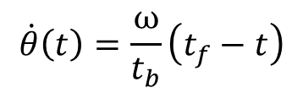
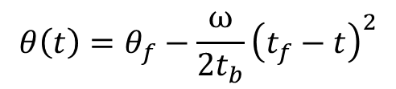
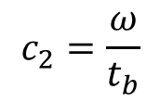
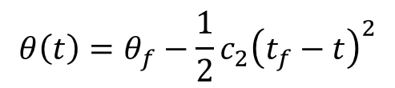
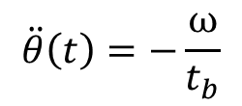
Final Parabolic segment is given by
$$θ\left(t\right)=θ_{f}−\frac{1}{2}c_{2}{\left(t_{f}−t\right)}^{2}$$
$$θ\left(t\right)=θ_{f}−\frac{ω}{2t_{b}}{\left(t_{f}−t\right)}^{2}$$
$$\dot{θ}\left(t\right)=\frac{ω}{t_{b}}\left(t_{f}−t\right)$$
$$c_{2}=\frac{ω}{t_{b}}$$
$$\ddot{θ}\left(t\right)=−\frac{ω}{t_{b}}$$

Slide 25
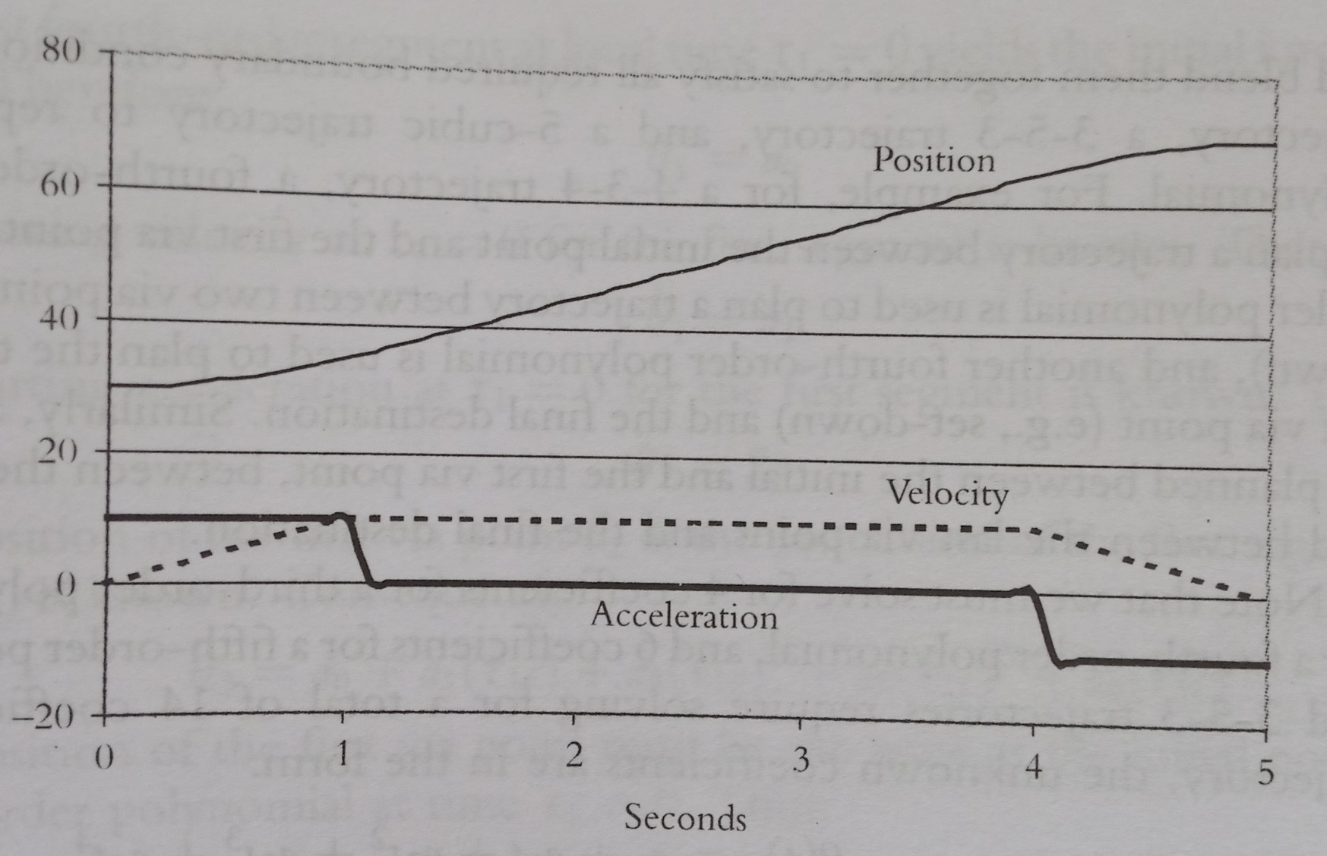
Displacement, Velocity and Acceleration

Slide 26
Problem
Joint 1 of a six axis robot is to go from initial angle of 30 deg to a final angle of 70deg in 5 seconds with a cruising velocity of 10deg/s. Find the necessary time for blending and plot the joint positions velocities and accelerations.

Slide 27
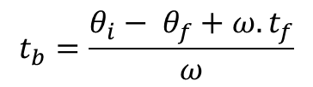
$$t_{b}=\frac{θ_{i}− θ_{f}+ω.t_{f}}{ω}$$

Slide 28


Solution
tb = 1sec
$$θ=30+5t^{2}$$
$$θ=θ_{A}+10\left(t−1\right)$$
$$θ=70−5{\left(5−t\right)}^{2}$$

Slide 29
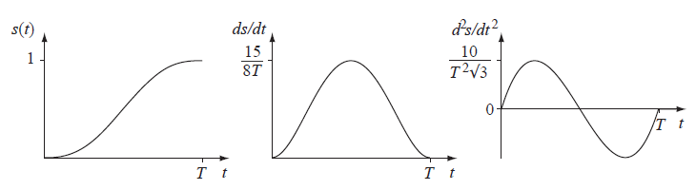
Fifth-order Polynomial Time Scaling
Plots of s(t), s˙(t), and s¨(t) for a fifth-order polynomial time scaling.

Slide 30
Fifth-order Polynomial Time Scaling
Displacement
$$θ\left(t\right)=a_{0}+a_{1}t+a_{2}t^{2}+a_{3}t^{3}+a_{4}t^{4}+a_{5}t^{5}$$

Slide 32
Fifth-order Polynomial Time Scaling
Plots of s(t), s˙(t), and s¨(t) for a fifth-order polynomial time scaling.

Slide 33
Fifth-order Polynomial Time Scaling
Displacement
$$θ\left(t\right)=a_{0}+a_{1}t+a_{2}t^{2}+a_{3}t^{3}+a_{4}t^{4}+a_{5}t^{5}$$
Velocity
$$\dot{θ}\left(t\right)=a_{1}+2a_{2}t+3a_{3}t^{2}+4a_{4}t^{3}+{5a}_{5}t^{4}$$
Acceleration
$$\ddot{θ}\left(t\right)=2a_{2}+6a_{3}t+12a_{4}t^{2}+{20a}_{5}t^{3}$$
Jerk
$$\overset{⃛}{θ}(t)=6a_{3}+24a_{4}t+{60a}_{5}t^{2}$$

Slide 34
Fifth-order Polynomial Time Scaling
Displacement
$$θ\left(t\right)=a_{0}+a_{1}t+a_{2}t^{2}+a_{3}t^{3}+a_{4}t^{4}+a_{5}t^{5}$$
$t$ = 0, $\dot{θ}\left(t\right)=$ 0
$t$ = $t_{f}$, $\dot{θ}\left(t\right)=$0
$t$ = 0, $\ddot{θ}\left(t\right)=$ 0
$t$ = $t_{f}$, $\ddot{θ}\left(t\right)=$ 0
$75a_{3}+500a_{4}+{3125a}_{5}$ = 0 ------------------ (1)
$30a_{3}+300a_{4}+{2500a}_{5}$ = 0 ------------------ (2)
$125a_{3}+625a_{4}+{3125a}_{5}$ = 45 ----------------- (3)
$$\left(3\right)−(1)$$
$$\left(1\right)−1.25(2)$$
$50a_{3}+125a_{4}$ = 45 ---------- (4)
$37.5a_{3}+125a_{4}$ = 0 --------- (5)

Slide 35
Fifth-order Polynomial Time Scaling
$$\left(3\right)−(1)$$
$$\left(1\right)−1.25(2)$$
$50a_{3}+125a_{4}$ = 45 ---------- (4)
$37.5a_{3}+125a_{4}$ = 0 --------- (5)
$$\left(4\right)−(5)$$
$12.5a_{3}$ = 45 ---------- (4)
$a_{3}$ = 3.6
Substituting in (4)
$a_{3}$ = 3.6
gives
$a_{4}$ = -1.08
Substituting in (3)
$a_{5}$ = 0.0864

Slide 36
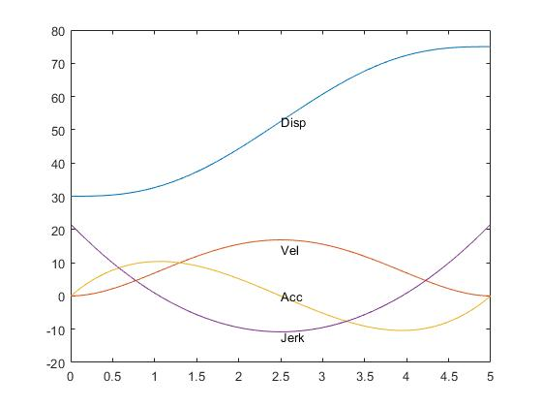
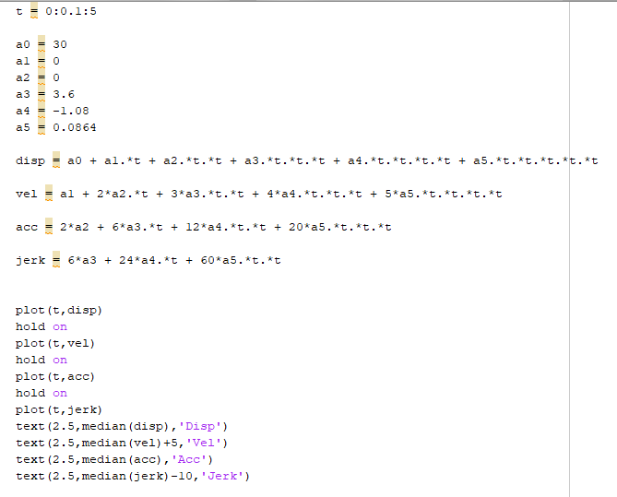
Fifth-order Polynomial Time Scaling

Slide 37
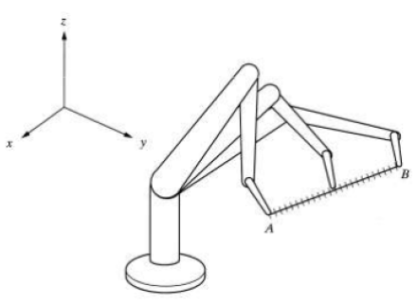
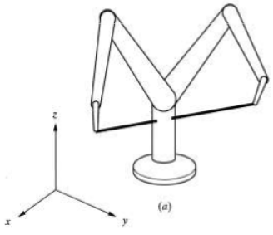
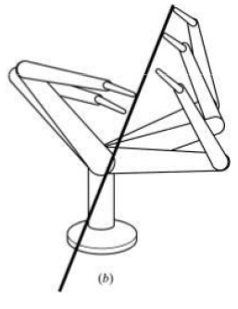
Cartesian Space Trajectory Planning
Sequential motions of a Robot to follow a straight line.
Challenges
The Trajectory may require a sudden change in joint angles
May force the robot to run into itself

Slide 39
THANK YOU
The presenter is grateful to the authors of the following textbooks.
Industrial Robotics - Mikell P. Groover
Fundamentals of Robotics – Robert Schilling
Introduction to Robotics Analysis, Control, Applications Saeed B. Niku

