Slide 1
Mechatronics (Merged - DEZG516/DMZG511/ESZG511)
Lecture

Slide 2
Session 7A
Type | Content Ref. | Topic Title | Study/HW Resource Reference
Pre CH
During CH | T1, T2 | Signal conditioning: Analog to digital conversion and vice versa | T1: Chapter 3 and 4, T2: Chapter 9
Post CH |  |  | Chapter end problems

Slide 3
A/D Converter Types

Slide 4
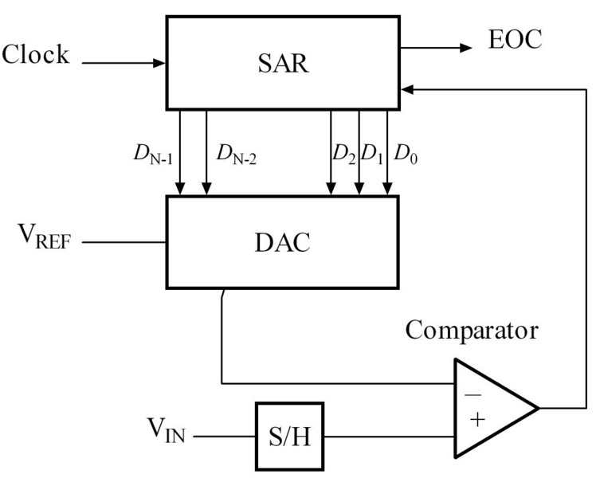
Successive Approximation Register type Analog - Digital Converter
The SAR is initialized so that the MSB is equal to a 1.
This code is fed into the DAC, which then supplies the analog equivalent of this digital code into the comparator circuit for comparison with the sampled input voltage.
If this analog voltage exceeds V_{in} the comparator causes the SAR to reset this bit; otherwise, the bit is left a 1.
Then the next bit is set to 1 and the same test is done, continuing this until every bit in the SAR has been tested.
The resulting code is the digital approximation of the sampled input voltage
SAR type ADC

Slide 5
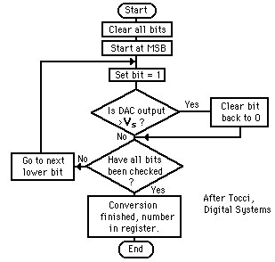
SAR ADC

Slide 6
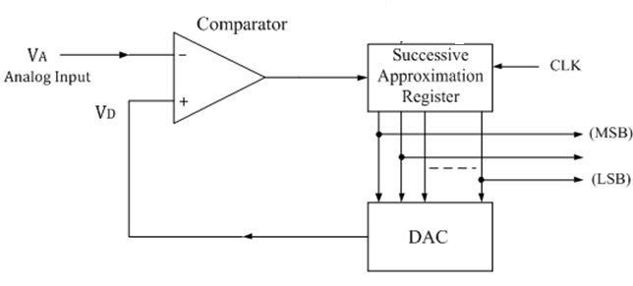
Successive approximation ADC
4 bit analysis
-Analog input is 3 Volts(V_{A}) - Say
-SAR generates 1 0 0 0
- DAC converts 1 0 0 0 to 8 Volts
Compare it in comparator
8>3, true, send next
0 1 0 0 (4 volts)
4>3 , true, send next
0 0 1 0 ( 2 volts)
2> 3, false hence, retain 0 0 1 0
Send next 1 (LSB)
0 0 1 1
Thus the digital O/P 0 0 1 1 of analog 3 Volts
Most commonly used ADC
n bit word takes n steps to make the comparison
If clock has frequency f, the time between pules is 1/f
Conversion time is n/f

Slide 7
Example 1
For a 10 bit ADC with a V_{ref} =1volts, find the digital equivalent of V_{in}=0.6

Slide 8

Cont….
For MSB i.e. bit 9
V= V_{ref} / 2
Compare V with V_{in}
If V_{in} is greater than V , turn MSB on i.e. =1
If V_{in} is less than V , turn MSB off i.e. = 0
V_{in} =0.6V and V =0.5
Since V_{in}> V, MSB is turned on i.e. = 1

Slide 9

Cont….
For MSB 1 i.e. bit 8
Compare V_{in}=0.6 V to V=V_{ref}/2 + V_{ref}/4= 0.5+0.25 =0.75V
Since 0.6<0.75, MSB 1 is turned off i.e = 0
For MSB 2 i.e. bit 7
Compare V_{in} with (V_{ref}/2+V_{ref}/8)=0.625
Since 0.6<0.625, MSB 2 is turned off i.e = 0
Notes:
When assessing for MSB 2, Vref/4 is not part of calculations because MSB 1=0.

Slide 10
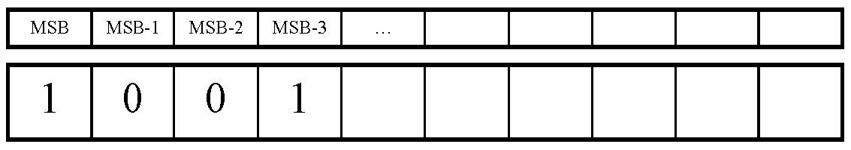
Cont….
For MSB 3 i.e. bit 6
Go to the last bit that caused it to be turned on (In this case MSB-1) and add it to V_{ref}/16, and compare it to V_{in}
Compare V_{in} to V= V_{ref}/2 + V_{ref}/16= 0.5625
Since 0.6>0.5625, MSB 3=1 (turned on)
Notes:
When assessing for MSB 3, Vref/4 and Vref/8 is not part of calculations because MSB 1=0 and MSB 2=0,

Slide 11
Cont….
This process continues for all the remaining bits
Thus, the digital equivalent of V_{in}=0.6 is: 1001100110
Notes:
If the example was repeated for 4 bit, you will see that the conversion error is more. For a converter >1o bit, the conversion error is lesser.

Slide 12
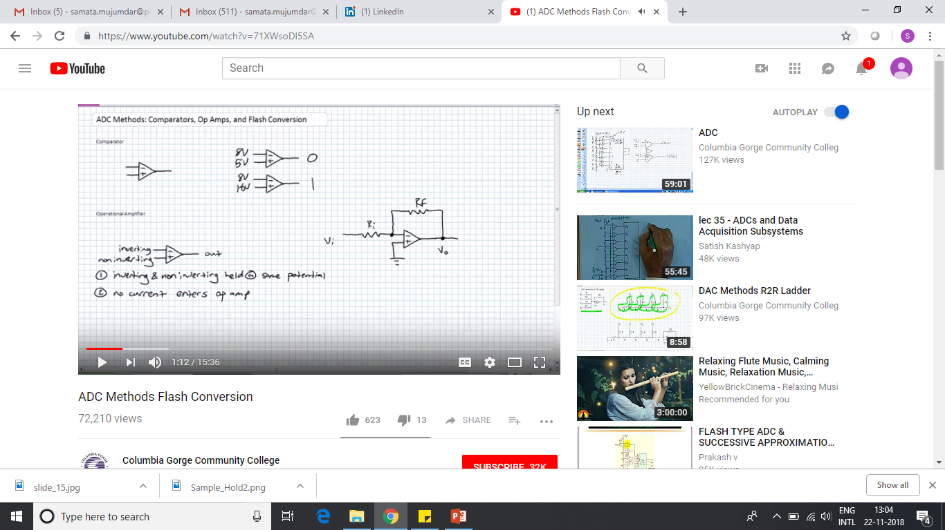
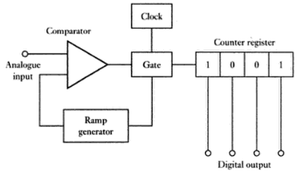
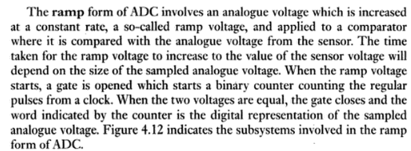
RAMP ADC (Single slope ADC)
+ > - value set it to 1
- > + value set it to 0

Slide 13
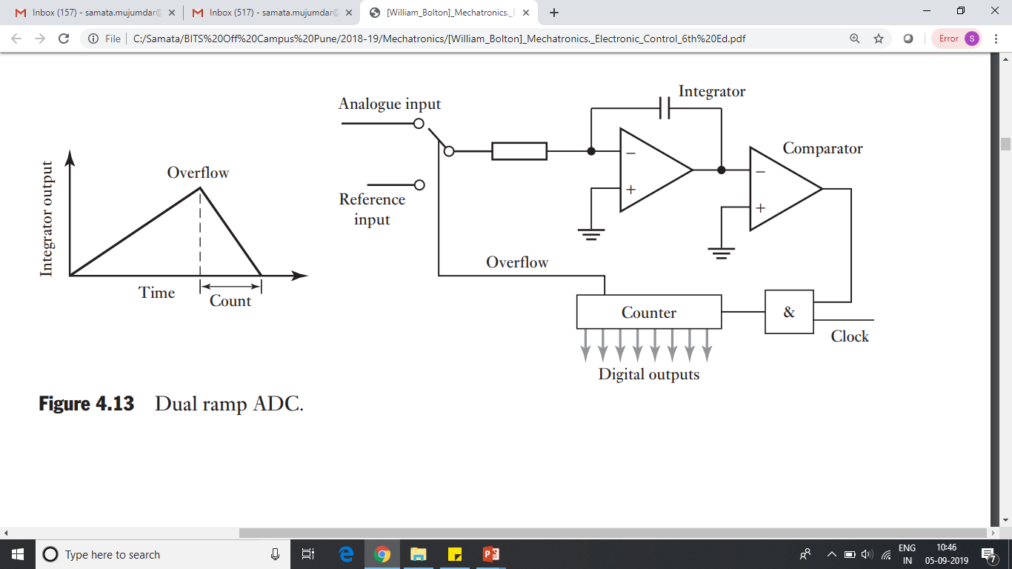
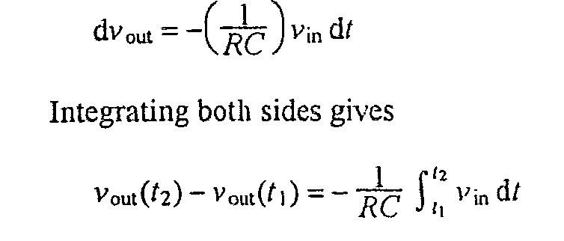
Dual slope A-D converters
The output from the comparator goes high as soon as the integrator output is more than a few millivolts.
When the comparator output is high, an AND gate passes pulses to a binary counter. The counter counts pulses until it overflows.
The counter then resets to zero, sends a signal to a switch which disconnects the unknown voltage and connects a reference voltage, and starts counting again.
The integrator voltage then decreases at a rate proportional to the reference voltage.
When the integrator output reaches zero, the comparator goes low, bringing the AND gate low and so switching the clock off.
The count is then a measure of the analogue input voltage.
polarity of the reference voltage is opposite to input voltage

Slide 14
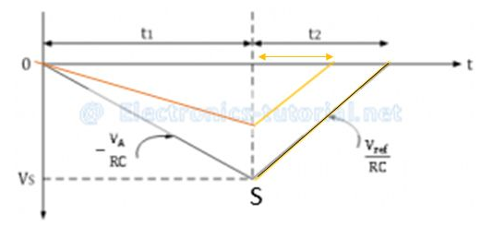
Fixed slope discharging
Fixed charging time
Vin = unknown voltage – for fixed amount of time
Vref = known voltage – variable amount of time
When switch is at Vin - Capacitor charges (lesser time)and
When switch is at Vref - Capacitor discharges (greater time) linearly with constant slope

Slide 15




Dual slope A-D converters

Slide 16
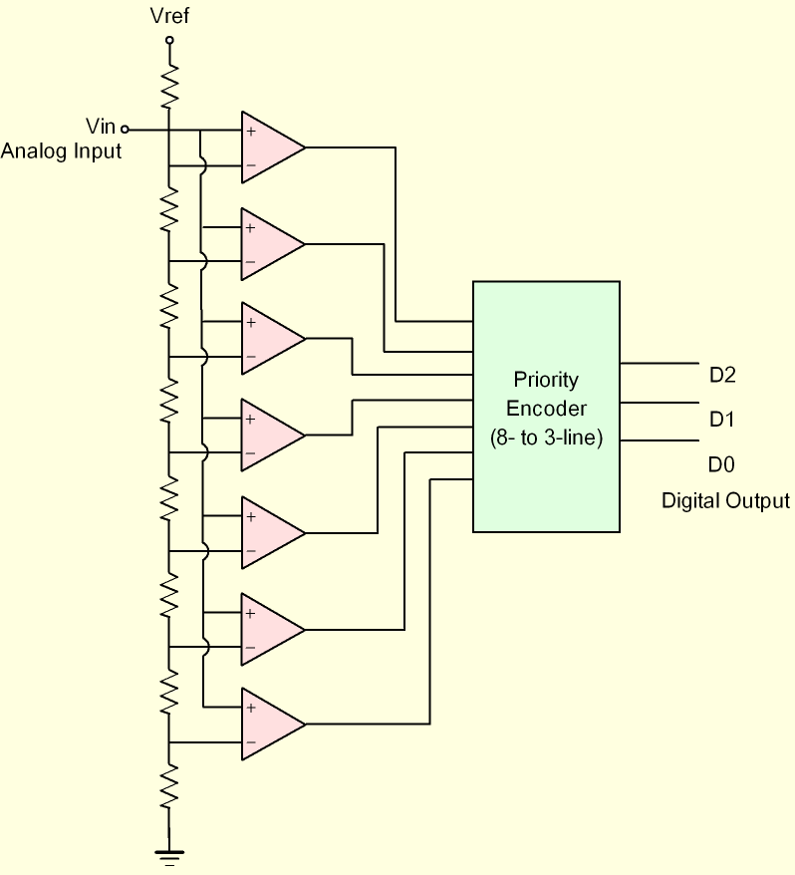
Flash A-D converters
For an n-bit converter, 2^n-1 separate voltage comparators are used in parallel.
A reference voltage is applied to a ladder of resistors so that the voltage applied as the other input to each comparator is 1 bit larger in size than the voltage applied to the previous comparator in the ladder.
when the analogue voltage is applied to the ADC, all those comparators for which the analogue voltage is greater than the reference voltage of a comparator will give a high output and those for which it is less will be low.

Slide 17

Flash A-D converters
Vin= 5.5 Volts (From Analog input)
Vref = 8 Volts (Constant)
D₇
8V
0
7V
0
6V
1
5V
1
1
3V
1
This is 3 bit Flash ADC – requiring 2³-1 comparators.
1
D₀
1

Slide 18
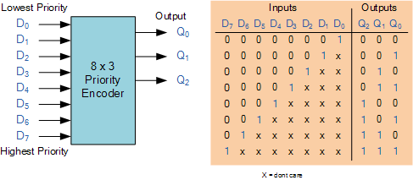
Flash A-D converters
Our case is 0 0 1 1 1 1 1 1
Output 1 0 1 corresponds to 5V

Slide 19
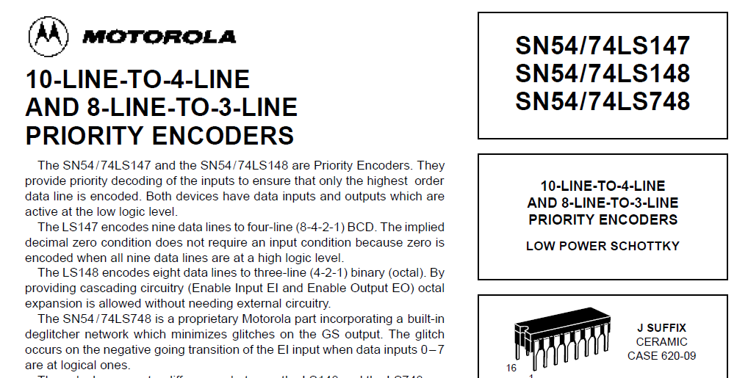
Priority Encoders

Slide 20

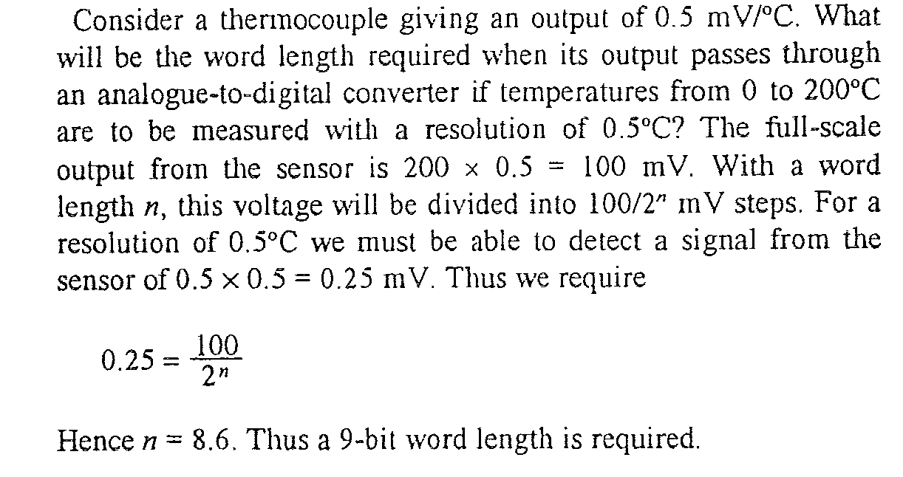
Calculation
Input to ADC is Voltage hence while calculating , consider range of Voltage i.e. output of sensor

Slide 21
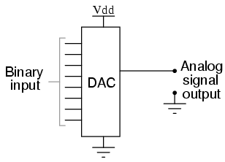
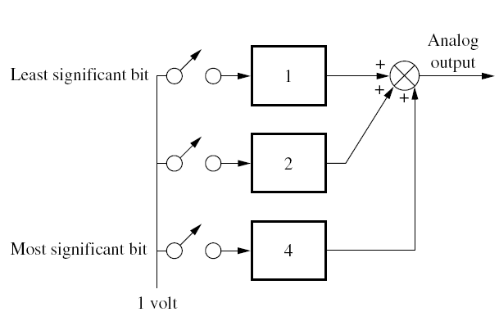
Digital -Analog Conversion
Properly weighted voltages are summed together to yield the analog output.
Three weighted voltages are summed. The three-bit binary code is represented by the switches
Thus, if the binary number is 110₂, the center and bottom switches are on, and the analog output is 6 volts. In actual use, the switches are electronic and are set by the input binary code.

Slide 22
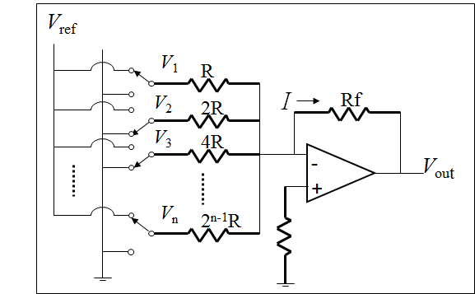
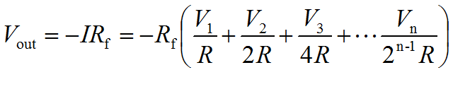
Weighted resistor DAC
MSB
The resistances are increased form MSB to LSB to adjust to the weightage of the binary digits
Availability Accurate resistances is a problem and that too at varying temperatures, Limited to 4 bit conversions
LSB

Slide 23
R-2R Digital - Analog Converter
4 Bit Digital-Analog Converter using R-2R Approach

Slide 24
R-2R Digital - Analog Converter
For binary input 0001 b₀ switch is connected to the opamp and the other bit switches are grounded.
Voltage V₀ is then equal to voltage division of V₁ across to two resistors, R, in series:
On similar lines:

Slide 25
Digital - Analog Converter
For binary input 1111, voltage V₀ is then equal to:
In generic terms, for a four bit DAC, the equivalent analog output is given by:

Slide 26
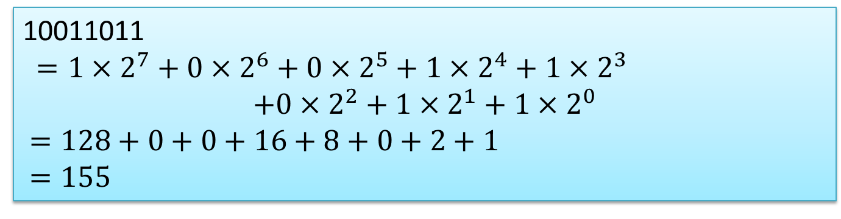
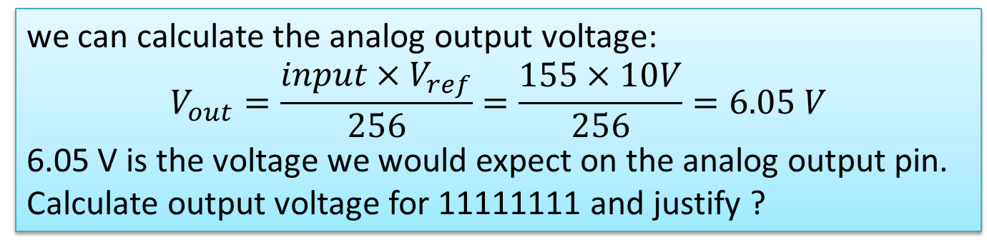
Example 1
An 8-bit R-2R DAC has a V_{ref} of 10 V. The binary input is 10011011. Find the analog output voltage.

Slide 27
Other Way of Solving Example 1
An 8-bit R-2R DAC has a V_{ref} of 10 Volts. The binary input is 10011011. Find the analog output voltage.

Slide 28
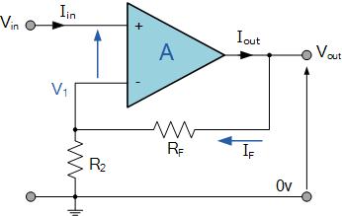
Voltage Amplifier
A non-inverting type voltage amplifier
Amplifies output voltage
Voltage input is applied to non-inverting terminal
Gain is positive and greater than unity
Consists of feedback resistor, R_{f}, to give stable, self-correcting and un-saturated output

Slide 29
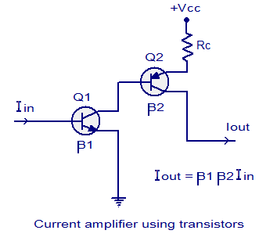
Current Amplifier
Amplifies current in a step by step process
Realized using multiple transistors
β is the gain of the transistor= collector current / base current = I_{C}/I_{B}
Output current is the product of input current and the gain, β

Slide 30
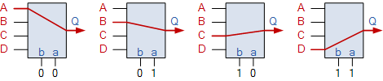
Multiplexer
Provides an output from just one of many input data
Avoids separate ADC and microprocessor for each measurement

Slide 31
Parity bit concept for error detection
At source, The data 10101 is given the even parity bit of 1, resulting in the bit sequence 101011.
Detects loss of data
During transmission of data, Suppose 101011 becomes , say 111011, receiver will detect lack of even parity and nullifies the data.

Slide 32
Thank you

