Slide 1
PROJECT TITLE – CUSTOM CLOUD
Presented by
Team No. 67
Abhi Bothera (E17CSE128)
Submitted
to
DEPARTMENT OF COMPUTER SCIENCE ENGINEERING
BENNETT UNIVERSITY, GREATER NOIDA, 201310, UTTAR PRADESH, INDIA

Slide 2
OUTLINE
Introduction & Background
Problem Statement
Why Custom Cloud?
Proposed Solution
Experiment and Implementation
Results Analysis and Validation
Conclusion
Future Work
References
Important Links
Demonstration

Slide 3

Introduction & Background
Custom Cloud is a typical cloud service selection to choose the optimal cloud services dependent on numerous clashing Quality of Service measures.
It is user-centric and compares various parameters like Response time, Availability, Throughput, Successabilty, Reliability, Compliance, Best Practices according to WS-I Basic Profile, Latency, Documentation and Web Service Relevancy Function.
Notes:
Custom Cloud is a typical cloud service selection to choose the optimal cloud services dependent on Quality of Service measures like Response time, Availability, Throughput, Latency, etc.
Basically, at Custom Cloud, the client gets the best of Cloud Service Providers after the comparison amongst more than 2500+ Cloud Service Providers according to particular usage and needs. We use a mixture of various Multi-Criteria Decision-Making methods, Machine Learning and Neural Network to evaluate the service providers.

Slide 4
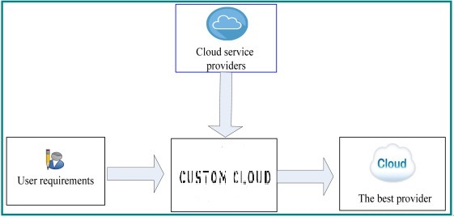
Block Diagram – Custom Cloud
Notes:
This is how the Custom Cloud works. A user inputs his preferences and Quality of Service attributes are fetched from CSPs to provide the best Cloud service Provider.

Slide 5
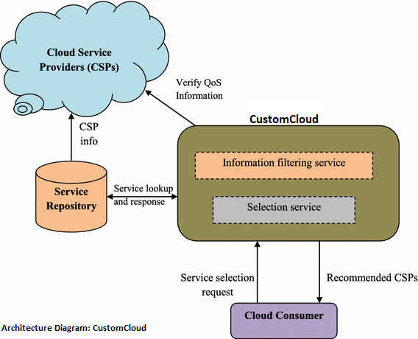
Notes:
Taking a deep dive into the architecture of Custom Cloud, it consists of an information filtering and selection service, where the client sends a service selection request and we fetch the CSP information from the dataset. Then, all of this data is passed through the Custom Cloud’s neural network and Best performing CSPs are recommended to the Cloud Customer.

Slide 6
Problem Statement
Definition 4.1. (Cloud Set): Consider a set C = {C1,C2,C3, . . . ,CM} of clouds, where, Ci , 1 ≤ i ≤ M denotes a cloud service provider (CS Pi) which offers the cloud Ci defined as Ci = < CS Pi .
Definition 4.2. (Quality of Service (QoS)): QoS refers to throughput, processing time, resource utilization, response time, latency, fairness, power, availability and reliability so that customers’ tasks can run in time and without any delay. Note that the requirements of QoS are vital issues for customers. Therefore, prior to the resource delivery, the customer and the CSP have to agree on these issues by signing a service level agreement (SLA).
Definition 4.3. (Customer Set): Consider a set S = {S1, S2, S3, . . . , Sn} of different users of Custom Cloud, where Si , 1 ≤ i ≤ n is the ith task with the set of instruction Ii (in MI).
Definition 4.4. (Performance Set): Consider a set P = {P1, P2, P3, . . . , Pn} of performance, where Pi , 1 ≤ i ≤ n and 0 ≤ P ≤ 1.
Definition 4.5. (Impact): Impact refers to a positive or negative effect that an attribute will have on the Performance Set.
Notes:
In past years, both the academic communities and industries have drawn significant attention to the cloud determination issue. These exploration works have a few focal points with respect to their condition, applications, and limitations. According to reports by Gartner, CERT and Nascommm, cloud service selection issue and cloud client necessities have additionally made numerous difficulties on Cloud service selection and hence made it one of the most crucial issue in the field of cloud computing. Therefore, a further study and investigation is required as there is a high demand of custom cloud services to provide better insights to the clients and help them choose the ideal Cloud Service Provider with maximized precision and minimized time complexity. Following is a mathematical representation of the problem CustomCloud aims to solve: A cloud set which denotes all the service providers, quality of service dataset, Customer preferences set, impacts and performance set.

Slide 7
Problem Statement
Definition 4.6. (Mapping and Mapping Function): The process of computing, matching, allocating the ranks to the CSPs based on their performances is referred as mapping. The mapping function f receives a request from a customer set S and Custom Cloud assigns ranks Ri , 1 ≤ i ≤ n , based on Performance Pi.
The problem is to map the Performance set P on the Cloud set C ( f: P → C ) such that the following objectives are fulfilled.
Affirm the objectivity of observing Quality of Service data.
Acquire high fulfillment degree dependent on cloud client's inclination.
The Average Cloud Utilization, Throughput, Reliability, Compliance and Availability are maximized.
Latency and Response time are minimized.
Notes:
Custom Cloud receives a request from a customer set S and assigns ranks R based on Performance P with the help of MCDM Techniques and Neural Network.

Slide 8
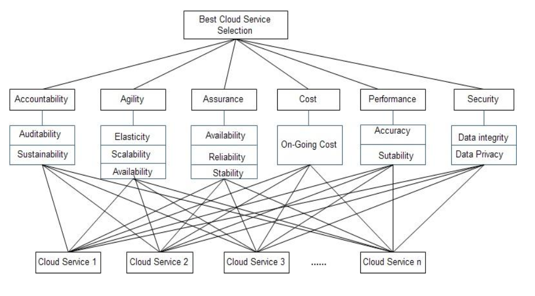
Figure: Criteria for Best CSP Selection
Notes:
The main problems that the project will solve:
To affirm the objectivity of observing Quality of Service data.
So that the Average Cloud Utilization, Throughput, Reliability, Compliance and Availability are maximized.
To minimize the Latency and Response time.

Slide 9
Why Custom Cloud?
What objective does Custom Cloud fulfill?
How is Custom Cloud useful to society?
Whom do we target?
Notes:
Why Custom Cloud? Looking at the mathematical problem statement in the previous slides, you might have questions like:
What objective does Custom Cloud fulfill?
How is Custom Cloud useful to society?
Whom do we target?
Custom Cloud is currently a research project that targets on selection of best services in the area of cloud computing.
Due to this pandemic, most of the people were not able to access their physical systems and wanted to shift to Cloud for their computational and storage needs.
We will provide them custom-made options which best suits their needs, and this is one of the Business aspects of the project.
After we have gained certain number of Clients and provided them with solution and gained Market Trust, we plan to approach Cloud Service Providers and generate revenue by recommending them certain changes so as to improve their Quality of Service.
So as of now, we basically target Small-Scale businesses who wants to shift to Cloud.
As CSP selection has been a hot research topic lately, we would like to contribute to the field by publishing our work in an esteemed journal like Applied SoftComputing.
Also, introducing the Machine Learning and Neural Network in this field enhances the performance and reduces the time taken to select the best CSP and hence make Custom Cloud a novel approach.

Slide 10
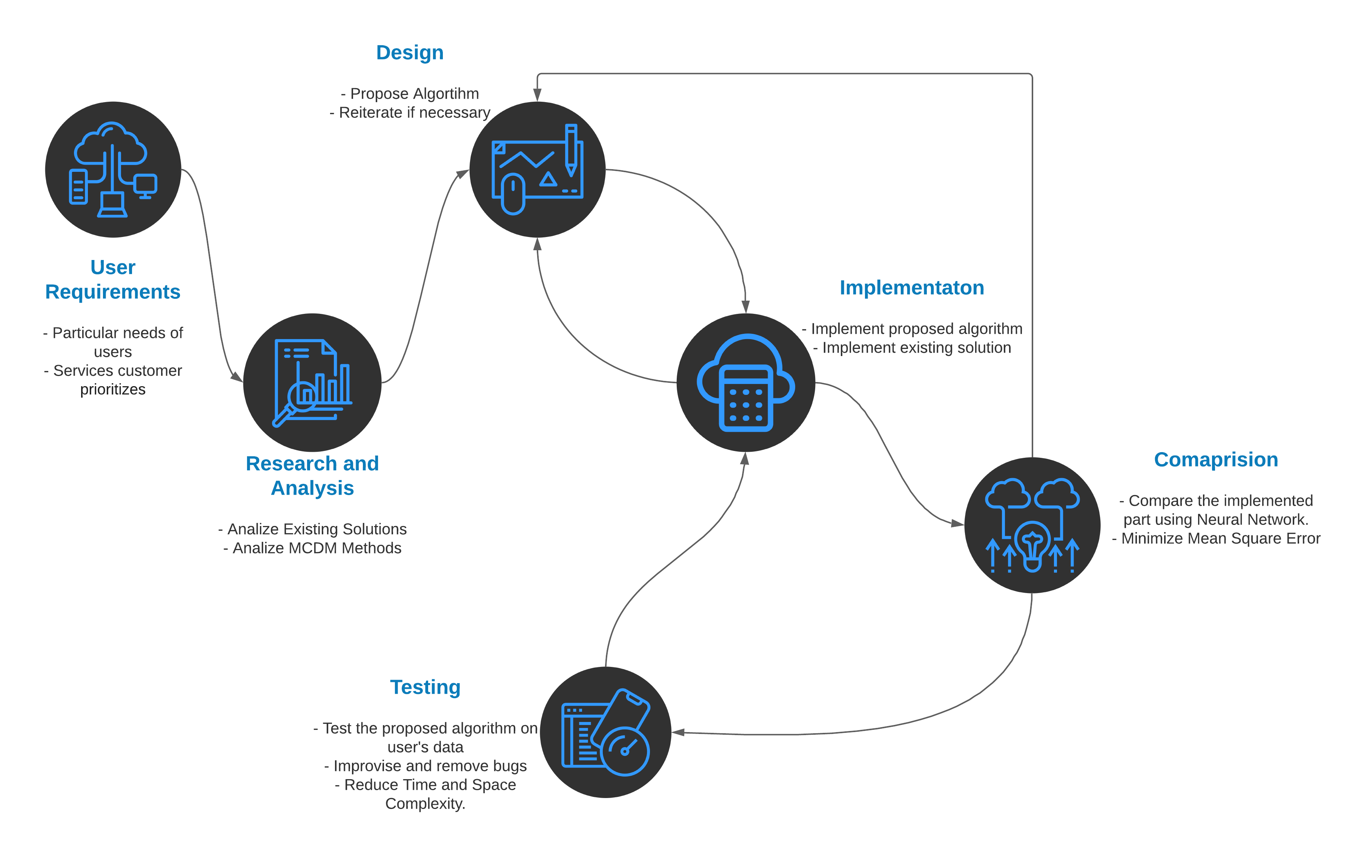
Proposed Solution
Figure: Proposed Solution
Notes:
Custom Cloud begins with taking users preferences as an input excel file and then pass them through AHP algorithm to obtain weights.
These weights are then used with the impact that can be either positive or negative on Multi Criteria Decision Making methods like WSM, TOPSIS and VIKOR. 80% of the performance scores of these algorithms are trained on a Neural Network and then tested on remaining 20%. Finally, MSE (Mean square errors) are minimized to obtain a trained and better performing Neural Network each time a client enters his preferences.
So, when a Client enters his preferences, he gets the best CSP for his particular needs in lesser time and the output is backed by more than 3 MCDM algorithms.

Slide 11
Algorithm
Step 1: Input from the user it taken.
Step 2: Analytic Hierarchy Process (AHP) is applied to the input matrix to obtain weights for further calculation.
Step 3: TOPSIS (Technique of Order Preference Similarity to the Ideal Solution), WSM (Weighted Sum Model) and VIKOR (VIšekriterijumsko KOmpromisno Rangiranje) methods are then applied using weights from Step 2.
Step 4: Calculate the final performance with the help of above results using the following formulae:
Final performance = (((0.2)*((Performance of WSM)^2)+ (0.3)*((Performance of TOPSIS)^2)+ (0.5)*((1 - Performance of VIKOR)^2))^(1/2))
Step 5: Use 80% of 2507 results to train the Neural Network and Test the Trained NN on the rest of Results for validation.
Step 6: Use the trained model to predict the rank based on User’s preferences from the input file.
Notes:
Weighted Sum Method that is WSM, TOPSIS and VIKOR are three of the best mcdm methods to obtain the ideal solution and as there is no particular method ranked as number 1, we have taken a combination of these three based on the performance on non fuzzy datasets. WSM is the most basic method. Topsis uses vector normalization to get the ideal output which is more useful in the case of fuzzy dataset, whereas VIKOR uses scaler normalisation for the same. We have given certain weightage to the performances of each of the above 3 methods which can be seen the formula to calculate the final performance. We then use the neural network, typically LSTM and decision making ML algorithm - random forest to find the ideal branch.

Slide 12
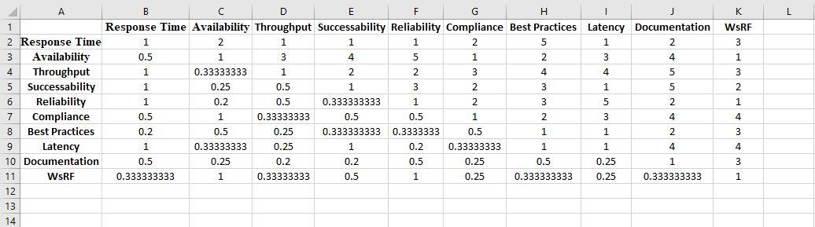
User Preferences Input File
Figure: Input File
Notes:
This is how a user input file looks like. Here, the lower half is reciprocal of the upper half of input square matrix.

Slide 13
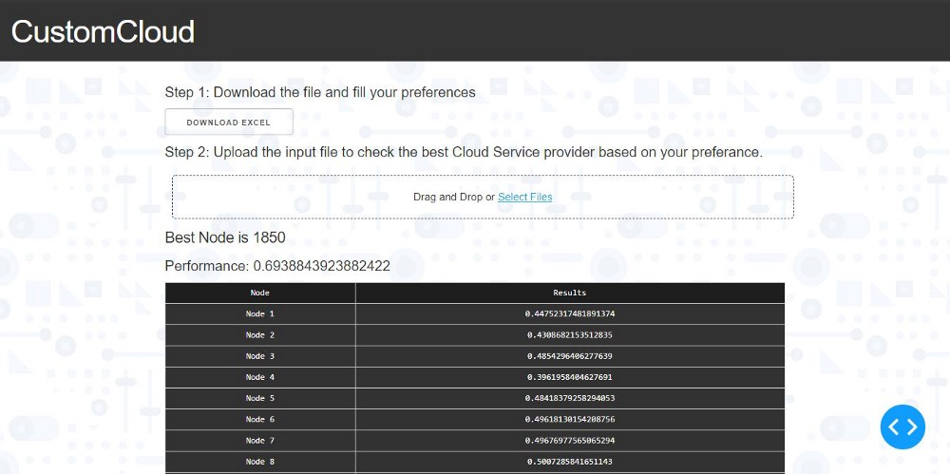
User Interface
Figure: Custom Cloud UI
Notes:
Here is a glimpse of the prototype user interface of Custom Cloud. It is made using Flask.

Slide 14
Experiment and Implementation
Following are the major requirements and dependencies to set up the experiment:
Python 3
Flask
Dash
Pandas
NumPy
QWS Dataset

Slide 15
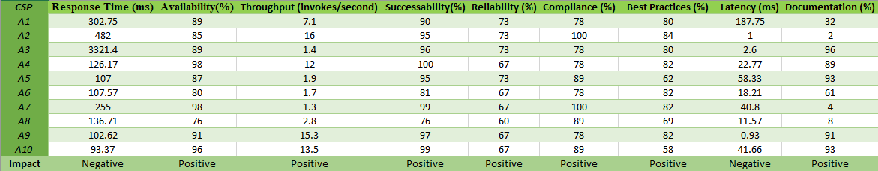
Results Analysis and Validation
Table: Test Input Data
Notes:
For the testing and validation, we used the above test data. We took 10 Cloud Service Providers and compared them on attributes like Response Time, Availability, Relieblity, Latency, etc. Each attribute comes with its own impact. For example, Latency has a negative impact, meaning – the lower the latency, higher will be the performance and vice verse for positive impact.

Slide 16
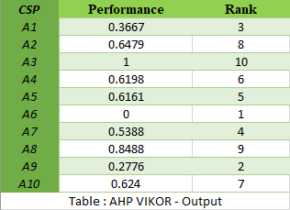
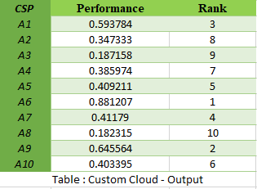
Results Analysis and Validation
Notes:
Here is a comparison of Hybrid MCDM algorithm, which is the latest and best performing with our Custom Cloud’s output. As you can see that the first, second and third ranks are consistent in both the outputs, our model is reliable.

Slide 17
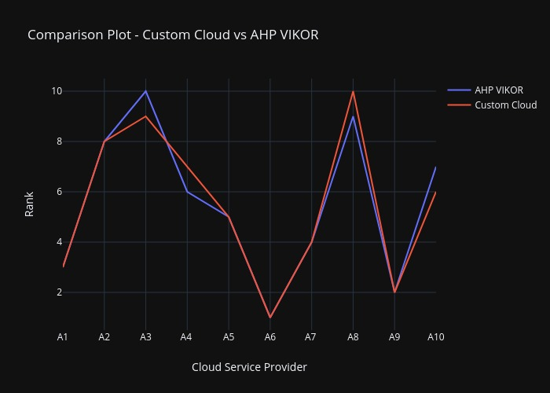
Results Analysis and Validation
Figure : Comparison Plot of Ranks – Custom Cloud vs AHP VIKOR
Notes:
And this is a comparison plot for the same. Now, how is Custom Cloud better? While Hybrid MCDM method takes above 9 seconds to rank the CSPs on a dataset of 2507 Nodes, Custom Cloud computes the result is less than 4 seconds. This is because LSTM flovoured Neural Network and Random Forest algorithm reduces the time complexity. Use of Machine Learning and Neural Network is First-in-class and has never been tried before. And as we know that reducing the latency and response time has been the major achievement, Custom Cloud sets a new milestone in the field of Cloud Computing.

Slide 18
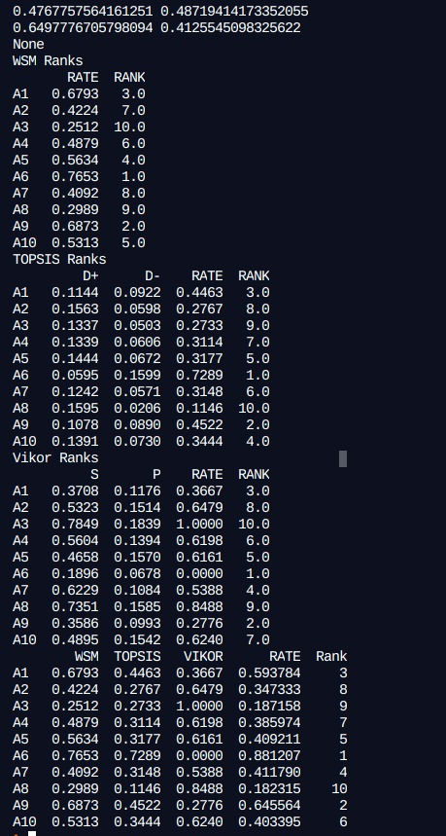
Results Analysis and Validation
Table A: WSM Ranks
Table B: TOPSIS Ranks
Table C: VIKOR Ranks
Notes:
Now, to be double sure, we have compared our ranks with the most used and best performing MCDM Techniques.

Slide 19
Results Analysis and Validation
Table: Comparison with Custom Cloud
Notes:
And I am happy to share that on a test data of 10 Node, we able to get consistent results.

Slide 20
Results Analysis and Validation
Figure : Comparison Plot of Ranks – MCDM Methods vs Custom Cloud
Notes:
To show it graphically, here is a radial comparison plot of ranks.

Slide 21
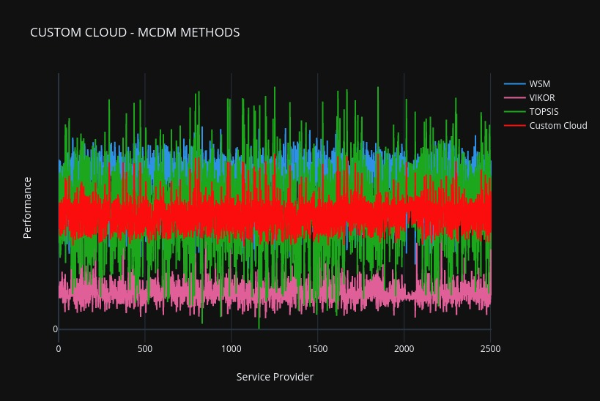
Conclusion
Custom Cloud offers a more reliable and fast way of selecting the best performing CSP in the least time complexity.
Figure : Plot – Custom Cloud vs MCDM methods.
Notes:
Following is a figure that compares the performance of most used MCDM Methods and Custom Cloud’s algorithm on the dataset of 2500+ Cloud Service Providers:

Slide 22
Future Work
Following are some of the tasks we would like to complete in the near future:
A prototype of a web-based UI using Flask was created to test and showcase the project for evaluation. The next step is to build a web app that supports all platforms and is easy to use.
Another self-set milestone is to publish a research paper in a reputed journal.
We also plan to enhance the Neural Network by training it over different inputs from various Clients.
After we have gained certain number of Clients and provided them with solution and gained Market Trust, we plan to approach Cloud Service Providers and generate revenue by recommending them certain changes so as to improve their Quality of Service.
Notes:
We currently aim to cater small businesses and people who wants to switch to Cloud from the traditional computing environments. After we have gained certain number of Clients and provided them with solution and gained Market Trust, we plan to approach Cloud Service Providers and generate revenue by recommending them certain changes so as to improve their Quality of Service.

Slide 23
References
Lecznar, Maciej, and Susanne Patig. Mell, Peter, and Tim Grance. ”Cloud computing providers: Characteristics and recommendations” E-Technologies: Transformation in a Connected World. Springer Berlin Heidelberg, 2011. 32-45
Saaty TL. The analytic hierarchy process. New York: McGraw- Hill, 1980
Martin Aruldoss, T. Miranda Laxmi and V. Prasanna Venkatesan, “A Survey on Multi Criteria Decision Making Methods and Applications”, Science and Education Publishing, Issue 1, Vol 1, pp. 31-43, 2013
Zavadskas, Edmundas & Antucheviciene, Jurgita & Chatterjee, Prasenjit. (2018). Multiple-Criteria Decision-Making (MCDM) Techniques for Business Processes Information Management. Information. 10. 4. 10.3390/info10010004.
Garg, Saurabh Kumar, Steve Versteeg, and Rajkumar Buyya. ”A framework for ranking of Cloud computing services”, Future Generation Computer Systems 29.4 (2013): 1012-1023
Yazdani, M.; Graeml, F.R. VIKOR and its Applications: A State-of-the-Art Survey. Int. J. Strateg. Decis. Sci. (IJSDS) 2014, 5, 56–83.
Peng, Y.; Kou, G.; Wang, G.; Shi, Y. FAMCDM: A fusion approach of MCDM methods to rank multiclass classification algorithms. Omega 2011, 39, 677–689.

Slide 24
Important Links
Custom Cloud Web Link - https://customcloud.herokuapp.com/
YouTube Video Web Link - https://youtu.be/B2AJ6FaR9sI
Blog Web Link - https://abhibothera.medium.com/custom-cloud-95d2b8b719f6
GitHub Code Web Link - https://github.com/abhibothera/CustomCloud

Slide 25
Demonstration

Slide 26
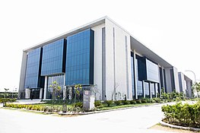
We are open to questions…

Slide 27
Thank You ☺

