Slide 1
Presentation on Software
BY
Abhinandan Bubnale

Slide 2
1.What is Software 2.Types of Software 3.Working of Software 4.Role of testing in Software
Content

Slide 3
What is software
Software is nothing but set of instructions or set of programs are known as Software
Software is a part of Computer which cannot be touched .software tell a computer what to do and how to do

Slide 4
Types of Software
System Software
Application software
Utility Software

Slide 5
1. System Software
System Software is Software designed to provide a platform to other software
System Software control and manage the operations of computer hardware
EX. Operating System (Windows,Android,linux)

Slide 6
2.Application Software
The Software that helps you to do a specific type of works is called as application software
EX : MS word,EXCEL

Slide 7
3.Utility Software
Utility software helps to manage, maintain and control computer resource
EX : Antivirus S/w
Backup S/W
Disk Tools

Slide 8
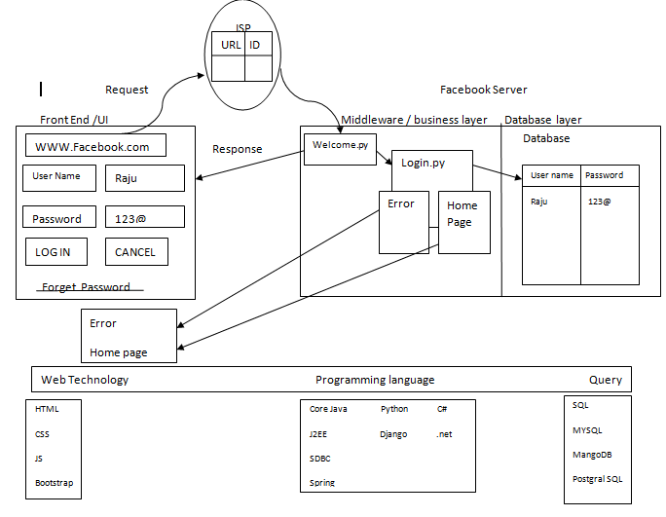
Working

Slide 9
Role of Testing in Software
Analyse customer Requirement
Find bugs/defect in software
Report the bug to the developer
Retesting
Insure Quality Product to Customer

Slide 10
Thank you
Any Question ?

