Slide 1

Instacart Market Basket Analysis
Business Data Mining - Group 13
17BM6JP25 : Abhishek Gupta
17BM6JP27 : Shaswat Roy
17BM6JP22 : Anshul Singhal
17BM6JP35 : Puneeth Gandla
17BM6JP44 : Ranadheer V

Slide 2
Sections
Problem Statement
Data Description
Feature Engineering
Exploratory Data Analysis
Prior, Train and Test Segmentation
How F1 score is maximized?
Model Structure
Why LightGBM?
Feature Importance
Model Evaluation & Results
Feature Importance
Handling Twist
Scope of Improvement

Slide 3
Problem Statement
Instacart is a grocery store that aims to provide a delightful shopping experience for users
Given certain users, the objective is to predict best items that can be added into the cart (by calculating reorder probabilities of all the items ordered previously)
The scope does NOT include recommending products which have never featured in the customer’s purchase history
To identify the department/aisle into which a new product can be introduced

Slide 4
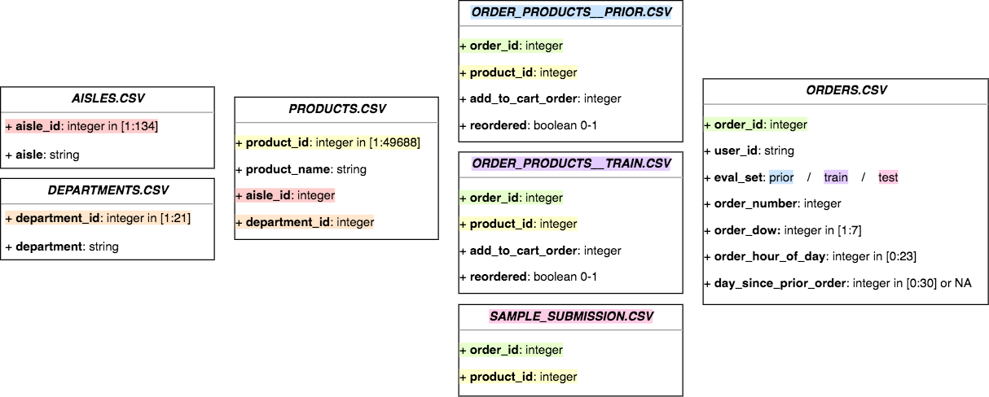
Data Description
All in all there are 3M grocery orders from more than 200k Instacart users, consisting of ~50k Products and 21 Departments

Slide 5
Features Engineered
User Features
User x Product Features
Total orders
Median days since prior order
Total products
Total distinct products
Avg new products per order
Avg basket size
Order length
Previous order length
Orders since last order
Product reorder ratio per user
Min order no.
Max order no.
# of times product ordered per user
Avg cart position
Orders since last order
Product Features
Reorder probability
No. of times ordered
Reorder ratio
Notes:
As suggested by you, we can add a new metric which shows in how many orders of a customer does a particular product appear
Additionally, as the days since prior order is more suited for predicting when the person will make an order, we can drop the median days since prior order in our analysis

Slide 6
EDA (1 of 8)
Highlighted buckets indicate the presence of outliers, underlining the importance of customers’ Median Days to Reorder

Slide 7
EDA (2 of 8)
Customer’s propensity to order in a particular day of the week has been identified using mode of DOW distribution for each user
Caveat
There are multiple customers having more than 1 modal value
Day 0 and Day 1 are the most favored by customers to place orders

Slide 8
EDA (3 of 8)
Products Most Reordered
Product Name | Aisle Name | Department Name | Reorder Ratio
Raw Veggie Wrappers | Prepared Meals | Deli | 0.941
Extrema Overnight Pads | Feminine Cream | Personal Care | 0.931
Orange Energy Shots | Energy Sports Drink | Beverages | 0.923
Chocolate Love Bar | Candy Chocolate | Snacks | 0.920
Soy Powder Infant Formula | Baby Food Formula | Babies | 0.914
Nighttime Sleep Aid | Other | Other | 0.911
Energy Shot, Grape Flavor | Energy Sports Drink | Beverages | 0.909
~50% of Top 20 products with highest reorder ratio belong to Beverages & Snacks department

Slide 9
EDA (4 of 8)
Products Least Reordered
Product Name | Aisle Name | Department Name | Reorder Ratio
Cheese & Mushroom Blend | Grains Rice Dried Goods | Dry Goods Pasta | 0
School Glue | More Household | Household | 0
Spinach Basil Garlic Linguini | Fresh Pasta | Dry Goods Pasta | 0
Tarragon Wine Vinegar | Oils Vinegars | Pantry | 0
Soppressata Piccante | Lunch Meat | Deli | 0
Large Rawhide Chews | Dog Food Care | Pets | 0
Oblong Glass Bakeware | Kitchen Supplies | Household | 0
‘Household’ & ‘Dry Goods Pasta’ products are reordered the least out of the entire market basket

Slide 10
EDA (5 of 8)
Products Most ORDERED
Product Name | Aisle Name | Department Name | # Times Ordered
Banana | Fresh Fruits | Produce | 472,565
Bag of Organic Bananas | Fresh Fruits | Produce | 379,450
Organic Strawberries | Fresh Fruits | Produce | 264,683
Organic Baby Spinach | Packaged Vegetables Fruits | Produce | 241,921
Organic Hass Avocado | Fresh Fruits | Produce | 213,584
Large Lemon | Fresh Fruits | Produce | 152,657
Organic Whole Milk | Milk | Dairy Eggs | 137,905
~70% of Top 20 most ordered products are organic foods and ~60% belong to the Fresh Fruits section

Slide 11
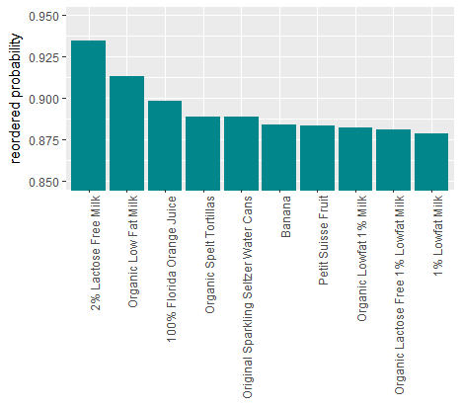
EDA (6 of 8)
Product Reorder Probability
How is product reorder probability calculated?
Consider the product Milk
No. of users who have ordered milk atleast once = 1,000
No. of users who have ordered milk atleast twice = 700
Milk reorder probability = 700/1000
= 70%
~ 50% of the Top 10 products with maximum reorder probability are Lactose Free and Low Fat milk

Slide 12
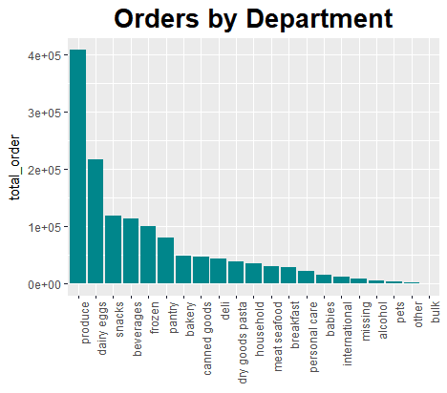
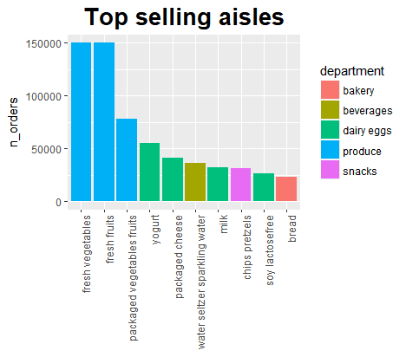
EDA (7 of 8)
Produce’ & ‘Dairy Eggs’ products are purchased most often and Fresh Vegetables & Fruits are most popular aisles

Slide 13
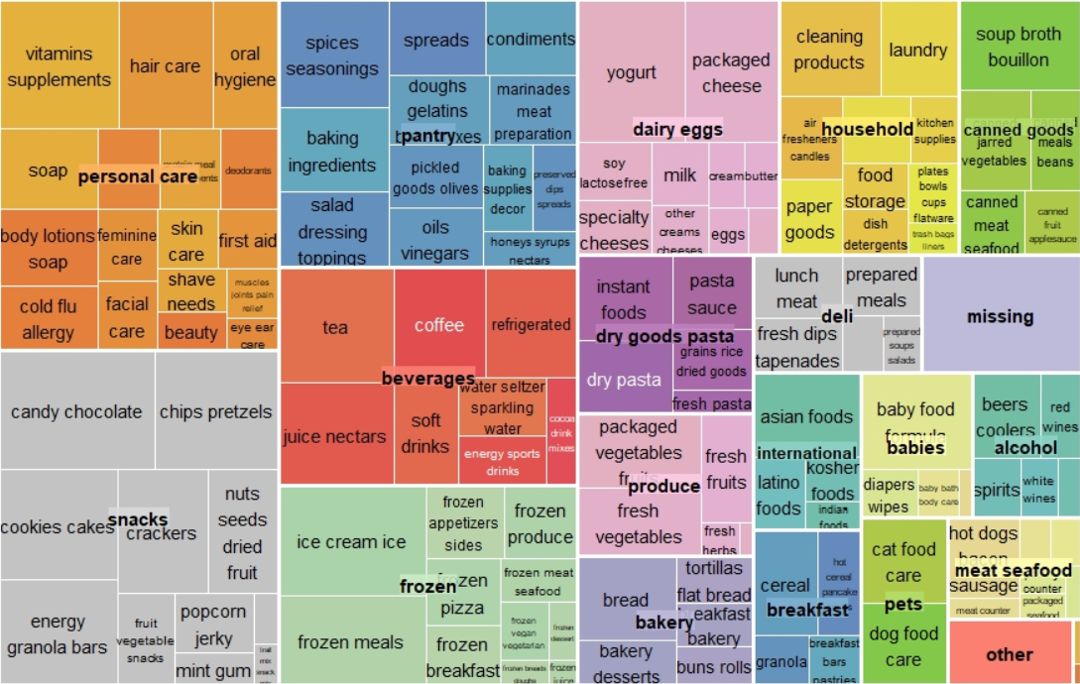
EDA (8 of 8)
Department Composition

Slide 14
Prior, Train and Test segmentation
Referring the image to the right, the users A, B and D are randomly selected to be in train dataset and the user C in the test dataset
Hence, the information regarding the ‘last order’ of the users A, B and D is provided completely as a part of train dataset
And as the ‘last order’ of user C goes into the test dataset, information regarding this order is incomplete and this is what is needed to be predicted (the items that go into the cart for this user)
Also, the information regarding previous orders for all users is present in the prior dataset
Reference: Instacart Kaggle #2

Slide 15
F1 Maximization
Let’s say for a user P(A) = 0.8 P(B) = 0.3
Recommend None
Recommend A
Recommend A & B
 | Probability
Only A | 0.8*(1-0.3) = 0.56
Only B | 0.3*(1-0.8) = 0.06
A and B | 0.8*0.3 = 0.24
None | (1-0.8)*(1-0.3) = 0.14
F1 Score | Probability
0 | 0*0.56= 0
0 | 0*0.06 = 0.06
0 | 0*0.24 = 0.15
1 | 1*0.14 = 0.14
Expected F1 Score: 0.14
F1 Score | Probability
1 | 1*0.56 = 0.56
0 | 0*0.06 = 0
0.66 | 0.66*0.24 = 0.15
0 | 0*0.14 = 0
Expected F1 Score: 0.71
F1 Score | Probability
0.66 | 0.66*0.56= 0.37
0.66 | 0.66*0.06 = 0.04
1 | 1*0.24 = 0.24
0 | 0*0.14 = 0
Expected F1 Score: 0.65
Max Expected F1 Score
Set threshold between 0.3 and 0.8 & Recommend products above threshold
We consider only those products which a user has ordered before and choose threshold to maximize expected F1 score

Slide 16
Model Structure
There is no intersection between users in train (131k) and test (75k) dataset, but the order information for all these users is present in the prior dataset
Prior dataset is used to form hypothesis and create features , whereas train dataset is used build model relation between these features to predict reorder probabilities
‘Last order’ of all users in the test dataset is taken from prior dataset and this is considered to be the cross-validation dataset
Hence the users in the cross-validation and test dataset are the same, but just their order IDs are different
For all the users in the test dataset, list of all possible items that can go into the cart selected based on their order history (from prior dataset)
Using F1 Maximization procedure mentioned in the above slide, threshold for each user in the test dataset is determined
And items that have a reorder probability greater than threshold go into the cart

Slide 17
Why LightGBM ?
Light GBM is computationally very fast and our dataset is very huge so when using Random Forest or any other classification model is computationally expensive.
It handles categorical variables itself without being explicitly requiring one- hot encoded variables.
Why not Collaborative Filtering ?
As per the objective of the problem we have to predict whether user will reorder a certain product based on information in the prior dataset. So we cannot recommend new item to a user who has earlier not bought that particular item

Slide 18
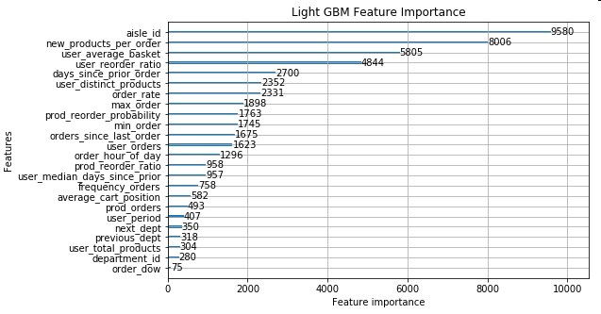
Feature Importance
Following features created, proved helpful in improving model
Avg new products per order
Avg basket size per user
Product reorder ratio per user
Distinct products ordered by a user
Total orders for a user
Max order

Slide 19
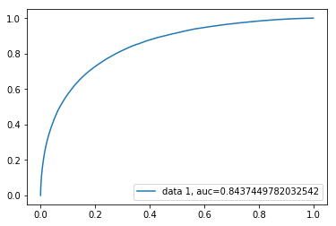
Model Evaluation and Results
Model Parameters
Model Output
Learning Rate : 0.05
Num_Iterations : 200
Metric : AUC
AUC: 0.8437
F1 Score : 0.3796
ROC Curve

Slide 20
Handling twist
1
Which products to remove?
Create product metric i.e. (Normalized Time Since Introduction* ) / ( Normalized orders* x Reorder Ratio* x Reorder Probability* )
We want to filter out products which have been introduced for a long time, are not selling much, are reordered very little and are reordered by very few people
In other words, we want to identify products which have maximum value for this metric
For every department, sort products in descending order of the value of the metric and products at the top are candidates for removal
If we have additional information about the perishability of a product i.e. average days till expiry and then if two products have same value of the metric defined above, then we should consider removing the product with shorter life
* Reorder Probability – Out of all customers who have ordered a product, how many have reordered it
* Reorder Ratio – Out of all orders of a product how many are reorders + ɛ (very small value)
* Normalized orders = (No. of orders – Min no. orders) / (Max no. orders – Min no. orders) + ɛ (ɛ added to avoid reorder ratio =0)
* Normalized Time Since Introduction is computed similarly

Slide 21
Handling twist
2
If information about price and holding cost is available
Tweak the product metric to add a profit term i.e. Profit = SP of 1 item - Holding cost of that item
(Normalized Time Since Introduction) / (Normalized orders x Reorder Ratio x Reorder Probability x Normalized Profit* )
We want to filter out products which have been introduced for a long time, are not selling much, are reordered very little, are reordered by very few people and provide low profit per unit sale to the store
In other words, we want to identify products which have maximum value for this new metric
For every department, sort products in descending order of the value of the metric and products at the top are candidates for removal
* Normalized profit is computed similarly as normalized orders and normalized time since introduction
We can augment the objective criteria with business objectives such as maintaining variety in product catalog, to finally decide which products to remove

Slide 22
Scope of improvement
To improve the model accuracy, labels for reorders ‘0’ can be created by taking all the items that are previously ordered by the users in the train dataset
Data from the prior data set can be added into the train dataset to improve prediction accuracy
To determine threshold for each user, rather than ‘maximizing the expectation’, iterative approaches like ‘Expectation Maximization’ can be used to improve the accuracy of predicting thresholds
Sequential association rules can be used to build additional features
Say a product A in a order is always followed by product B in the next order, we can use this information to predict next items in the cart of a user

Slide 23
Thank You

