Slide 1
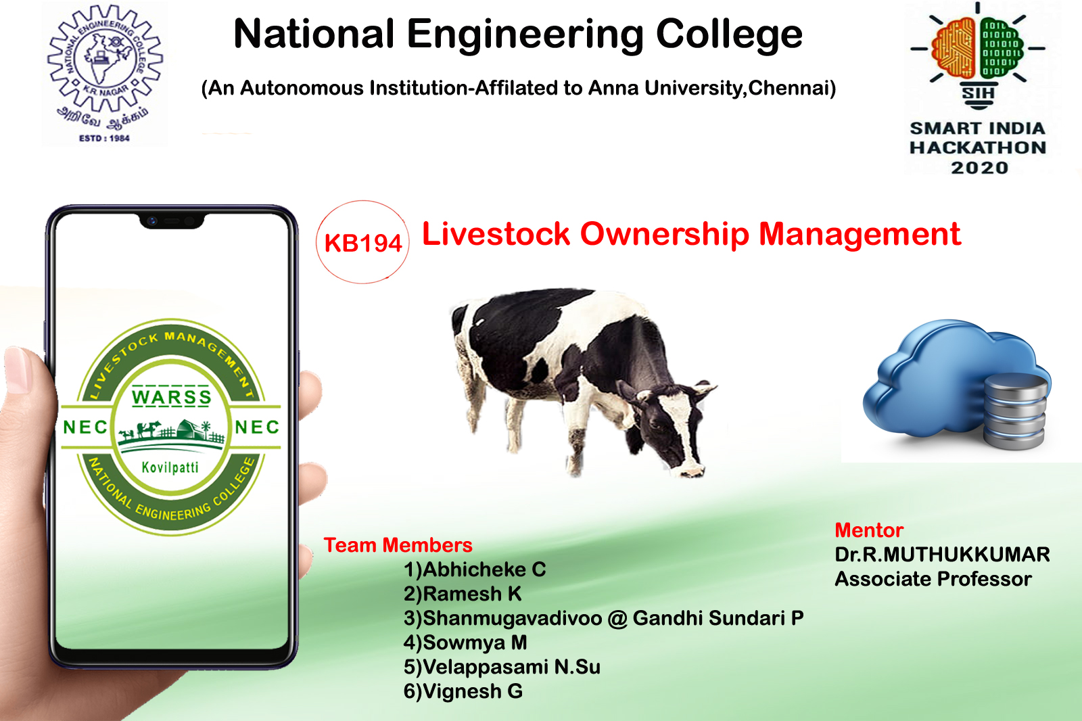
K.R.Nagar, Kovilpatti - 628 503
www.nec.edu.in
Team Members
Abhicheke C
Ramesh K
Velappasami N SU
Vignesh G
Shanmugavadivoo @ Gandhi Sundari P
Sowmya M
Mentor
Dr.R.MUTHUKKUMAR
Associate Professor

Slide 2






PROBLEM STATEMENT
All India livestock census database to design suitable fields to capture the dynamic events in livestock population changes.
App Should:
Provide facility for operators to add, delete, and modify livestock details using suitable identification mechanism during birth, sale, and death.
Provide officials access to data and stats across different geographical areas.

Slide 3






High-Level Solution Design
Supervisor
Web Admin Portal
Field Officer
Data Collection App
Staging Data Storage
Finalized Data

Slide 4

Mobile APPLICATION
General Info
Name
Phone
Aadhar
Address
Species
Cows
Buffalo
Sheep
Goat
Horse
Commercial
Domestic
Generating Unique Id
Features
New born
Death
Update
Ownership Change
Buy / Sale
Field Officer
Farm
Non-Farm
Data Collection by Field Officers

Slide 5










Technical Design
Internet
APK

Slide 6
Future implementations

Slide 7
Data collection
Areas
Rural
Urban
General Info
Sex | Breed
Age | Birth
Death | Sale
Usage
Domestic
Commercial
Habitation
Farm
Non-Farm
Real-time Sync
Species
Cattle
Cows
Buffalo
Sheep
Goat
Pig
Poultry
Commercial Production
Meat
Milk
Egg
Wool
Categories
Indigenous
Exotic
Crossbred
Graded
Offline Sync
Staging Data Storage
Field Officer
Data Collection App installed in Tab

Slide 8

Data processing & Administration
Data Validation
Processing
Correction
Approval
Rejection
Scheduling
FO Allocation
Auto Alerts
Exceptional Survey
Supervisor
Collaboration
Veterinary Dept
Welfare Schemes
Geography
Village
Taluk
District
States
Staging Data Storage
Reporting
Livestock Statistics
Commercial Statistics
Finalized Data
Web Admin Portal

Slide 9
APP & WEB ADMIN PORTAL Features
PIN/OTP Based Login
Livestock Owner/Rearer Details
Add, Modify, Mark for Removal
Unique ID mechanism for Cattle & Owner
Image Upload
Ownership Change
Data Sync- Offline/Online
Flexible Options
Privileged Login
Mobile App Access Control
Data Review & Correction
Data Approval & Rejection
Data Visualization
Cloud Sync
Auto Alerts & Reminders
Other Dept Collaboration
Add/Remove Data Collection Categories

Slide 10




recommendations
Field Officers
- VAO or Officer from AHD
- Panchayat Sarpanch
- PDS Official
Supervising Officers
- Officer from Survey Dept
- Manages Taluk level FOs
- Reports to District HQ
Survey Scheduling
Quarterly/Seasonal
Monitoring & Progress Check
Training
- Workshops on Data Collection
- Instruction Manuals on App Usage
- E-learning options
- Dedicated Support Desk for FO
- Resolving Issues online

Slide 11
Implementation plan
PILOT Implementation
Identify 2 or3 Taluks with Rural & Urban areas combined
Assign Field Officers & Supervisors
Data Collection on variety of livestock
Document Practical issues on field and Report back to Supervisors
Adapt App to handle issues
Record Feedback from Field Officers & Supervisors
BIG-BANG Implementation
Prepare Infra to handle Big-Bang Implementation
Detailed Cost-Analysis
Trained Field Officers & Supervisors
Survey Scheduling plays a vital role

Slide 12

Thank you

