Slide 1
RESTAURANT MANAGEMENT SYSTEM
Using Tkinter.
Under the guidance of PRITI DALVI Ma’am

Slide 2
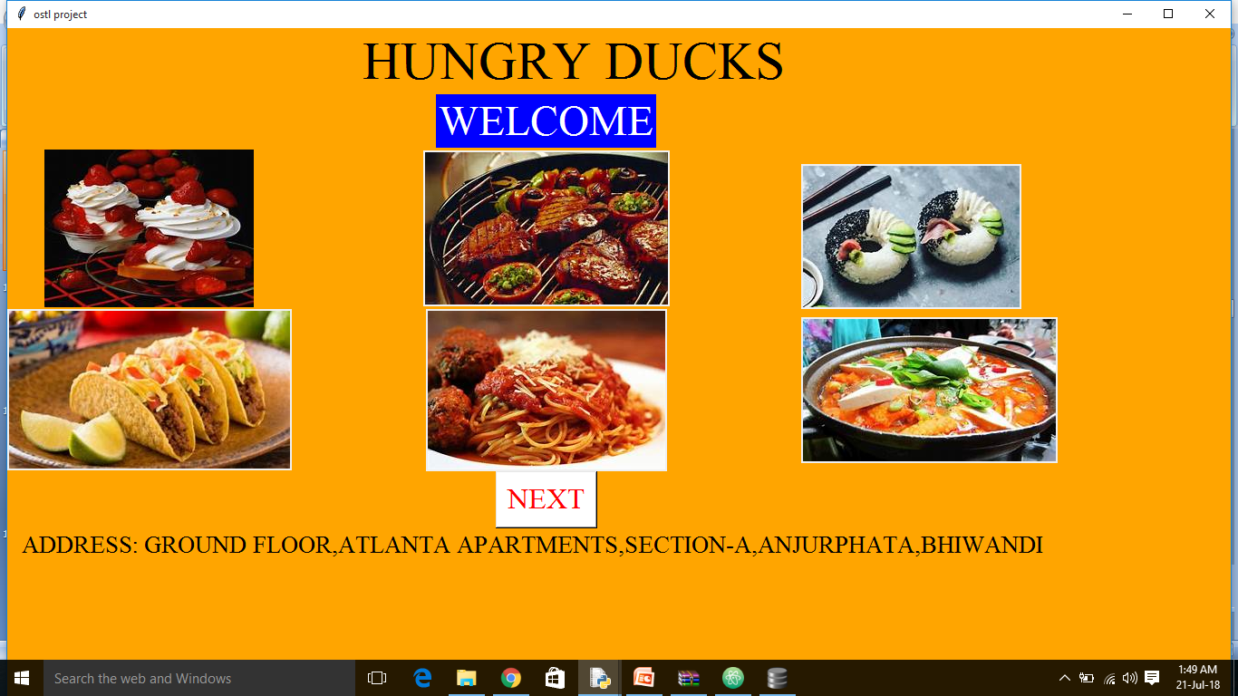
WELCOME FRAME

Slide 3
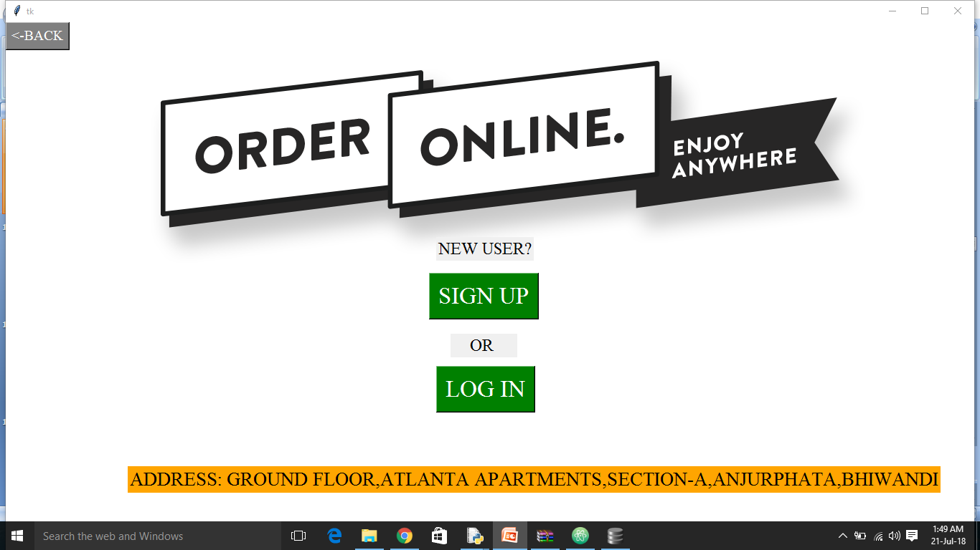
FRONT FRAME

Slide 4
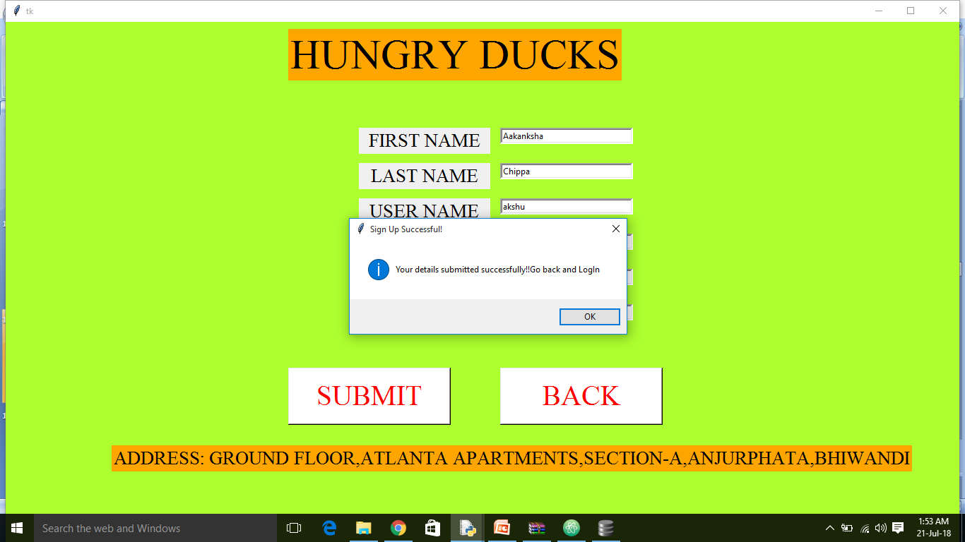
SIGN UP PAGE

Slide 5
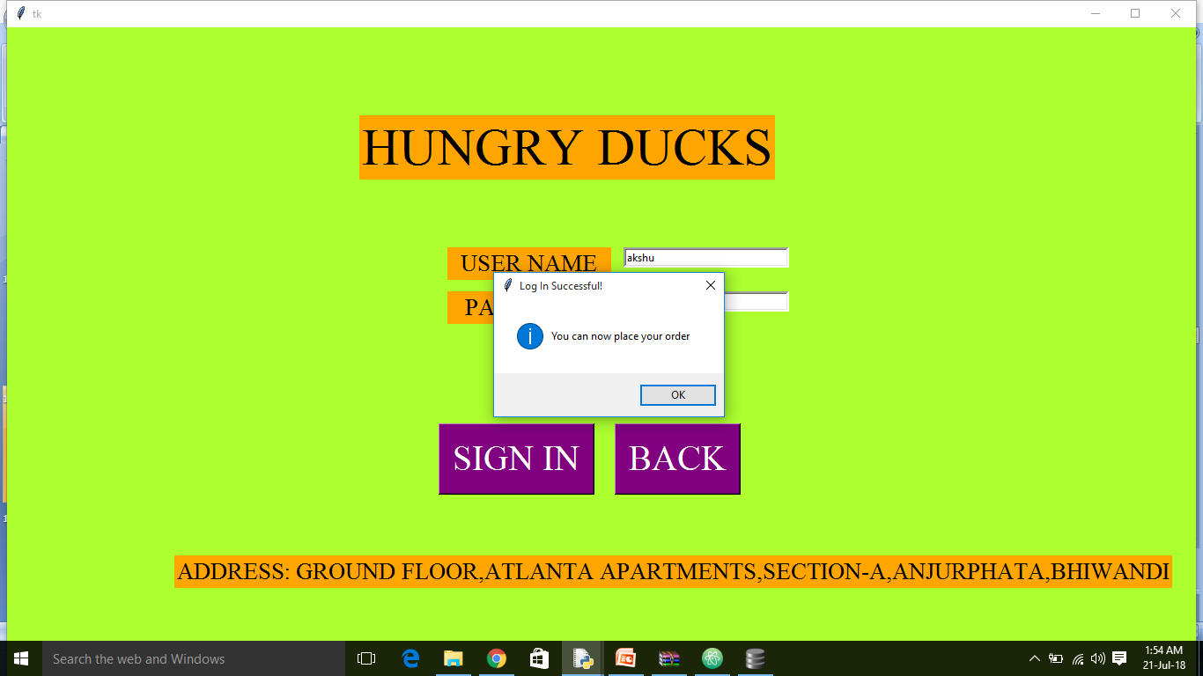
LOGIN PAGE

Slide 6
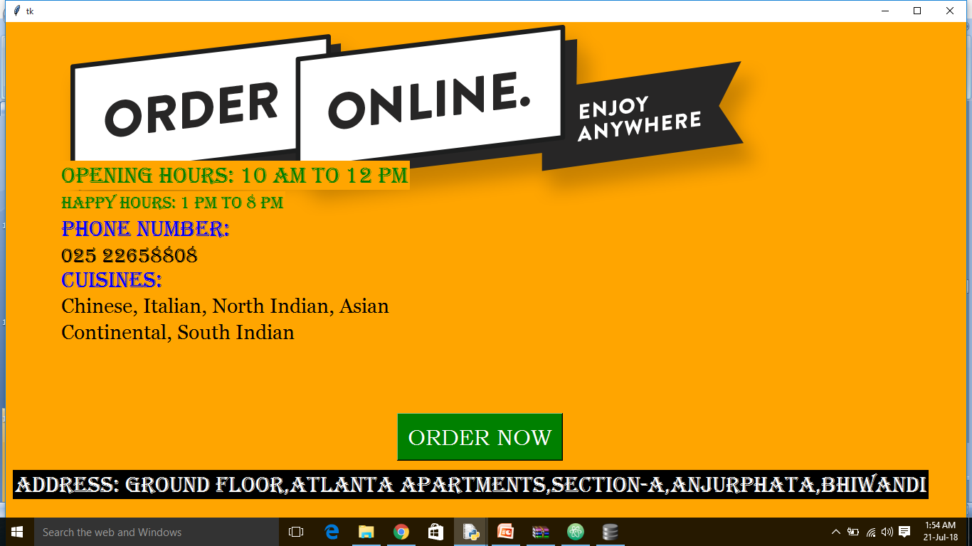
DETAILS OF HUNGRY DUCKS

Slide 7
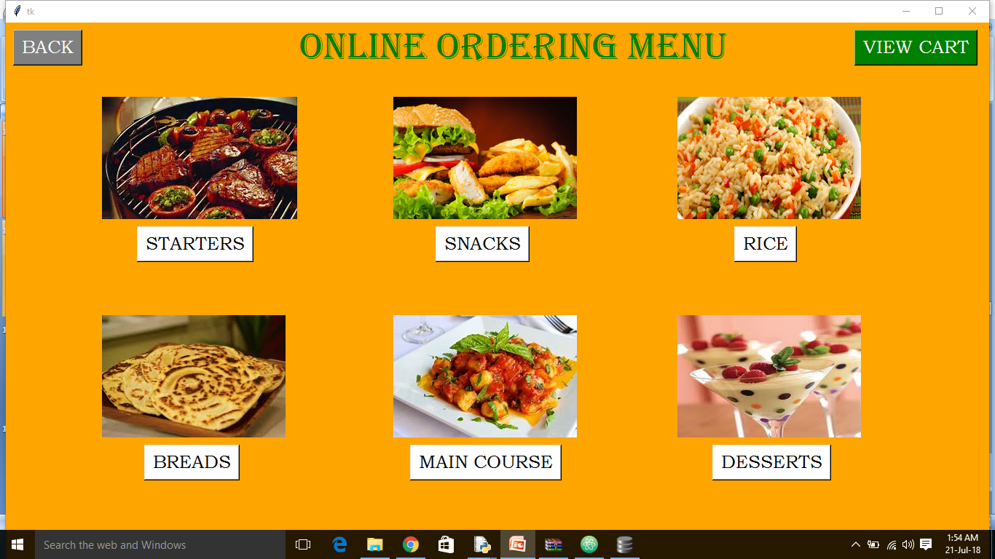
MENU PAGE

Slide 8
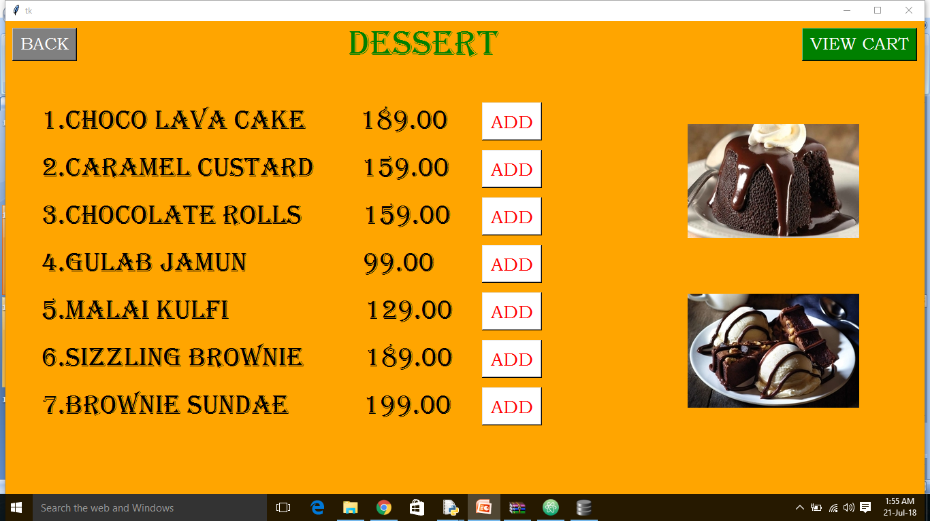
MENU OF DESERT

Slide 9
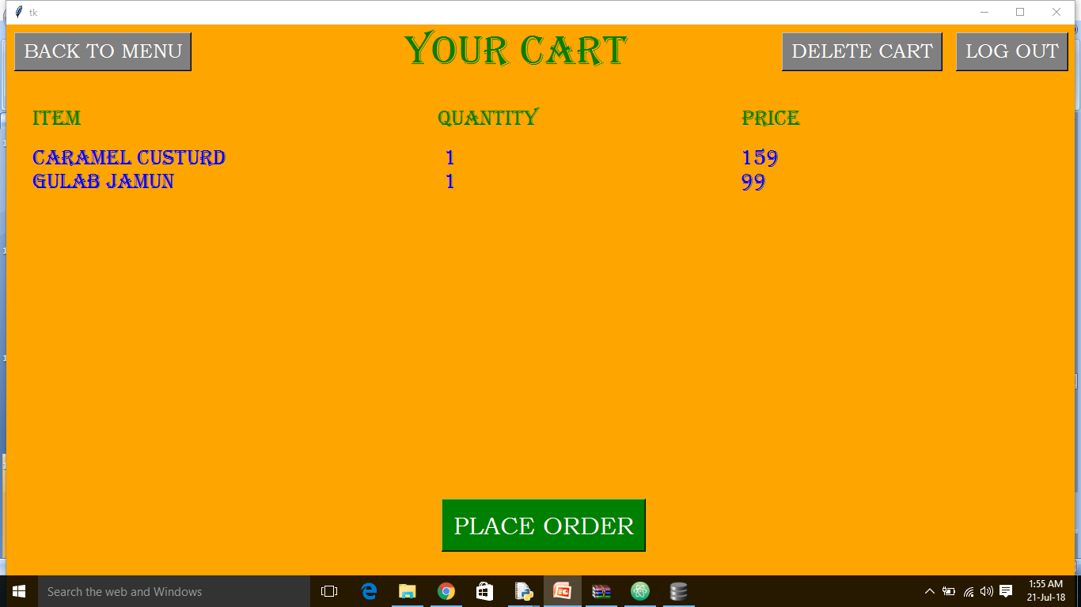
ORDERED DETAILS

Slide 10
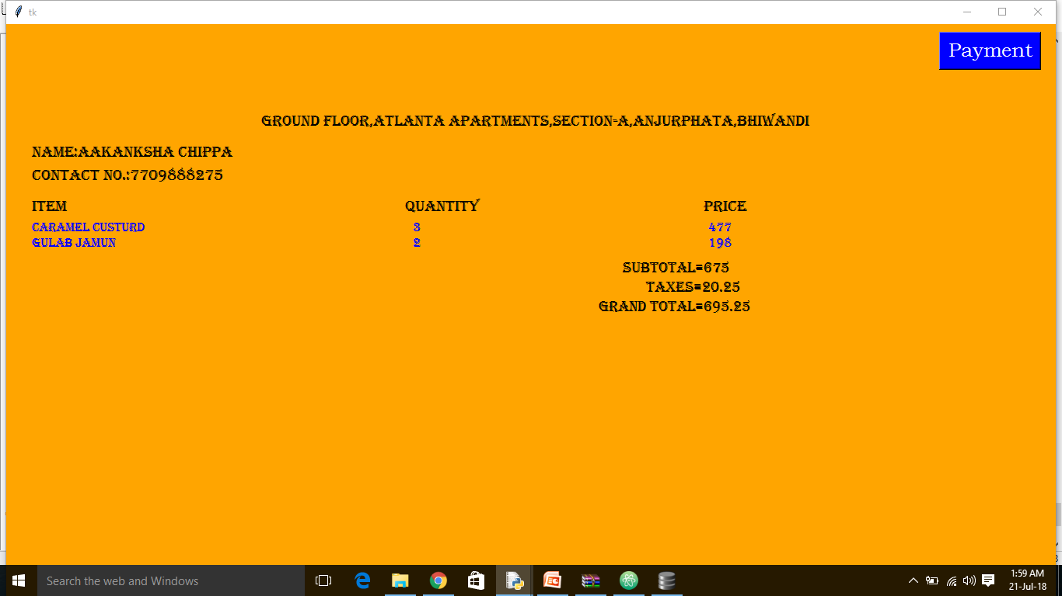
PAYMENT DETAILS

Slide 11
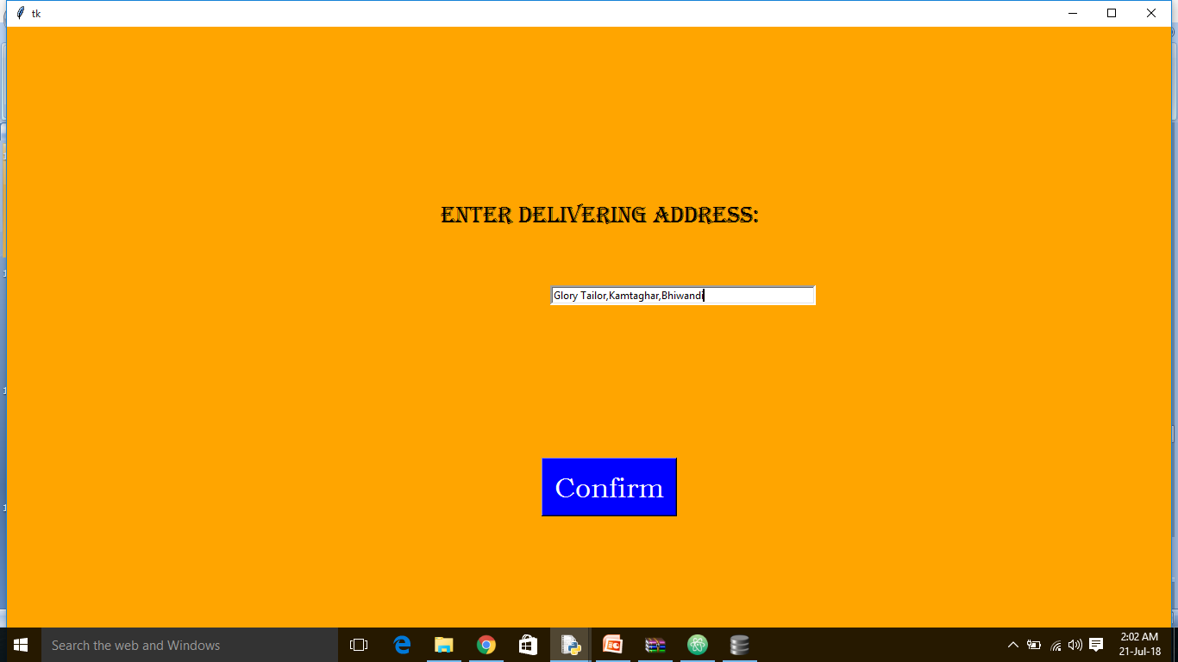
ADDRESS OF CUSTROMER

Slide 12
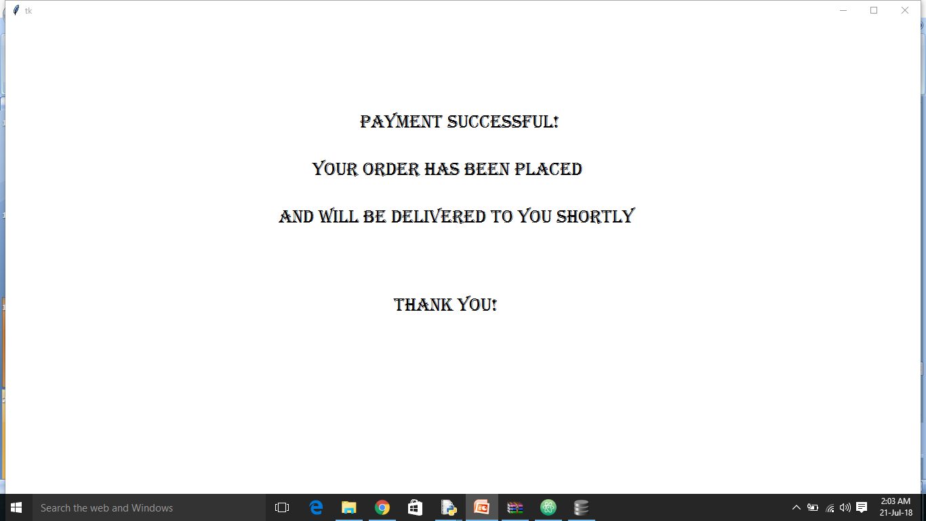
THANKING PAGE

Slide 13
Customer details table
cust_fname | cust_lname | cust_uname | cust_mob | pas
shravs | kota | shavu | 12345 | 123456
Aakanksha | Chippa | akshu | 7709888275 | chinnu

Slide 14
Items table
item_id | name | price
1 | Choco lava cake | 189
2 | Caramel custard | 159
3 | Chocholate rolls | 159
4 | Gulab jamun | 99
…… | ……. | ……

Slide 15
uname | Item_id | quantity | price
shravs | Gulab jamun | 2 | 198
aakanksha | Choco lava cake | 1 | 189
hema | Chocholate rolls | 1 | 159

