Slide 1

MAHARASHTRA INSTITUTE OF TECHNOLOGY, CHH. SAMBHAJINAGAR
Minor Project (MDM) — Civil
Construction Site Noise
& Dust Compliance Monitor
A Software-Based Environmental Monitoring and Compliance System
NAME
ROLL NO.
BRANCH
Rutuja Ghorband
C-29
CSD
Gayatri Dixit
BT41049
CSE
Abhinav Deshmukh
BT41040
CSE
GUIDE
Dr. Sumeet Jaiswal

Slide 2

01 — INTRODUCTION
What Is the Project?
Construction activities generate pollution that is difficult to track manually.
Pollution-Generating Activities
The System Will:
Excavation
Collect
→
Analyze
→
Compare
→
Alert
→
Report
Drilling
Concrete mixing
A centralized software platform where monitoring data is recorded and analyzed — turning scattered readings into clear, actionable compliance status.
Demolition
Cutting
Regulatory Basis
Transportation of materials
The project is inspired by the need for systematic environmental monitoring. CPCB's noise framework recognizes construction activity among sources of noise pollution and provides ambient noise standards based on area categories.
These contribute to noise and particulate pollution on site.
2

Slide 3

02 — PROBLEM STATEMENT
Existing Problems
Manual recording of readings
“
Data scattered across Excel sheets / paper records
There is a need for a centralized software system that can organize construction-site noise and dust monitoring data, automatically evaluate it against configured applicable limits, identify violations, visualize trends, and generate compliance reports.
Difficult to identify repeated violations
No centralized dashboard
Difficult historical analysis
Time-consuming report preparation
Limited visibility of which construction zone has problems
PROBLEM STATEMENT
3

Slide 4
03 — OBJECTIVES
Main Objectives
1
Develop a software-only monitoring platform
6
Generate alerts for abnormal readings
2
Record noise and dust / particulate measurements
7
Maintain historical monitoring records
3
Allow CSV / Excel data import
8
Provide graphical visualization
4
Compare readings against configured applicable thresholds
9
Generate downloadable compliance reports
5
Classify readings as Normal, Warning or Exceeded
10
Add AI-based anomaly detection as an advanced feature
4

Slide 5

04 — LITERATURE REVIEW
What Existing Research Shows
2021
Kim et al., Int. J. Environ. Res. Public Health
2020
Utepov et al., IoT-Based Noise Monitoring (NOMOS)
Built an IoT particulate-matter (PM2.5/PM10) monitoring system for construction sites, noting no system then existed for real-time PM tracking across multiple site locations.
Found that most commercial noise-monitoring tools are not IoT-integrated, which limits simultaneous data sync, remote storage and processing.
2019
CRPASE — Construction Site Ambient Noise Monitoring
2025
Huang et al., Building and Environment (Systematic Review)
Observed that conventional noise-level meters need an operator on site and only capture readings during working hours, motivating continuous cloud-based monitoring.
Reviewed 82 studies (2014–2024) on construction noise and found rising use of IoT/Bluetooth tracking, alongside a continuing gap in accessible reporting tools.
Research Gap
Prior work largely tackles noise OR dust in isolation using dedicated IoT hardware. Few offer an accessible, software-only platform that combines both, checks readings against configured thresholds, and generates alerts and reports — the gap this project addresses.
5

Slide 6

05 — METHODOLOGY
How the System Works
SITE OFFICER
WORKED EXAMPLE
↓
User enters:
Enter / Upload Data
Noise = 78 dB(A)
↓
Threshold Exceeded
DATABASE
The system checks the relevant configured limit for the site's area / category and monitoring period.
Review required
↓
Data Analysis
↓
Noise Analysis
Dust Analysis
REFERENCE STANDARD
↓
Under India's Noise Pollution Rules, residential-area ambient limits are 55 dB(A) Leq during daytime and 45 dB(A) Leq at night. Industrial, commercial and silence-zone limits differ, and are configured per zone in the system.
Compliance Check
↓
Alert / Status
55 dB(A)
Residential · Day
45 dB(A)
Residential · Night
↓
Dashboard → Report Generation
6

Slide 7


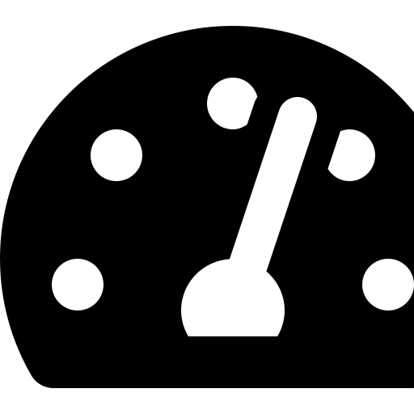


06 — KEY FEATURES
What the System Does
Noise Monitoring
Dust Monitoring
Dashboard
Alert System
Reports
Date & time
PM2.5
Live status
Auto-flags readings
Daily reports
Zone
PM10
Total violations
that exceed
Weekly reports
dB(A) Leq
Date & time
Noise & dust trends
configured limits
Monthly reports
Duration
Zone
Zone performance
Violation reports
Status
Status
Compliance %
Construction Site Noise & Dust Compliance Monitor
7

Slide 8

07 — TECHNOLOGY STACK
Technologies & System Requirements
Frontend
React.js
Backend
Python + Flask / FastAPI
Database
MySQL
Hardware Requirement
Data Analysis
Python, Pandas
NONE
AI / ML
Scikit-learn
for the current project
Charts
Chart.js
Authentication
JWT / session-based authentication
The prototype works with:
Manual data entry +
CSV / Excel upload
Reports
Python PDF library
Data Import
CSV / Excel
Future versions can optionally integrate external monitoring sources.
8

Slide 9


08 — PROGRESS ACHIEVED
Where We Are Today
Problem identification & requirement gathering completed
Literature review of 4+ related studies and CPCB standards completed
Design Phase
Complete
System architecture and data flow finalized (site officer → database → analysis → dashboard)
Database schema designed for noise, dust, zones, thresholds and alerts
~40% of project timeline complete
Technology stack finalized (React, FastAPI/Flask, MySQL, Pandas, Scikit-learn)
Development of the software modules is the next milestone, based on the finalized architecture and schema.
Low-fidelity UI wireframes for dashboard and data-entry forms completed
Compliance / threshold-comparison logic designed on paper
9

Slide 10
09 — WORK PLAN
Roadmap to Completion
Remaining work is organized into six phases leading up to the final review.
PHASE 1
PHASE 2
PHASE 3
Requirement Analysis & Design
Database & Backend Development
Frontend & Dashboard Development
Completed
Weeks 3–5
Weeks 6–8
PHASE 4
PHASE 5
PHASE 6
Compliance Engine, Alerts & Reports
AI Anomaly Detection Module
Testing, Integration & Final Review
Weeks 9–10
Weeks 11–12
Weeks 13–14
10

Slide 11

10 — EXPECTED OUTCOMES
What the Final Software Will Deliver
Centralized monitoring
Historical analysis
Noise & dust data management
Alerts
Automatic threshold checking
Compliance reports
Violation detection
AI-based anomaly detection
Dashboard visualization
Future Scope
Mobile app, cloud deployment, GIS-based pollution mapping, multi-site monitoring and organization-wide analytics.
11

Slide 12

Thank You
Questions & Discussion
Construction Site Noise & Dust Compliance Monitor

