Slide 1
Home Automation Using ESP8266
Presented By
Abhijit Dutta
(Department of Computer Science ,Kanchrapara College ,2nd Year)
Rohit Ghosh
(Department of Computer Science ,Kanchrapara College ,2nd Year)

Slide 2
CONTENTS
Abstract
Introduction
Idea Behind
Main Idea
Home Automation
Iot – is it something new?
System Functions
System Features
Product Components
Functional Block Representation
Product Components
Circuit Diagram
Flowchart of the device
Advantages and disadvantages
Applications of home Automation
Future Scope of this Projects
Quality Assurance
Reference
Thank You

Slide 3
Abstract
The most important source of motivation in continuity of technological developments is to upgrade human living standards. The technological development provides and increases human-beings safety and comfort directly and indirectly. Developing technologies for this purpose directly affects the life standards by means of smart home systems design.

Slide 4
Introduction
Home Automation Using ESP8266 enables remote control of home appliances and devices through Wi-Fi connectivity.
The ESP8266, a cost-effective microcontroller, serves as the core component, allowing seamless integration with IoT platforms.
This technology enhances convenience, energy efficiency, and security, making homes smarter and more efficient.

Slide 5
IDEA BEHIND
Convenience and Control: Automate and control home appliances remotely using smartphones or voice commands.
Cost-Effective Solution: ESP8266 offers an affordable way to implement IoT-based home automation.
Energy Efficiency: Monitor and optimize energy usage to reduce waste and lower costs.
Scalability: Easy to integrate with multiple devices and expand as per user needs.
Smart Living: Enhances comfort, security, and overall quality of life.

Slide 6
MAIN IDEAS
Home Automation
Internet of Things

Slide 7
Home Automation
Automation of house , house work ,household activities
Simplicity
Affordability
Easy to control

Slide 8
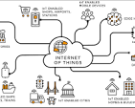
IOT – Is it something new?
IoT stands for Internet of Things, and it's a network of physical objects that are connected to the internet and can communicate with each other and with other devices. IOT devices, also known as "smart objects", are embedded with sensors, software, and other technologies that allow them to collect and share data.

Slide 9
System Functions
To control lighting , fan , appliances , communication systems and home security devices.
To improve Convenience ,comfort ,energy efficiency and security.

Slide 10
System Features
Wireless Connectivity
Expansion Capability
Protocol Compatibility
Application Control
Device Management
Savings
Convenience

Slide 11
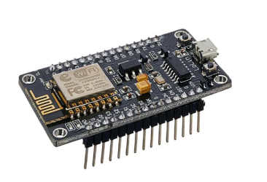
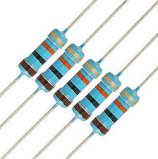
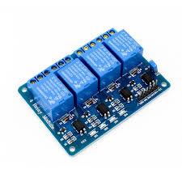
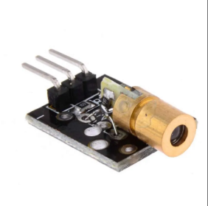
Product Components
1. ESP8266 WIFI MODULE
3. REGISTER
2. 4 CHANNEL RELAY MODULE
4. PIR SENSOR

Slide 12
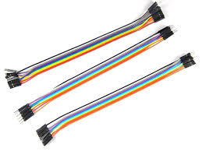
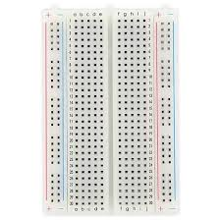
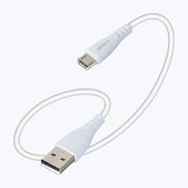
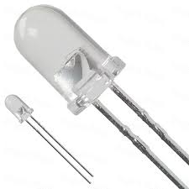
Product Components
5. JUMPERS WIRES
6. BREADBOARD
7. USB CABLE
8. LED

Slide 13
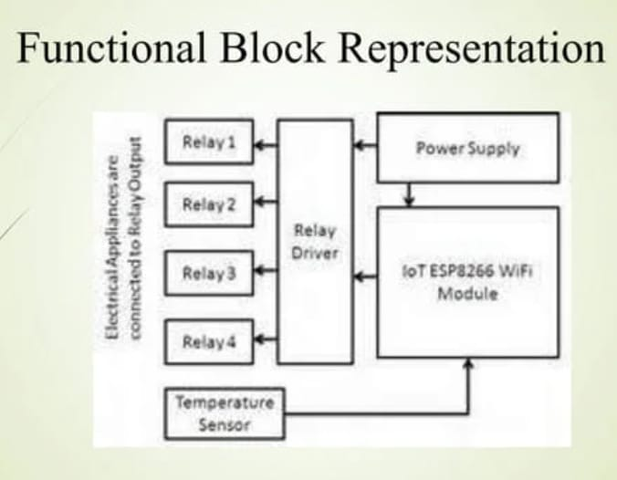
Functional Block Representation

Slide 14
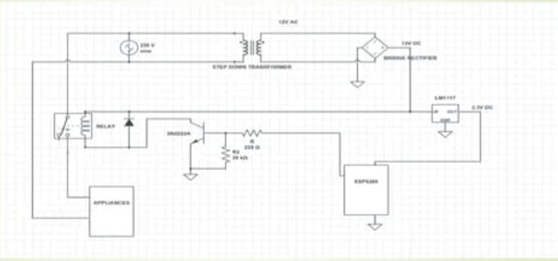
Circuit Diagram

Slide 15
Flowchart of The Device
Start
A P Mode
by default
AP/Client
192.168.4.1
Password:
Password123
If Client
Connect to wifi
User Connected
Access the server
Port forwarding
Include voice control
Control appliances/sensors
Access from outside of network

Slide 16
Web Server Page

Slide 17
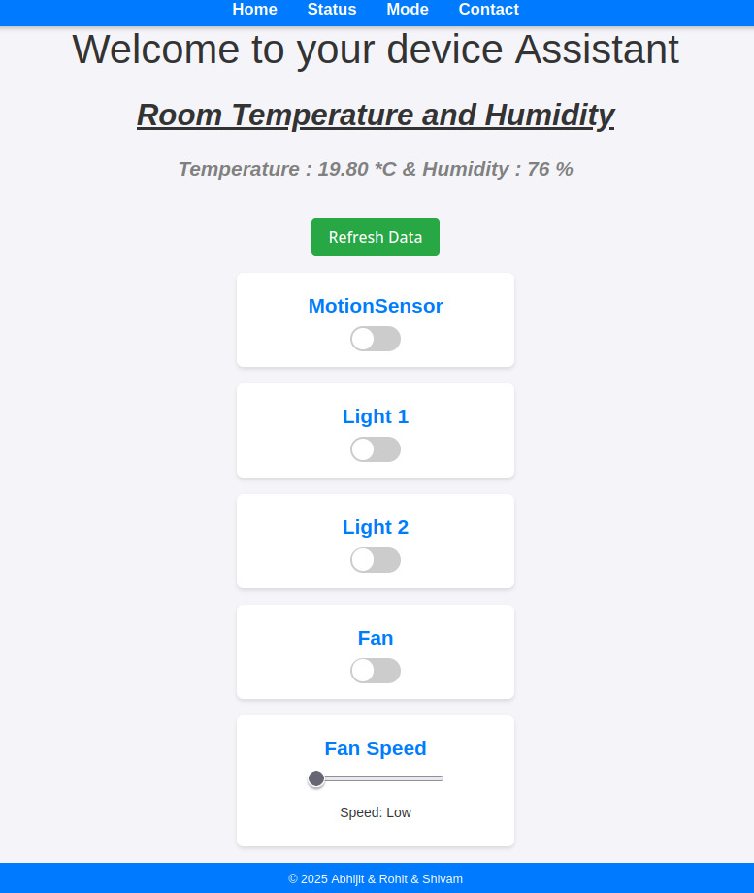
Web Server Page

Slide 18
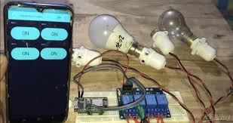
Web Server Page

Slide 19
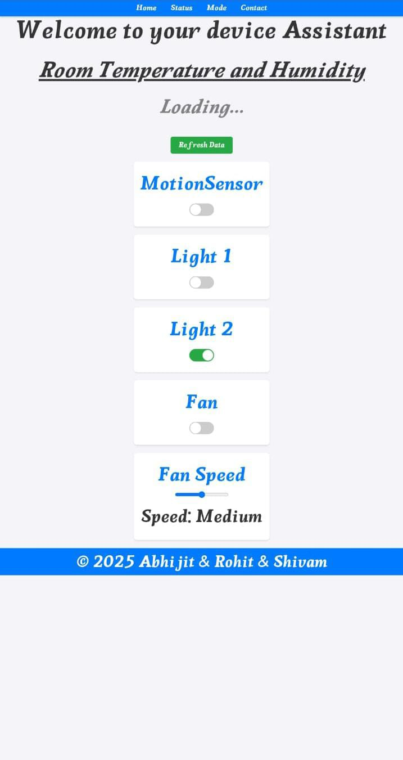
Web Server Page

Slide 20
Web Server Page

Slide 21
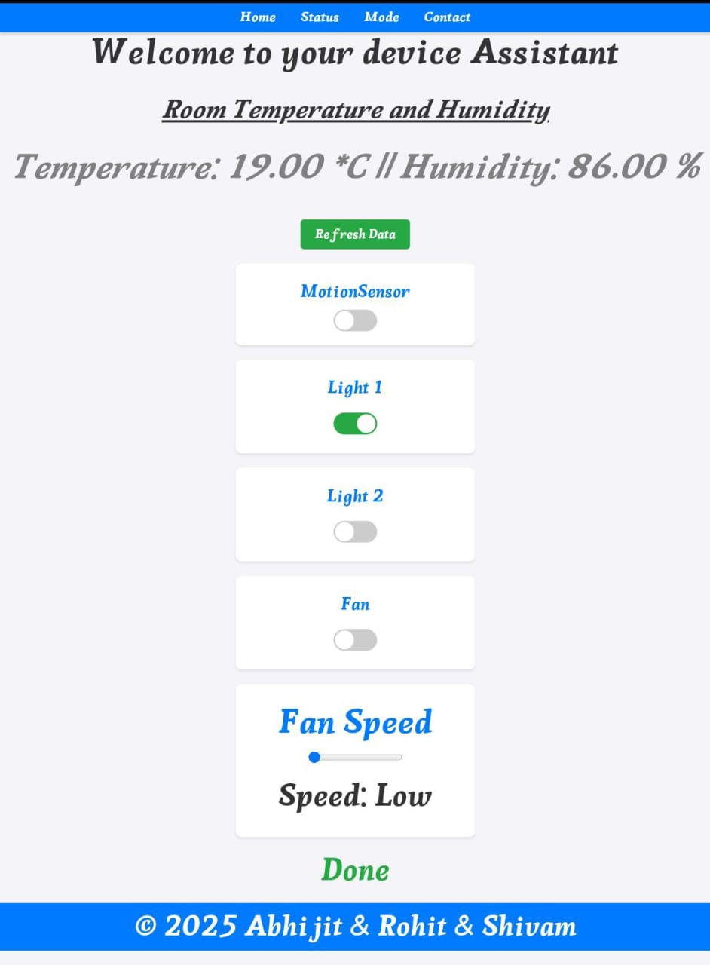
Web Server Page

Slide 22
Web Server Page

Slide 23
Web Server Page

Slide 24
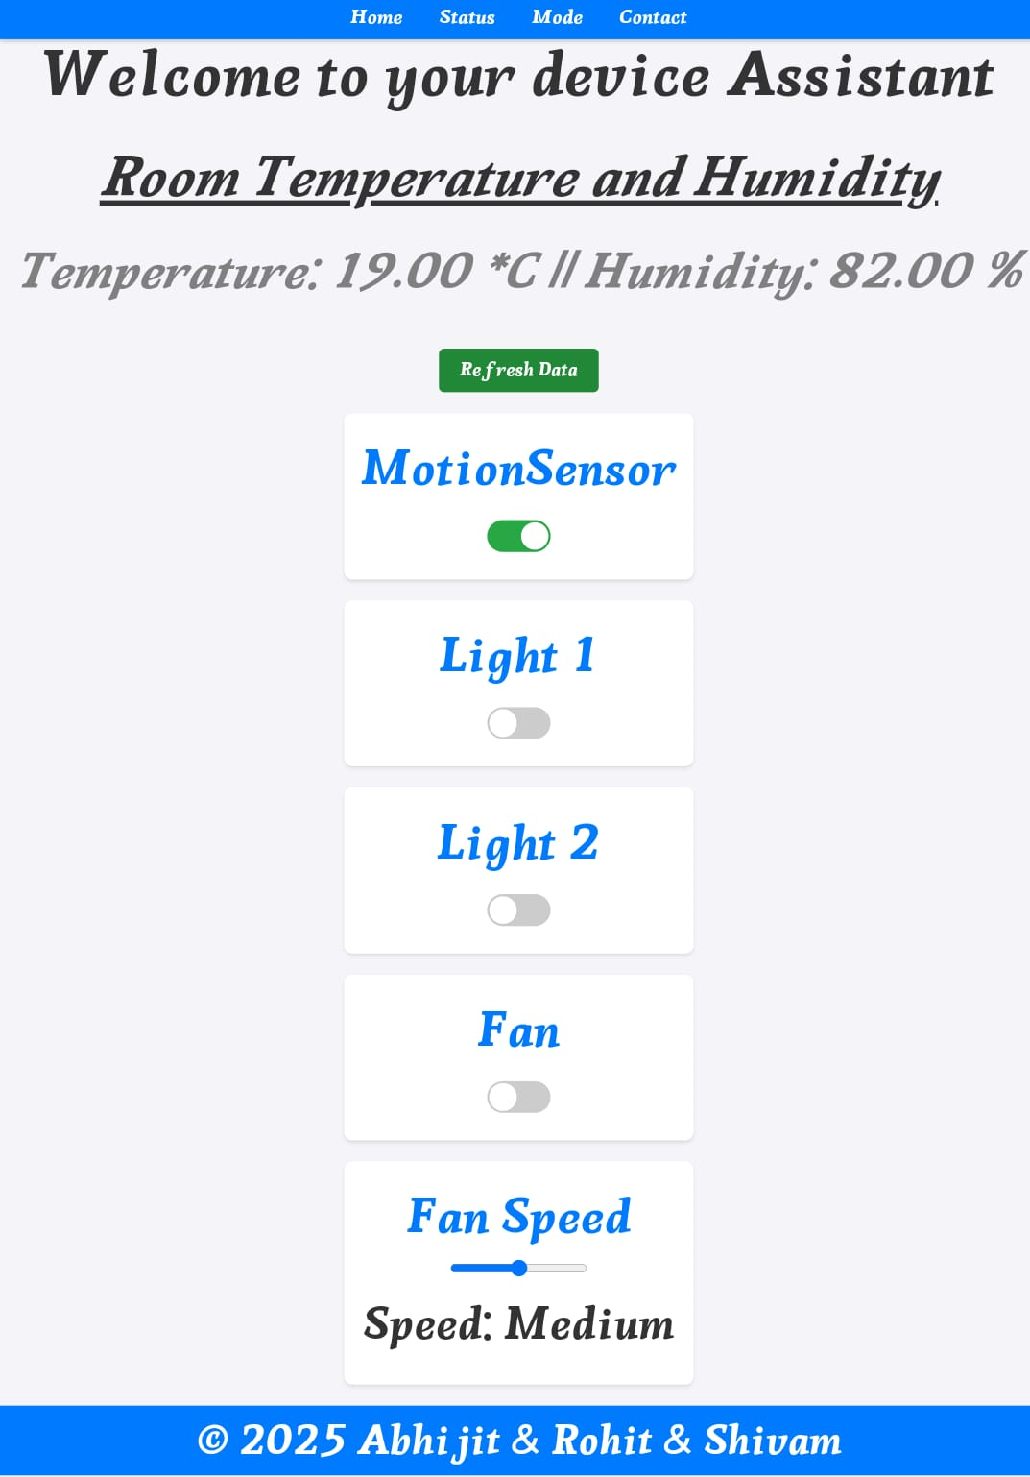
Web Server Page

Slide 25
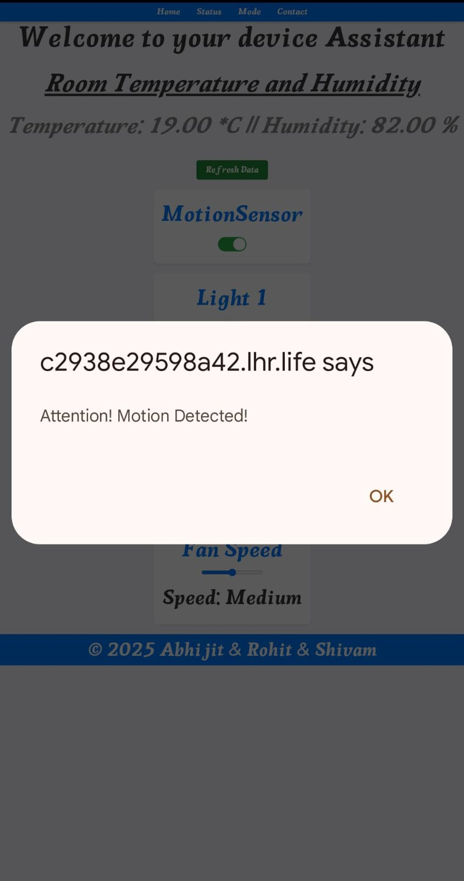
Web Server Page

Slide 26
Web Server Page

Slide 27
Advantages
The purpose of a home automation system is to streamline how your home functions. Consider some of benefits:
The main advantage of "Home Automation through ESP8266" is that the "Physically Challenged and Disabled People".
Remote access: Control your home from mobile devices, including your laptop, tablet, or smartphone.
Convenience. Program devices to turn on automatically at certain times, or access their settings remotely from anywhere with an Internet connection
Increased safety: Smart fire detectors, carbon monoxide monitors, pressure sensors, and others home automation security features can help protect your home from disaster.
Energy efficiency: Home automation allows you to be more mindful of your power usage. For example, you can save on energy bills by reducing the length of time that lights stay on, or by lowering temperatures when you leave a room.

Slide 28
Disadvantages
In a review of home automation devices. Consumer Reports found two main concerns for consumers:
A Wi-Fi network connected to the internet can be vulnerable to hacking.
Technology is still in its infancy, and consumers could invest in a system that becomes abandonware . In 2014, Google bought the company selling the Revolv Hub home automation system, integrated it with Nest and in 2016 shut down the servers Revolv Hub depended on, rendering the hardware useless.
Microsoft Research found in 2011, that home automation could involve high cost of ownership, inflexibility of interconnected devices, and poor manageability.

Slide 29
Future Scope of this Project
In the future, we shall design Voice Control integration.
Integrating AI for predictive behaviour.
We will add some advanced sensors.
Cloud integration : storing data on the cloud could help track appliance usage patterns and improve automation.
Finally, the hardware implementation in Model.

Slide 30
Applications of home Automation
The inefficiency of operation of conventional wall switches can be overwhelmed using various home automation systems (without using conventional switching methods)
We can control device from a long distance , thus it gives ease of access.
The loss of power can be reduced and manpower required for home automation is very less compared to conventional methods.
Faster operation and efficient.

Slide 31
Cost Estimation
Components | Cost(In Rupees)
ESP8266(wifi Module) | 250
4-Relay Channel | 250
Pir sensor | 70
Bread board | 60
(16*2)LCD Display with I2C//IIC interface | 200
Jumper Wires | 150
Other Miscellancous items | 150
Total cost 1,130

Slide 32
Quality Assurance

Slide 33
Conclusion
Hence IOT is going to be a revolution in next 5 years.
Successfully implemented cost-effective IoT-based home automation using ESP8266.
Enables remote control of appliances with convenience and security.
Scalable and adaptable for future upgrades like AI and voice control.
A step toward a smarter, connected living experience.

Slide 34
Reference
https://arduino.esp8266.com/stable/package_esp8266com_index.json
https://arduino.cc
https://www.esp8266.com/wiki/doku.php
https://github.com/esp8266/Arduino
https://espressif.com
https://localhost.run
https://w3schools.com

Slide 35
THANK YOU Control your home happily

Slide 36
ANY QUERIES OR SUGGESTIONS

