Slide 1


SAFELANE API
Revolutionizing Road Safety.

Slide 2

What is our Main Idea?
We will develop an API which will provide real-time notifications to users about nearby emergency vehicles such as ambulances and fire brigades and alert them.
We'll seamlessly integrate SafeLane API into partner map systems, collaborating closely with their technical teams to optimize performance and functionality.
We'll create SafeLane API, using Google Maps’ API, to accurately offer real-time notifications of nearby emergency vehicles.
We'll market SafeLane API to B2B sectors such as car and ambulance manufacturers. Through targeted sales and strategic partnerships, we'll highlight its value in enhancing road safety.
STEP 3
STEP 1
STEP 2

Slide 3
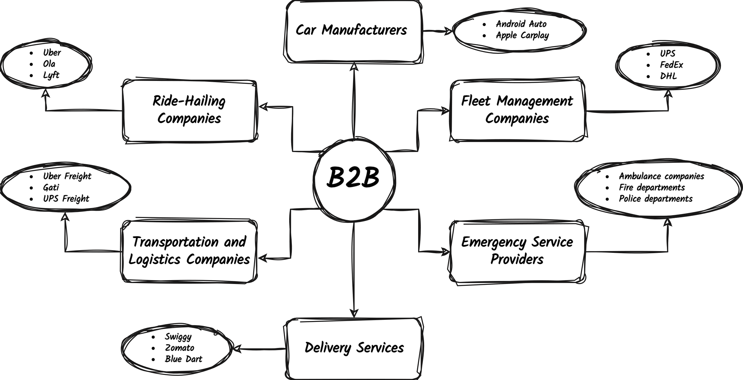

Slide 4



Why SafeLane?
Health Systems Transformation Platform reports that 30% of deaths in emergencies occur due to delays in care, highlighting the systemic challenges.
Niti Aayog indicates that nearly half of heart attack patients take over 400 minutes to reach hospitals, significantly exceeding the "golden hour" for swift intervention.
30%
Deaths
SafeLane addresses this challenge by providing real-time notifications to drivers about nearby emergency vehicles.
With the increasing adoption of GPS navigation systems, we offer a crucial solution to enhance road safety.

Slide 5



Market Opportunity
The global car GPS navigation system market was valued at $23,840 million in 2022 and is expected to reach $29,580 million by 2029. (Source: Straits Research)
SafeLane API taps into this lucrative market by offering a unique feature for emergency vehicle notifications.
B2B businesses, including car manufacturers, ambulance manufacturers, and delivery services, stand to benefit from integrating SafeLane into their systems.
Growth

Slide 6



Evaluating the Opportunity
Market research indicates a growing demand for safety-focused features in GPS navigation systems.
Competitive analysis reveals limited solutions addressing real-time emergency vehicle notifications.
Additionally, we’ll ask for feedback from potential B2B clients to gauge interest and validate the need for a real-time emergency vehicle notification system.

Slide 7
Reverse Brainstorming
Identifying Potential Failures | Flipping Challenges into Strategies
Users may find the notifications intrusive or distracting. | Customizable notification settings Include an opt-in feature - receive emergency vehicle notifications only during specific times or in certain locations.
Integration with existing mapping systems could be complex or incompatible. | Develop a flexible and modular API Offer documentation, tutorials and support services
Legal and privacy concerns may arise regarding the collection and use of user data. | Implement robust data privacy measures, including encryption and anonymization Ensure compliance with regulations such as GDPR
Compatibility issues with older vehicle models or navigation systems used by B2B clients. | Develop backward compatibility modules or retrofitting solutions Flexible deployment options
B2B skepticism or uncertainty about the reliability and effectiveness of SafeLane API. | Provide B2B clients with access to case studies, testimonials, and success stories from other businesses that have successfully implemented SafeLane API Offer pilot programs or trial periods to allow B2B clients to test the effectiveness of SafeLane API in real-world scenarios

Slide 8



Future Plans
Expand SafeLane API into a standalone B2C application for individual users, offering real-time emergency vehicle notifications for enhanced road safety.
Integrate advanced route optimization algorithms to recommend the best and shortest routes based on real-time traffic conditions and emergency vehicle routes.
Implement crowdsourced reporting features in the SafeLane app to provide real-time data on incidents and hazards for more efficient response efforts.
PLAN°1
PLAN°2
PLAN°3

Slide 9

THANK
YOU
SAFELANE
API
Submitted by:
Abhiraj Chaudhuri - 22000214 (Batch A)
Abhishek Yadav - 22000215 (Batch A)
Ajin K James - 22000216 (Batch A)
Rohan Agarkar - 22000269 (Batch B)
Parita Tarvani - 22000781 (Batch A)

