Slide 1
Agile / Scrum
Andrew Ingraham
aci2110@columbia.edu
Notes:
Draw backlog item on chalkboard
Draw

Slide 2

jobs.about.com
Some currently open positions:
Data Warehouse Engineer (Python, MongoDB, Hadoop)
Software Engineer, Data Analytics
QA Engineer
Big Data Search Engineer
Full Stack Developer, CMS
Infrastructure Engineer
Java Engineer - Front End
Lead Java Application Developer - Front End
Lead Java Application Developer - Services
Server Side Developer, COLT (C++, Boost, Python)
Sr. Search Engineer (Big Data)
Front End Developer, COLT (Javascript, CSS, XHTML)
Front End Developer, Data Analytics
Sr. Front End Developer
Notes:
Mention you’re happy to refer people

Slide 3
ScriptEd
ScriptEd.org
ScriptEd teaches computer programming to students in low income communities, and places its students in internships with technology firms.

Slide 4
Agile
Time-boxed
Iterative
Incremental
Feature-based
Business / User Value Driven
Feedback Loops; Response to Change
Agility is a dial, not a switch
Notes:
Agility is a dial, not a switch

Slide 5
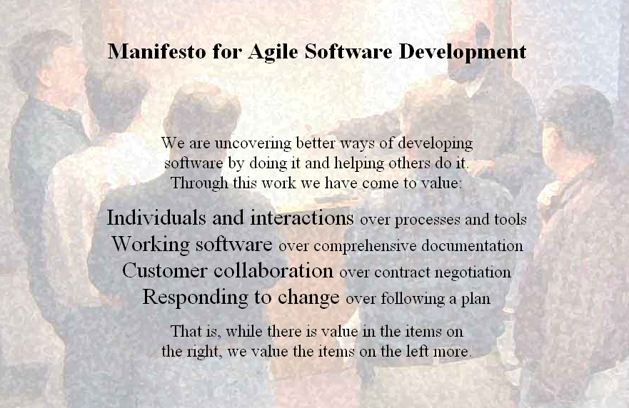
Agile Manifesto

Slide 6
Scrum = Visibility + Flexibility
One of the agile development methods
Others include XP, Lean, Kanban
Stackholder / Customer Feedback
Self-directed, self-organized teams
Each sprint (iteration) delivers tested, fully-functional software for demonstration.
This is only a process and on its own won’t do anything to improve results. All it does is highlight the roadblocks in the way of your team's productivity. It’s up to you and your team to respond to that information.
Notes:
Mention agile is more of a philosophy and general approach while scrum is an implementation of that philosophy

Slide 7
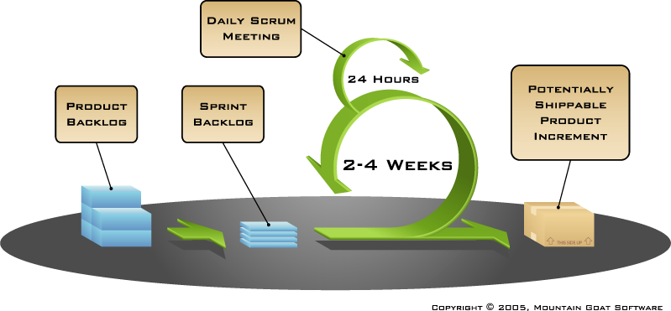
Scrum Process

Slide 8
Scrum Roles & Responsibilities
Product Owner
Accountable for product success
Defines all product features
Responsible for prioritizing product features
Maintains Product Backlog
Conducts the Sprint Review
Scrum Master
Holds daily 15 minute team meeting (Daily Scrum)
Removes obstacles
Shields team from external interference
Conducts Sprint Retrospective at end of sprints
Team
Cross-functional, about 5-9 members
Selects the sprint (iteration) goal
Has the right to do everything within the Definition of Done to reach the sprint (iteration) goal
Organizes itself and its work
Demos work to end-users and stackholders

Slide 9
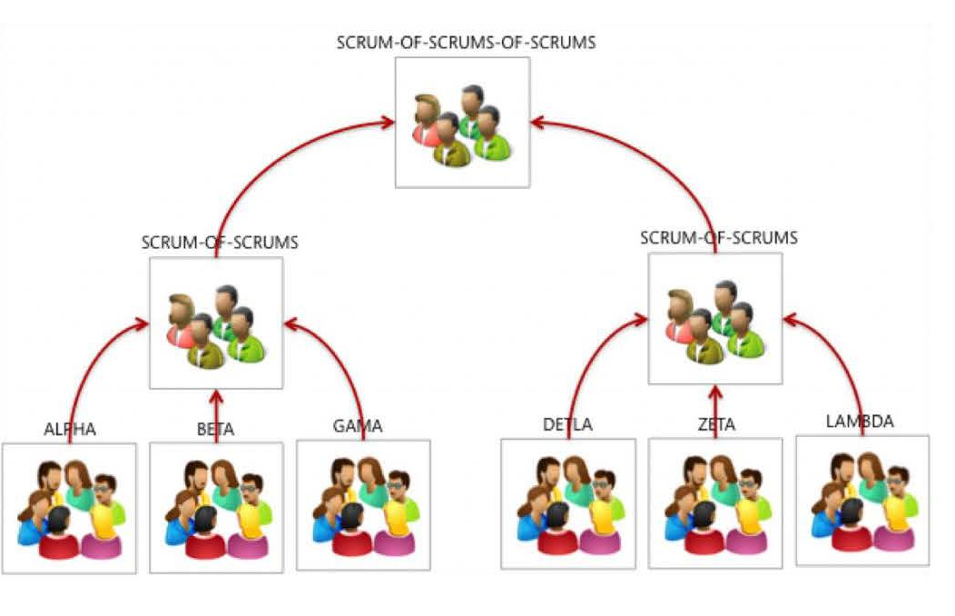
Scaling Agile

Slide 10
Scrum Components – Backlogs
Product Backlog
Managed by Product Owner
High-level view of all the user stories that must be completed to finish the project
Estimates are in points (1, 2, 3, 5, 8, 13, 20, 40, 100)
Sprint Backlog
Managed by Team
Detailed lists of tasks the team must complete to finish all of the user stories in a sprint (iteration)
Estimates are in hours

Slide 11
Scrum Process

Slide 12
Scrum Components - Daily Scrum
Time-boxed
Declare 3 things
Progress since the last scrum
What you’re going to work on until the next scrum
Obstacles preventing progress
Update Burndown
Visitors invited to listen and observe

Slide 13
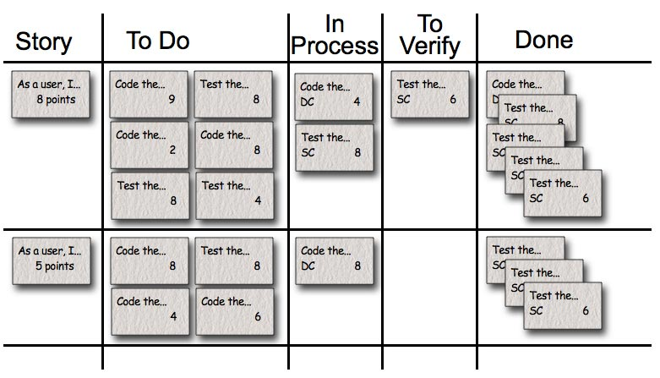
Scrum Components - Task Board

Slide 14
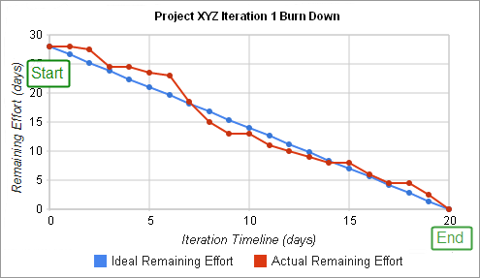
Scrum Components - Burndown Chart
Notes:
What do you do if you’re way behind schedule? What about way ahead?

Slide 15
Sprint Review
Product Owner “presents” project
Team demonstrates what was “done” in the Sprint
Discuss obstacles and what was learned
Sprint Burndown & Release Burndown
Collect feedback
Informal and open

Slide 16
Scrum Components – Sprint Retrospective
What worked?
What isn’t working?
Prioritize what potential improvements the team has identified and implement them in the subsequent sprint (iteration)
Time-boxed (3 hours)

Slide 17
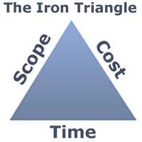
The Iron Triangle

Slide 18
Definition of Done
“Done” = Potentially Shippable
Maintains quality and transparency of product and process
Is dynamic and changes over time

Slide 19
Setting Goals
Is a goal like “Increase pageviews” a good goal?
Goals must be measurable
If a task or user story is not moving you towards one of your goals why would you do it?

Slide 20
Exercise: Create a Product Backlog
Establish 3-4 outcome goals for what you’re working on. These should be measurable, testable goals.
For example, if I were creating a website for a new sport that is trying to make it into the Olympics, I might have these as my goals:
Double attendance of local events in next year
Get 10,000,000+ signatures for petition to include our sport in the next Olympics
Raise $300,000 necessary to apply for Olympic recognition as a sport
Then, create ~10 user stories from the user’s perspective that work towards those 3-4 goals. You’re encouraged to include the user stories you created for the last class assignment. These should be written on index cards and follow the format on the chalk board.
Assign points to each User Story based on relative size of effort
1, 2, 3, 5, 8, 13, 20, 40, 100
Assign a business value of High, Medium, or Low to each User Story
Prioritize the list
Notes:
If your User Stories contain the word “user”, you probably don’t know your customer/audience well enough

Slide 21
Exercise: Release Planning
Using our website backlog
Develop a release plan
Use an estimated velocity of 12 points per sprint
What does your plan look like?
How did you maximize value?

Slide 22
Exercise: Definition of Done
Guidelines
Sample DoD
“Done” = Potentially Shippable
Quality Check defines when a task is done
You don’t need to include every Task/Action for every User Story
Create a row of post-its with your Tasks/Actions. Try to order them based on the order they should be completed.
Create a second row directly underneath your Tasks/Actions of their corresponding Quality Checks.
Task / Action | Quality Check
Write code components | Code meets coding and naming standards and checked into repo
Create / Update unit tests | Unit tests pass 100%
Conduct code review | All issues addressed
Create wireframes and UI | UI meets standards
Perform code coverage test | Code coverage is same or better %
Update user guide | Updates reviewed and checked in
Update build scripts | Builds completing without error

Slide 23
Exercise: Sprint Planning
Take one of your User Stories and, using your Definition of Done, break it up into Tasks and write them on post-its.
Each Task should have the number of hours expected to finish it.
If time permits, repeat this for each of the User Stories in your first sprint. Once completed, add up all the Tasks’ hours. This is your estimate of how many development hours it will take to complete this sprint. Do they fit in your sprint?

Slide 24
Agile Process Review

Slide 25
Questions
aci2110@columbia.edu

