Slide 1
Valorant Esports Pre-Match Betting Advisory System
Using Machine Learning to Predict Winning Probabilities and Simulate Odds and Earning Projections.
Author: Abhishek Mahendra Pawar
Institution: National College of Ireland
Date: December 12, 2024

Slide 2
Introduction
Esports means electronic sport
Over the last few years, the esports world has seen significant growth and Valorant has become the most popular competitive game.
Valorant was developed by Riot Game in 2020 it’s an FPS game.
World esports revenue surpasses $1.5 billion in 2023
With the rapid growth of the betting industry, betting platforms have started to take advantage of this opportunity and are offering bets on professional valorant matches such as VCT (VALORANT Champions Tour).
Esports have a unique fast-changing nature.

Slide 3
Problem Statement
the majority of esports betting platforms depend on simple odds calculation methods such as basic statistical or manual calculation.
These approaches fail to consider all the important factors that could influence the match results like team selection, map, player’s stats, and recent performance as a team.
Research question: How machine learning and deep learning models can be utilized to predict match results and generate simulated odds for Valorant, providing bettors with accurate probability-based information and earnings projections?

Slide 4
Objectives of the Project
Develop a Valorant PreMatch Betting Advisory System using machine learning algorithms
Collecting and preprocessing historic data such as match data, player statistics, map performance, and team data.
Building and compare the performance of multiple machine learning algorithms.
Deploying the best model for predicting match outcomes and betting odds.
Creating a user interface that allows bettors to input team selections and get predictions and earnings projections.

Slide 5
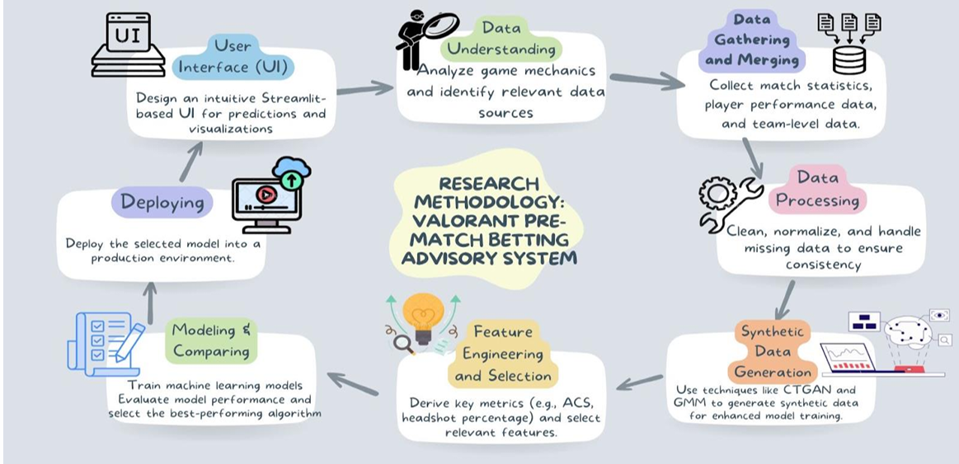
Methodology Overview
Notes:
The research methodology is a customized version of CRISP-DM, tailored as per project. 8 step

Slide 6
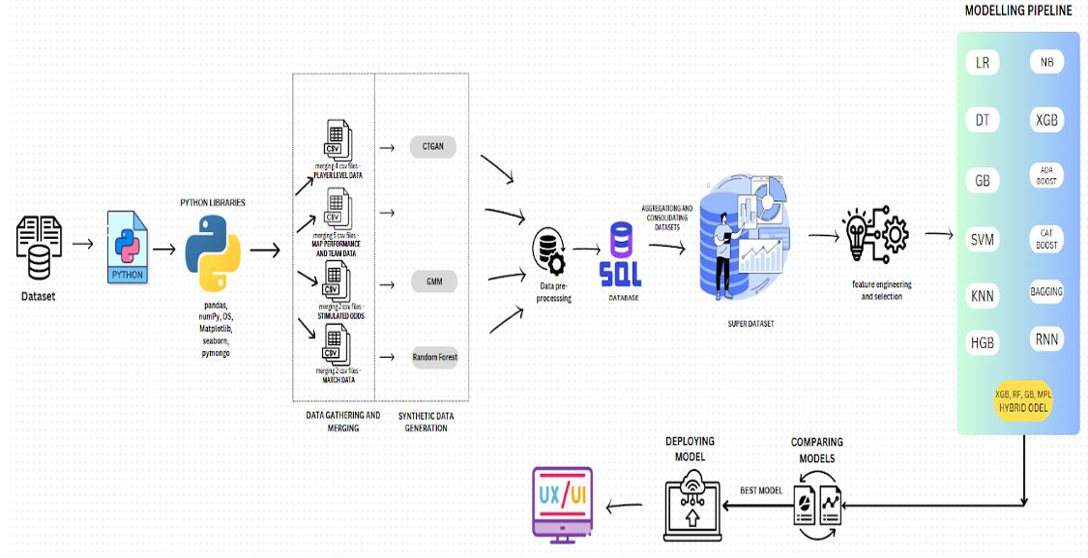
Design Specification

Slide 7
Data Collection, Processing And Synthetic data generation
Data collection
Data merging
Data cleaning
Synthetic data generation using CTGAN and GMM
Finally, uploading datasets in MongoDB

Slide 8
Feature Engineering
Aggregating player_level_data such as team performance, such as a sum of kills, the sum of deaths, total assists, mean of average combat score (ACS), mean of headshot percentage, and total first blood
Aggregating and combining data from several databases player_level_data, map_performance, Match_Data and simulated_odds to create superdataset

Slide 9
Modeling
Firstly, the best features from the superdataset were chosen for modeling.
LabelEncoder was used to convert text data into numerical data. And standardscaler was used to standardize all features for modeling.
Data is split into 80:20 for train and test.
multiple machine-learning models were used to predict match outcome. Models such as – SVM, Logistic Regression, Decision Tree Classifier, KNN, RNN, Hybrid models, etc.

Slide 10
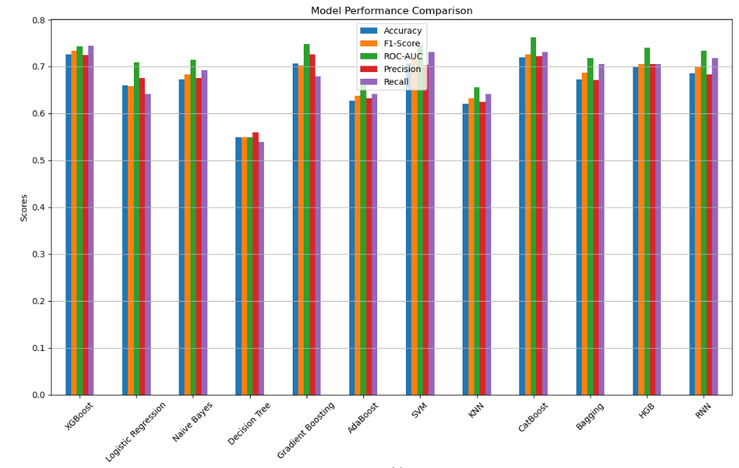
Evaluation
Evaluation Metrics used are Accuracy, Precision, Recall, F1-Score, ROC-AUC.
Out of 13 models top 3 best performing models are XGBoost, CatBoost and hybrid model.
XGBoost outperforms every model with an accuracy of 73%, F1 of 73%, ROC-AUC of 76%, and precision and recall of 73% on such complex data.
XGBoost is fast and uses less computation power which makes it the best choice for deployment.

Slide 11
Deployment
Firstly, we optimized the xgboost model, and then the model was serialized with joblib and converted to BSON so that it could be stored in MongoDB with labelencoder and standscaler for future use.
Fetch model from DB and deserialize the model for the deployment.
The model is integrated with the application to make real-time predictions.
Were model predicts winning Probabilities for both the teams, simulates odd and shows earning projections.

Slide 12
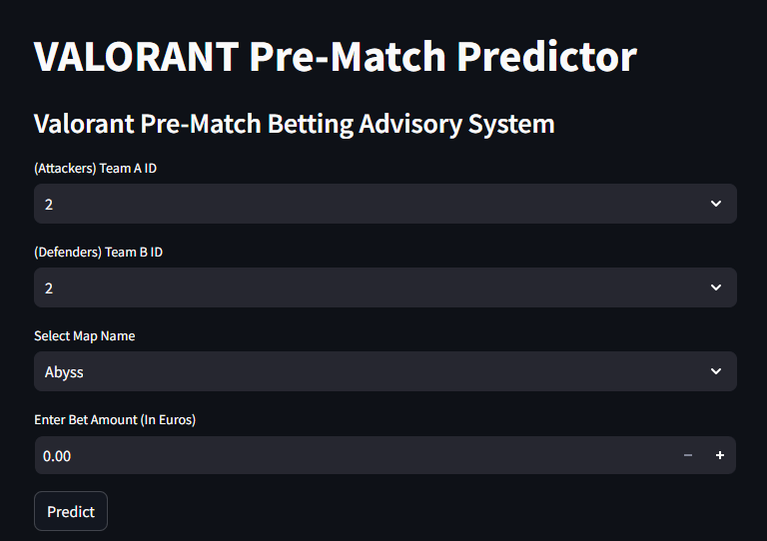
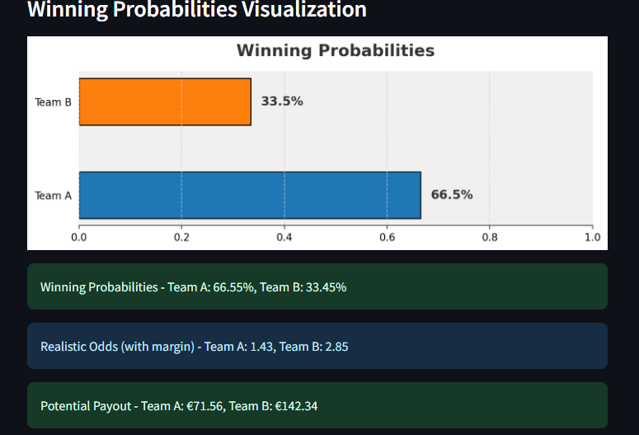
User Interface
Built using Streamlit for simplicity and interactivity.
Features:
Input team IDs, map, and bet amount.
View predictions, simulated odds, and potential earnings.

Slide 13
Conclusion and Future Work
Projects help bettors to make wise decision using machine learning
Future improvements:
project framework and techniques that can apply to any competitive Esports games like CS:GO, League of Legends.
Integrate real-time data for dynamic predictions or api.

