Slide 1

Project Title - AI Based network intrusion detection system
NAME : ABHIGNA M N
[AICTE ID : STU684d4e83577461749896835]

Slide 2

PROBLEM STATEMENT
This project aims to design and implement an AI-Based Network Intrusion Detection System (NIDS) that uses Machine Learning techniques to identify abnormal network behaviour. The system provides a real-time dashboard for monitoring traffic, classifies activities as normal or malicious, and helps security administrators respond quickly to potential threats.

Slide 3
Project Description
The AI-Based Network Intrusion Detection System (NIDS) is designed to detect malicious activities in network traffic using Machine Learning. The system is trained on real cybersecurity data to identify abnormal behavior and classify it as normal or attack. It provides a simple web-based dashboard where users can train the model, simulate live network traffic, and instantly see detection results. This project shows how AI can improve network security by making intrusion detection faster, smarter, and more reliable than traditional rule-based systems.

Slide 4

WHO ARE THE END USERS?
Network Administrators – to monitor traffic and detect intrusions.
Cybersecurity Analysts – to analyze attacks and improve defenses.
IT Security Teams – to protect organizational networks.
Students & Researchers – to learn and experiment with AI in cybersecurity.
Organizations & Enterprises – to enhance overall network security.

Slide 5

Technology Used
Python – core programming language
Machine Learning (Random Forest) – for intrusion detection
Pandas & NumPy – data processing and analysis
Scikit-learn – ML model training and evaluation
Streamlit – web-based dashboard and UI
CIC-IDS2017 Dataset – real-world network traffic data
VS Code – development environment

Slide 6
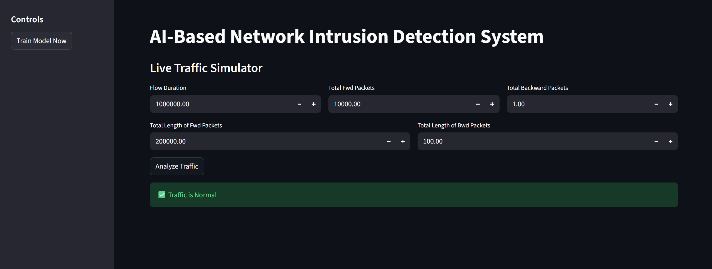
RESULTS
Demo Link

Slide 7
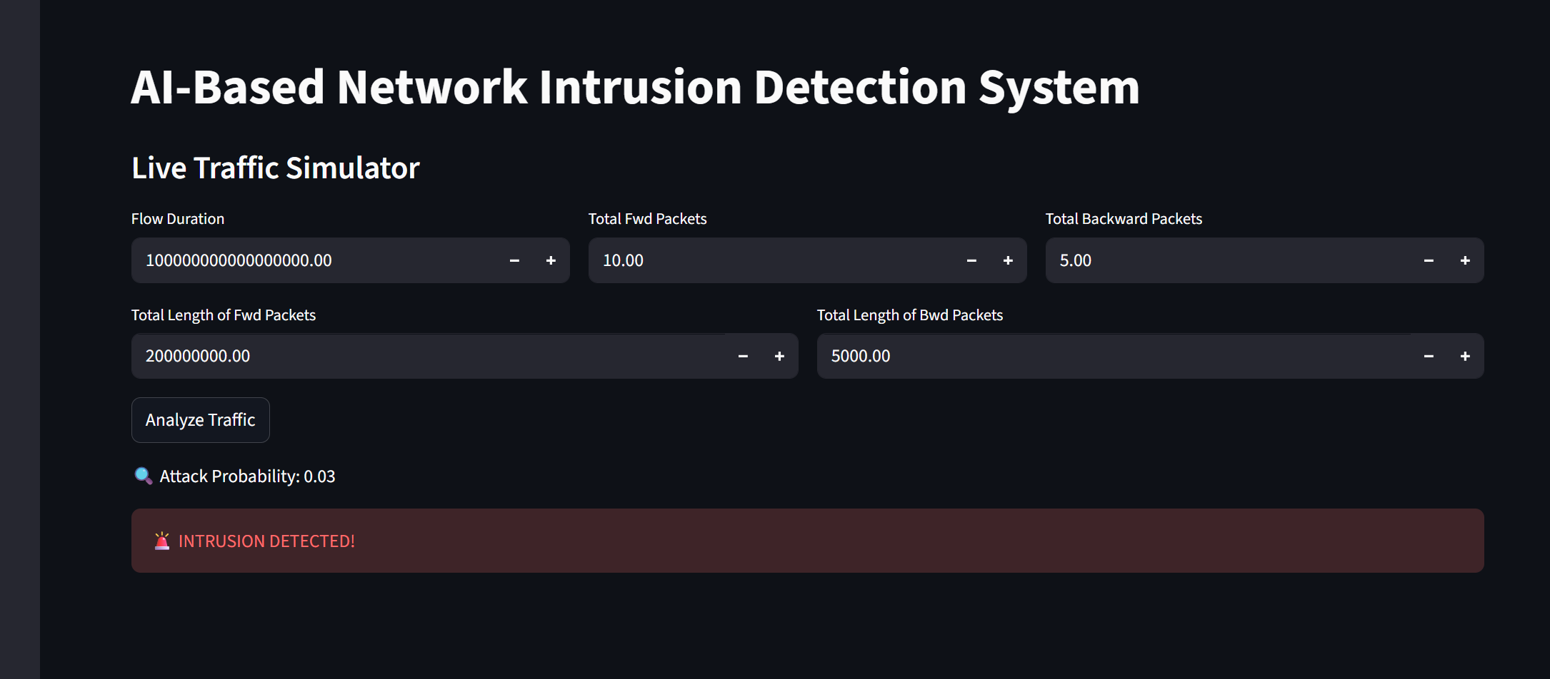
RESULTS
Demo Link

Slide 8
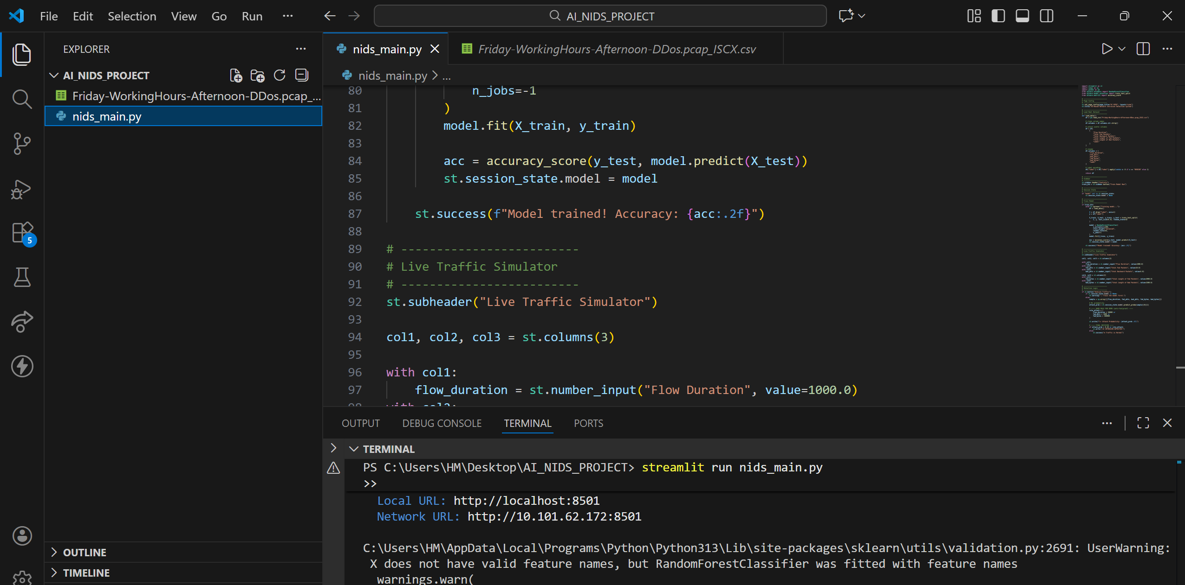

Slide 9

Certificate - Protection from browser attacks

Slide 10

Certificate - Introduction to System Security

Slide 11

Certificate - Securing Android Devices

Slide 12
GitHub link
https://github.com/abhigna2627/Network_Intrusion_Detection_System

Slide 13
Thank you
.
.

