Slide 1

Data flow Pre-Scheduling in Out of Order Processors
By,
Group 1
Abhigna Bheemineni
Manikandeshwar Sasidhar
Nishka Sathisha
Swetha Chiliveri

Slide 2
What is a Data flow Pre-Scheduler?
A Data flow Pre-Scheduler is a technique utilized in out-of-order processors with large instruction windows.
It aims to optimize instruction scheduling by analyzing data dependencies among instructions and reordering them accordingly.
By exploiting the program's data flow characteristics, the pre-scheduler aims to enhance instruction-level parallelism and improve overall performance in modern processors.

Slide 3
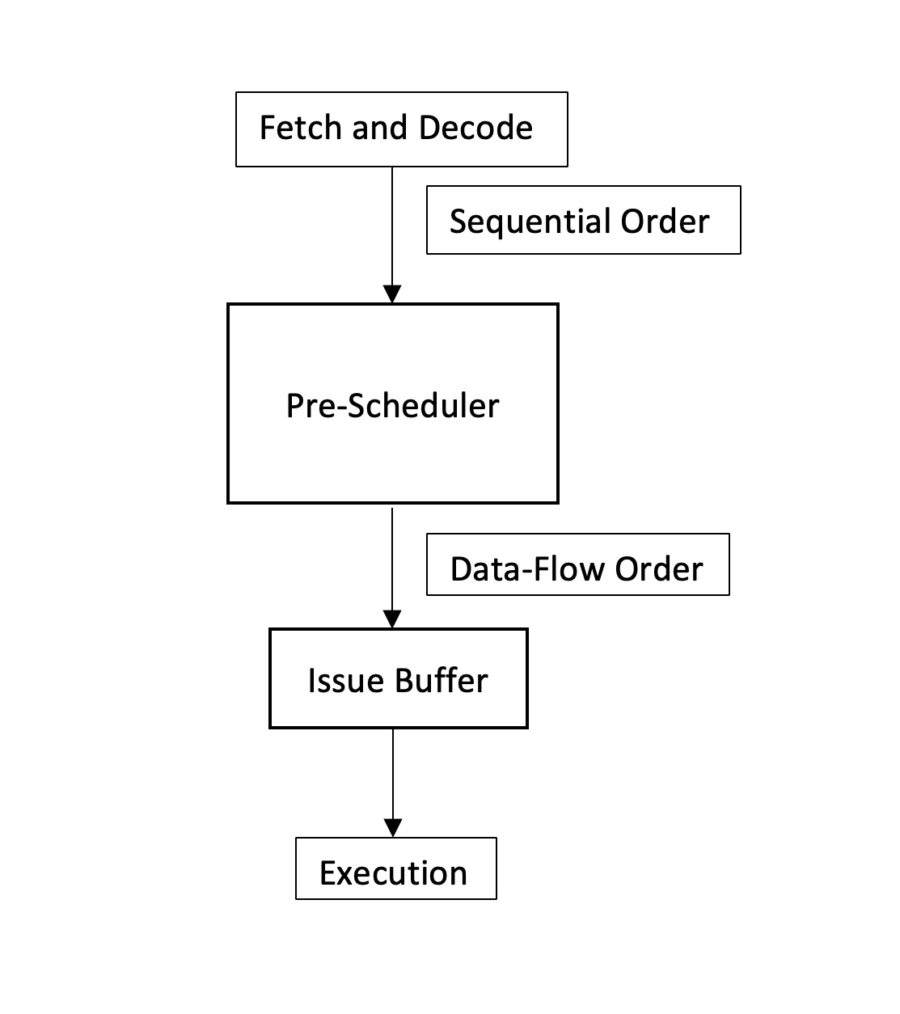
Block diagram

Slide 4
Functionality
Implemented an algorithm for instruction scheduling.
The algorithm includes the following strategies.
Priority is given to WAR dependences among all other dependences.
Instructions with dependences are placed in the pre-scheduler buffer with a distance equal to execution latency.
Whenever there is a WAR dependence between two instructions, the affected instruction is scheduled at the location with the minimum weight.
The algorithm ensures no two instructions of the same type are in the same row of the pre-scheduler buffer.
Overall, the goal is to optimize instruction scheduling and enhance parallelism.

Slide 5
Implementation
The simulated processor is an out-of-order super-scalar processor based on the RV32I integer instruction set.
First, instructions are fetched sequentially, followed by decoding to extract information about instruction type, source and destination registers, and execution time.
The decoded instructions are stored in an array, forming groups of ready-to-schedule instructions.
An instruction scheduling algorithm has been developed to operate on the stored instruction array.
The algorithm processes the instruction sets from the array, aiming to optimize instruction scheduling.
The scheduling algorithm enhances instruction-level parallelism and overall performance in an out-of-order superscalar processor.

Slide 6
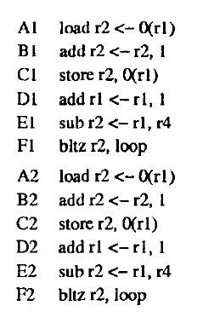
Results
Instructions after Scheduling
Instructions before Scheduling
0: 0000A103
4: 00110113
8: 00112023
C: 00108093
10: 40408133
14: 0020C063
18: 0000A103
1C: 00110113
20: 00112023
24: 00108093
28: 40408133
2C: 0020C063
pre_arr[0][0] = 0x0000a103
pre_arr[0][1] = 0x00108093
pre_arr[1][0] = 0x40408133
pre_arr[1][1] = 0x00108093
pre_arr[2][0] = 0x0020c063
pre_arr[2][1] = 0x40408133
pre_arr[3][0] = 0x0020c063
pre_arr[4][0] = 0x00110113
pre_arr[5][0] = 0x00112023
pre_arr[6][0] = 0x0000a103
pre_arr[10][0] = 0x00110113
pre_arr[11][0] = 0x00112023

Slide 7
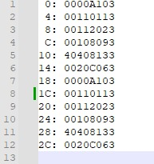
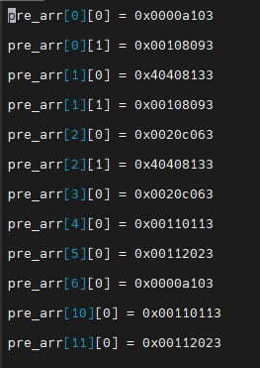
Results
Instructions before Scheduling
Instructions after Scheduling

Slide 8
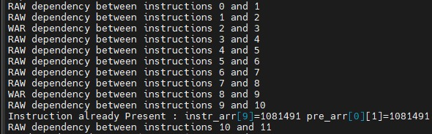
Data Dependences

Slide 9
Observations
Increased Instruction-Level Parallelism
Hide instruction latencies and memory access delays
Optimizes instruction execution order dynamically, improving instruction throughput and minimizing stalls
Allows for better utilization of processor resources
Enables out-of-order instruction completion, ensuring both correct program semantics and maximizing performance.

Slide 10
References
[1] Michaud, P., Seznec, A. Data-Flow Prescheduling for Large Instruction Windows in Out-of-Order Processors. In Proceedings HPCA Seventh International Symposium on High-Performance Computer Architecture, Monterrey, Mexico, 2001, pp. 27-36. doi: 10.1109/HPCA.2001.903249.
[2] Butler, M., Patt, Y. An investigation of the performance of various dynamic scheduling techniques. In Proceedings of the 25th International Symposium on Microarchitecture, 1992.
[3] Aragón, J.L., González, J., González, A., Smith, J.E. Dual Path Instruction Processing.
[4] Palacharla, S., Jouppi, N., Smith, J.E. Complexity effective superscalar processors. In Proceedings of the 24th International Symposium on Computer Architecture, 1997.
[5] Agarwal, V., Hrishikesh, M.S., Keckler, S.W., Burger, D. Clock rate versus IPC: the end of the road for conventional microarchitectures. In Proceedings of the 27th Annual International Symposium on Computer Architecture, 2000.

Slide 11
Thank you!

