Slide 1

Seattle King County Housing
Saurabh Harne
Roshan Ambhore
Abhigna Ramamurthy
Benazeer Shabbir Shaikh

Slide 2
Agenda
Introduction
Business Questions
Exploratory Data Analysis
Logistic Regression Model
Decision Tree Model
Random Forest Model
Recommendation & Conclusion

Slide 3

Introduction
Dataset considered in the project is “Seattle King County Housing”
King County has a rich history of houses catering to varied population
The Objective of the Project is to analyze insights on preferences of the Customer Segment using exploratory data analysis
Further analysis to accurately understand the factors contributing to the property pricing in the King County.

Slide 4
Business Questions
Identify customer preferences and intrinsic characteristics of King County real estate
Uncover the main features driving the pricing of houses in King County

Slide 5
Exploratory Data Analysis
Majority of houses are below 1.3M, with highest price group range between 250K to 500K.
Most of the houses are aged between 26 to 50 years with no waterfront access or view feature.
Buyers prefer 3-4 bedrooms, and 1-2.5 bathroom are present.
Bigger the basement or higher the overall grade of the house, higher are the House prices.
Zip codes closer to water bodies have higher average housing prices.
Notes:
Data Profiling and Data Cleansing to improve the Data Quality
Dropped duplicated old records of houses
Correct formatting of attributes
Calculated attributes like age group, and price group of houses were created
Resolved outliers

Slide 6
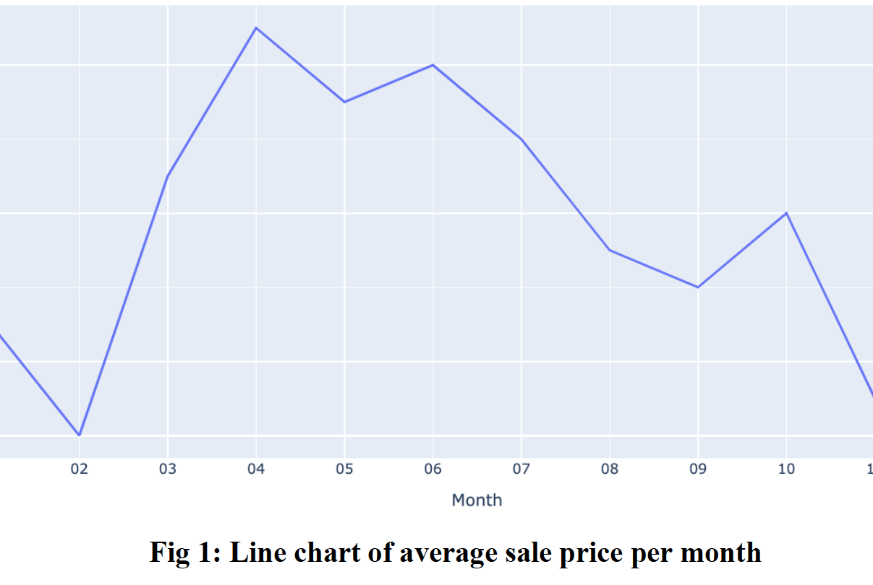
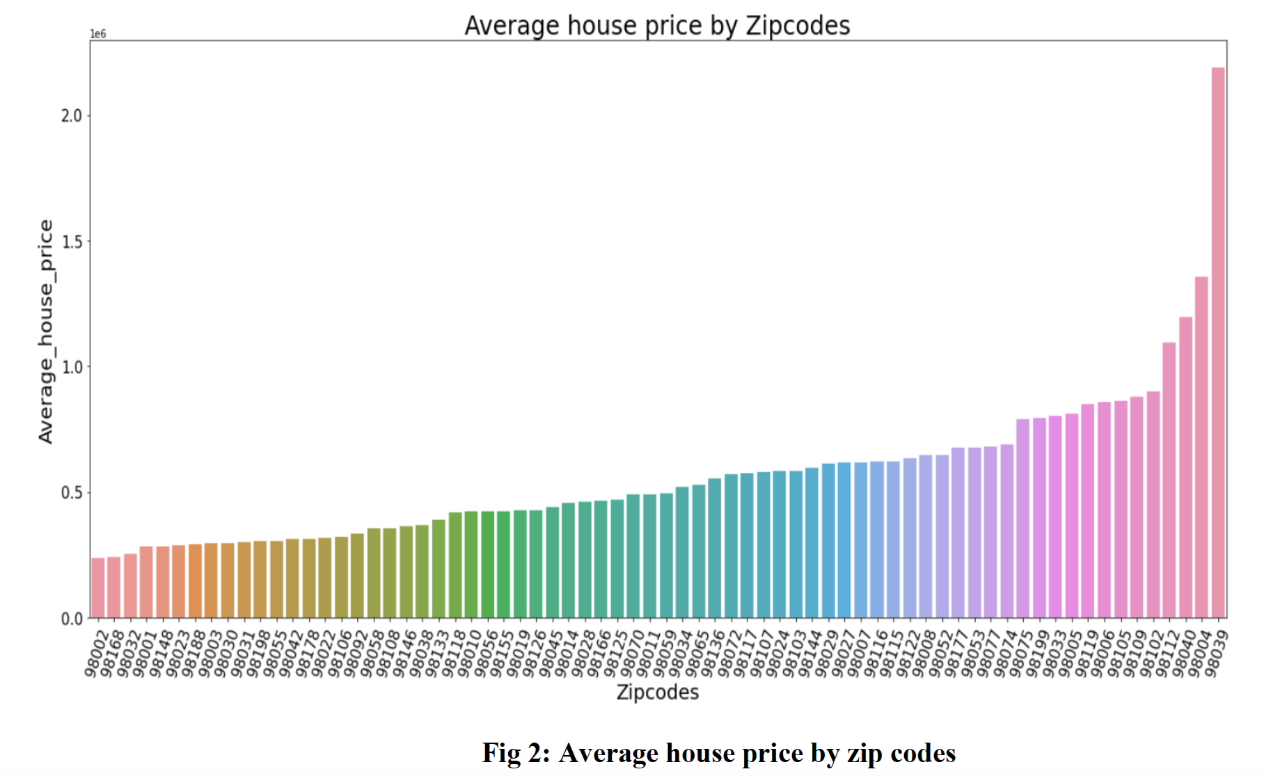
Two Main Recommendation from EDA
Consider busy periods of home buying in King County into recommending economical solution to home buyers
Determine average price of zip code helping home buyers to narrow down the search

Slide 7
Logistic Regression Model
Price is labelled “0”for Low price value houses (<$750,000) and “1” for High price value houses (>=$750,000).
The significant attributes obtained using Logit Regression Model are “Waterfront”(4.10) and “Sqft living”(0.9173).
Model is 89.7% accurate with 78.4% precision, 52.7% recall and MSE of 0.103.
Notes:
The model is aimed to assist the real estate business owners to understand the most significant factors contributing to pricing of the houses in King County.
- Dataset has attributes with differing scales, we standardized the dataset before performing any modelling
- The scaled data was then used for training and testing independent attributes.

Slide 8
Decision Tree Model
Decision Tree Classification Model with maximum depth of 4 levels in order to predict the price category of the house in King County.
The significant variable obtained is “sqft_living”, as it is the Root node of the model.
Model is 88.8% accurate with 79.8% precision, 44.2% recall and MSE of 0.112.
Notes:
The model is aimed to assist the real estate business owners to understand the most significant factors contributing to pricing of the houses in King County.
- Dataset has attributes with differing scales, we standardized the dataset before performing any modelling
- The scaled data was then used for training and testing independent attributes.

Slide 9
Random Forest Model
With a reduced performance of decision tree, it can be said that model might have overfitted the results to the training dataset. Hence considering an ensemble Decision Tree model like Random Forest would help in further investigation.
Feature importance identifies “Sqft living” feature to be significant.
Model is 88.9% accurate with 69.7% precision, 59% recall and MSE of 0.111.
Notes:
The model is aimed to assist the real estate business owners to understand the most significant factors contributing to pricing of the houses in King County.
- Dataset has attributes with differing scales, we standardized the dataset before performing any modelling
- The scaled data was then used for training and testing independent attributes.

Slide 10

Recommendation & Conclusion
The analysis is aimed to assist the real estate business owners to understand the most significant factors contributing to pricing of the houses in King County.
Based on customers financial availability, recommending houses with proximity to “Waterfront” or not would be key.
Offering Price Per Square foot living area options based on Zip codes as per customers’ financial resources.
This information will assist the real estate Business Stakeholders in devising strategies as per the Business clients' requirements ,their financials abilities, and benefit the organization by proposing them with economical solutions.
Notes:
It is evident that the optimum accuracy is obtained from the Logistic
Forward Stepwise Regression Model with optimum Accuracy and Precision, minimum Time
taken by the Model for execution (calculated via stop watch) and the lowest MSE value, as we
know the lower the MSE, the better is the forecast.
WATERFRONT - Proximity to "Waterfront" is one of the most significant variable influencing the High pricing (“>750,000”) of the Housing property in King County, Washington.
Customers with finance availability (“>750,000”) can be recommended for Houses with waterfront view because the waterfront property is limited in supply with high buyer demand, with appreciation rate to be steadier over time, On the contrary the Customer with finance availability (“<750,000”) can be recommended for purchasing home away from the Waterfront because it will be more economical investment which is vital for majority of the consumers.
SQFT_LIVING - For example, a
larger living area combined with a reduced overall house price is frequently more desirable to
a Customer with a large family. In such cases, Real estate agents may advise purchasing houses
in Zip codes with low average housing prices rather than Zip codes with higher housing price
averages. Our recommendation to the upper management of Real Estate Agencies or
Businesses would be to optimize the House search for clients by recommending that they
purchase similar-sized Dwelling properties in lower-cost Zip codes.

Slide 11
References
Burhanykiyakoglu. (2019, May 23). Predicting House prices. Kaggle. Retrieved March 5, 2022, from https://www.kaggle.com/burhanykiyakoglu/predicting-house-prices
Geomms. (n.d.). Geomms/predicting-Seattle-housing-prices. GitHub. Retrieved March 5, 2022, from https://github.com/geomms/Predicting-Seattle-Housing-Prices
Plotly Python Graphing Library. (n.d.). Plotly: The front end for ML and data science models. https://plotly.com/python/
Why Are Waterfront Properties More Expensive? - Coastal Dream Life. (n.d.). Coastal Dream Life. https://coastaldreamlife.com/why-are-waterfront-properties-moreexpensive/#:~:text=Waterfront%20properties%20are%20more%20expensive,demand,%20naturally%20boosting%20the%20prices.
Should I use a decision tree or logistic regression for classification? (n.d.). Data Science Stack Exchange. https://datascience.stackexchange.com/questions/6048/should-i-use-adecision-tree-or-logistic-regression-for-classification

