Slide 1
PROJECT 30
Sports Club Membership &
Tournament Management System
DBMS Project • Review 1
Problem Identification • Literature Survey • Project Planning • SRS • ER Design
Presented by: ____________________
Course: Database Management Systems

Slide 2
Review 1 — Requirement Coverage
5 Marks
Problem Identification
Literature Survey
Project Planning
• Current challenges in member records, scheduling, tournaments, fees and equipment tracking.
• Study existing sports-club management platforms and identify common capabilities and gaps.
• Define scope, milestones, deliverables, technology stack and responsibilities.
SRS
Conceptual Design
Initial Relational Schema
• Define users, functional requirements, non-functional requirements and business rules.
• ER model covering the required principal entities and their relationships.
• Proposed tables with primary keys, foreign keys and relationships.
REVIEW 1 DELIVERABLES FROM PROJECT 30
• Problem identification, scope, objectives, users and functional requirements
• Conceptual design / ER diagram
• Initial relational schema showing proposed tables, primary keys and relationships
DBMS PBL • Project 30 • Review 1 2

Slide 3
1. Problem Identification
Why this system is needed
CURRENT SITUATION
PROPOSED SOLUTION
• Sports clubs manage members, teams, coaches, facilities, training, tournaments, payments and equipment.
• Manual files or disconnected spreadsheets make it difficult to keep records consistent.
• Facility and team schedules can conflict when bookings are maintained separately.
• Tournament fixtures, results and standings require repeated manual updates.
• Fee dues and equipment returns are harder to track without a centralized database.
Centralized Relational Database
• Single source of truth for club operations
• Linked records using PK/FK relationships
• Validation and integrity constraints
• Reports for management decisions
Core outcome
• Reduce duplication and manual coordination
• Improve schedule visibility
• Track payments, results and equipment
• Support future Java/Python front end
DBMS PBL • Project 30 • Review 1 3

Slide 4
2. Literature Survey
Existing solutions & learning
SportMember
TeamSnap
Key Learning for Our DBMS
• Member database and role-based access
• Activities/calendar and attendance
• Membership and match-fee payments
• Facility/equipment booking
• Tournament organization
• Pools/brackets and standings
• Scheduling and conflict support
• Online registration and results
• Sports operations are naturally relational
• Member, team, schedule and payment data must be connected
• Tournament data benefits from structured fixtures/results
• Our academic implementation emphasizes ER design, normalization and integrity
Research conclusion
Existing platforms demonstrate the value of integrated membership, scheduling, payments and tournament management. Our project converts these requirements into a structured academic RDBMS with explicit entities, relationships, constraints and reporting.
Sources: SportMember; TeamSnap; MySQL Reference Manual.
DBMS PBL • Project 30 • Review 1 4

Slide 5
3. Scope & Objectives
What the project will cover
Membership
Sports & Teams
Training & Facilities
Tournaments
• Member registration
• Plans & status
• Payments & fee dues
• Sports/team creation
• Player assignment
• Coach management
• Training schedules
• Facility booking
• Conflict prevention
• Tournament setup
• Participants & fixtures
• Results & standings
Equipment
Reports
Database Objectives
Application Objective
• Equipment records
• Issue/return tracking
• Overdue status
• Memberships
• Facility use
• Player performance
• Fee dues & equipment
• Relational design
• 3NF normalization
• Data integrity
• Efficient retrieval
• Java/Python front end
• CRUD, search, validation
• Reporting
PRIMARY OBJECTIVE
Build a centralized database that makes sports-club membership and tournament operations easier to manage, query and report.
DBMS PBL • Project 30 • Review 1 5

Slide 6
4. Users & Functional Requirements
SRS — system actors
Club Admin
Coach
Member / Player
• Members, sports, teams, coaches, facilities
• Teams, players, training sessions
• Membership, team, training, fixtures
Tournament Manager
Accounts Staff
Equipment Manager
• Tournaments, participants, fixtures, results
• Membership payments and fee dues
• Equipment issue and returns
CORE FUNCTIONAL REQUIREMENTS
• Register, update and search members
• Manage plans, payments and active membership
• Create sports/teams and assign coaches & players
• Schedule training and book facilities
• Create tournaments and fixtures
• Enter results and generate standings
• Issue/return equipment and track overdue items
• Generate management reports
DBMS PBL • Project 30 • Review 1 6

Slide 7
5. Software Requirements Specification (SRS)
Initial requirements baseline
Functional Requirements
Non-Functional Requirements
Business Rules
• CRUD operations for core entities
• Search and filtering
• Scheduling and booking
• Fixture/result management
• Payment and equipment tracking
• Reports and standings
• Data integrity and consistency
• Usability and clear input validation
• Reliable transaction handling
• Fast retrieval through suitable indexes
• Maintainable modular design
• Role-based access in application
• Active membership required for participation
• No overlapping facility/team schedules
• Scores must be valid
• Facility capacity must not be exceeded
• Equipment return limits must be enforced
• Use PK, FK, UNIQUE, NOT NULL, CHECK and DEFAULT
TECHNOLOGY PLAN
• Database: MySQL (proposed)
• Front end: Python or Java
• ER modeling: relational conceptual design
• Testing: CRUD, constraint, conflict and validation tests
DBMS PBL • Project 30 • Review 1 7

Slide 8
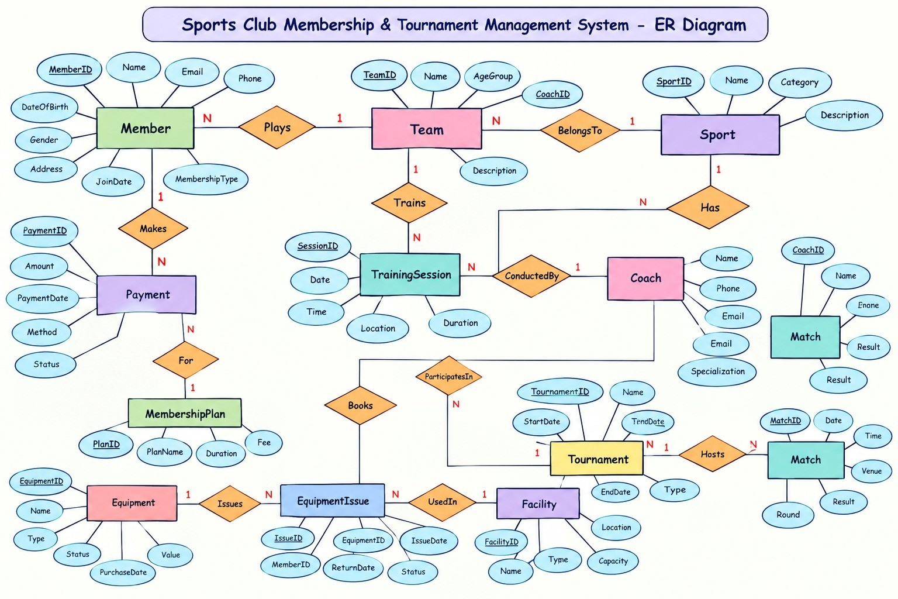
6. Conceptual Design — ER Diagram
Principal entities
MEMBER
SPORT
FACILITY
TOURNAMENT
EQUIPMENT
MEMBERSHIP PLAN
TEAM
TRAINING SESSION
PARTICIPANT
EQUIPMENT ISSUE
PAYMENT
COACH
FIXTURE
TEAM MEMBER
RESULT
Note: TEAM_MEMBER resolves the M:N Member–Team relationship. PARTICIPANT links tournament participation to a team.
DBMS PBL • Project 30 • Review 1 8

Slide 9
7. ER Design — Key Relationships
Cardinality decisions
Membership
Payments
Teams
• PLAN 1 : M MEMBER
• One plan can serve many members.
• MEMBER 1 : M PAYMENT
• A member can make multiple payments.
• SPORT 1 : M TEAM
• A sport can contain multiple teams.
Players
Training
Facilities
• TEAM M : N MEMBER
• Resolved through TEAM_MEMBER.
• TEAM 1 : M TRAINING
• A team has multiple sessions.
• FACILITY 1 : M TRAINING
• A facility hosts sessions at different times.
Tournaments
Results
Equipment
• TOURNAMENT 1 : M FIXTURE
• Each tournament contains multiple fixtures.
• FIXTURE 1 : 1 RESULT
• A completed fixture records its result.
• MEMBER 1 : M ISSUE
• A member can have multiple issue records.
DESIGN NOTE
Associative entities keep many-to-many relationships explicit and support later normalization.
DBMS PBL • Project 30 • Review 1 9

Slide 10
8. Initial Relational Schema — Core Tables
PK = Primary Key • FK = Foreign Key
MEMBER
MEMBERSHIP_PLAN
PAYMENT
SPORT
• Member_ID (PK)
• Name, DOB, Gender
• Phone, Email
• Join_Date, Status
• Plan_ID (PK)
• Plan_Name
• Duration, Fee
• Payment_ID (PK)
• Member_ID (FK)
• Plan_ID (FK)
• Amount, Date, Status
• Sport_ID (PK)
• Sport_Name
• Category
COACH
TEAM
TEAM_MEMBER
• Coach_ID (PK)
• Coach_Name
• Phone, Specialization
• Team_ID (PK)
• Team_Name
• Sport_ID (FK)
• Coach_ID (FK)
• Team_ID (PK, FK)
• Member_ID (PK, FK)
• Join_Date, Role
Relationships: PAYMENT → MEMBER / PLAN • TEAM → SPORT / COACH • TEAM_MEMBER → TEAM / MEMBER
DBMS PBL • Project 30 • Review 1 10

Slide 11
8. Initial Relational Schema — Operations Tables
Proposed tables
FACILITY
TRAINING_SESSION
TOURNAMENT
PARTICIPANT
• Facility_ID (PK)
• Name, Location
• Capacity, Type
• Training_ID (PK)
• Team_ID (FK)
• Coach_ID (FK)
• Facility_ID (FK)
• Date, Start, End
• Tournament_ID (PK)
• Name, Sport_ID (FK)
• Start_Date, End_Date
• Location
• Participant_ID (PK)
• Tournament_ID (FK)
• Team_ID (FK)
FIXTURE
RESULT
EQUIPMENT
EQUIPMENT_ISSUE
• Fixture_ID (PK)
• Tournament_ID (FK)
• Team1_ID / Team2_ID (FK)
• Facility_ID (FK)
• Date, Start_Time
• Result_ID (PK)
• Fixture_ID (FK)
• Team1_Score
• Team2_Score
• Winner_Team_ID (FK)
• Equipment_ID (PK)
• Name, Category
• Quantity
• Available_Quantity
• Issue_ID (PK)
• Equipment_ID (FK)
• Member_ID (FK)
• Issue_Date
• Expected/Actual Return
• Status
Next design stage: normalize to 3NF and add DDL constraints, indexes and validation logic.
DBMS PBL • Project 30 • Review 1 11

Slide 12
9. Project Planning & Milestones
From Review 1 to final demo
1
2
3
4
5
NOW
NEXT
WEEK 11
WEEK 11
WEEK 16
Requirements
& SRS
ER + Schema
Validation
3NF + DDL
+ Sample Data
Queries +
Prototype
Python/Java App
+ Final Demo
Planned testing
Planned deliverables
• CRUD tests
• Duplicate/invalid input tests
• Foreign-key tests
• Schedule conflict tests
• Score/capacity tests
• Report verification
• ER diagram
• Normalized schema
• SQL scripts + sample data
• Queries/views
• Prototype + source code
• Screenshots + report
DBMS PBL • Project 30 • Review 1 12

Slide 13
10. Current Progress & Next Steps
Review 1 status
COMPLETED / PREPARED
NEXT ACTIONS
• Problem statement and motivation defined
• Scope and objectives prepared
• Users and functional requirements identified
• Literature survey completed at a high level
• SRS baseline and business rules identified
• Principal entities and relationships mapped
• Initial relational schema drafted
• Finalize ER diagram and cardinalities
• Review attributes and keys with the team
• Normalize schema to 3NF
• Prepare functional dependencies and data dictionary
• Implement DDL and integrity constraints
• Insert realistic sample data
• Develop SQL reports and prototype
Target for Review 1: clear requirements + defensible ER design + initial schema
DBMS PBL • Project 30 • Review 1 13

Slide 14
References
Literature survey & technical reference
• Project brief: DBMS_PBL_70_Unique_Project_Statements.docx — Project 30 requirements.
• SportMember — club/team management, membership, activities, payments and facility/equipment features.
• TeamSnap — tournament organization, standings, scheduling, registration and results.
• MySQL 8.0 Reference Manual — PRIMARY KEY, UNIQUE and FOREIGN KEY constraints.
Online sources
https://www.sportmember.com/
https://www.teamsnap.com/for-business/features/tournaments
https://dev.mysql.com/doc/refman/8.0/en/constraint-primary-key.html
https://dev.mysql.com/doc/refman/8.0/en/create-table-foreign-keys.html
Thank you — Questions & Discussion
DBMS PBL • Project 30 • Review 1 14

