Slide 1
Angularfilestructure

Slide 2
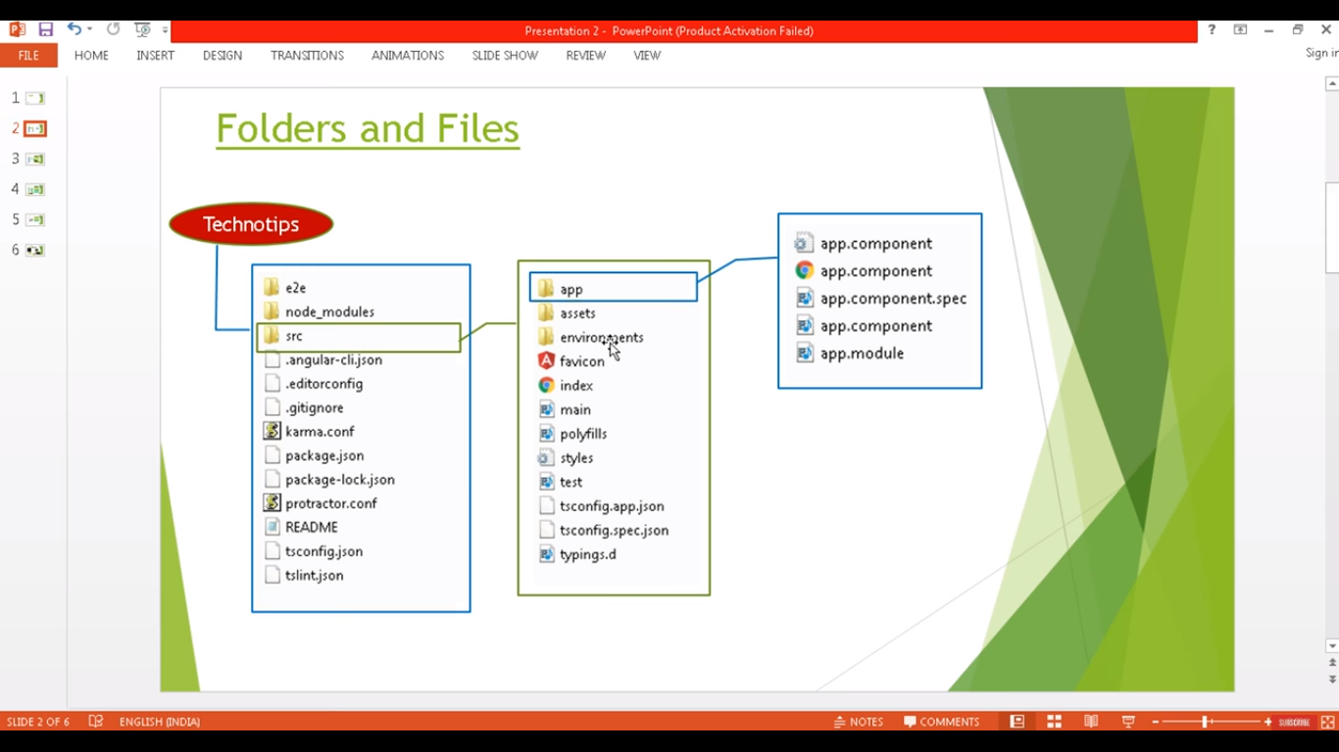

Slide 3
e2e
Used for
Unit testing
Component testing
Automation testing

Slide 4
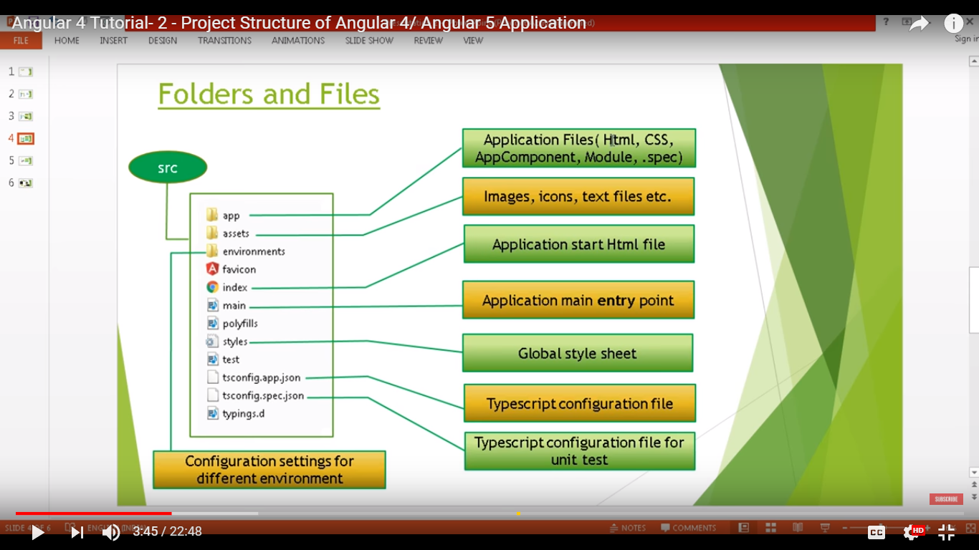

Slide 5
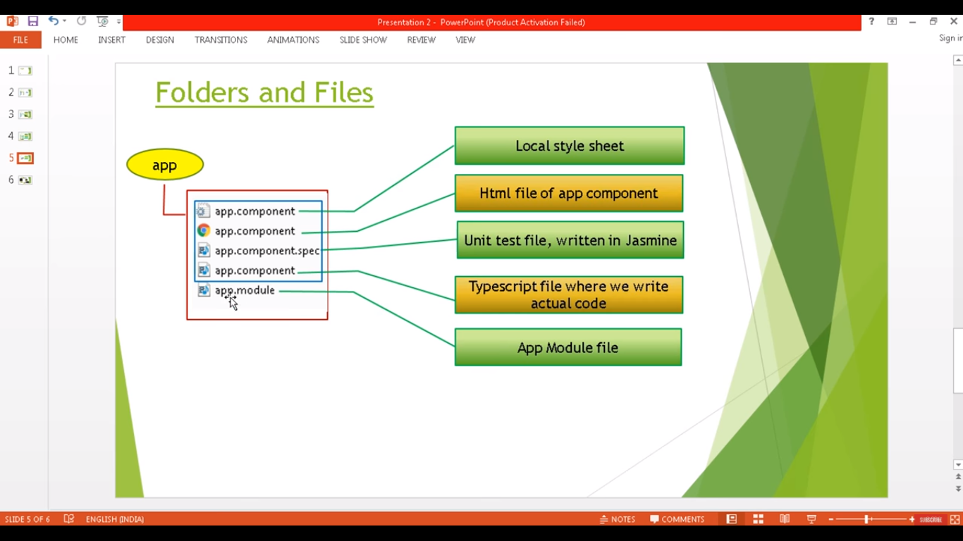

Slide 6
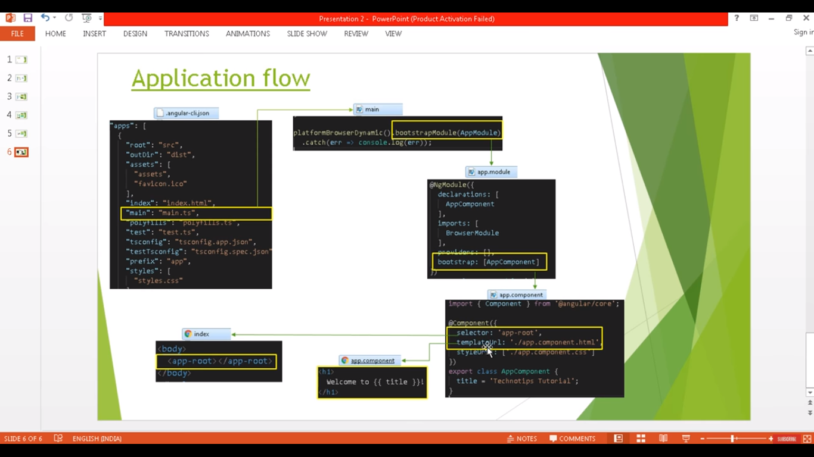

Slide 7
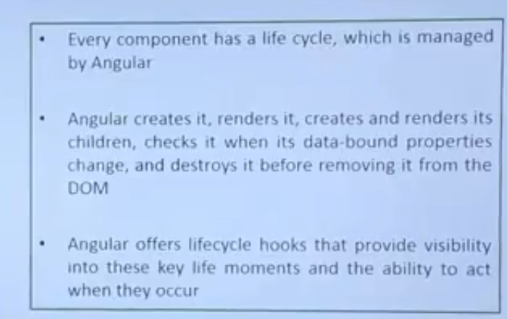

Slide 8
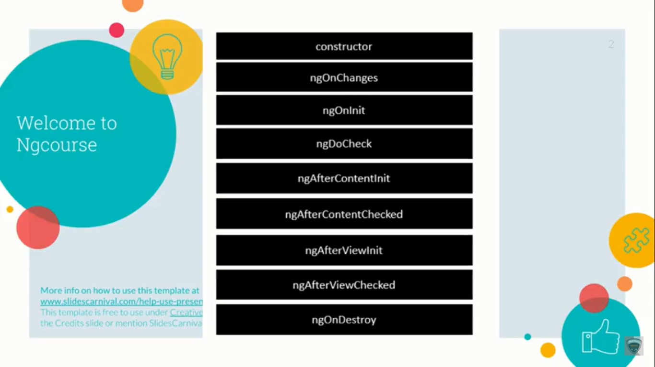

Slide 9
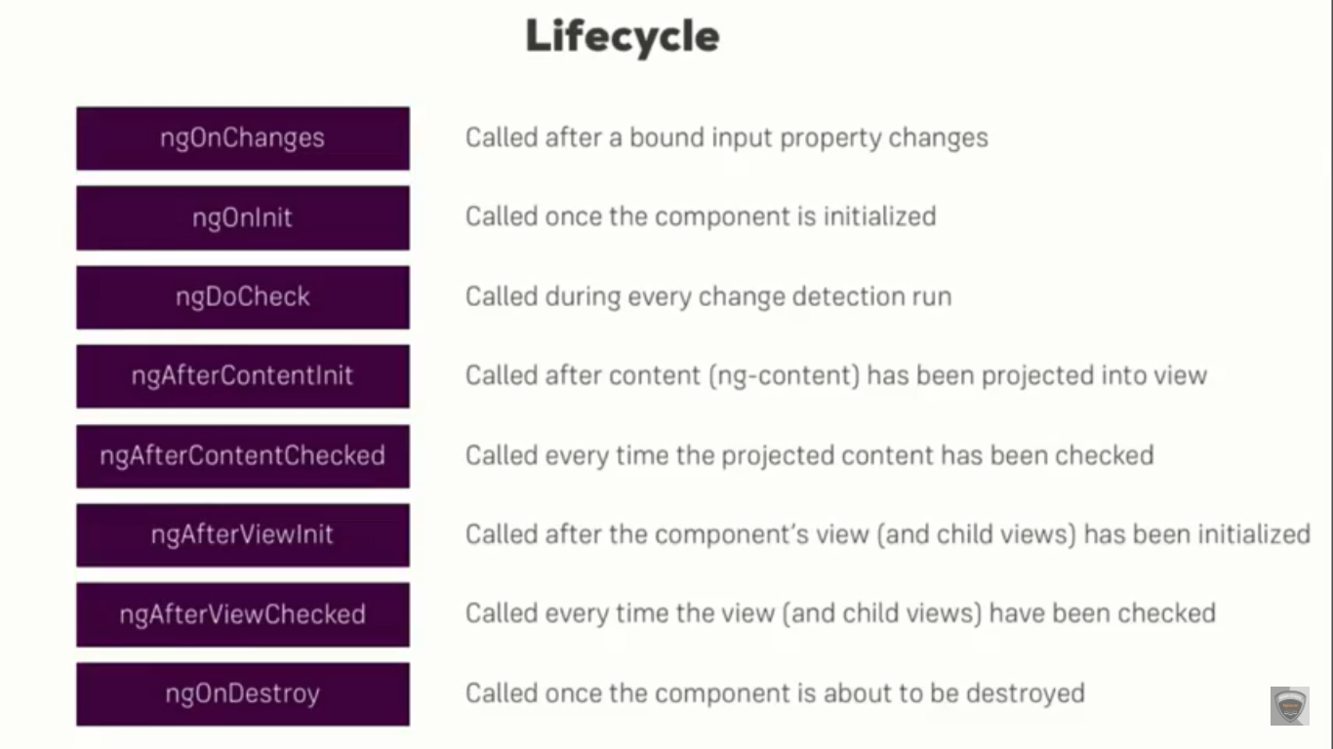

Slide 10
npm install typescript -g
Tsc –init
Npm install lite-server -g

