Slide 1
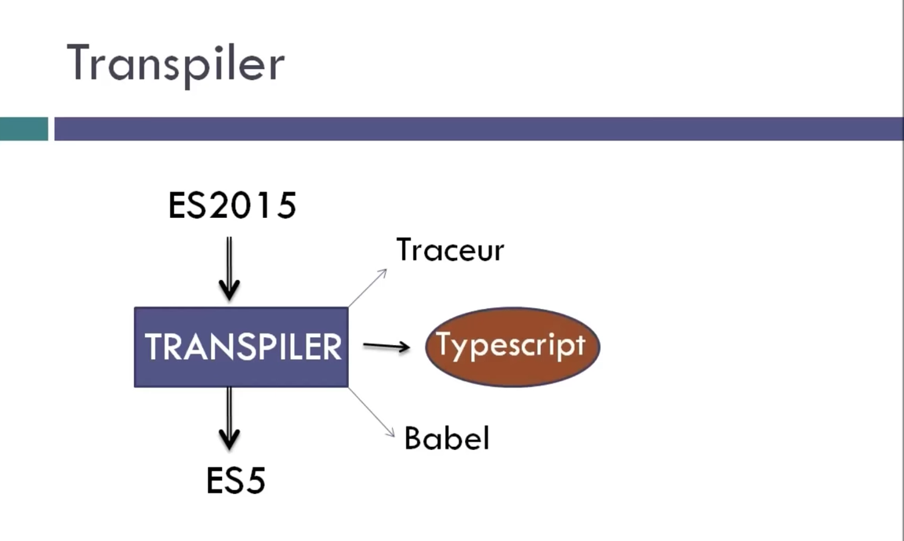

Slide 2
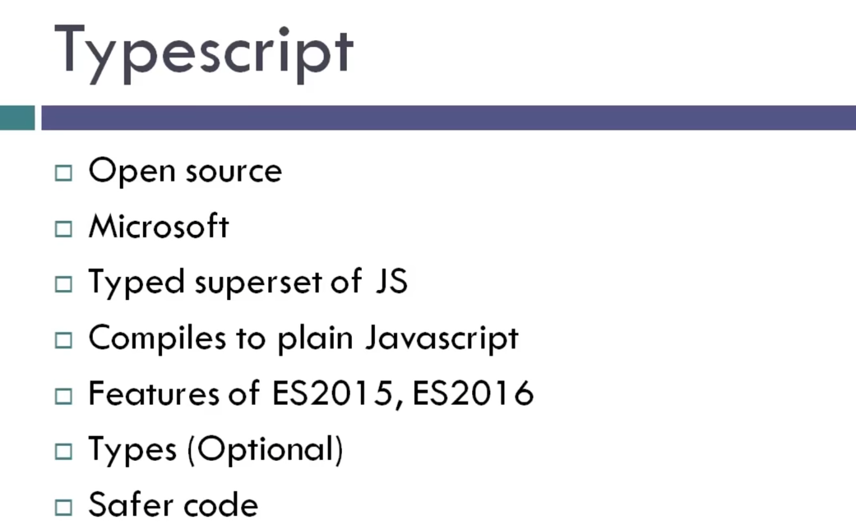

Slide 3
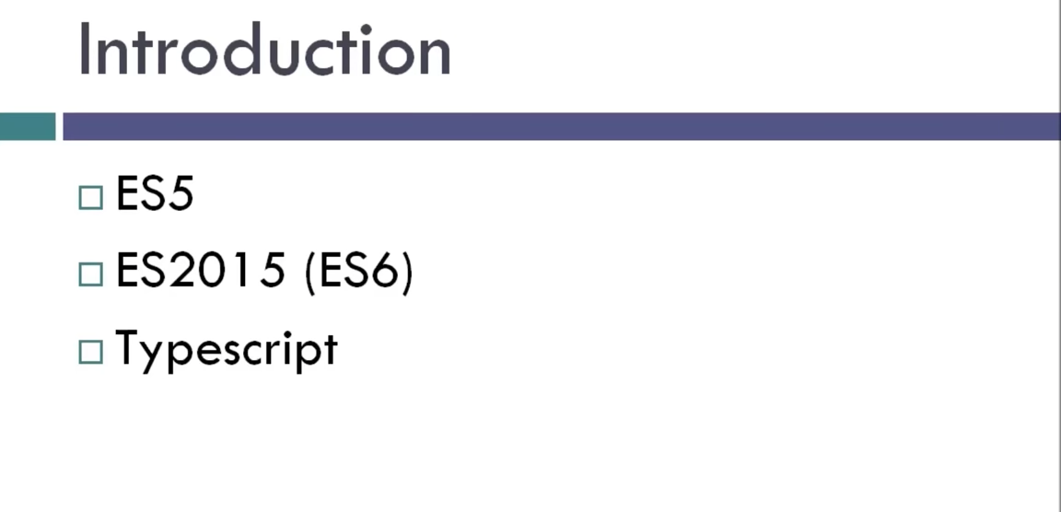

Slide 4
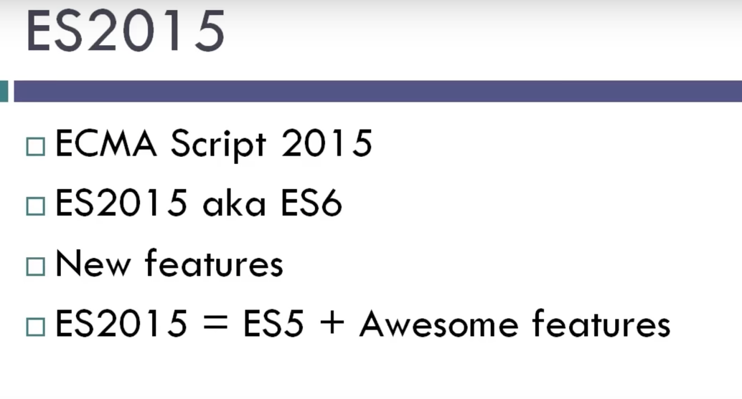

Slide 5
What is Typescript?
TypeScript is a strongly typed, object oriented, compiled language. It was designed by Anders Hejlsberg (designer of C#) at Microsoft. TypeScript is both a language and a set of tools. TypeScript is a typed superset of JavaScript compiled to JavaScript. In other words, TypeScript is JavaScript plus some additional features.

Slide 6
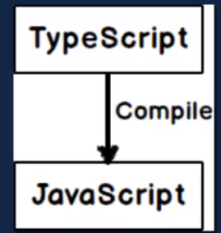

Slide 7


Slide 8
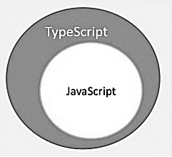

Slide 9
configuration
Cntl +shit +b (task.json)
Npm install typescript –g
tsc –init
Npm install lite-server -g

Slide 10
A TypeScript program is composed of −
Modules
Functions
Variables
Statements and Expressions
Comments

Slide 11
Identifiers in TypeScript
Identifiers in TypeScript
Identifiers are names given to elements in a program like variables, functions etc. The rules for identifiers are −
Identifiers can include both, characters and digits. However, the identifier cannot begin with a digit.
Identifiers cannot include special symbols except for underscore (_) or a dollar sign ($).
Identifiers cannot be keywords.
They must be unique.
Identifiers are case-sensitive.
Identifiers cannot contain spaces.

Slide 12
TypeScript ─ Keywords
break | as | any | switch
case | if | throw | else
var | number | string | get
module | type | instanceof | typeof
public | private | enum | export
finally | for | while | void
null | super | this | new
in | return | true | false
any | extends | static | let
package | implements | interface | function
new | try | yield | const
continue | do

Slide 13
loops
While
Do while
For

Slide 14
Whitespace and Line Breaks
TypeScript ignores spaces, tabs, and newlines that appear in programs. You can use spaces, tabs, and newlines freely in your program and you are free to format and indent your programs in a neat and consistent way that makes the code easy to read and understand.
TypeScript is Case-sensitive
TypeScript is case-sensitive. This means that TypeScript differentiates between uppercase and lowercase characters.
Semicolons are optional
Each line of instruction is called a statement. Semicolons are optional in TypeScript.

Slide 15
Comments in TypeScript
Comments in TypeScript
Comments are a way to improve the readability of a program. Comments can be used to include additional information about a program like author of the code, hints about a function/ construct etc. Comments are ignored by the compiler.
TypeScript supports the following types of comments −
Single-line comments ( // ) − Any text between a // and the end of a line is treated as a comment
Multi-line comments (/* */) − These comments may span multiple lines.

Slide 16
Features of TypeScript
TypeScript is just JavaScript. TypeScript starts with JavaScript and ends with JavaScript. Typescript adopts the basic building blocks of your program from JavaScript. Hence, you only need to know JavaScript to use TypeScript. All TypeScript code is converted into its JavaScript equivalent for the purpose of execution.
TypeScript supports other JS libraries. Compiled TypeScript can be consumed from any JavaScript code. TypeScript-generated JavaScript can reuse all of the existing JavaScript frameworks, tools, and libraries.
JavaScript is TypeScript. This means that any valid .js file can be renamed to .ts and compiled with other TypeScript files.
TypeScript is portable. TypeScript is portable across browsers, devices, and operating systems. It can run on any environment that JavaScript runs on. Unlike its counterparts, TypeScript doesn’t need a dedicated VM or a specific runtime environment to execute.

Slide 17
The benefits of TypeScript include −
Compilation − JavaScript is an interpreted language. Hence, it needs to be run to test that it is valid. It means you write all the codes just to find no output, in case there is an error. Hence, you have to spend hours trying to find bugs in the code. The TypeScript transpiler provides the error-checking feature. TypeScript will compile the code and generate compilation errors, if it finds some sort of syntax errors. This helps to highlight errors before the script is run.
Strong Static Typing − JavaScript is not strongly typed. TypeScript comes with an optional static typing and type inference system through the TLS (TypeScript Language Service). The type of a variable, declared with no type, may be inferred by the TLS based on its value.
TypeScript supports type definitions for existing JavaScript libraries. TypeScript Definition file (with .d.ts extension) provides definition for external JavaScript libraries. Hence, TypeScript code can contain these libraries.
TypeScript supports Object Oriented Programming concepts like classes, interfaces, inheritance, etc.

Slide 18
A TypeScript program is composed of
Modules
Functions
Variables
Statements and Expressions
Comments

Slide 19
enum
Enum can store bunch of numbers
You can not modify it

Slide 20
Identifiers in TypeScript
Identifiers in TypeScript
Identifiers are names given to elements in a program like variables, functions etc. The rules for identifiers are −
Identifiers can include both, characters and digits. However, the identifier cannot begin with a digit.
Identifiers cannot include special symbols except for underscore (_) or a dollar sign ($).
Identifiers cannot be keywords.
They must be unique.
Identifiers are case-sensitive.
Identifiers cannot contain spaces.

Slide 21
Valid identifiers | Invalid identifiers
firstName | Var
first_name | first name
num1 | first-name
$result | 1number

Slide 22
TypeScript ─ Keywords
break | as | any | switch
case | if | throw | else
var | number | string | get
module | type | instanceof | typeof
public | private | enum | export
finally | for | while | void
null | super | this | new
in | return | true | false
any | extends | static | let
package | implements | interface | function
new | try | yield | const
continue | do | catch

Slide 23
Comments in TypeScript
TypeScript supports the following types of comments −
Single-line comments ( // ) − Any text between a // and the end of a line is treated as a comment
Multi-line comments (/* */) − These comments may span multiple lines.

Slide 24


Variable Declaration in TypeScript
When you declare a variable, you have four options −
Declare its type and value in one statement.
Declare its value but no type. The variable type will be set to any
.
Declare neither value not type. In this case, the data type of the variable will be any and will be initialized to undefined.

Slide 25
TypeScript and Object Orientation
TypeScript is Object-Oriented JavaScript. Object Orientation is a software development paradigm that follows real-world modelling. Object Orientation considers a program as a collection of objects that communicate with each other via mechanism called methods. TypeScript supports these object oriented components too.
Object − An object is a real time representation of any entity. According to Grady Brooch, every object must have three features −
State − described by the attributes of an object
Behavior − describes how the object will act
Identity − a unique value that distinguishes an object from a set of similar such objects.
Class − A class in terms of OOP is a blueprint for creating objects. A class encapsulates data for the object.
Method − Methods facilitate communication between objects.

Slide 26
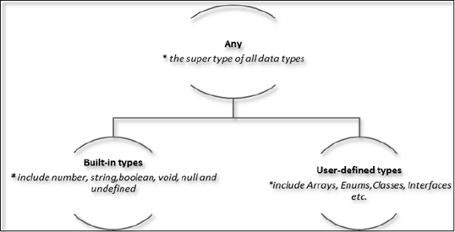

Slide 27
The Any type
The any data type is the super type of all types in TypeScript. It denotes a dynamic type. Using the any type is equivalent to opting out of type checking for a variable.

Slide 28
Built-in types
Data type | Keyword | Description
Number | number | Double precision 64-bit floating point values. It can be used to represent both, integers and fractions.
String | string | Represents a sequence of Unicode characters
Boolean | Boolean | Represents logical values, true and false
Void | void | Used on function return types to represent non-returning functions
Null | null | Represents an intentional absence of an object value.
Undefined | undefined | Denotes value given to all uninitialized variables

Slide 29
User-defined Types
User-defined types include Enumerations (enums), classes, interfaces, arrays, and tuple.

Slide 30
Type Assertion in TypeScript
TypeScript allows changing a variable from one type to another. TypeScript refers to this process as Type Assertion.
Var str=‘1’
Var str2:number=<number> <any> str

Slide 31
Arithmetic operators
Logical operators
Relational operators
Bitwise operators
Assignment operators
Ternary/conditional operator
String operator
Type Operator

Slide 32
Type Operators
It is a unary operator. This operator returns the data type of the operand. Take a look at the following example
Var num =12
Console.log(typeof num)

Slide 33
instanceof
This operator can be used to test if an object is of a specified type or not. The use of instanceof operator is discussed in the chapter classes.

Slide 34
Function
Sr.No | Funtions & Description
1. | Defining a FunctionA function definition specifies what and how a specific task would be done.
2. | Calling a FunctionA function must be called so as to execute it.
3. | Returning FunctionsFunctions may also return value along with control, back to the caller.
4. | Parameterized Function Parameters are a mechanism to pass values to functions.

Slide 35
Lambda Function
Lambda refers to anonymous functions in programming. Lambda functions are a concise mechanism to represent anonymous functions. These functions are also called as Arrow functions.
Lambda Function - Anatomy
There are 3 parts to a Lambda function −
Parameters − A function may optionally have parameters
The fat arrow notation/lambda notation (=>) − It is also called as the goes to operator
Statements − represent the function’s instruction set
Tip − By convention, the use of single letter parameter is encouraged for a compact and precise function declaration.
Lambda Expression
It is an anonymous function expression that points to a single line of code. Its syntax is as follows −

Slide 36
loops
for (initial_count_value; termination-condition; step) {
//statements
}

Slide 37
Function
Functions are the building blocks of readable, maintainable, and reusable code.
The Function Constructor
Recursion and TypeScript Functions

Slide 38
Anonymous Function
Functions that are not bound to an identifier (function name) are called as anonymous functions.
var msg = function() {
return "hello world";
}
console.log(msg())
var res = function(a:number,b:number) {
return a*b;
};
console.log(res(12,2))

Slide 39
Function Overloads
Step 1 − Declare multiple functions with the same name but different function signature. Function signature includes the following.
The data type of the parameter
function disp(string):void;
function disp(number):void;
The number of parameters
function disp(n1:number):void;
function disp(x:number,y:number):void;
The sequence of parameters
function disp(n1:number,s1:string):void;
function disp(s:string,n:number):void;

Slide 40
String
The String object lets you work with a series of characters. It wraps the string primitive data type with a number of helper methods.
var var_name = new String(string);

Slide 41
S.No. | Property & Description
1. | ConstructorReturns a reference to the String function that created the object.
2. | LengthReturns the length of the string.
3. | PrototypeThe prototype property allows you to add properties and methods to an object.

Slide 42
TypeScript - String concat()
var str1 = new String( "This is string one" );
var str2 = new String( "This is string two" );
var str3 = str1.concat( str2 );
console.log("str1 + str2 : "+str3)

Slide 43
Array
Features of an Array Here is a list of the features of an array −
An array declaration allocates sequential memory blocks.
Arrays are static. This means that an array once initialized cannot be resized.
Each memory block represents an array element.
Array elements are identified by a unique integer called as the subscript / index of the element.
Like variables, arrays too, should be declared before they are used. Use the var keyword to declare an array.
Array initialization refers to populating the array elements.
Array element values can be updated or modified but cannot be deleted.

Slide 44
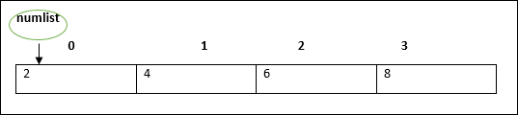
var numlist:number[] = [2,4,6,8]

Slide 45
Array Object
An array can also be created using the Array object. The Array constructor can be passed.
A numeric value that represents the size of the array or
A list of comma separated values.
The following example shows how to create an array using this method.
var arr_names:number[] = new Array(4)
for(var i = 0;i<arr_names.length;i++;) {
arr_names[i] = i * 2
console.log(arr_names[i])
}

Slide 46
Arrays in TypeScript
S.No. | Concept & Description
1. | Multi-dimensional arraysTypeScript supports multidimensional arrays. The simplest form of the multidimensional array is the twodimensional array.
2. | Passing arrays to functionsYou can pass to the function a pointer to an array by specifying the array's name without an index.
3. | Return array from functionsAllows a function to return an array

Slide 47
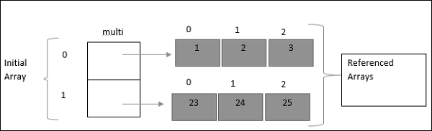
Declaring a Two-Dimensional array
var multi:number[][] = [[1,2,3],[23,24,25]]
console.log(multi[0][0])
console.log(multi[0][1])
console.log(multi[0][2])
console.log(multi[1][0])
console.log(multi[1][1])
console.log(multi[1][2])

