Slide 1
CS18000: Problem Solving and Object-Oriented Programming
Notes:
Welcome slide for display pre-bell.

Slide 2
Simple Graphical User Interfaces
Dialogs

Slide 3
Command Line vs. GUI
Command line
Program prompts user for data
User enters data via keyboard
Output in a “terminal window”
Old days: the terminal was the window
GUI (Graphical User Interface)
Window displays set of “controls” or “widgets”
User interacts with controls
Program responds to user “events” with actions
Notes:
We say that GUI programming is “event driven”. Instead of the program driving the user to do things in a specific order, the user drives the program to do things in his/her desired order. More or less.

Slide 4
Window System Concepts
The window system is a separate component of operating systems
Window system component active on local system
Access to frame buffer, keyboard, and mouse
X Window System protocol supports remote access
Application running locally contacts local window system to create GUI
Application running remotely does not have that option (unless using X environment)
Said to be running “headless”
Notes:
Need a picture here.

Slide 5
Java Architecture Reminder
Java compiler (javac)
Compiles Java source (.java) to byte code (.class)
Byte code is machine independent
Java runtime (java)
Each OS combination requires different version (Mac, Windows, Linux, 32-bit, 64-bit, Android, etc.)
Implements Java Virtual Machine (JVM)
Reads byte code, interprets instructions
Uses resources managed by OS
Specifically: the window system, if present
Notes:
Draw a couple of pictures: MyProgram.java -> javac -> MyProgram.class.
File copied to different machines, each with different java runtime. Execution proceeds in OS-dependent manner.
MyProgram.class -> java -> OS and library calls

Slide 6
Command Line and Remote Access
When connecting to a computer remotely…
e.g., to a server (like data.cs.purdue.edu)
Generally, only command line is available
Attempting to create a GUI results in HeadlessException
X Window System allows a remote application to open a window on local machine
Requires local X Server
Requires other configuration
Notes:
Show demonstrations with ssh to data with and without –X flag

Slide 7
Dialog Concepts
Prerequisite: application must be running on JVM with window system configured
Java dialogs are “modal”
Application code (your program) “blocks” waiting for user response
Similar to using Scanner to read from keyboard
Java GUI components adapt to “Look and Feel” of local system

Slide 8
JOptionPane Class
Java workhorse for modal dialogs
Part of Java GUI package: “Swing”
import javax.swing.JOptionPane;
Several static methods for typical use cases…
showMessageDialog
showInputDialog
showConfirmDialog
showOptionDialog
Notes:
Show JOptionPaneOverview example…

Slide 9
JOptionPane Class
Common arguments…
Location where dialog pops up (null is center screen)
Message to be included in dialog box (may be string or icon or html)
Message type (used for “look and feel” and helpful icon)
Option type (what buttons should be included by default)
Options (e.g., array of Strings for button names)
Icon to replace default icon of message type
Title string to be used in window heading
Initial value (a default value for certain option types)
Many arguments can be omitted for default values

Slide 10
Message Type Parameter
Message Type selects icon to display
Look and Feel dependent
Possible values
JOptionPane.PLAIN_MESSAGE (-1)
JOptionPane.ERROR_MESSAGE (0)
JOptionPane.INFORMATION_MESSAGE (1)
JOptionPane.WARNING_MESSAGE (2)
JOptionPane.QUESTION_MESSAGE (3)

Slide 11
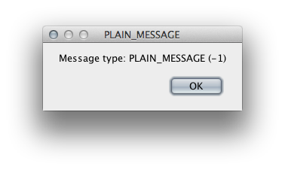
JOptionPane.PLAIN_MESSAGE

Slide 12
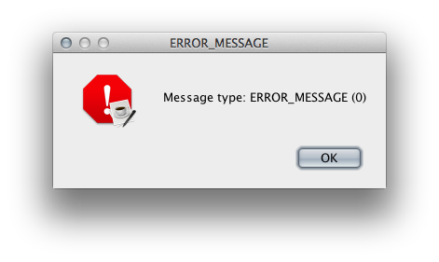
JOptionPane.ERROR_MESSAGE

Slide 13
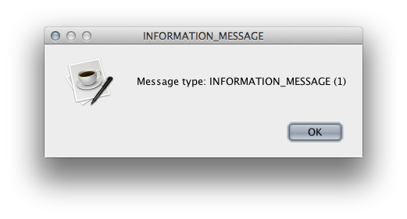
JOptionPane.INFORMATION_MESSAGE

Slide 14
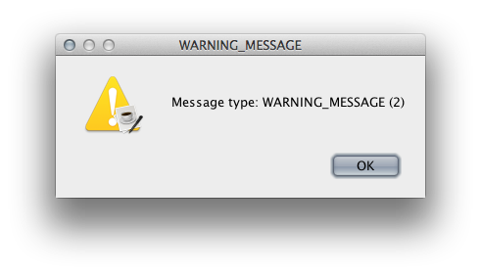
JOptionPane.WARNING_MESSAGE

Slide 15
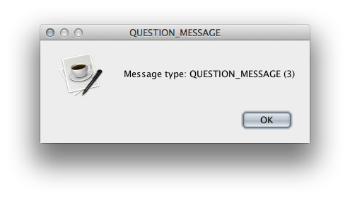
JOptionPane.QUESTION_MESSAGE

Slide 16
showMessageDialog
Simplest dialog
At minimum, displays message to user
Can include other parameters to affect appearance
Only one of these methods with a void return value—it is a do-only method
Notes:
See ShowMessage class example.

Slide 17
showConfirmDialog
Asks the user to confirm an action
Default options: “Yes”, “No”, “Cancel”
Returns int value indicating which button user selected
Various button combinations available…
“Yes” or “No”
“OK” or “Cancel”
Or user configurable with list of Strings
Notes:
See ShowConfirm class example.

Slide 18
Values with showConfirmDialog
Parameter option types...
JOptionPane.YES_NO_OPTION
JOptionPane.YES_NO_CANCEL_OPTION
JOptionPane.OK_CANCEL_OPTION
Returns one of…
JOptionPane.YES_OPTION (0) (same as OK_OPTION)
JOptionPane.NO_OPTION (1)
JOptionPane.CANCEL_OPTION (2)
JOptionPane.CLOSED_OPTION (-1)

Slide 19
showInputDialog
Asks the user for some input
Returns String value
Input may be…
Freely typed text
Selected from drop-down box or list
Allows simplified arguments
To create a drop-down box or list…
Provide array of Strings and default value
Must cast return value to String
Notes:
See ShowInput class example.

Slide 20
showOptionDialog
Generalized version: configurable buttons
Returns index of button selected
Way too many parameters…
Component parentComponent
Object message
String title
int optionType
int messageType
Icon icon
Object[] options
Object initialValue
Notes:
See ShowOption class example.

Slide 21
Dialog Demo Code
Available here: http://bit.ly/WeYeZC

Slide 22
Simple Graphical User Interfaces
GUI Examples

Slide 23
Problem: CodonExtractor
Write a program that reads a DNA sequence from the user and displays the codons in it
Definitions:
DNA sequence: sequence of chars in ACGT
Codon: sequence of three chars in DNA sequence
Algorithm:
Prompt user for DNA, check for valid input
Break DNA into 3-character chunks, display
Repeat until user indicates done

Slide 24
CodonExtractor: main Method
int continueProgram;
do {
// Read DNAsequence
String input = JOptionPane.showInputDialog("Enter a DNA sequence");
input = input.toUpperCase(); // Make upper case
String message = "Do you want to continue?";
if (isValid(input)) // Check for validity
displayCodons(input); // Find and display codons
else
message = "Invalid DNA Sequence.\n" + message;
continueProgram = JOptionPane.showConfirmDialog(null, message,
"Alert",
JOptionPane.YES_NO_OPTION);
} while (continueProgram == JOptionPane.YES_OPTION);
JOptionPane.showMessageDialog(null, "Thanks for using the Codon Extractor!");

Slide 25
CodonExtractor: isValid
public static boolean isValid(String dna) {
String validBases = "ACGT";
for (int i = 0; i < dna.length(); i++) {
char base = dna.charAt(i);
if (validBases.indexOf(base) == -1)
return false; //base not in "ACGT"
}
return true;
}

Slide 26
CodonExtractor: displayCodons
public static void displayCodons(String dna) {
String message = "";
// Get as many complete codons as possible
for (int i = 0; i < dna.length() - 2; i += 3)
message += "\n" + dna.substring(i, i + 3);
// 1-2 bases might be left over
int remaining = dna.length() % 3;
if (remaining == 1)
message += "\n"+ dna.substring(dna.length() - 1,
dna.length()) + "**";
else if (remaining == 2)
message += "\n"+ dna.substring(dna.length() - 2,
dna.length()) + "*";
message = "dna length: " + dna.length() + "\n\nCodons: " + message;
JOptionPane.showMessageDialog(null, message,
"Codons in DNA",
JOptionPane.INFORMATION_MESSAGE);
}

Slide 27
Problem: Prompting for a File Name
JFileChooser (javax.swing.JFileChooser)
Use new to create an object
Set title bar with setDialogTitle(title)
Show with showOpenDialog(null)
Return value is an int: 0 open, 1 cancel
Get the File selected with getSelectedFile()
File object describes the name and location of (the path to) the file
Notes:
Used in Project 4.

Slide 28
Solution: Prompting for a File Name
import java.io.File;
import javax.swing.JFileChooser;
public class FileChooser {
public static void main(String[] args) {
JFileChooser fc = new JFileChooser();
fc.setDialogTitle("Choose Important File");
int val = fc.showOpenDialog(null);
System.out.println(val);
File f = fc.getSelectedFile();
System.out.println(f);
}
}

