Slide 1
CS18000: Problem Solving and Object-Oriented Programming
Notes:
Welcome slide for display pre-bell.

Slide 2
Constructing Graphical User Interfaces
Frames
Panels
Widgets
Notes:
Project 6b will (likely) be to develop a display program for the SafeWalk system. Will use techniques from this week’s lectures.

Slide 3
Review
Review from earlier lecture on GUIs
  JOptionPane
  JFileChooser
One-shot, pop-up dialogs
Notes:
As you know, the modal dialogs block the current thread. As you might realized, there must be (and is) another thread running that handles interaction with the popup dialog box. More on that later…

Slide 4
Paradigm Shift: User in Charge
Old style: program prompts, user responds
New style: user directs program what to do next
Program must respond to a variety of user-initiated events
  Keystrokes
  Button clicks
  Mouse movements

Slide 5
Model-View-Controller
A software paradigm for constructing GUIs
Not rigid: Has many variations
Divides responsibilities into three pieces:
  Model: the data (or database) underlying the application
  View: the GUI components visible to the user
  Controller: the “glue” that implements the “business rules” of the application
Controller…
  updates view when model changes
  updates model when user interacts with view
Idea: Separates responsibilities to manage complexity; allows specialists in each area
Notes:
Specialists: artists and interface layout designers, database administrators, interaction designers/developers

Slide 6
GUI Concept: Interface Hierarchy
A GUI is composed of a hierarchical set of interface elements called components or window gadgets (widgets)
At the top-level is…
  A frame
  A window that interacts with the user’s desktop
Inside a frame is (among other things)…
  A menu bar
  A panel to layout the top-level components
Then come the interface widgets…
  User-interface elements
  Generally visible to the user
  Include labels, buttons, text fields, scroll bars, canvases, etc.
  A panel is also a widget, to permit creation of sub-layouts
Notes:
Sketch these names on the board.

Slide 7
GUIs in Java
Two packages of classes
  java.awt: original “Abstract Window Toolkit”
  javax.swing: newer, better and built on AWT
    These are the “J” classes
    In most cases, we will use these

Slide 8
Class JFrame
Basic top-level window
Interacts with “window manager”
Houses and lays out interactive controls
Two approaches to using:
  Create raw JFrame object (we will use)
  Extend JFrame then create object (also common)

Slide 9
Example: EmptyFrame
import javax.swing.JFrame;
public class EmptyFrame {
public static void main(String[] args) {
JFrame jf = new JFrame("Empty Frame");
jf.setSize(640, 480);
jf.setDefaultCloseOperation(
JFrame.DISPOSE_ON_CLOSE);
jf.setVisible(true);
}
}
Notes:
Show this example and a few variants of the setSize and setTitle

Slide 10
JFrame Operations
setDefaultCloseOperation: window close
  Use DISPOSE_ON_CLOSE (graceful shutdown)
  Not EXIT_ON_CLOSE (equivalent to System.exit())
setSize: set width and height (e.g., 640x480)
setResizable: true or false
setVisible: true or false (true also “validates”)
setTitle: String to appear in title bar
add: adds components to the component pane

Slide 11
Panels and Layout Managers
Panels are used to group widgets for layout
Panels are hierarchical
  may contain sub-panels
Layout managers define the rules
  how widgets and sub-panels are placed relative to one another

Slide 12
Class JPanel
Java panel class
Special features of JFrame
  jf.getContentPane() is a JPanel
  jf.add(…) automatically adds to content pane
  Default Content pane layout manager is “BorderLayout”

Slide 13
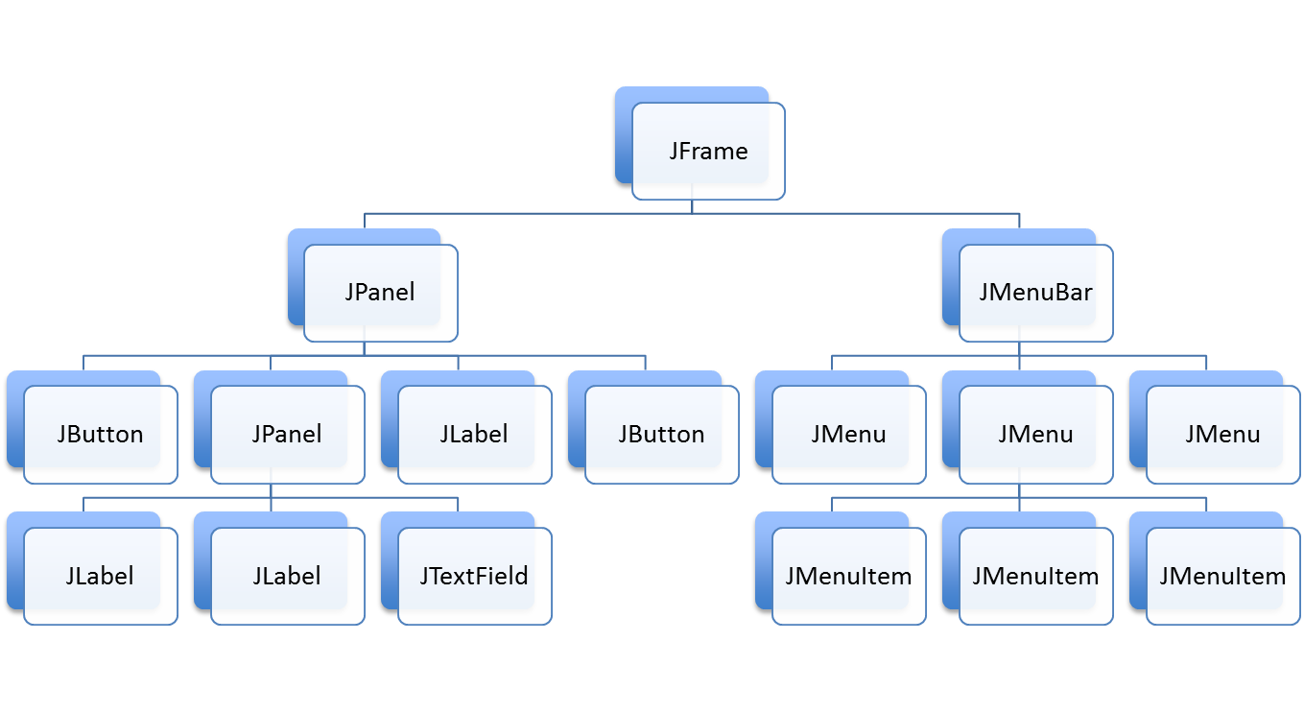
A Java GUI: A Tree of Components

Slide 14
Example Layout Manager: BorderLayout
Divides pane into five regions
  Center
  North, East, South, West
Can add one component to each region
jf.add(component, BorderLayout.CENTER)
More about layout managers later

Slide 15
Example: Adding Buttons to Borders
JButton jbCenter = new JButton("Center");
JButton jbNorth = new JButton("North");
JButton jbSouth = new JButton("South");
JButton jbEast = new JButton("East");
JButton jbWest = new JButton("West");
jf.add(jbCenter, BorderLayout.CENTER);
jf.add(jbNorth, BorderLayout.NORTH);
jf.add(jbSouth, BorderLayout.SOUTH);
jf.add(jbEast, BorderLayout.EAST);
jf.add(jbWest, BorderLayout.WEST);

Slide 16
Widgets for Interaction
JLabel
JButton
JTextField
JTextArea
Also, radio buttons, scroll bars, toggles, …

Slide 17
Constructing Graphical User Interfaces
Events
Notes:
Last time we looked at the basic set up of frame, panels, and adding widgets, like buttons to the GUI. Today we look at how to interact with those widgets and how to lay them out in an organized fashion.

Slide 18
Event Handling
Events connect the user to your program
Event sources (from the user)
  Keystrokes
  Mouse actions (buttons and movement)
Event listeners (your program)
  A method in your code
  Linked to a widget (or other event source)
  Processes events generated by that widget
Notes:
Two concepts here with overlapping terminology: source/listener, publisher/subscriber, observable/observer.

Slide 19
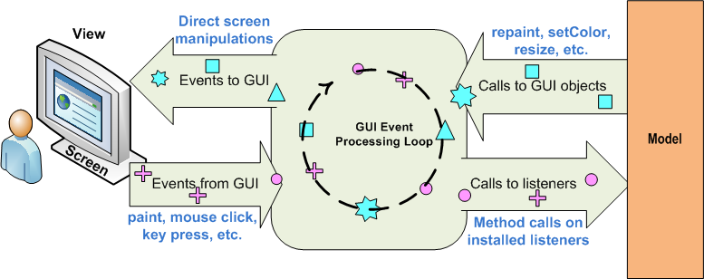
Java Event Handling
Event Dispatch Thread (EDT)
Controller
Source: http://www.clear.rice.edu/comp310/JavaResources/GUI/
Notes:
EDT is the Java term; Android just says UI Thread.

Slide 20
EDT: The Event Dispatch Thread
The Java GUI is controlled by its own thread, the EDT
Typical scenario:
  Main thread
    Builds JFrame and lays out interface
    Makes the JFrame visible
    Returns from main method; main thread exits
  EDT continues running
    Interacts with user
    Invokes “listeners” (or “call backs”) to handle events
Thus, your event-handling code runs on the EDT

Slide 21
A Better Way to Launch a JFrame
In slide 9, JFrame launched from main() method
This usually works ok, but sometimes runs into problems including deadlock
It is better to launch the JFrame so that it runs on the EDT
This is done by using SwingUtilities.invokeLater(Runnable method)
Causes method to be executed on the EDT
Notes:
We’re only going to look at the ActionListener interface for buttons; the others provide similar and more functionality for other GUI components.
Android has OnClickListeners, for example.

Slide 22
Example: EmptyFrame (1)
import javax.swing.SwingUtilities;
import javax.swing.JFrame;
public class EmptyFrame {
public static void main(String[] args) {
// Execute all GUI-related code on the EDT.
// This causes the run() method to execute inside the EDT.
SwingUtilities.invokeLater(new Runnable() {
public void run() {
createGUI();
}
});
}
Notes:
Show this example and a few variants of the setSize and setTitle

Slide 23
Example: EmptyFrame (2)
public static void createGUI() {
JFrame jf = new JFrame("Empty Frame");
jf.setSize(640, 480);
jf.setDefaultCloseOperation(
JFrame.DISPOSE_ON_CLOSE);
jf.setVisible(true);
}
}
Notes:
Show this example and a few variants of the setSize and setTitle

Slide 24
Observers (“Listeners”) in Java
ActionListener (buttons)
MouseListener (component entry/exit)
MouseMotionListener (component)
ItemListener (check boxes)
DocumentListener (text fields)
KeyListener (text boxes)
Notes:
We’re only going to look at the ActionListener interface for buttons; the others provide similar and more functionality for other GUI components.
Android has OnClickListeners, for example.

Slide 25
ActionListener Interface
Must implement:
  public void actionPerformed(ActionEvent e)
ActionEvent includes methods:
  getSource(): widget (object) generating event
  getActionCommand(): associated string
  getWhen(): time of event
source.setActionCommand(String s) sets the String returned by getActionCommand()
Notes:
The ActionEvent is how the GUI tells your controller what has happened. The two most used attributes are the widget generating the event and the programmer-definable “action command” associated with the widget.
The getActionCommand() method reads a string that is associated with the source using setActionCommand()

Slide 26
Example: PushMe (1)
import javax.swing.SwingUtilities;
import javax.swing.JFrame;
import javax.swing.JButton;
import javax.swing.JLabel;
import java.awt.BorderLayout;
import java.awt.event.ActionListener;
import java.awt.event.ActionEvent;
public class PushMe implements ActionListener {
static JFrame frame;
public static void main(String[] args) {
SwingUtilities.invokeLater(new Runnable() {
public void run() {
createGUI();
}
});
}

Slide 27
Example: PushMe (2)
public static void createGUI() {
frame = new JFrame("Push Me");
frame.setSize(200, 100);
frame.setDefaultCloseOperation (JFrame.DISPOSE_ON_CLOSE);
JButton button = centeredButton();
button.addActionListener(new PushMe());
frame.setVisible(true);
}

Slide 28
Example: PushMe (3)
public void actionPerformed(ActionEvent e) {
JButton b = (JButton) e.getSource();
if (b.getActionCommand().equals("last time"))
frame.dispose();
if (b.getActionCommand().equals("push")){
b.setActionCommand("last time");
b.setText("Push Again");
}
}

Slide 29
Example: PushMe (4)
static JButton centeredButton() {
String[] location = { BorderLayout.NORTH, BorderLayout.EAST, BorderLayout.SOUTH, BorderLayout.WEST };
for (String s : location) {
frame.add(new JLabel(" "), s);
}
JButton jb = new JButton("Push Me");
jb.setActionCommand("push");
frame.add(jb);
return jb;
}
}

Slide 30
Source to Listener Relationships
One-to-One
  One event source sends to one listener
  Simple
Many-to-One
  Many event sources send to one listener
  Allows single piece of code to handle multiple buttons
One-to-Many
  One source sends to many listeners
  Less used, but allows independent actions on same button press
Notes:
Draw pictures for these.

Slide 31
Using the ActionListener
Technique 1: Create a named class that implements ActionListener
  Create object
  Attach object to one or more buttons
Technique 2: Create an object of a nested class and attach to a button
Technique 3: Create an object of an unnamed (anonymous inner) class and attach to a button

Slide 32
Example: Implement ActionListener
public class ListenerTechnique1 implements ActionListener {
public static void main(String[] args) {
// initialization omitted
JButton button = new JButton("Push Me");
button.addActionListener(new ListenerTechnique1());
button.setActionCommand("doit");
// finish and make visible omitted
}
public void actionPerformed(ActionEvent ae) {
System.out.printf("Button pressed: %s\n",
ae.getActionCommand());
}
}

Slide 33
Example: Use Nested Class
// this class is nested inside main method (for example)…
class OneShot implements ActionListener {
public void actionPerformed(ActionEvent ae) {
System.out.printf("Button pressed: %s\n”,
ae.getActionCommand());
}
}
button.addActionListener(new OneShot());

Slide 34
One-Shot ActionListener
Don’t care about name
Only want to create one object
Java allows simplification…
Declare the method, class, create object, and add action listener all in one step!
Uses Anonymous Inner Class

Slide 35
Anonymous Inner Class
Declare the method, class, create object, and add action listener all in one step!
button.addActionListener(new ActionListener() {
public void actionPerformed(ActionEvent ae) {
// do something with ae
}
});

Slide 36
Constructing Graphical User Interfaces
Layout Managers
Worker Threads

Slide 37
Adapter Classes
Problem
  Some interfaces have many methods
  Your use may only need one of them
  Interface requires implementations for all
Solution
  Adapter class provides default (empty) implementations for all
  You create a subclass of the adapter class, overriding the ones you want to change
Notes:
You probably won’t need this for your project this semester…

Slide 38
Example: MouseAdapter Class
Provides implementations for
  mouseEntered(…)
  mouseClicked(…)
  mouseExited(…)
  mousePressed(…)
  mouseReleased(…)
You override only the ones you need

Slide 39
Layout Managers
Containers like JPanel have a Layout Manager
Layout Manager called by container to position and size each of its “children”
Several Layout Managers available…
  BorderLayout (center plus N-E-S-W)
  FlowLayout (left-to-right, top-to-bottom)
  GridLayout (m x n grid of equal size)
  …others (BoxLayout, GridBagLayout, …)
In general, re-layout as sizes change
Important

Slide 40
FlowLayout
Default layout manager (except for JFrame content pane)
Added widgets “flow” together, one after another
By default…
  Left to right to fill space, then top to bottom
  Each line is centered
  Widgets are left at “preferred” size
Notes:
Type in the FlowLayout example on the next slide.

Slide 41
Example: FlowLayout (1)
import javax.swing.SwingUtilities;
import javax.swing.JFrame;
import javax.swing.JPanel;
import javax.swing.JButton;
public class FlowLayoutExample {
public static void main(String[] args) {
SwingUtilities.invokeLater(new Runnable() {
public void run() {
createGUI();
}
});
}

Slide 42
Example: FlowLayout (2)
public static void createGUI() {
JFrame frame = new JFrame("FlowLayout Example");
frame.setSize(500, 300);
frame.setDefaultCloseOperation(JFrame.DISPOSE_ON_CLOSE);
JPanel panel = new JPanel(); // defaults to FlowLayout
for (int i = 1; i <= 10; i++) {
JButton button = new JButton("Button " + i);
panel.add(button);
}
frame.add(panel);
frame.setVisible(true);
}
}

Slide 43
GridLayout
Created with rows x cols dimensions
Added widgets are arranged in given number of rows and columns
Each component takes all the available space within its cell, and each cell is exactly the same size
setLayout(new GridLayout(0,4));
four columns per row, as many rows as it takes

Slide 44
Example: GridLayout (1)
import javax.swing.SwingUtilities;
import javax.swing.JFrame;
import javax.swing.JPanel;
import javax.swing.JButton;
import java.awt.GridLayout;
public class GridLayoutExample {
public static void main(String[] args) {
SwingUtilities.invokeLater(new Runnable() {
public void run() {
createGUI();
}
});
}

Slide 45
Example: GridLayout (2)
public static void createGUI() {
JFrame frame = new JFrame("GridLayout Example");
frame.setDefaultCloseOperation(JFrame.DISPOSE_ON_CLOSE);
JPanel panel = new JPanel(new GridLayout(3, 4));
for (int i = 1; i <= 12; i++) {
JButton button = new JButton("Button " + i);
panel.add(button);
}
frame.add(panel);
frame.pack(); // set top-level window to “right” size to fit
frame.setVisible(true);
}
}

Slide 46
Changing the JFrame’s LayoutManager
What if I don’t want to use BorderLayout for the JFrame’s top level JPanel?
I can set its LayoutManager to any other as shown below…
public static void createGUI() {
JFrame jf = new JFrame();
JPanel jp = jf.getContentPane();
jp.setLayout(new FlowLayout());
jp.add(...); // uses FlowLayout
...
}
Notes:
Show this example and a few variants of the setSize and setTitle

Slide 47
Factory Pattern
A design pattern for creating objects
Uses static method rather than “new”
BorderFactory example:
  BorderFactory.createLineBorder(Color.RED)
  BorderFactory.createTitledBorder("Sub Panel")
Returns a suitable (perhaps “new”) object
Allows reuse of “read-only” (shared) objects

Slide 48
Example: Using Sub-Panels (1)
import javax.swing.SwingUtilities;
import javax.swing.JFrame;
import javax.swing.JPanel;
import javax.swing.JButton;
import javax.swing.BorderFactory;
import javax.swing.border.Border;
import java.awt.Color;
public class SubPanelExample {
public static void main(String[] args) {
SwingUtilities.invokeLater(new Runnable() {
public void run() {
createGUI();
}
});
}

Slide 49
Example: Using Sub-Panels (2)
public static void createGUI() {
JFrame frame = new JFrame("SubPanel Example");
frame.setDefaultCloseOperation (JFrame.DISPOSE_ON_CLOSE);
JPanel pane1 = new JPanel();
JPanel pane2 = new JPanel();
// continued ...

Slide 50
Example: Using Sub-Panels (3)
// ... continued
Border b1 = BorderFactory.createLineBorder(Color.RED);
Border b2 = BorderFactory.createTitledBorder("Sub Panel");
pane1.setBorder(b1);
pane2.setBorder(b2);
addButtons(pane2, 5);
addButtons(pane1, 2);
pane1.add(pane2);
addButtons(pane1, 3);
frame.add(pane1);
frame.setVisible(true);
}
// continued ...

Slide 51
Example: Using Sub-Panels (4)
// ... continued
static int counter = 0;
static void addButtons(JPanel pane, int count) {
for (int i = 1; i <= count; i++)
pane.add(new JButton("Button " + ++counter));
}
}

Slide 52
Canvas Class
A blank rectangular area that can be added to a Component (e.g., a Panel)
Permits drawing operations by subclassing and overriding “void paint(Graphics g)” method

Slide 53
Graphics Class
“Knows” how to draw on a given Canvas
Coordinates in pixels (for our purposes)
  Upper left is 0,0
  x moves to right; y moves down
Graphics context includes
  Current color
  Current font (when drawing text)
  Other properties

Slide 54
Graphics Class Operations
Call from within paint(), running on EDT
Examples…
  g.drawLine(x1, y1, x2, y2)
  g.drawRect(x, y, width, height)
  g.fillOval(x, y, width, height)
  g.drawString(s, x, y)
When model changes, call repaint(), allowable from non-EDT, which calls paint() later

Slide 55
Example: View (1)
import javax.swing.SwingUtilities;
import javax.swing.JFrame;
import java.awt.Canvas;
import java.awt.Color;
import java.awt.Graphics;
public class View extends Canvas {
Model model;
View(Model model) {
this.model = model;
SwingUtilities.invokeLater(new Runnable() {
public void run() {
createGUI();
}
});
}
Notes:
Need to explain what a Canvas is.

Slide 56
Example: View (2)
public static void createGUI() {
JFrame frame = new JFrame();
frame.setDefaultCloseOperation (JFrame.DISPOSE_ON_CLOSE);
frame.setSize(640, 480);
frame.add(this);
repaint();
frame.setVisible(true);
}
// continued...
Notes:
Need to explain what a Canvas is.

Slide 57
Example: View (3)
// ... continued
/**
* The paint method is called on the EDT in response to a call to
* repaint().
*/
public void paint(Graphics g) {
int x = model.getX();
int y = model.getY();
int width = model.getWidth();
int height = model.getHeight();
g.setColor(Color.RED);
g.fillOval(x, y, width, height);
}
}

