Slide 1

DSTORY

Slide 2

Introduction
A Software that explores dynamics of Social Media Marketing.
Introduction Research Solution Business Plan

Slide 3
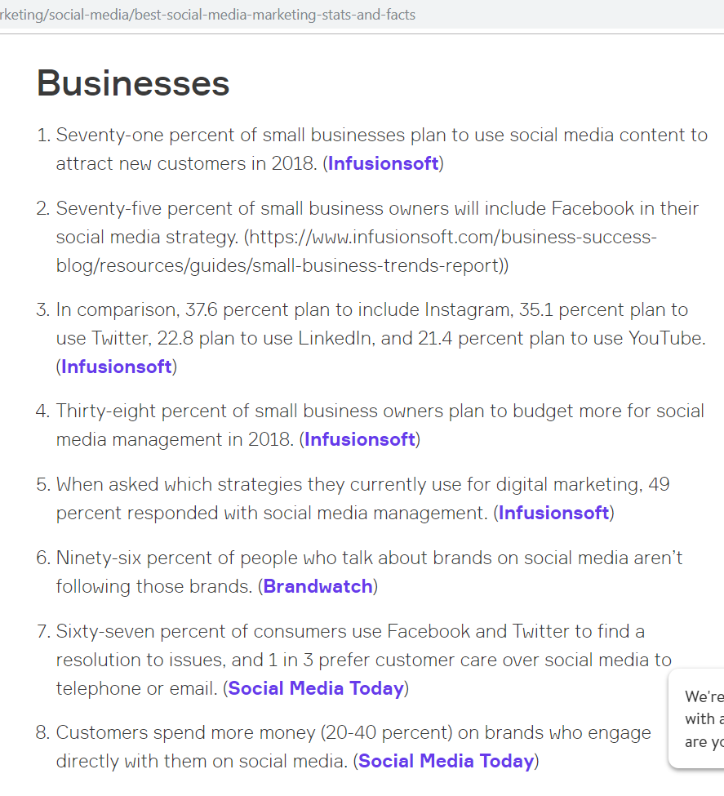
Research
The Trends in Social Advertising survey, recently conducted by the research team at Pivot, found that a full 60% of respondents expected social advertising to be very valuable to them.
In 2018, social media for business will be a force to be reckoned with. There are currently 3.03 billion active social media users, (2.8 billion of which access their social media accounts via mobile phone) and just between Q2 and Q3 of 2017, the amount grew by 121 million, according to Marketing Sherpa. With numbers like these, it’s more important than ever for businesses to have a stake in the market.
https://www.infusionsoft.com/business-success-blog/marketing/social-media/best-social-media-marketing-stats-and-facts
Introduction Research Solution Business Plan

Slide 4
Disadvantage
Advantages
Tarnish brand name : In the event that a negative information finds its way onto social media platform, the public will have the chance to express their dissatisfaction.
Time consuming : People may deliberately ignore your page because they may be interested in other sites. To get them to appreciate and share your posts may take time.
Cost effective : It can be much cheaper than traditional advertising and promotional activities. The costs of maintaining a social media presence are minimal.
Website traffic : Social content can boost traffic to your website.
Evaluation : It is easy to measure how much website traffic you receive from social media.
Introduction Research Solution Business Plan

Slide 5
Disadvantage
Advantages
Ineffective use : Social media can be used ineffectively.
No personal touch : Social media Ads are mostly sponsored by fitted in between user’s interface , making it irritating and lack the personal touch
Customer interaction : You can deliver improved customer service and respond effectively to feedback.
Target audience : You can choose to maintain a presence on particular social networks that are in line with your target audience.
Introduction Research Solution Business Plan

Slide 6
Implications
Social Media marketing is becoming a more ferociously used arsenal now . As more and more businesses are using this weapon to expand their market in growing competition.
Growth rate of number of such social media account in past half decade is phenomenal indicating more rapid user base in future . As for businesses looking forward to grow in future can find their potential customer on these platforms easily and more effectively.
Social Media marketing comes with many advantages and merits , but all that looks good is not good enough . Taking account for ineffective users on social media platforms , time consumption and lack of emotional touch , all merits of social media marketing doesn’t seem so powerful.
Such insights of social media marketing could be solved with few amendment and here at ADSTORY we give it our try.
Introduction Research Solution Business Plan

Slide 7
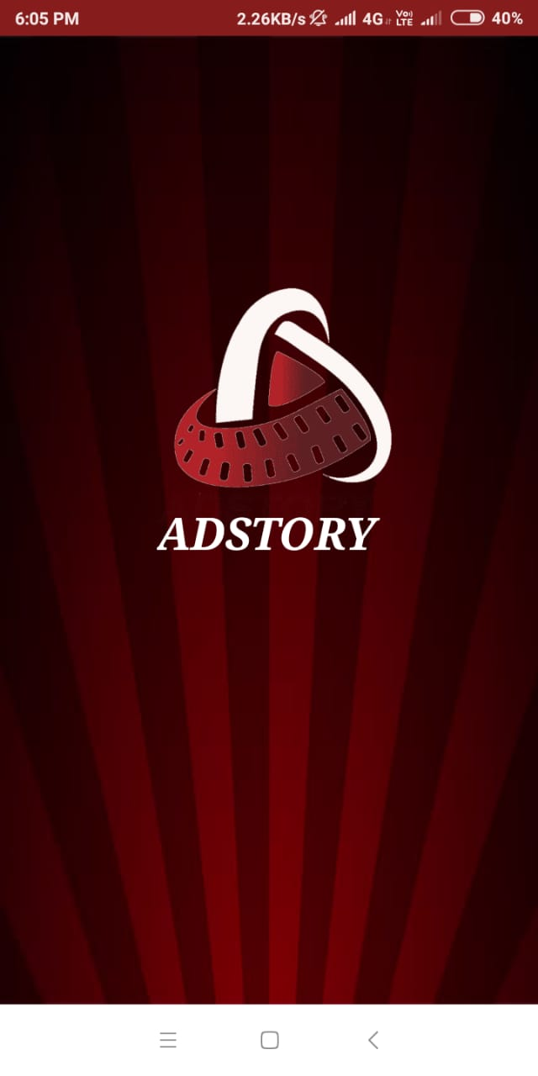
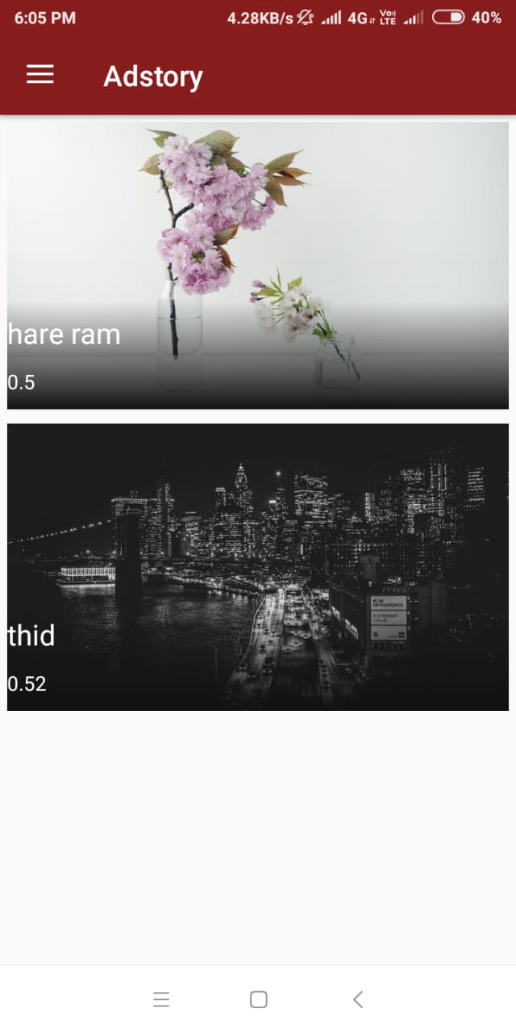
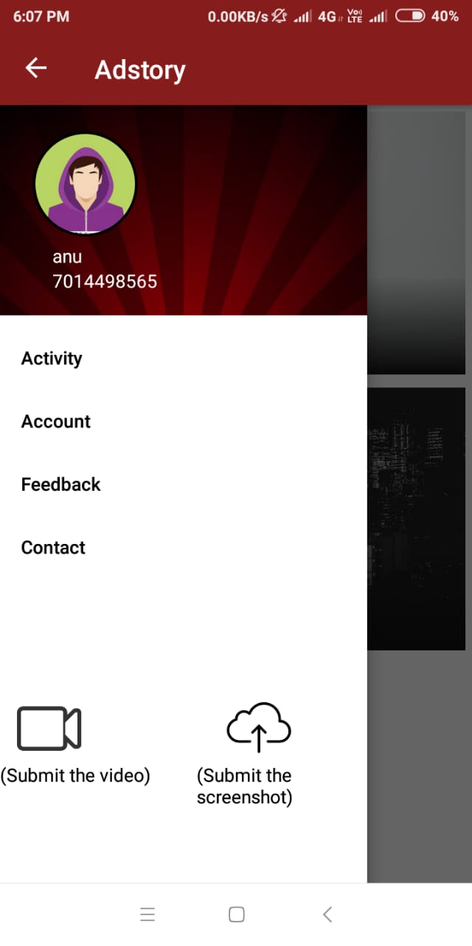
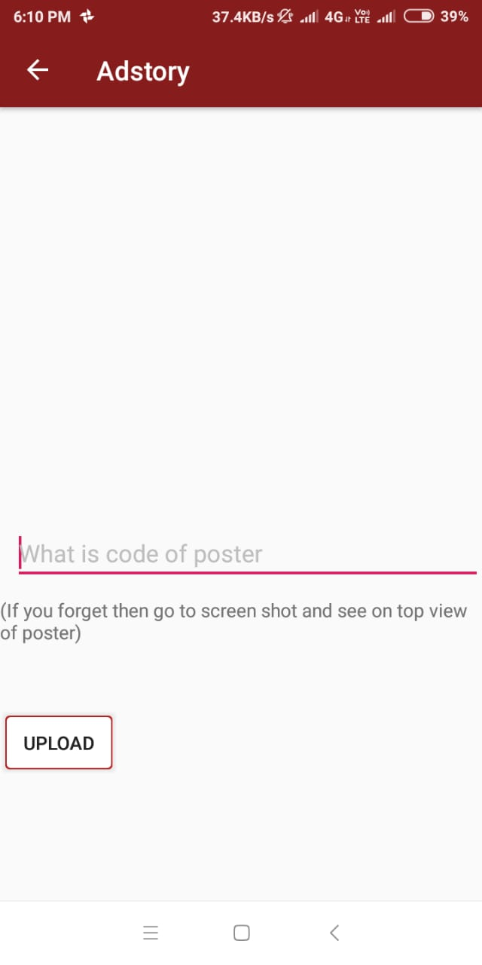
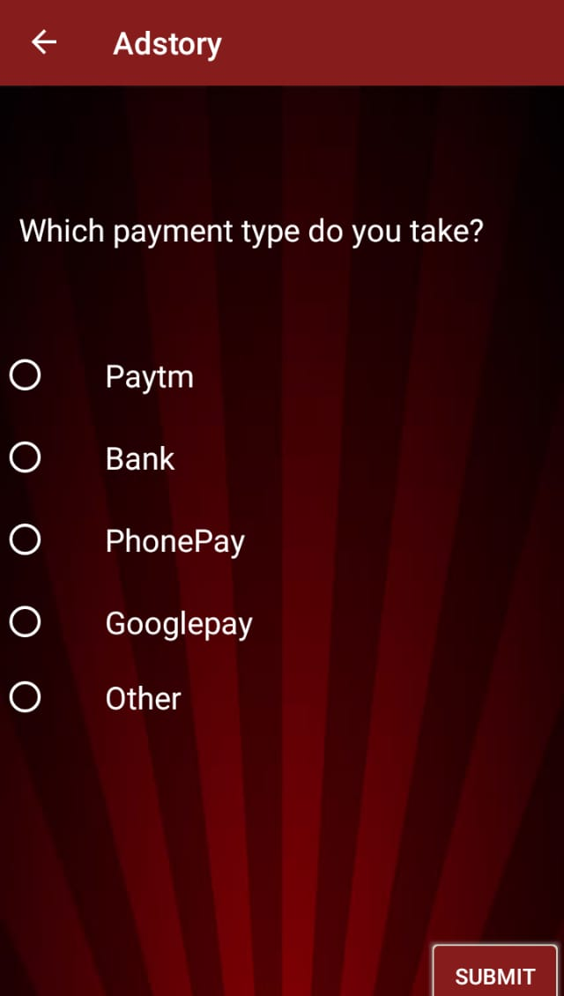
The Solution!
dstory
Introduction Research Solution Business Plan

Slide 8
The Solution!
dstory
Introduction Research Solution Business Plan

Slide 9
The Solution!
dstory
Introduction Research Solution Business Plan

Slide 10
Business Plan
Introduction Research Solution Business Plan

