Slide 1
OBE Implementation
Module :University Setting
Submitted By
G. ABHINAY [AP23110011114]
T. SWETHA PRIYA [AP23110011116]
A. MANOJ [AP23110011118]
G. VISHNU VARDHAN [AP23110011138]

Slide 2
Introduction to Project
Our University (herewith considered as SRM-AP) is going to implement OBE(Outcome Based Education) in their university and you assigned in the project to develop an application with any programming Language you are well versed and you were supposed to do searching and sorting using learned algorithms,comparing your sorting algorithm with any one of existing algorithm,displaying the time complexity of both algorithms and explaining advantages and disadvantages of the algorithm

Slide 3
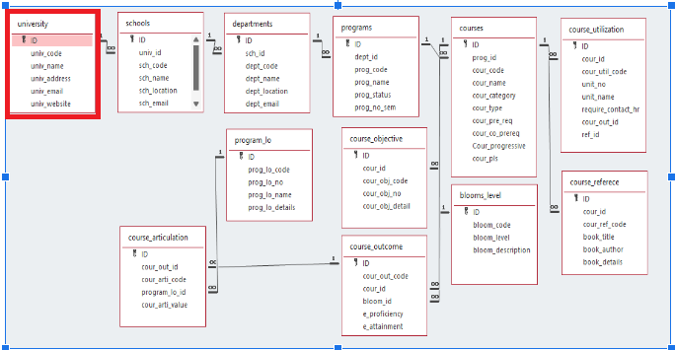
Architecture Diagram

Slide 4
Module Description : University Setting
This module is used to create,Update,Retrieve,Delete(hereafter known as CURD) details of the module and storing the details in the text file.you have to provide option for searching and sorting of fields mentioned below according to algorithms given for you
Sorting : Merge sort and Quick sort.
Searching : Linear search and Binary search

Slide 5
University Setting:Field/table details
Field Name | Data type
id | integer
univ_code | String
univ_name | String
univ_address | String
univ_email | String
univ_website | String

Slide 6
University Setting:Programming Details
File name: university
Function/method name
Create: university_create
Update: university_update
Retrieve: university_retrieve
Delete: university_delete
Sorting: university_mergesort
university_quicksort
Searching: university_linearsearch
university_binary search
Storing: university_storing

Slide 7
University Setting:Programming Details
Comparison(both searching and Sorting):
For Searching-university_compare_linearsearch
university_compare_binarysearch
For Sorting- university_compare_quicksort
university_compare_mergesort
Time Complexity(both searching and Sorting):
university_complexity_linearsearch
university_complexity_binarysearch
university_complexity_mergesort
university_complexity_quicksort

Slide 8
University Setting:Programming Details
Algorithm Details(pseudocode or steps)(both searching and Sorting):
For searching: university_algo_linearsearch
university_algo_binarysearch
For sorting: university_algo_quicksort
university_algo_mergesort
File name(for storing the details)
File name to be used is: university_setting .txt

Slide 9
University : Time Complexity of Sorting Algorithm
Sl.No | Algorithm Name | Time complexity
1 | Merge sort | O(n log n)
2 | Quick sort | O(n log n)

Slide 10
University : Time Complexity of Searching Algorithm
Sl.No | Algorithm Name | Time complexity
1 | Linear search | O(n)
2 | Binary search | O(log n)

Slide 11
Source Code :
#include <stdio.h>
#include <stdlib.h>
#include <string.h>
#include <time.h>
#define MAX_UNIVERSITIES 100
#define MAX_STRING_LENGTH 100
// Define the structure for university records
typedef struct {
int id;
char univ_code[MAX_STRING_LENGTH];
char univ_name[MAX_STRING_LENGTH];
char univ_address[MAX_STRING_LENGTH];
char univ_email[MAX_STRING_LENGTH];
char univ_website[MAX_STRING_LENGTH];
} University;
// Function prototypes
void university_create(University universities[], int *count);
void university_update(University universities[], int count);
void university_retrieve(University universities[], int count);
void university_delete(University universities[], int *count);
void university_mergesort(University universities[], int left, int right);

Slide 12
Source Code :
void merge(University universities[], int left, int mid, int right);
void university_quicksort(University universities[], int low, int high);
int partition(University universities[], int low, int high);
int university_linearsearch(University universities[], int count, int id);
int university_binarysearch(University universities[], int left, int right, int id);
void university_storing(University universities[], int count);
void university_compare_linearsearch(University universities[], int count, int id);
void university_compare_binarysearch(University universities[], int count, int id);
void university_compare_quicksort(University universities[], int count);
void university_compare_mergesort(University universities[], int count);
void university_complexity_linearsearch(int n);
void university_complexity_binarysearch(int n);
void university_complexity_mergesort(int n);
void university_complexity_quicksort(int n);
void writeToFile(University universities[], int count);
int main() {
University universities[MAX_UNIVERSITIES];
int count = 0;
int choice;
do {
printf("\nUniversity Management System\n");
printf("1. Create University\n");
printf("2. Update University\n");

Slide 13
Source Code :
printf("3. Retrieve Universities\n");
printf("4. Delete University\n");
printf("5. Sort Universities (Merge Sort)\n");
printf("6. Sort Universities (Quick Sort)\n");
printf("7. Search University (Linear Search)\n");
printf("8. Search University (Binary Search)\n");
printf("9. Store Universities to File\n");
printf("10. Exit\n");
printf("Enter your choice: ");
scanf("%d", &choice);
switch (choice) {
case 1:
university_create(universities, &count);
break;
case 2:
university_update(universities, count);
break;
case 3:
university_retrieve(universities, count);
break;
case 4:
university_delete(universities, &count);
break;
case 5:

Slide 14
Source Code :
university_compare_mergesort(universities, count);
break;
case 6:
university_compare_quicksort(universities, count);
break;
case 7: {
int id;
printf("Enter university ID to search: ");
scanf("%d", &id);
university_compare_linearsearch(universities, count, id);
break;
}
case 8: {
int id;
printf("Enter university ID to search: ");
scanf("%d", &id);
university_compare_binarysearch(universities, count, id);
break;
}
case 9:
university_storing(universities, count);
break;
case 10:
printf("Exiting...\n");
break;

Slide 15
Source Code :
default:
printf("Invalid choice! Please try again.\n");
}
} while (choice != 10);
return 0;
}
// Function implementations
void university_create(University universities[], int *count) {
if (*count >= MAX_UNIVERSITIES) {
printf("Cannot add more universities.\n");
return;
}
University u;
printf("Enter ID: ");
scanf("%d", &u.id);
printf("Enter University Code: ");
scanf("%s", u.univ_code);
printf("Enter University Name: ");
scanf(" %[^\n]", u.univ_name); // To read string with spaces
printf("Enter University Address: ");
scanf(" %[^\n]", u.univ_address);
printf("Enter University Email: ");
scanf("%s", u.univ_email);

Slide 16
Source Code :
printf("Enter University Website: ");
scanf("%s", u.univ_website);
universities[*count] = u;
(*count)++;
printf ("University added successfully!\n");
}
void university_update(University universities[], int count) {
int id, found = 0;
printf("Enter ID of the university to update: ");
scanf("%d", &id);
for (int i = 0; i < count; i++) {
if (universities[i].id == id) {
found = 1;
printf("Updating details for ID %d:\n", id);
printf("Enter new University Code: ");
scanf("%s", universities[i].univ_code);
printf("Enter new University Name: ");
scanf(" %[^\n]", universities[i].univ_name);
printf("Enter new University Address: ");
scanf(" %[^\n]", universities[i].univ_address);
printf("Enter new University Email: ");
scanf("%s", universities[i].univ_email);
printf("Enter new University Website: ");

Slide 17
Source Code :
scanf("%s", universities[i].univ_website);
printf("University updated successfully!\n");
break;
}
}
if (!found) {
printf("University with ID %d not found.\n", id);
}
}
void university_retrieve(University universities[], int count) {
printf("List of Universities:\n");
for (int i = 0; i < count; i++) {
printf("ID: %d, Code: %s, Name: %s, Address: %s, Email: %s, Website: %s\n",
universities[i].id, universities[i].univ_code, universities[i].univ_name,
universities[i].univ_address, universities[i].univ_email, universities[i].univ_website);
}
}
void university_delete(University universities[], int *count) {
int id, found = 0;
printf("Enter ID of the university to delete: ");
scanf("%d", &id);
for (int i = 0; i < *count; i++) {
if (universities[i].id == id) {

Slide 18
Source Code :
found = 1;
for (int j = i; j < *count - 1; j++) {
universities[j] = universities[j + 1];
}
(*count)--;
printf("University with ID %d deleted successfully!\n", id);
break;
}
}
if (!found) {
printf("University with ID %d not found.\n", id);
}
}
void university_mergesort(University universities[], int left, int right) {
if (left < right) {
int mid = left + (right - left) / 2;
university_mergesort(universities, left, mid);
university_mergesort(universities, mid + 1, right);
merge(universities, left, mid, right);
}
}
void merge(University universities[], int left, int mid, int right) {
int i, j, k;

Slide 19
Source Code :
int n1 = mid - left + 1;
int n2 = right - mid;
University *L = (University *)malloc(n1 * sizeof(University));
University *R = (University *)malloc(n2 * sizeof(University));
for (i = 0; i < n1; i++)
L[i] = universities[left + i];
for (j = 0; j < n2; j++)
R[j] = universities[mid + 1 + j];
i = 0;
j = 0;
k = left;
while (i < n1 && j < n2) {
if (L[i].id <= R[j].id) {
universities[k] = L[i];
i++;
} else {
universities[k] = R[j];
j++;
}
k++;
}

Slide 20
Source Code :
while (i < n1) {
universities[k] = L[i];
i++;
k++;
}
while (j < n2) {
universities[k] = R[j];
j++;
k++;
}
free(L);
free(R);
}
void university_quicksort(University universities[], int low, int high) {
if (low < high) {
int pi = partition(universities, low, high);
university_quicksort(universities, low, pi - 1);
university_quicksort(universities, pi + 1, high);
}
}

Slide 21
Source Code :
int partition(University universities[], int low, int high) {
int pivot = universities[high].id;
int i = (low - 1);
for (int j = low; j < high; j++) {
if (universities [j].id < pivot) {
i++;
University temp = universities[i];
universities[i] = universities[j];
universities[j] = temp;
}
}
University temp = universities[i + 1];
universities[i + 1] = universities[high];
universities[high] = temp;
return (i + 1);
}
int university_linearsearch(University universities[], int count, int id) {
for (int i = 0; i < count; i++) {
if (universities[i].id == id) {
return i; // Return the index if found
}
}
return -1; // Return -1 if not found
}

Slide 22
Source Code :
int university_binarysearch(University universities[], int left, int right, int id) {
while (left <= right) {
int mid = left + (right - left) / 2;
if (universities[mid].id == id) {
return mid; // Return the index if found
}
if (universities[mid].id < id) {
left = mid + 1; // Search in the right half
} else {
right = mid - 1; // Search in the left half
}
}
return -1; // Return -1 if not found
}
void university_storing(University universities[], int count) {
writeToFile(universities, count);
}
void writeToFile(University universities[], int count) {
FILE *file = fopen("university_setting.txt", "w");
if (file == NULL) {
printf("Error opening file!\n");
return;

Slide 23
Source Code :
}
for (int i = 0; i < count; i++) {
fprintf(file, "ID: %d, Code: %s, Name: %s, Address: %s, Email: %s, Website: %s\n",
universities[i].id, universities[i].univ_code, universities[i].univ_name,
universities[i].univ_address, universities[i].univ_email, universities[i].univ_website);
}
fclose(file);
printf("Data stored successfully in university_setting.txt\n");
}
void university_compare_linearsearch(University universities[], int count, int id) {
clock_t start = clock();
int index = university_linearsearch(universities, count, id);
clock_t end = clock();
if (index != -1) {
printf("University found at index %d\n", index);
} else {
printf("University with ID %d not found.\n", id);
}
university_complexity_linearsearch(count);
double time_taken = ((double)(end - start)) / CLOCKS_PER_SEC;
printf("Linear Search Time: %f seconds\n", time_taken);
}
void university_compare_binarysearch(University universities[], int count, int id) {

Slide 24
Source Code :
university_quicksort(universities, 0, count - 1); // Ensure the array is sorted
clock_t start = clock();
int index = university_binarysearch(universities, 0, count - 1, id);
clock_t end = clock();
if (index != -1) {
printf("University found at index %d\n", index);
} else {
printf("University with ID %d not found.\n", id);
}
university_complexity_binarysearch(count);
double time_taken = ((double)(end - start)) / CLOCKS_PER_SEC;
printf("Binary Search Time: %f seconds\n", time_taken);
}
void university_compare_quicksort(University universities[], int count) {
clock_t start = clock();
university_quicksort(universities, 0, count - 1);
clock_t end = clock();
printf("Universities sorted using Quick Sort.\n");
university_complexity_quicksort(count);
double time_taken = ((double)(end - start)) / CLOCKS_PER_SEC;
printf("Quick Sort Time: %f seconds\n", time_taken);
}
void university_compare_mergesort(University universities[], int count) {

Slide 25
Source Code :
clock_t start = clock();
university_mergesort(universities, 0, count - 1);
clock_t end = clock();
printf("Universities sorted using Merge Sort.\n");
university_complexity_mergesort(count);
double time_taken = ((double)(end - start)) / CLOCKS_PER_SEC;
printf("Merge Sort Time: %f seconds\n", time_taken);
}
void university_complexity_linearsearch(int n) {
printf("Time Complexity of Linear Search: O(n)\n");
}
void university_complexity_binarysearch(int n) {
printf("Time Complexity of Binary Search: O(log n )\n");
}
void university_complexity_mergesort(int n) {
printf("Time Complexity of Merge Sort: O(n log n)\n");
}
void university_complexity_quicksort(int n) {
printf("Time Complexity of Quick Sort: O(n log n) on average, O(n^2) in the worst case\n");
}

Slide 26
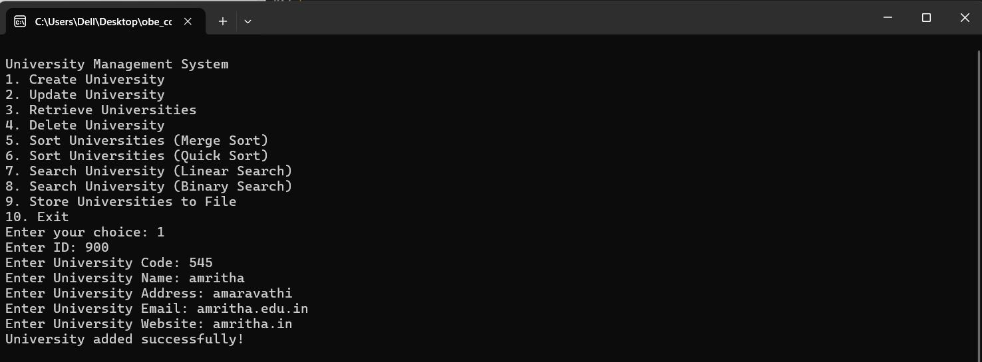
Screen Shots

Slide 27
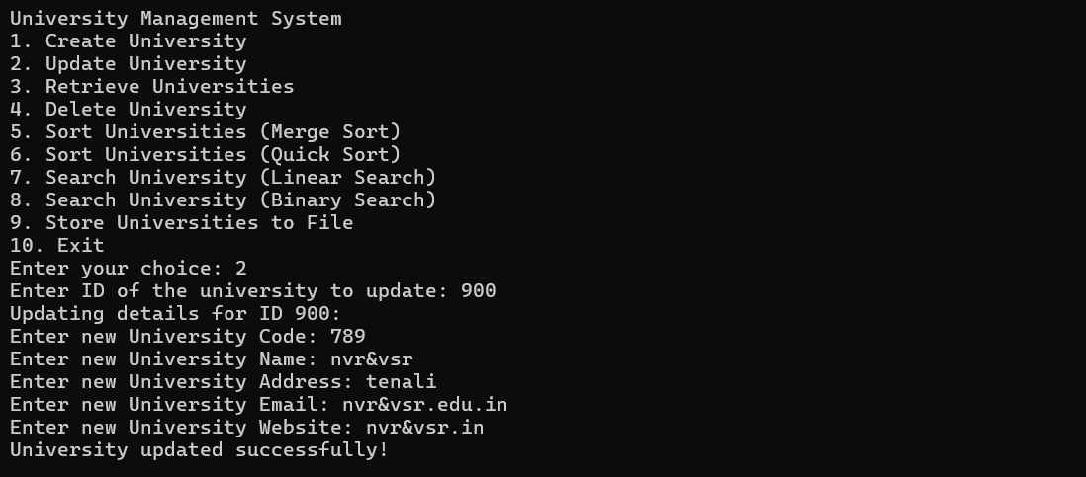
Screen Shots

Slide 28
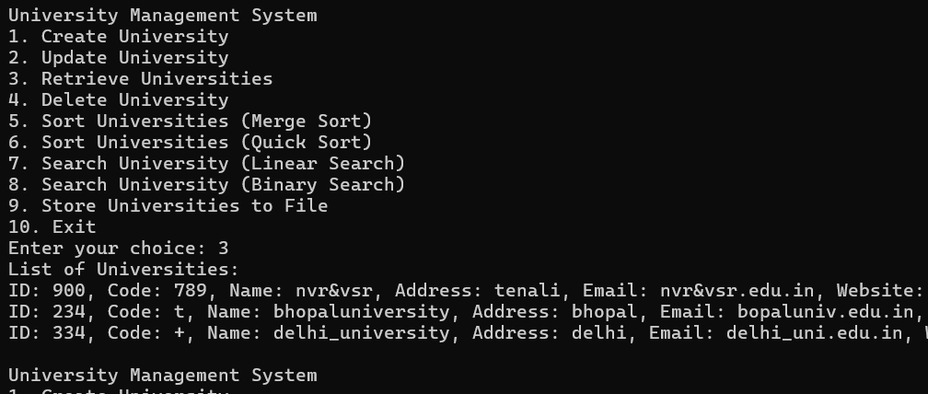
Screen Shots

Slide 29
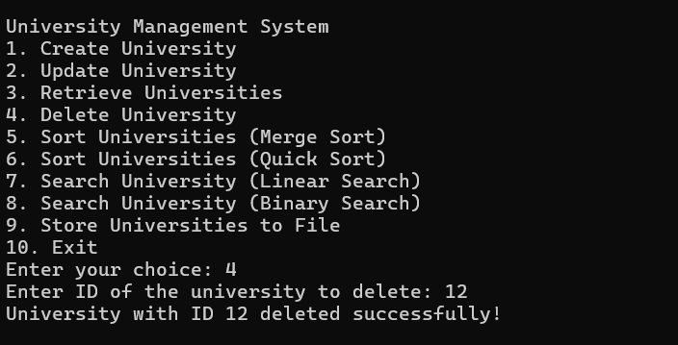
Screen Shots

Slide 30
Conclusion

Slide 31
Thank You

