Slide 1
File System Implementation

Slide 2
Two aspects
Simplified version of a typical UNIX file system
Introduce some of the basic on-disk structures, access methods, and various policies that you will find in many file systems today.
Other file systems
AFS (the Andrew File System)
ZFS (Sun’s Zettabyte File System)
Two aspects
data structures of the file system.
What types of on-disk structures are utilized by the file system to organize its data and metadata?
access methods.
How does it map the calls made by a process, such as open(), read(), write(), etc., onto its structures?
Which structures are read during the execution of a particular system call? Which are written?
How efficiently are all of these steps performed?

Slide 3
Outline
Explain about simple file system
i-node
Directory organization
Access paths

Slide 4
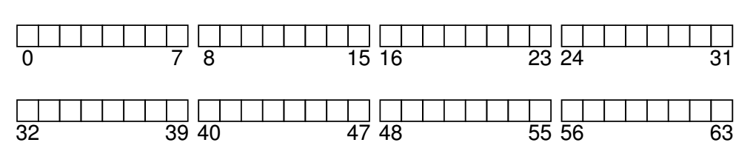
Overall Organization
Disk is divided into blocks
For example, the block size is 4k.
Assume a small disk has 64 small blocks.

Slide 5
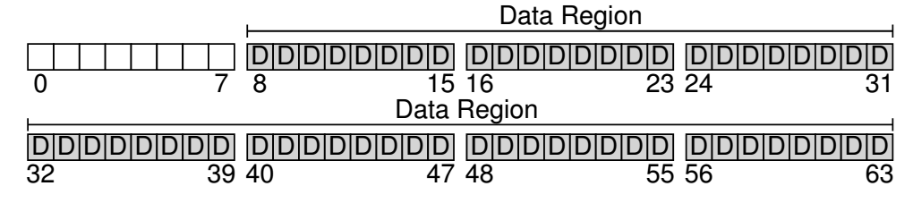
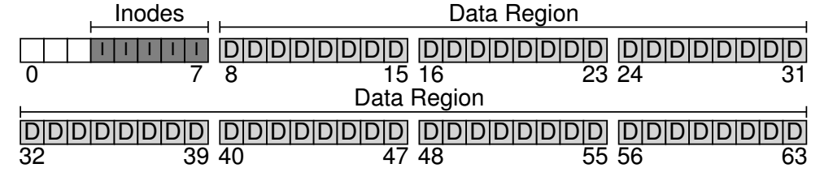
We will allocate 56 blocks for data
File system has to track information about files
To store this information i-nodes are used
Five blocks are assigned to i-nodes.
The inodes are typically not that big, for example 128 or 256 bytes.
Assuming 256 bytes per inode, a 4-KB block can hold 16 inodes, and our file system above contains 80 total inodes.

Slide 6
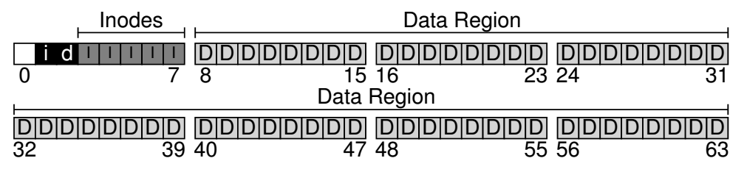
Tracking of Files: bit maps
We have to track whether inodes or data blocks are free or allocated.
Bitmaps are used
One for data region and one for inode region

Slide 7
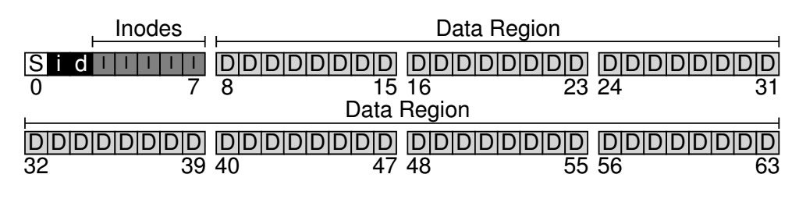
Super Block
The superblock contains information about this particular file system, including, for example, how many inodes and data blocks are in the file system (80 and 56, respectively in this instance), where the inode table begins (block 3), and so forth. It will likely also include a magic number of some kind to identify the file system type (in this case, vsfs).

Slide 8
Mounting of a File System
Reading of super block and initialize the parameters and attaching the volume to the file system tree

Slide 9
File Organization
i-node is the short form of index node
Each inode is implicitly referred to by a number (called the inumber), which we’ve earlier called the low-level name of the file.
In vsfs (and other simple file systems), given an i-number, you should directly be able to calculate where on the disk the corresponding inode is located.

Slide 10
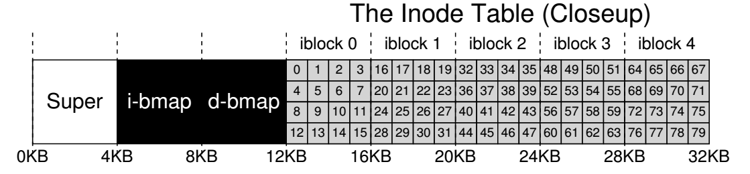
To read inode number 32, the file system would first calculate the offset into the inode region (32 · sizeof(inode) or 8192), add it to the start address of the inode table on disk (inodeStartAddr = 12KB), and thus arrive upon the correct byte address of the desired block of inodes: 20KB.
Recall that disks are not byte addressable, but rather consist of a large number of addressable sectors, usually 512 bytes. Thus, to fetch the block of inodes that contains inode 32, the file system would issue a read to sector 20×1024/ 512 , or 40, to fetch the desired inode block. More generally, the sector address iaddr of the inode block can be calculated as follows:
blk = (inumber * sizeof(inode_t)) / blockSize; sector = ((blk * blockSize) + inodeStartAddr) / sectorSize;

Slide 11
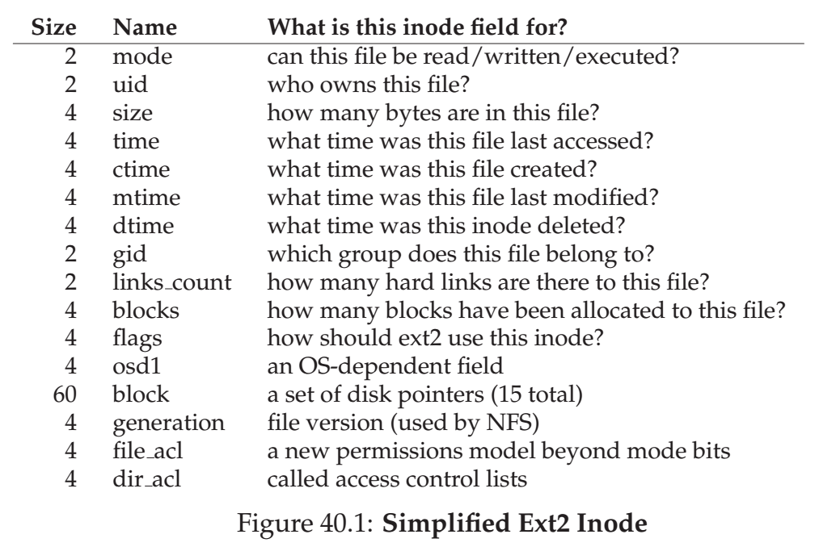

Slide 12
Supporting Big files
Multi-level index
Instead of pointing to data block, i-node points to block of pointers.
Notion of extents are used
An extent is simply a disk pointer plus a length (in blocks); thus, instead of requiring a pointer for every block of a file, all one needs is a pointer and a length to specify the on-disk location of a file.
Link based approaches

Slide 13
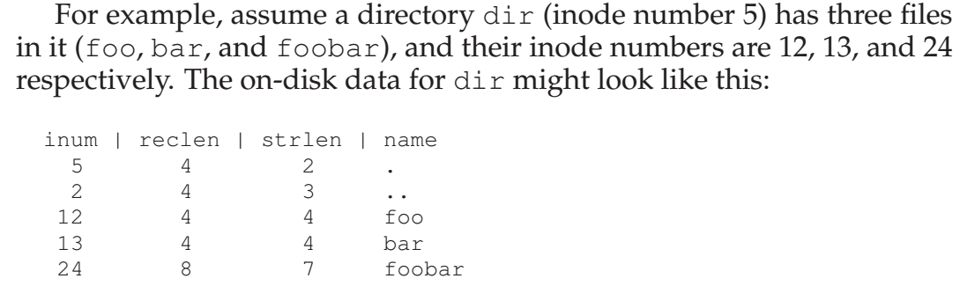
Directory Organization
A directory has list of pairs (entry name and i-node number)
File systems treat directories as special type of file.

Slide 14
Access Paths: Reading and Writing
Reading and writing require several I/Os

Slide 15
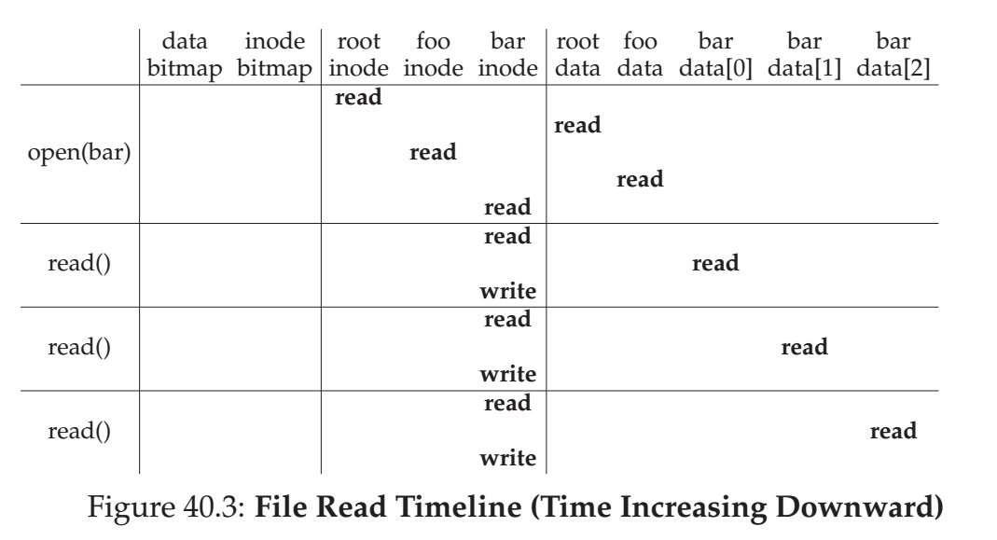

Slide 16
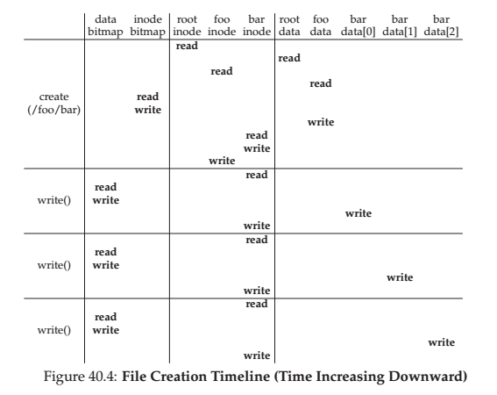

Slide 17
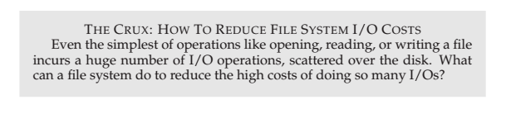

Slide 18
Techniques: Caching and buffering
Use caching or DRAM to cache important blocks

