Slide 1
SSAD course Agile Dev Processes
Sep 2018

Slide 2
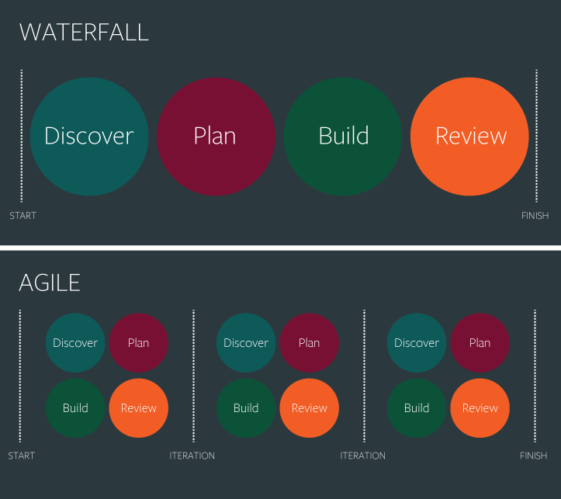
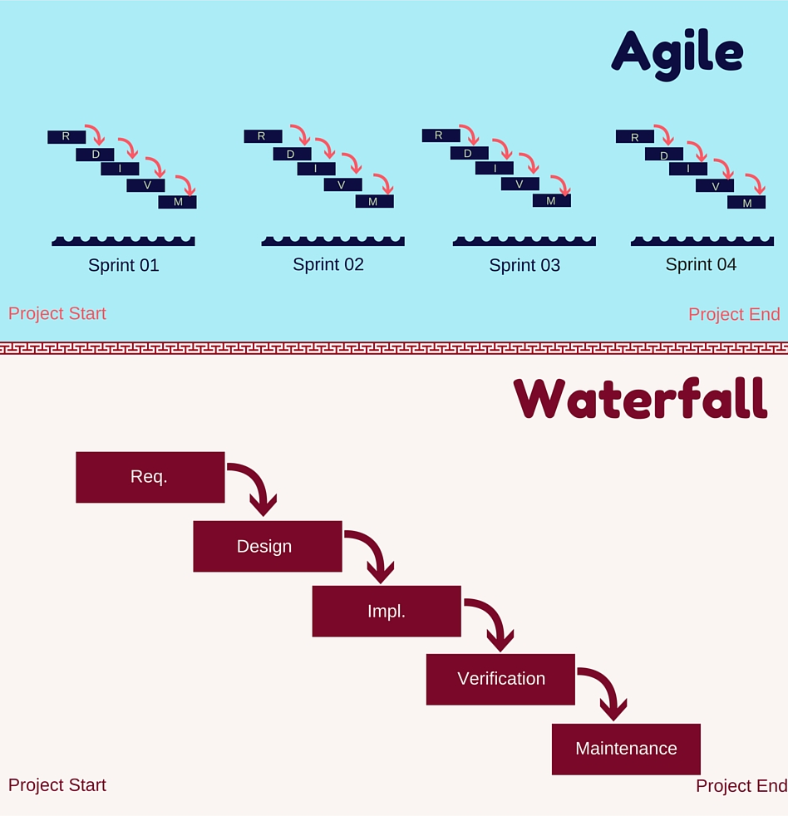

Slide 3
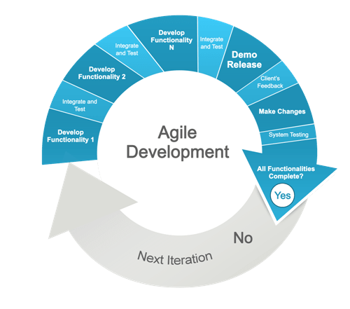
Sprints: Release dev iterations

Slide 4
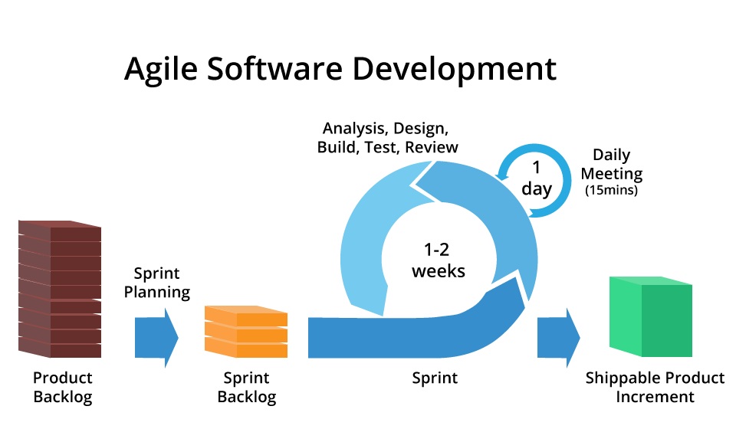

Slide 5
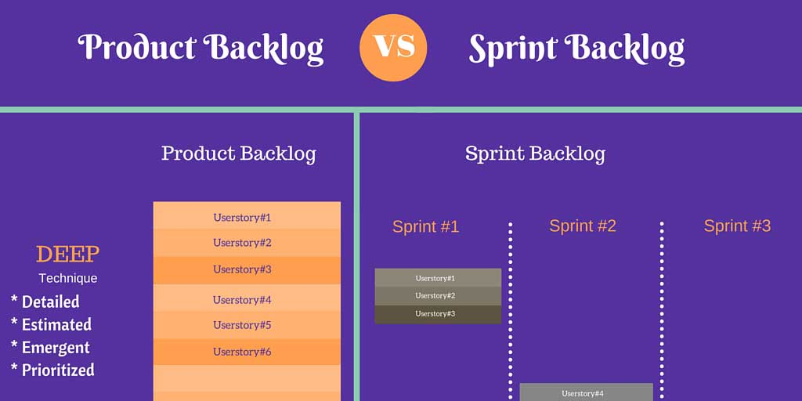
Backlogs

Slide 6
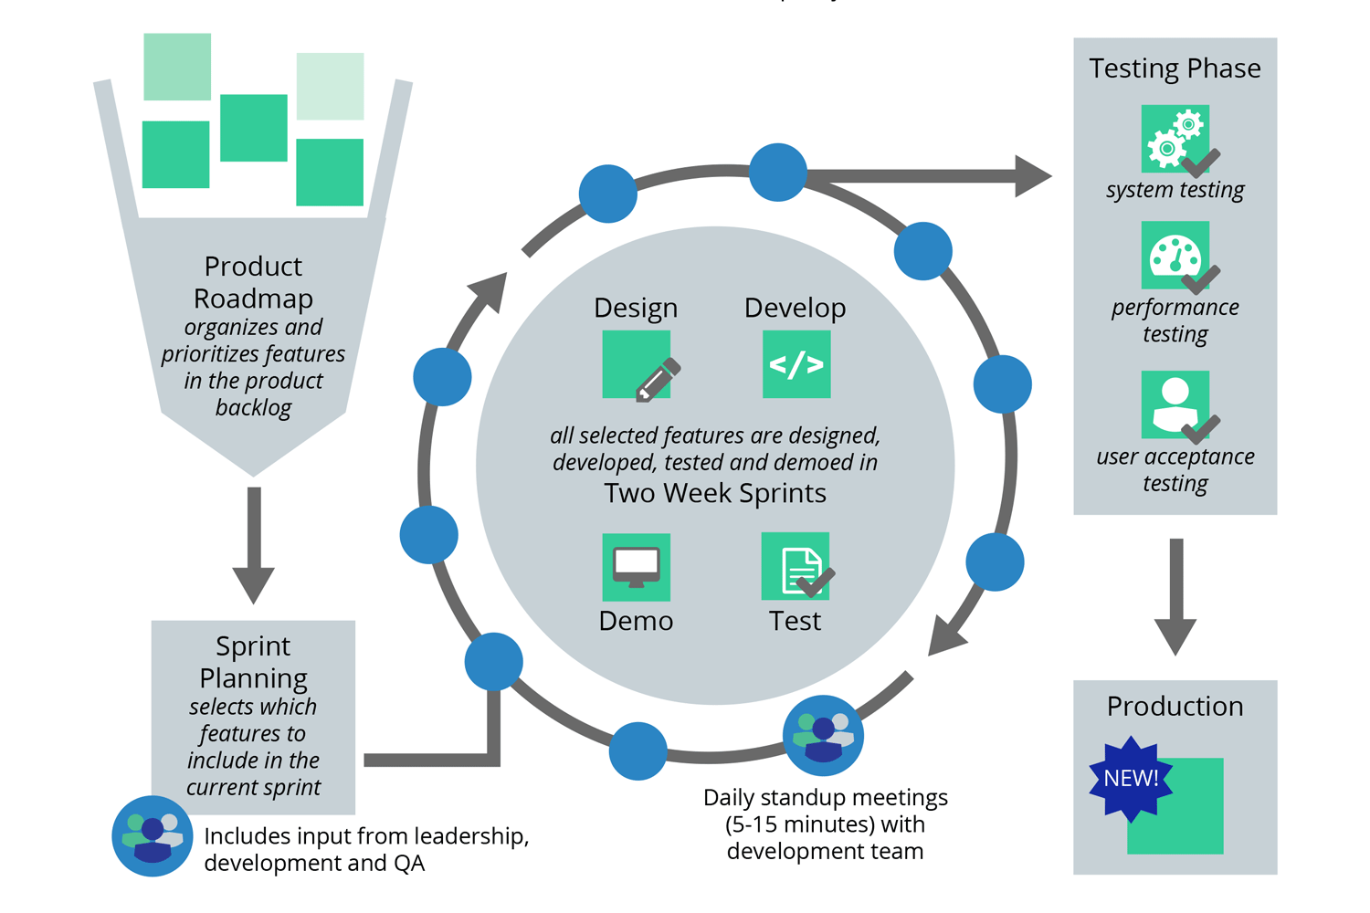
Releases

Slide 7
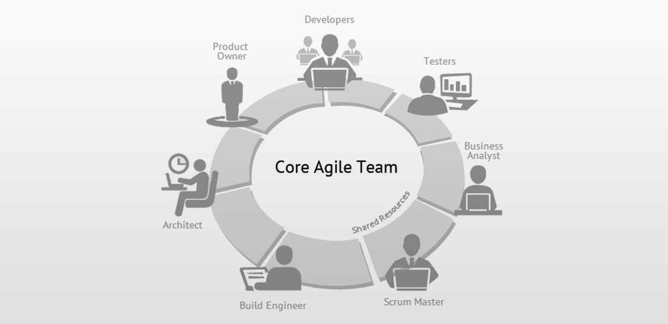

Slide 8
Class Assignment
Create your project release backlog
List usecases
For each usecase list 2-3 features
Mark usecases and features in sprint

